Slide 1
IBM Applied Data Science Capstone
Opening a restaurant in Norway
Alexander Podolski

Slide 2
Research Question
"What is the best location to open a restaurant in Norway?"

Slide 3
Data
Foursquare API
Simplemaps.com

Slide 4
Methodology
Python programming language with various libraries
K-Means clustering

Slide 5
Procedure
Importing data
Understanding data
Data cleaning
Getting venue info with Foursquare API
Data conversion / manipulation
Analysis
Analysing results
Providing a recommendation

Slide 6
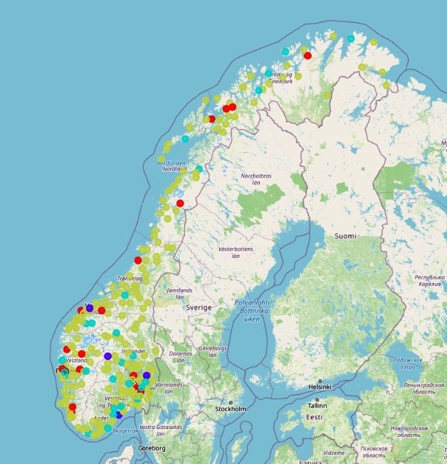
Results – The 4 Clusters

Slide 7
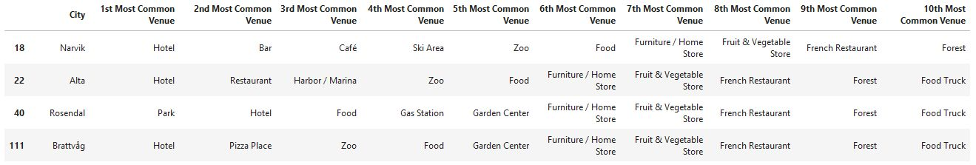
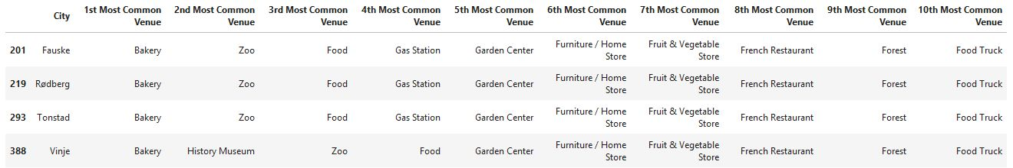
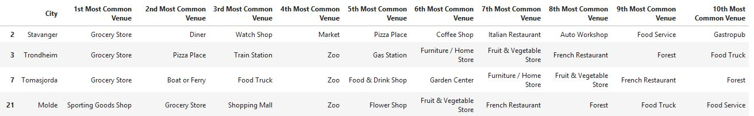
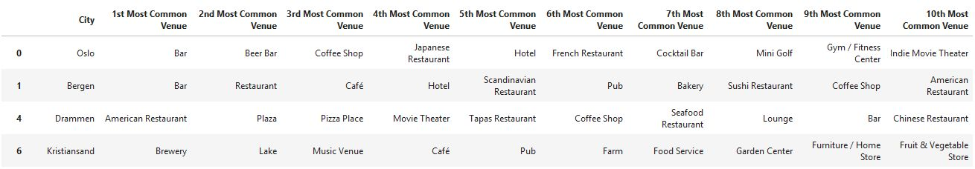
Results – The 4 Clusters

Slide 8
Discussion
Population
Popularity
Oslo
Bergen

Slide 9
Conclusion
Result
Recommendation
Implication
Further research

Slide 10
Thank You

