Slide 1

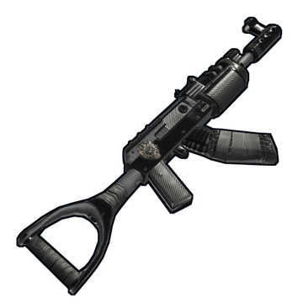
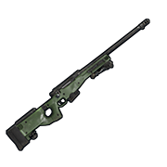
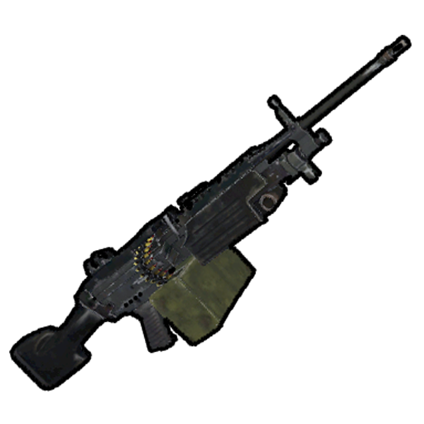
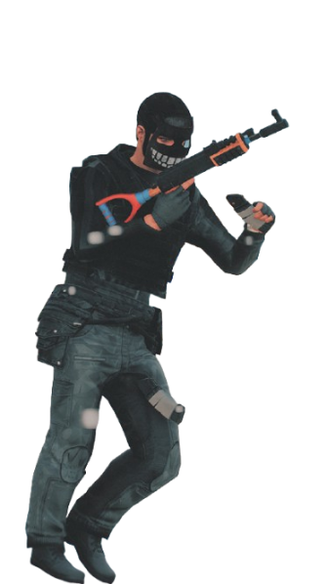
Havoc Guns Inc.
By:
- Alexis Grandbois
- William Corriveau
- Felix Ouellet

Slide 2
Types :

Slide 3
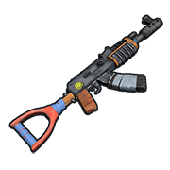
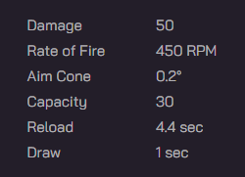
$19, 999 USD
Assault Rifle
The Assault Rifle is an accurate, powerful, and fully automatic rifle that fires 5.56 rifle rounds. It has a moderate rate of fire which allows for proficiency at close to medium range. Strong recoil makes it more difficult to fire in full-auto at long range, but experienced users may be able to control it more effectively. The Assault Rifle is generally used as an end-game multipurpose weapon, able to take fights at any range.

Slide 4
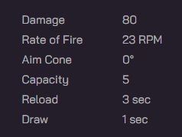
$49, 999 USD
A military issue high powered rifle. Offers more accuracy at longer ranges than the Assault Rifle at the tradeoff of being expensive to make.

Slide 5
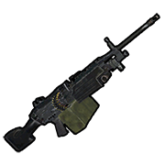
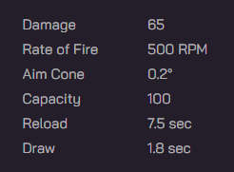
$199, 999 USD
The M249 Light Machine Gun can only be found in this shop. It has a magazine capacity of 100 5.56 bullets, the largest in the store. It does more damage than the Assault Rifle and has a slightly faster rate of fire while being way easier to control recoil-wise, allowing for very accurate and deadly bursts in long-range when coupled with a Holographic sight or an 8x scope.

Slide 6
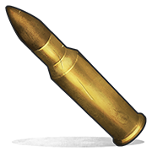
$2 / Rounds
Standard high powered ammunition, used by any rifle in the store currently. Offers superior damage, range, accuracy, damage drop off and air resistance

Slide 7
Thanks For Listening!!!
Use code “BESTPRENSENTATION” for 10% off your first order

