Slide 1

Gotta decide ‘em all!
Part 2
Mehmet Alp Şarkışla – Burak Suyunu

Slide 2
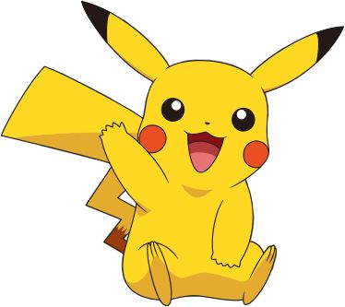
Previously on gotta decide them all
Ash and his Pikachu attends to a conference in Amsterdam.
Pikachu makes every decision for Ash.
Pikachu can make future plans, respond to unplanned event and when Ash has free time, Pikachu randomly chooses an activity.

Slide 3
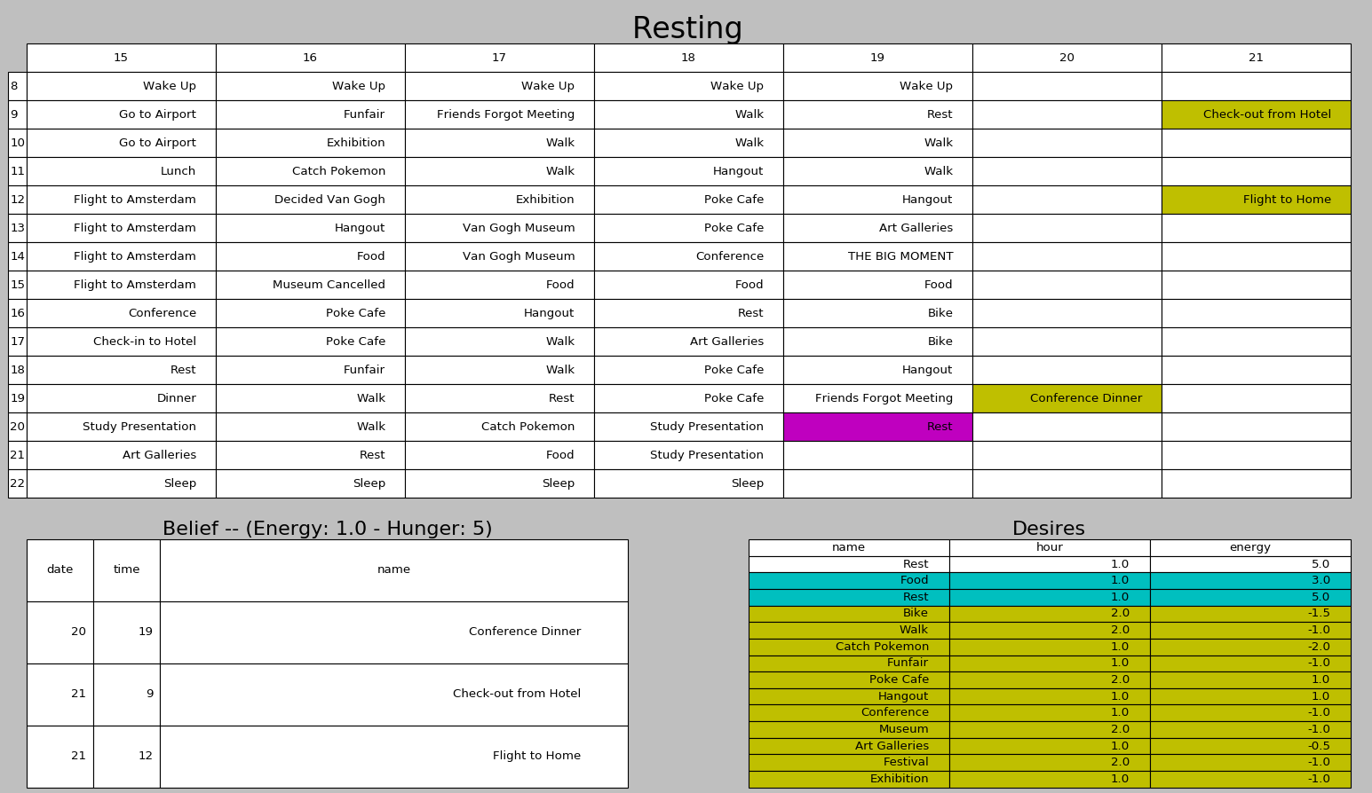
Previously on gotta decide them all

Slide 4

Ash wants to watch a movie
Ash wants to watch a movie.
But as always he can’t decide what to watch.
Pikachu wants to help.
But Pikachu doesn’t know anything about movies.
Also she is a little shy.
She doesn’t like to communicate with other people’s Pokemons.
So she asks a friend of her to talk with other Pokemons.

Slide 5
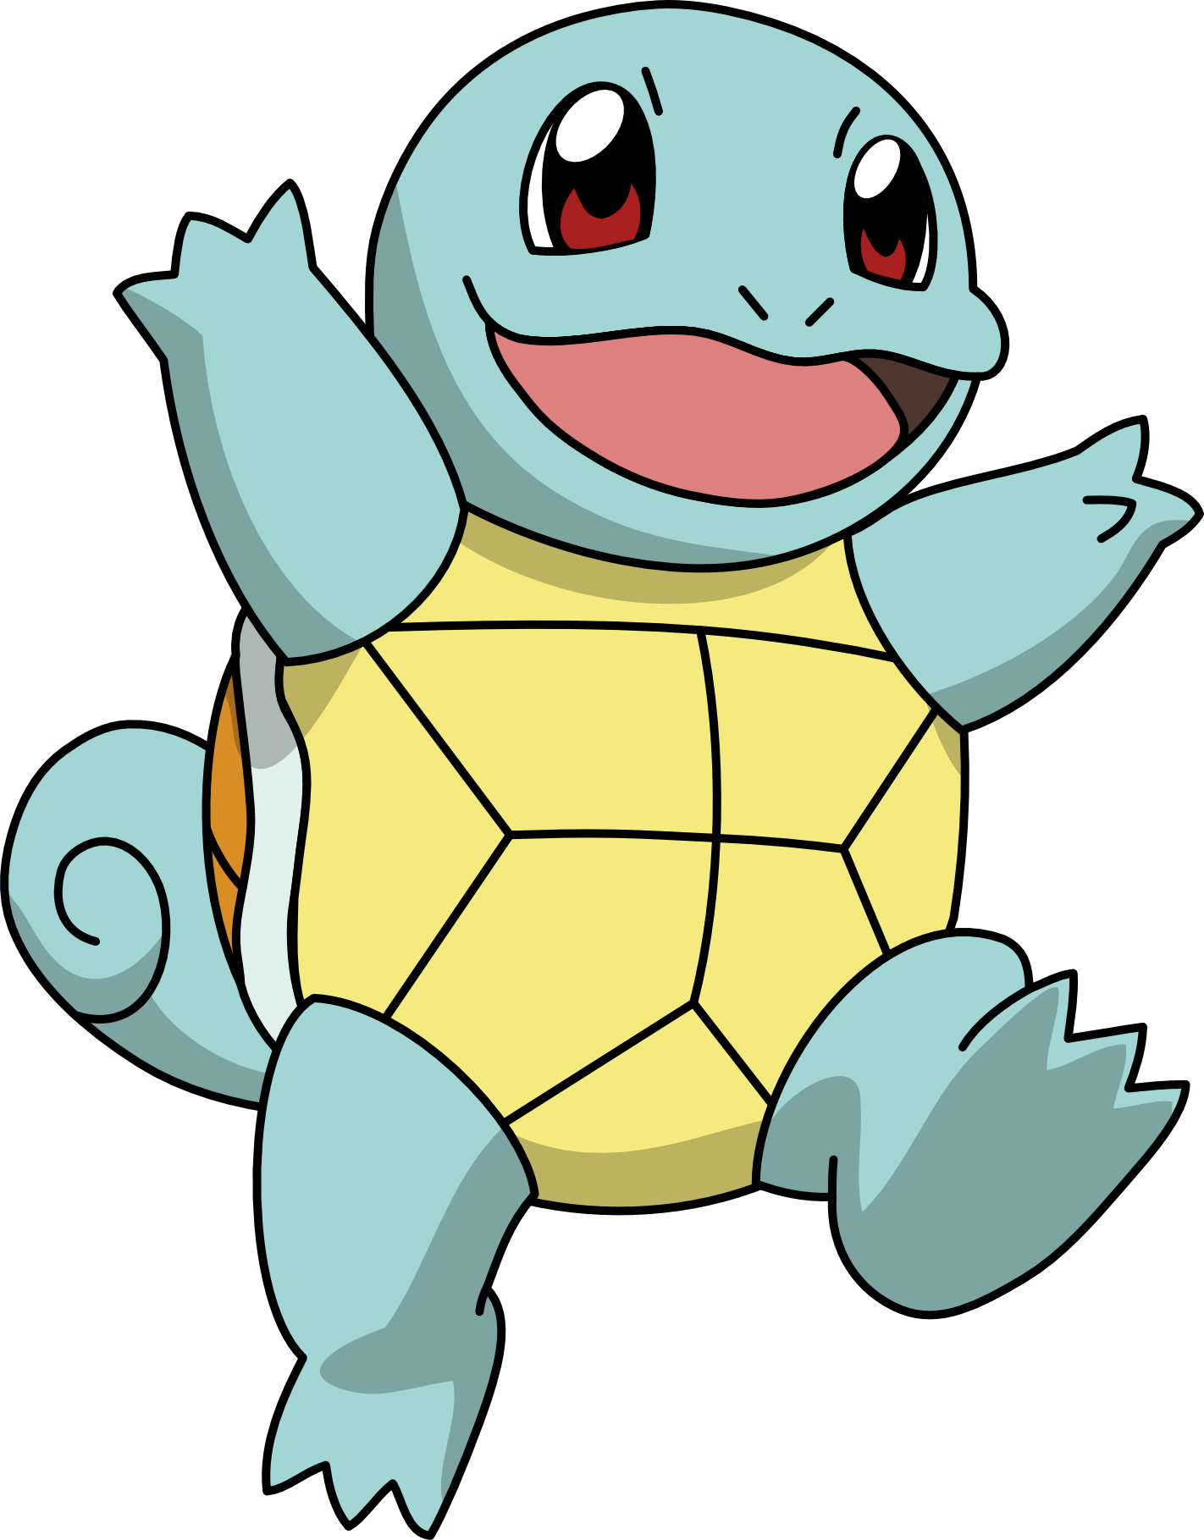
Squirtle

Slide 6
About Squirtle
Squirtle is a very social pokemon
All the time he talks about movies with ash’s friends’ pokemons.
So he knows all of ash’s friends’ movie preferances.
But Squirtle doesnt belive every info he gets. He trusts other friends’ pokemons as much as Ash trusts his friends
Using these info Squirtle choses a movie for Ash.

Slide 7
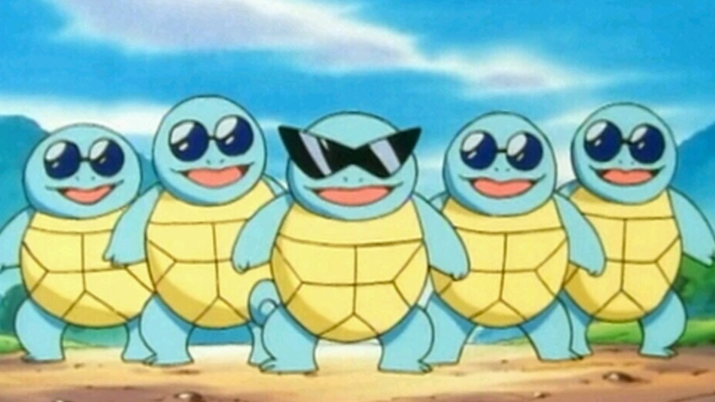
SquirtleTrust (FilmTrust)
Squirtle has a gang of Pokemons which are collecting information from other Pokemons and saving them in the SquirtleTrust.
In SquirtleTrust there are two tables:
Movie Ratings: Pokemon ID, Movie ID, Rating Value (-2, 2)
Trust Ratings: Trustor ID, Trustee ID, Trust Value

Slide 8
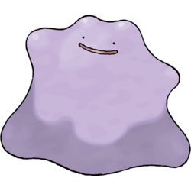
What is Trust ?
First of all, Squirtle can easily chose the movie with the best average rating according to Ash’s friends.
However
Does everyone has the same taste of movie?
Do we trust everyone equally?
Do we trust a person who watched 1 movie more than a person who watched 100 movies?
…
Hmmm, so we need a TRUST value for each person.
SQUIRTLE, I CHOOSE YOU! GIVE ME THE FORMULA!

Slide 9
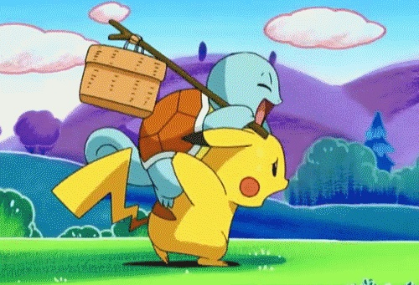
Trust
Trust = Movie Knowledge * Friendship Level

Slide 10
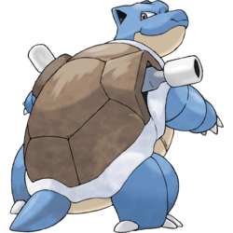
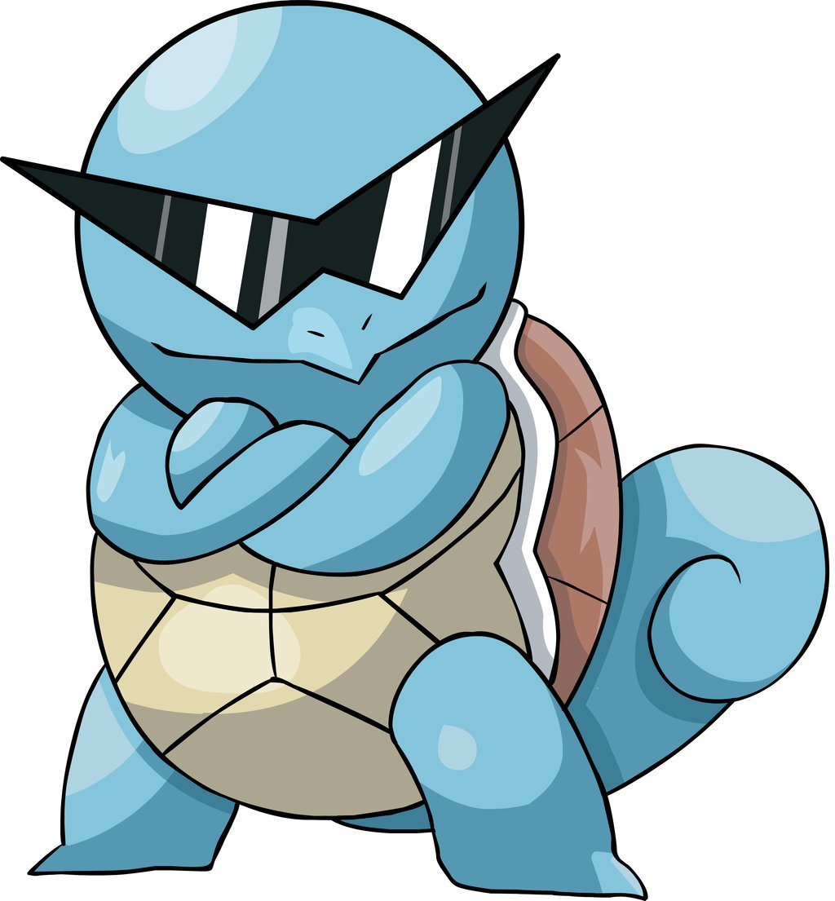

Trust -> Movie Knowledge
Movie Knowledge = IMDB Accuracy + Squirtle Accuracy
= +

Slide 11
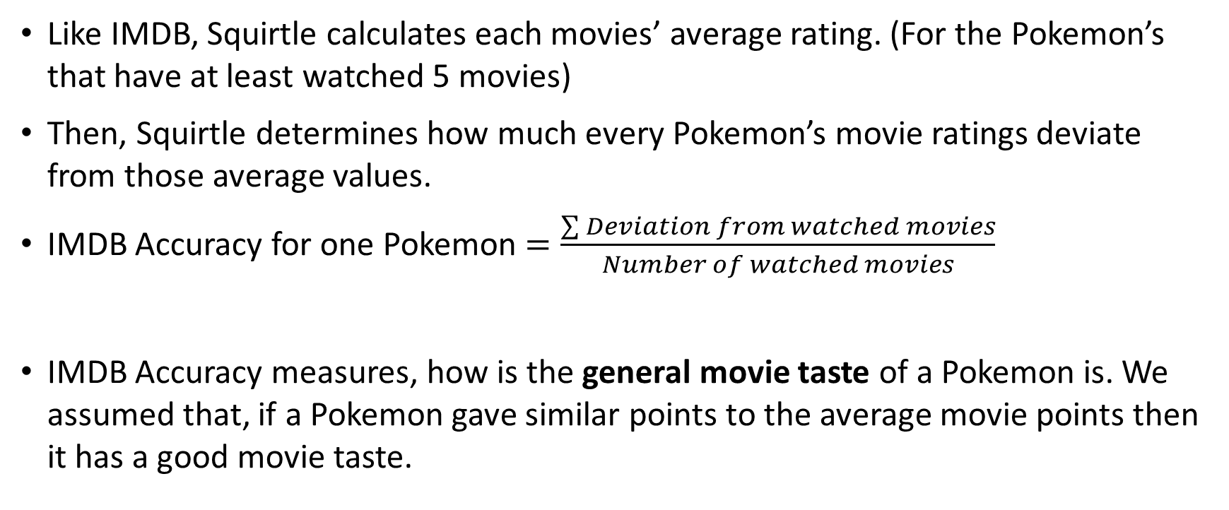
Trust -> Movie Knowledge -> IMDB Accuracy
Like IMDB, Squirtle calculates each movies’ average rating. (For the Pokemon’s that have at least watched 5 movies)
Then, Squirtle determines how much every Pokemon’s movie ratings deviate from those average values.
IMDB Accuracy for one Pokemon $=\frac{\sum{Deviation from watched movies}}{Number of watched movies}$
IMDB Accuracy measures, how is the general movie taste of a Pokemon is. We assumed that, if a Pokemon gave similar points to the average movie points then it has a good movie taste.

Slide 12
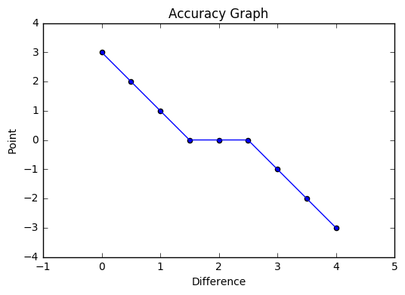
Trust -> Movie Knowledge -> IMDB Accuracy

Slide 13
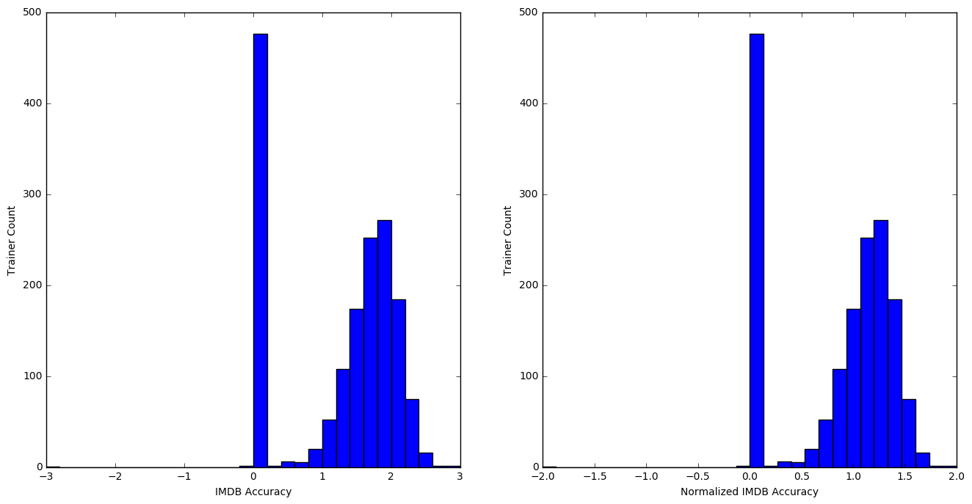
Trust -> Movie Knowledge -> IMDB Accuracy

Slide 14
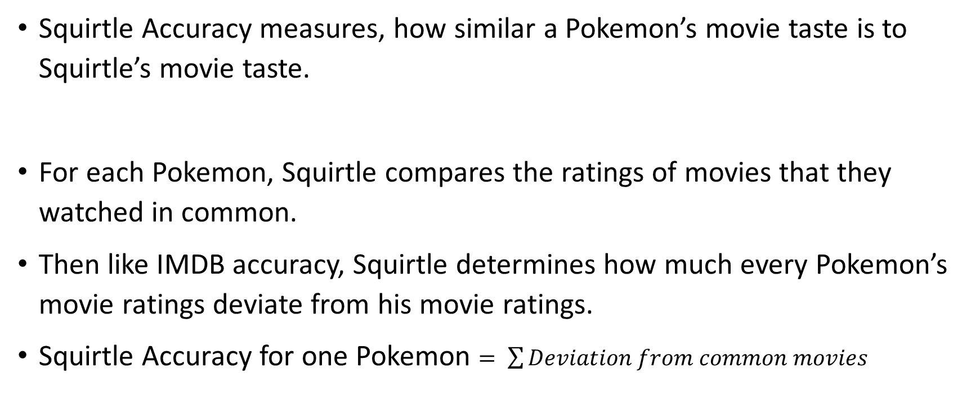
Trust -> Movie Knowledge -> Squirtle Accuracy
Squirtle Accuracy measures, how similar a Pokemon’s movie taste is to Squirtle’s movie taste.
For each Pokemon, Squirtle compares the ratings of movies that they watched in common.
Then like IMDB accuracy, Squirtle determines how much every Pokemon’s movie ratings deviate from his movie ratings.
Squirtle Accuracy for one Pokemon $= \sum{Deviation from common movies}$

Slide 15
Trust -> Movie Knowledge -> Squirtle Accuracy

Slide 16
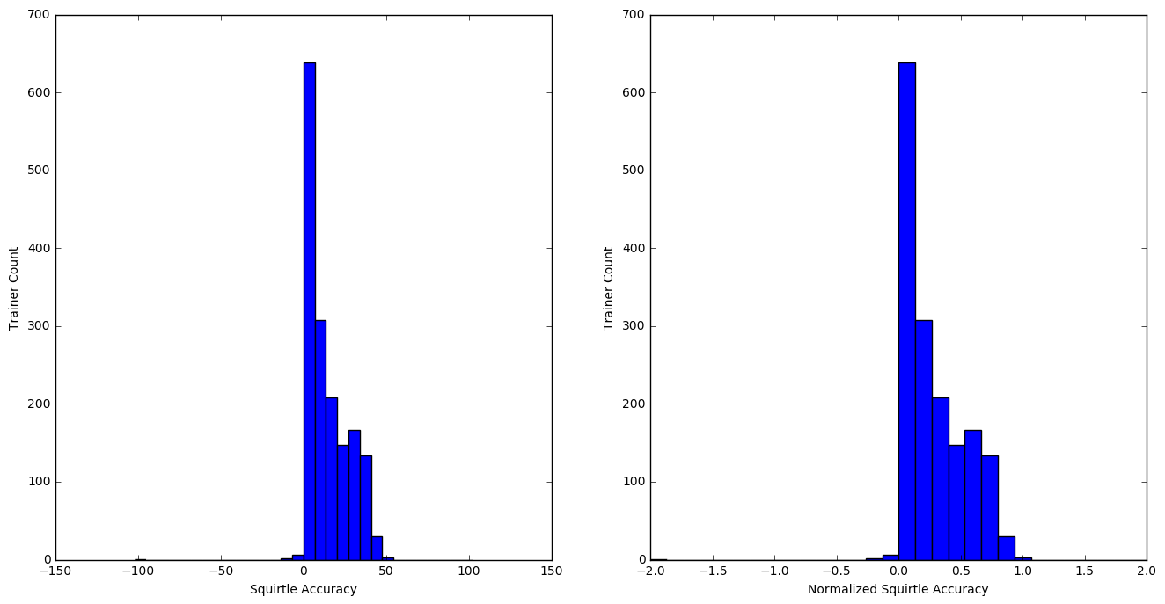
Trust -> Movie Knowledge -> Squirtle Accuracy

Slide 17
Trust -> Movie Knowledge
After calculating IMDB Accuracy and Squirtle Accuracy we normalized their values to between [-2, 2].
Purpose of the normalization is to drag both equation to same value space to make calculations and also to make them comparable to real movie ratings.
Movie Knowledge = (0.4*IMDB accuracy) + (0.6*Squirtle accuracy)

Slide 18
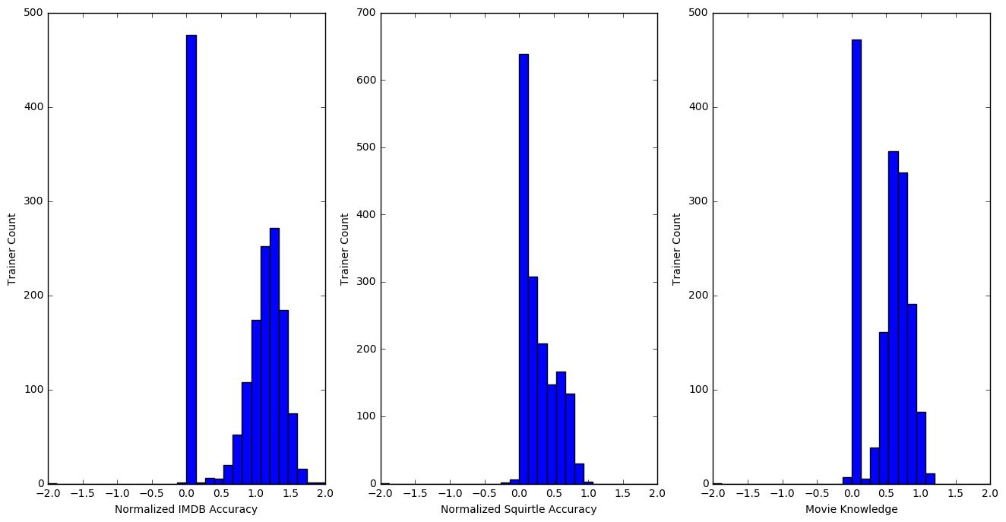
Trust -> Movie Knowledge

Slide 19
Trust -> Friendship Level
Friendship level means that how closely Ash knows a person in terms of its movie taste.
For his initial friends (from SquirtleTrust), the value is 1.
The value is 0 for people who is not friend of Ash.
For the new people Ash meets, Squirtle uses a formula to calculate friendship level.
But wait! How can Ash meet with new people?

Slide 20
Remember hangouts

Slide 21

Trust -> Friendship Level
If a Hangout Success:
Ash meets with a new person who is a friend of the Ash’s hangout friend.
Squirtle adds the new person to Ash’s friend list with the following Friendship Level:
Friendship Level of new friend =
Friendship Level of Ash’s prior friend * Movie Knowledge of Ash’s prior friend^{(*)}
^{(*)}: Movie Knowledge of Ash’s prior friend is mapped between (0.5, 1) for this equation.

Slide 22
Trust -> Friendship Level
user | trust | IMDB acc. | Squirtle acc | Movie Knowledge
OnIx | 1 | 1.45645173056 | 0.176470588235 | 0.688463045164
Charmender | 1 | 1.39472702768 | 0.313725490196 | 0.746126105188
Mew | 1 | 1.07338661944 | 0.117647058824 | 0.499942883071
Zubat | 1 | 1.11352192881 | 0.490196078431 | 0.739526418583
Staryu | 0.854892

Slide 23
Trust -> Friendship Level
user | trust | IMDB acc. | Squirtle acc | Movie Knowledge
OnIx | 1 | 1.45645173056 | 0.176470588235 | 0.688463045164
Charmender | 1 | 1.39472702768 | 0.313725490196 | 0.746126105188
Mew | 1 | 1.07338661944 | 0.117647058824 | 0.499942883071
Zubat | 1 | 1.11352192881 | 0.490196078431 | 0.739526418583
Staryu | 0.854892 | 1.40175090455 | 0.372549019608 | 0.784229773585
Togepi | 0.697518

Slide 24
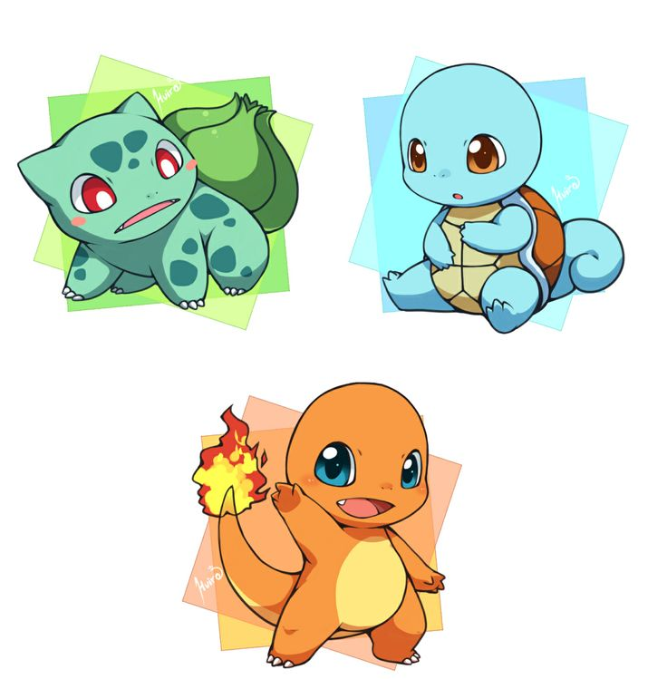
Trust -> Friendship Level
If a Hangout Failures:
Ash got cross with his friend and Squirtle cross out this person from Ash’s friend list.

Slide 25
$$Trust =Movie Knowledge∗ Friendship Level$$
$$Trust = \left(\left(0.4∗IMDB Accuracy\right) + (0.6∗Squirtle Accuracy)\right)∗ Friendship Level$$

Slide 26

New Movie Ratings
After calculating trust values for each friend of Ash:
New Movie Rating of Ash’s friend =
Trust value of Ash’s friend * Movie Rating of Ash’s friend
Important:
New Movie Rating is between [-4, 4] while Normal Movie Rating is between [-2, 2].
Squirtle normalizes the new movie ratings to compare.
But the important part is that the purpose of the new movie rating is for purely comparison.
So the values are not that important.

Slide 27
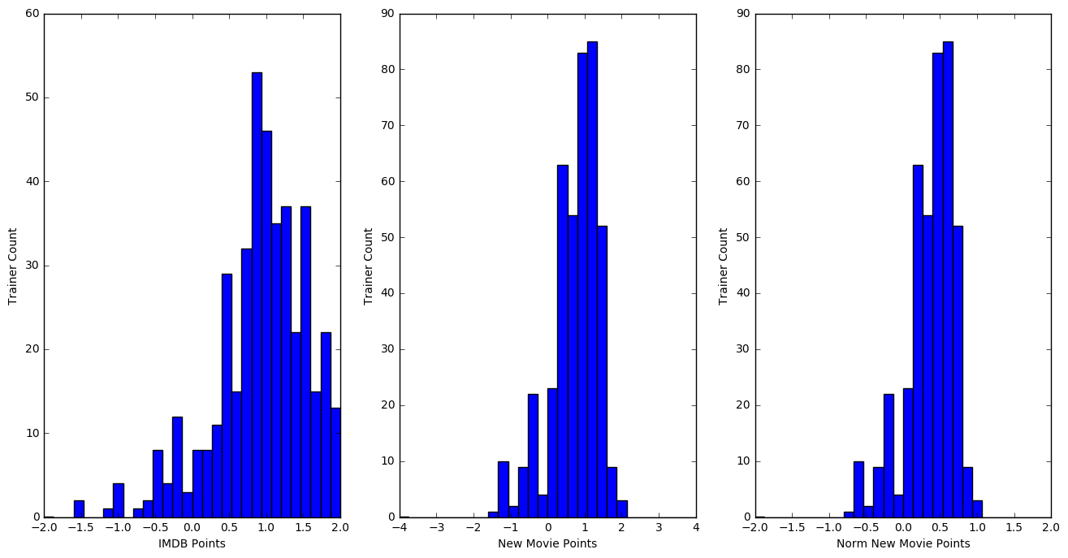
Movie Points vs New Movie Points

Slide 28
Choosing the Right Movie
If Squirtle can choose a movie reliably* according to Ash’s friends’ recommendations:
He takes the movie with the highest new movie rating, and makes a group of candidate movies from the movies that are at most 0.15 points less than the highest rated movie.
Then choses a movie probabilistically from the candidate list according to movies new ratings.
*Reliability: If there is at least a movie with more than new movie rating of 1 or 3 movies with more than new movie rating of 0.8.

Slide 29
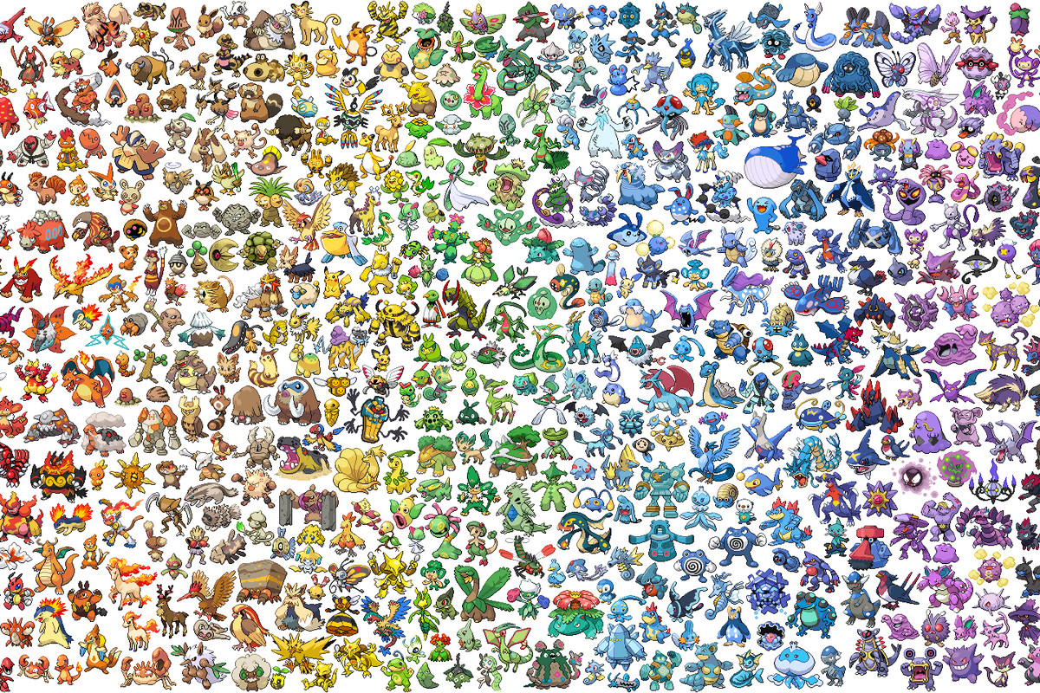
Choosing the Right Movie
If Squirtle can not choose a movie reliably according to Ash’s friends’ recommendations:
Squirtle finds all the friends of Ash’s friends.
Squirtle treats those new people as Ash’s friends according to the Hangout new friend adding process.*
Then without checking the reliability constraint, Squirtle chooses a movie for Ash with the method mentioned in the previous slide.
* If there is a person who is friend of more than one person, then take the average trust of all the persons to calculate its friendship level.

Slide 30
Demo Time!

