Slide 1

VHF/UHF Wireless Uplink Solutions for Remote Wireless Sensor Networks
KTH Royal Institute of Technology
Alp Sayin
22 May 2013
sayin[at]kth[dot]se

Slide 2
outline
Background
Problem
Goals
Theory
Design
Implementation
Experiments
Results
Conclusions
Future Work
Q & A

Slide 3
background - general
Atmel ATMega128RF-chip with IEEE 802.15.4Transceiver as Mote
The mote software is based on the Contiki operating system.
A mote automatically becomes a sink mote when connected via a TTL/USB converter
Gateway is usually a Bifrost/Alix system or Raspberry Pi without internet connection

Slide 4
background - sensors
Sensors
Pressure
Temperature
Precipitation
Soil moisture
Solar efficiency
Drinking water quality
Turbidity
Acidity
Redox-potential

Slide 5
background - motes
MCU
Atmel ATMega128Rfa1
Internal ADC
Built-in IEEE 802.15.4 Radio Transceiver
OS
TinyOS
NesC
Contiki-Os
C99

Slide 6
background - communication
Inter-node communication
IEEE 802.15.4
10-20 meters range
250 kbit/s raw data rate
Contiki Rime Protocol
Sink-Gateway communication
RS232 Uart Communication
Sensd by Robert Olsson and Jens Laas

Slide 7
background - gateway
Sink Node
Any Herjulf mote can be used as a sink node
No extra programming required
Gateway
Alix 2d13 machine
Bifrost Os
Voyage Linux

Slide 8
background - uplink
Uplink
Cabled connection
Fiber optic
Ethernet cables
Wireless connection
GSM network (GPRS, HSDPA etc.)
Satellite link
Dedicated terrestrial wireless link on a suitable frequency
Physical transportation of data
Delay tolerant network

Slide 9
problem
Get the collected data out from the gateway of a WSN to a remote repository with internet access.
Explore 434 MHz and 144 MHz frequencies and associated protocol stacks to optimize the range and QoS
Try from dedicated hardware solutions to software defined radio links to optimize power consumption and flexibility.

Slide 10
goals
A feasible, minimum hardware, low-cost, low-power, long range solution to the problem of getting the sensor data out from the sink mote to a remote repository
To implement IP over the same solution, so that existing user programs, or newly developed programs could be used over this link

Slide 11
theory – physical link
VHF / UHF Bands
144 Mhz Band (2 m band)
433 Mhz Band (70 cm band)
Modulation
Bi-phase encoding (Manchester)
1200 baud AFSK

Slide 12
theory – data link
ONLY FRAME FORMAT!
Ethernet
Max payload 1500 byte
18 bytes header
6 byte source and destination
2 byte length
4 byte CRC checksum
IEEE 802.15.4
Max payload 256 byte
21 bytes header
2 byte frame control
1 byte sequence number
4-20 byte address information
2 byte frame check sequence
AX.25
Max Payload 256 byte
18 bytes header
7 byte source and destination
1 byte control
1 byte protocol identifier
2 byte CRC checksum

Slide 13
theory – network layer
IP
IPv4
20 byte header
4 byte source and destination
2 byte header checksum
2 byte total length
1 byte time-to-live
IPv6
40 byte header
16 byte source and destination
2 byte payload length
1 byte time-to-live
APRS
Rests on AX.25
Text based protocol
No header requirement except AX.25 headers

Slide 14
theory – transport layer
UDP
Easy to implement, difficult to use
TCP
Difficult to implement, easier to use
APRS
Pseudo-routing routines are implemented
Based on broadcast flooding with reverse poisoning

Slide 15
theory – application layer
HTTP
Simple request/response protocol
Can be used for any resource access application
Requires TCP
TFTP
An old yet reliable protocol (still used in some routers for flashing)
Can work on UDP
Has limitations (e.g. file size < 4 GB)
APRS
Generally used for weather and location reporting
Also has a telemetry message option for reporting arbitrary measurements
Messages are collected in a single open repository (accessible via aprs.fi)

Slide 16
theory - hardware
TNC with Radio rigs
Radio
MAAS AHT-UV-2
YAESU FT8900
TNC
Hardware TNC
Software TNC
soundmodem
Dedicated Radio modules
Radiometrix Bim2A
Radiometric UHX1

Slide 17
design - protocols
AX.25
IPv4
TCP
UDP
APRS
APRS
Data-Link
Network
Transport
Application
HTTP
TFTP
APRS
Physical
VHF/UHF Analog or Digital Modulation
Figure.1 Resulting branches in the project after design decisions

Slide 18
design - final
HTTP/TCP/IPv4/AX.25
Soundmodem
Analogue Modulation
Linux Platform
TFTP/UDP/IPv4/AX.25
Radiotftp
Digital Modulation
Linux Platform
Radiotunnel
Digital Modulation
Linux Platform
Radiotftp_process
Digital Modulation
Contiki Platform
APRS/AX.25
APRS
Analogue Modulation
Linux Platform
Figure.2 Resulting solutions after hardware decisions

Slide 19
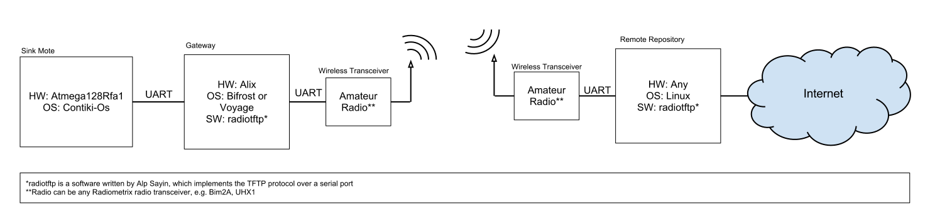
implementation - radiotftp
TFTP < UDP < IPv4 < AX.25 < Bi-phase Encoded Digital Stream
Tailored solution for the problem
Completely in C, easier to port
Figure.3 System diagram for radiotftp solution

Slide 20
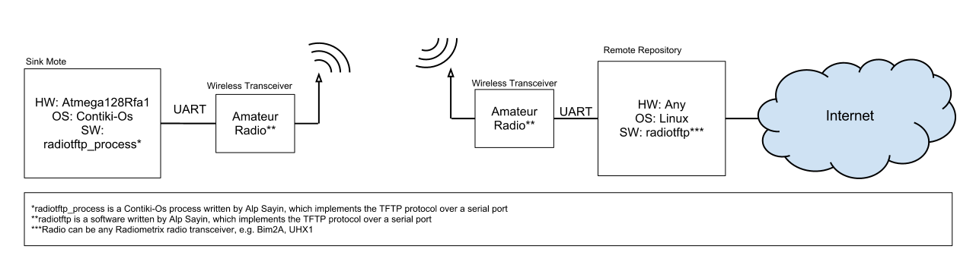
implementation – radiotftp_process
TFTP < UDP < IPv4 < AX.25 < Bi-phase Encoded Digital Stream
Tailored solution for the problem
Contiki-Os over Atmega128Rfa1 port of radiotftp
Figure.4 System diagram for radiotftp_process solution

Slide 21

implementation - radiotunnel
IPv4 > AX.25 > Bi-phase Encoded Digital Stream
Flexible solution, open for any application layer compatible with UDP or TCP
Easy to implement with use of virtual kernel interfaces
Figure.5 System diagram for radio_tunnel solution

Slide 22

implementation - soundmodem
IPv4 > AX.25 > AFSK Analog Stream
Flexible solution, open for any application layer compatible with UDP or TCP
Software is already there
Requires more hardware
Figure.6 System diagram for soundmodem solution

Slide 23
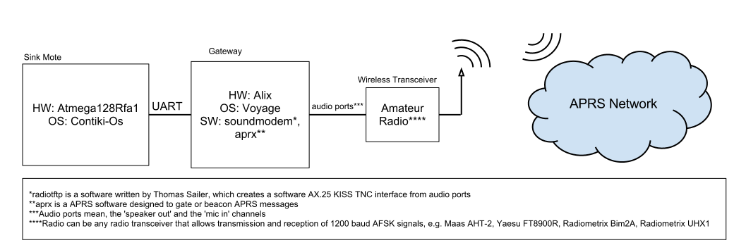
implementation - aprs
APRS > AX.25
Utilizes the APRS network
Limited by APRS and radio amateur rules
Figure.7 System diagram for APRS solution

Slide 24
experiments
Radiotftp
Parameters: Distance, Transfer Size
Outputs: Transfer Time, Packet Error Rate, Power Consumption
Radiotunnel
Parameters: Transfer Size
Outputs: Transfer Time, Channel Utilization, Power Consumption
Soundmodem
Parameters: Transfer Size
Outputs: Transfer Time, Channel Utilization, Power Consumption
General Experiments with Radiometrix Devices
Parameters: Distance
Outputs: Received Signal Strength Indicator (RSSI)

Slide 25
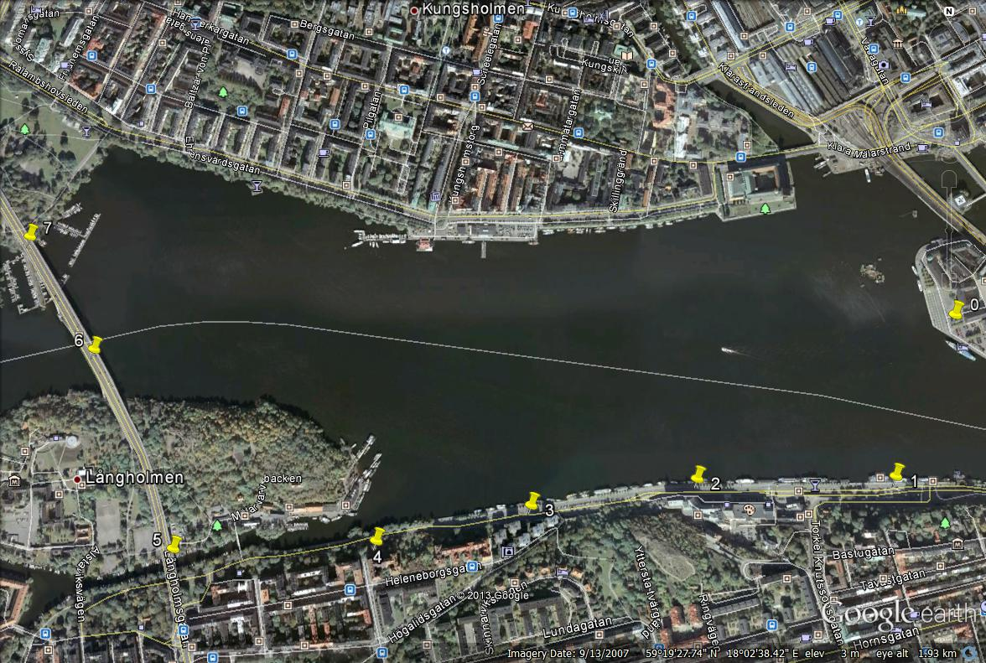
experiments – outdoor map
2120 meters
1950 meters
1820 meters
1390 meters
700 meters
395 meters
1050 meters
Figure.8 Map of Gamla Stan Experiments (image from Google Maps)

Slide 26
results
 | Transfer Time 127 bytes | Transfer Time 2 kbytes
radiotftp uhx1 | 00:08.915 | 00:21.727
radiotftp bim2a | 00:00.873 | 00:02.414
radiotunnel uhx1 | 02:56.029 | 12:09.429
radiotunnel bim2a | 02:00.120 | 02:05.261
soundmodem | 02:09.707 | 02:59.324
Table.1 Average transfer times with minimum distance between transceivers

Slide 27
results – transfer times
Figure.9 Transfer time plots for single packet delivery
Figure.10 Transfer time plots for many-packet delivery

Slide 28
results – packet error rate
Figure.11 Error rate plots for single packet delivery
Figure.12 Error rate plots for many-packet delivery

Slide 29
results - bitrate
Figure.13 Bitrate plots for single packet delivery
Figure.14 Bitrate plots for many-packet delivery

Slide 30
results – RSSI
Location | RSSI (UHX1) | RSSI (Bim2a)
No Signal Applied | 64 | 0.28
0 (Base) | 196 | 0.48
1 | 136 | 0.40
2 | 122 | 0.30
3 | 116 | 0.31
4 | 133 | 0.38
5 | 103 | N/A
6 | 126 | N/A
7 | 121 | N/A
Table.2 RSSI readings from various locations with UHX1 and Bim2A

Slide 31
conclusions - radiotftp
The effect of overhead can be heavily observed. On the other hand, many-packet transactions are statistically more probable to disconnect (‘Experiments with radiotftp’).
The bitrate difference in bands shows itself also in the final throughput.
While using the 2 meter band, the distance does not seem to have much effect. On the other hand, obstructions on the wave path cause a lot of distortion.
While using the 70 cm band, the received power decays much more relative to the 2 meter band and therefore observed to have a much shorter range.
In both bands having a high ground has a good impact on signal strength.

Slide 32
Conclusions - general
Radiotftp solution seems to have much greater bitrate compared to others, but this is simply an effect of utilizing the channel more efficiently. On the other hand, other solutions can’t use the channel this efficiently, even if they wanted to.
The radiotunnel solution shows almost an exponential growth in transfer time with respect to the file size. This is due to the manual forced drop of the packets to ensure half-duplex operation.
Soundmodem proved itself to be a faster option compared to radiotunnel, even with its low raw bitrate (1200 bps).
If the radiotunnel is not to be improved to act as an half-duplex interface, and if soundmodem solution can be improved to use radiometrix devices, then radiotunnel solution can deprecated.
Some suggestions could be made according to some requirements:
If higher throughput is required; radiotftp,
If easy-setup and easy API is required; radiotunnel
If standardization and easy API is required; soundmodem
If standardization and set-it-and-forget-it kind of application is required; APRS solution would be suggested.

Slide 33
future work - radiotftp
The radiotftp code base should be improved to have multiple-size queues and multiple timers. It already supports it, but it is not a default.
The radiotftp code should be cleaner for further developers. It should look like an open API -which, it is-, and there should be an open documentation for it.
The radiotftp solution can be optimized more by changing the place of the delays and/or replacing the delays with non-busy waits.

Slide 34
future work – radiotftp_process
The radiotftp_process code could be optimized to work with higher baudrates than 2400. So that it would consume less CPU time while transmission.

Slide 35
future work - radiotunnel
The radiotunnel code should not be improved anymore, but instead, an actual device driver should be written for fine tuning.

Slide 36
future work - soundmodem
The soundmodem solution should be moved on to work with Radiometrix devices. In such way, a more portable hardware can be obtained. And the users won’t need to worry about handheld radios’ power consumption.

Slide 37
future work - APRS
If possible, the APRS solution should also be tested in open field and packet loss should be recorded.

Slide 38
future work - general
The uhx1_programmer can be extended to be able to program the frequency of the UHX1 devices, so that frequency can be selected while running to avoid interference.
The devtag library could be incorporated to use USB device tags instead of USB device names to select the proper USB FTDI device.
A team has already started working on an implementation of a Delay Tolerant Network (DTN) based on this project’s outcomes.

Slide 39
questions & answers
Thank you for listening
More information:
http://alpsayin.com/vhf_uhf_uplink_solutions_for_remote_wireless_sensor_networks
http://github.com/alpsayin
http://code.google.com/p/kth-wsn-longrange-radio-uplink/ (old)
sayin[at]kth[dot]se
WSN Team 2012
http://ttaportal.org/menu/projects/wsn/fall-2012/
https://github.com/organizations/WSN-2012
https://docs.google.com/presentation/pub?id=1rL40Es9D6ZoAD4bN72XcnrYqhL56eWsP8E4WOMR8C-E&start=false&loop=false&delayms=3000

Slide 40
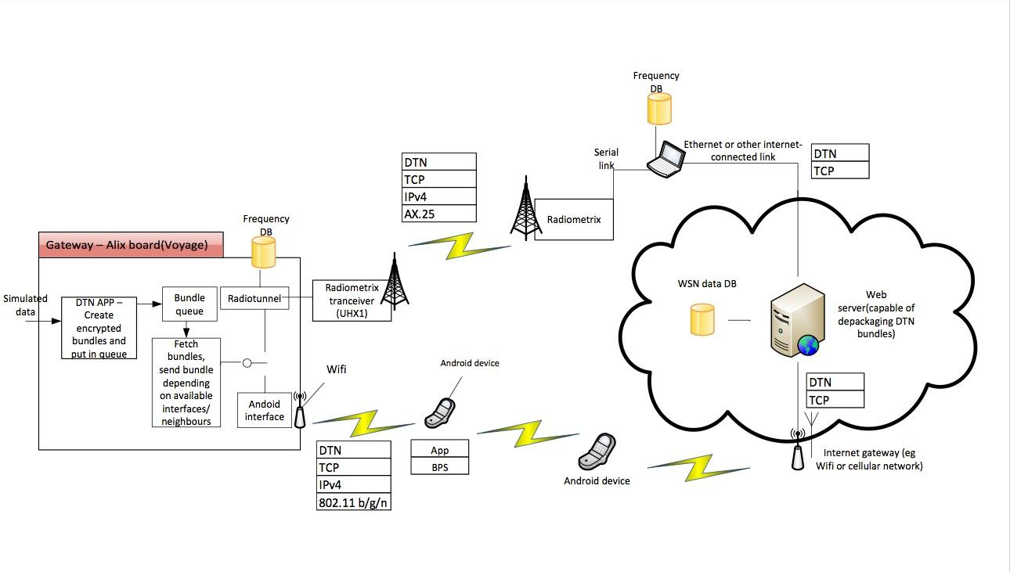
extra - future work
Figure.15 Topology of a VHF Link with a Delay Tolerant Network as fallback
*Courtesy of WSN Team 2012 (KTH Communications System Design, Design Project Team)

Slide 41
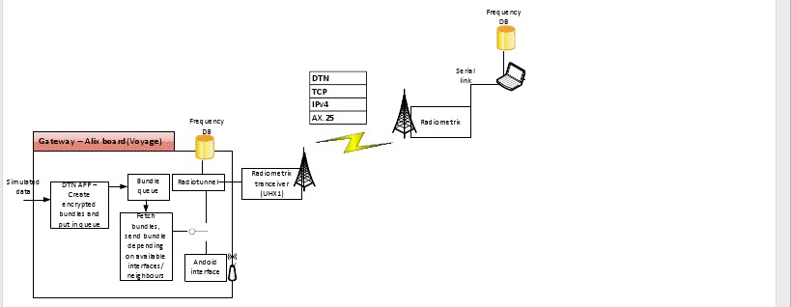
extra - delay tolerant network
Spectrum Database Radio(SDB) Solution
Selection Mechanism Implementation
Figure.16 Topology of VHF link part of the WSN Team’s project
*Courtesy of WSN Team 2012 (KTH Communications System Design, Fall 2012 Design Project Team)

Slide 42
extra - demo
Wireless Sensor Network
This Computer
UHF Uplink with RadioTftp
RaspberryPi Gateway
Sink Mote
Figure.17 Topology of the demo setup

