Slide 1
VHF/UHF Wireless Uplink Solutions for Remote Wireless Sensor Networks Alp Sayin 28.11.2012
KTH Royal Institute of Technology

Slide 2
Outline
Background
Problem
Goals
Communication Protocols
Proposed Solutions
Experiments
Data & Conclusions
Future Work
Demo
Questions

Slide 3
Background
Atmel ATMega128RF-chip with IEEE 802.15.4Transceiver as Mote
The mote software is based on the Contiki operating system.
A mote automatically becomes a sink mote when connected via a TTL/USB converter
Gateway is usually a Bifrost/Alix system or Raspberry Pi without internet connection

Slide 4
Problem
Get the collected data out from the gateway of a WSN to a remote repository with internet access.
434 MHz and 144 MHz frequencies and associated protocol stacks to optimize the range and QoS
From dedicated hardware solutions to software defined radio links to optimize power consumption and flexibility.

Slide 5
Communication Protocols
Data-Link
AX.25? Ethernet? 802.15.4?
Network
APRS? IPv4? IPv6?
Transport
UDP? TCP?
Application
HTTP? FTP? TFTP? APRS?

Slide 6
Proposed Solutions
RadioTftp
RadioTftp Process for Contiki
RadioTunnel
Soundmodem
APRS

Slide 7
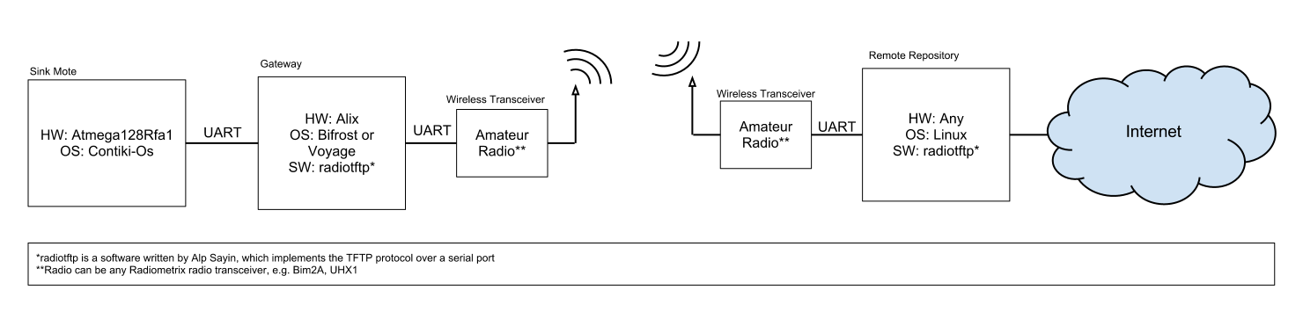
RadioTftp

Slide 8
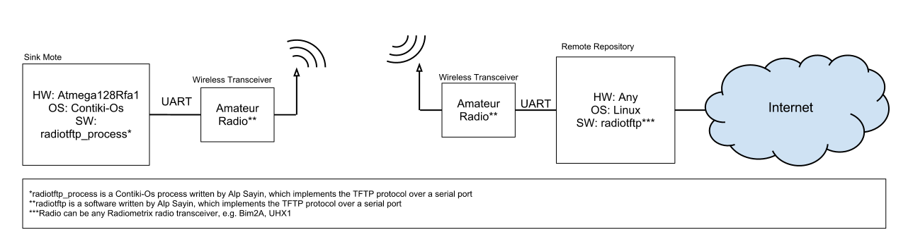
RadioTftp Process for Contiki

Slide 9

RadioTunnel

Slide 10

Soundmodem

Slide 11
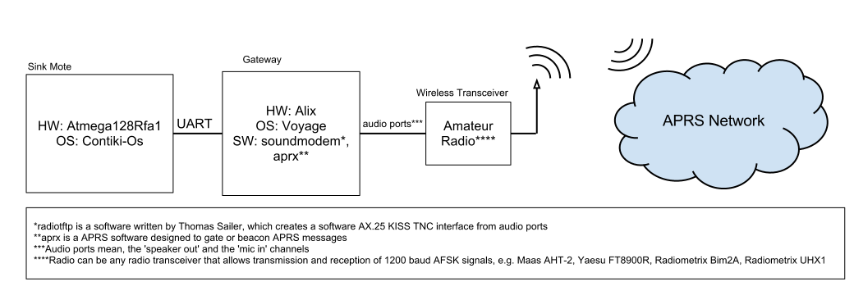
APRS

Slide 12
Experiments
Outdoor Experiments (Around Riddarfjärden)
General Hardware Testing (i.e. RSSI vs. Distance)
RadioTftp
Indoor Experiments (Lab Testing)
RadioTunnel
Soundmodem

Slide 13
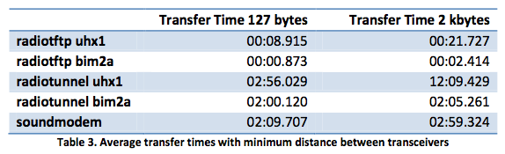
Data & Conclusions
Maximum Distance with 2m band with 10 mw: 2.1 km
Packet Error Rate with RadioTftp = 15%
Maximum Distance with 70cm band with 10 mw: 400 meters
Packet Error Rate with RadioTftp = 35%

Slide 14
Data & Conclusions
RadioTftp
Effect of protocol overhead can be heavily observed.
The bitrate has a direct effect on throughput.
RadioTftp has the greatest throughput, since it utilizes the channel the most efficiently.

Slide 15
Data & Conclusions
Concerning all solutions:
RadioTunnel solution shows a great decrease in throughput with respect to transfer size.
Soundmodem is better than RadioTunnel from most aspects.
2m band has much greater range with respect to 70cm band with same power output.
Obstructions on the signal path are fatal.
Having a high ground is always better.

Slide 16
Conclusion
There is no one best solution.
Depending on the situation any of the solutions could be desirable.

Slide 17
Future Work
The radiotunnel code should not be improved anymore, but instead, an actual device driver should be written for fine tuning.
The radiotftp code base should be improved to have multiple-size queues and multiple timers.
The soundmodem solution should be moved on to work with Radiometrix devices.
The uhx1_programmer can be extended to be able to program the frequency of the UHX1 devices.

Slide 18
WSN Team 2012
Andreas Torbiörnsson
Konstantinos Vaggelakos
Elena Rakhimova
Natalia Paratsikidou
Xiaohang Chen
Md. Iqbal Hossain
Fabio Viggiani

Slide 19
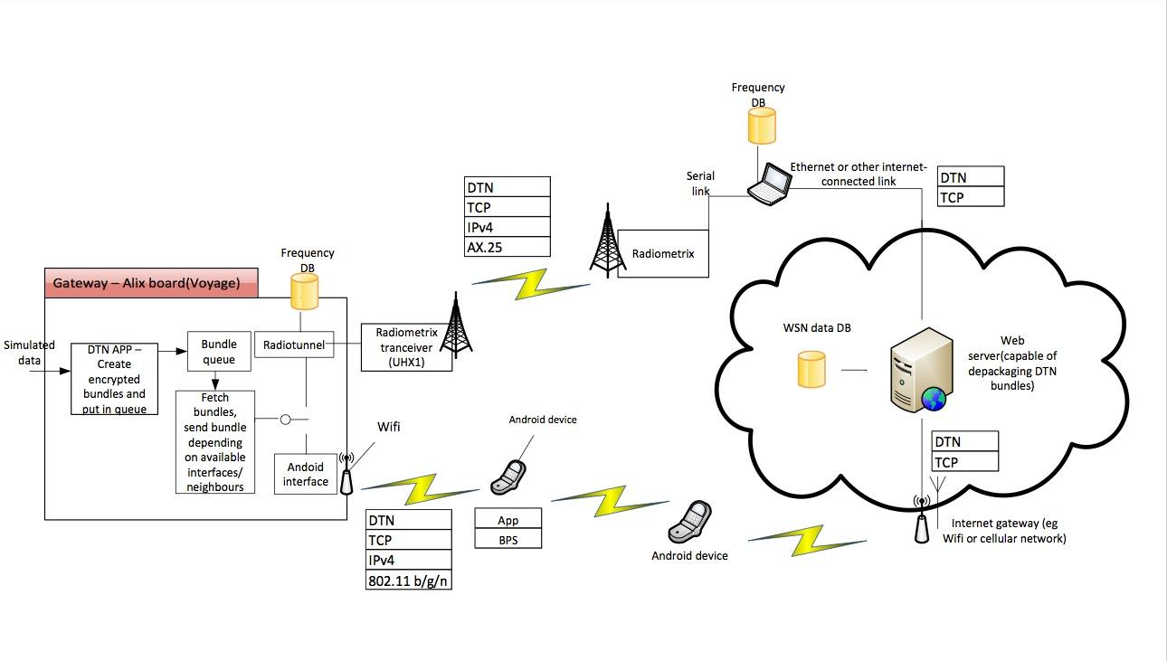
Future Work
*Courtesy of WSN Team 2012 (KTH Communications System Design, Design Project Team)

Slide 20
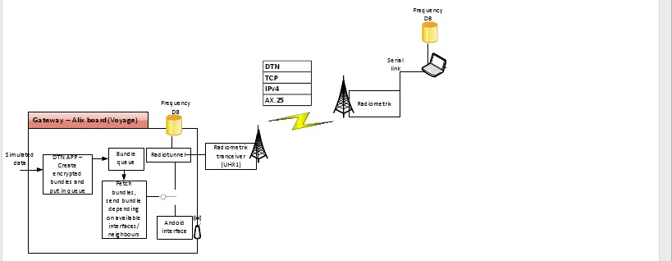
Delay Tolerant Network
Spectrum Database Radio(SDB) Solution
Selection Mechanism Implementation
*Courtesy of WSN Team 2012 (KTH Communications System Design, Fall 2012 Design Project Team)

Slide 21
Demo
Wireless Sensor Network
This Computer
UHF Uplink with RadioTftp
RaspberryPi Gateway
Sink Mote

Slide 22
Questions
Thank you for listening
More information:
http://alpsayin.com/vhf_uhf_uplink_solutions_for_remote_wireless_sensor_networks
http://github.com/alpsayin
http://code.google.com/p/kth-wsn-longrange-radio-uplink/ (old)
sayin[at]kth[dot]se
WSN Team 2012
http://ttaportal.org/menu/projects/wsn/fall-2012/
https://github.com/organizations/WSN-2012
https://docs.google.com/presentation/pub?id=1rL40Es9D6ZoAD4bN72XcnrYqhL56eWsP8E4WOMR8C-E&start=false&loop=false&delayms=3000

