Slide 1
CREDENZA
Test Account Management
DEC 2025
Paramount

Slide 2
The Problem We're Solving
❌ Before Credenza
✓ With Credenza
→ Hard-coded credentials scattered across repos
→ No visibility into who's using which accounts
→ Account conflicts causing test failures
→ Manual coordination via Slack & spreadsheets
→ No audit trail to track usage or issues
→ Time wasted searching for available accounts
→ Centralized account management
→ Account usage assignment & coordination
→ Usage control, tracking & reporting
→ Dynamic allocation for any criteria
→ API integration with test suites
→ No more PRs for account maintenance
Estimated time savings: 30-60 minutes per tester per day
Paramount
2

Slide 3
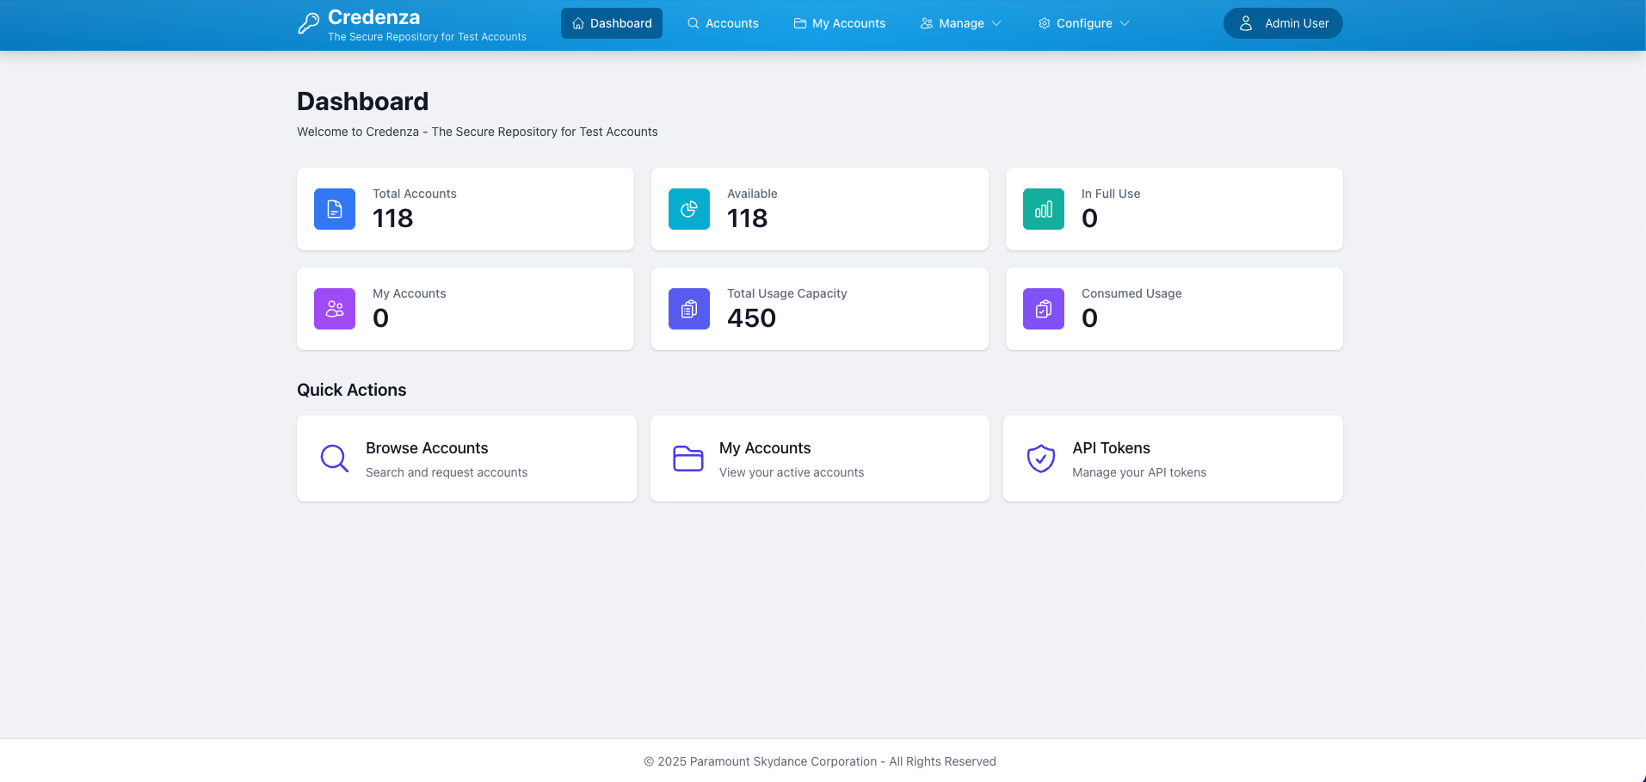
Introduction
• Centralized account management
• Account Usage Assignment to User & Better Coordination
• Usage Control, tracking & Reporting
• Dynamic allocation & multiple account setup for a given criteria
• API Integration with test suite
• No more PRs for Test Account Maintenance
[Dashboard Screenshot]
Paramount
3

Slide 4

Credenza Demo
Paramount
Click to play Credenza Dashboard Demo
4

Slide 5
Automation Integration
🔑 KEEPER
Credenza Token
🔐 Credenza
Application
Account Request
Automation Test
App Config
(Credentials)
Credenza Account Manager
(Requests, Tracking, Releases)
Credenza Client
(API Integration)
Test Tear Down
Fail-over
quality-engineering-test
Existing Credential
Properties
Credenza URL
configs
Credenza API
POJO Models
https://github.com/paramount-streaming/quality-engineering-test/compare/credenza-poc
Paramount
5

Slide 6
Administration Features
• User management, and force release of accounts
• Region, Environment, Platform, and Application management
• Account Usage and Request Error details
• Audit Trail details for detailed analysis
• Database browser
• Full API documentation access
👤
Paramount
6

Slide 7
Enhancements
• Account Criteria definitions and support in requests
• Automatic account provisioning for Staging
• Regular Health checks on account
• Auto healing of account issues
• Flagging & Reporting of accounts that could not be healed
☁️ API
Application User
Management API
Integration
Paramount
7

Slide 8
API Integration POC Demo
Paramount
Click to play API Integration Demo
8

Slide 9
What's Next
❓ Feedback & Clarification
⚙️ Environment Decisions
🚀 Rollout Plan
• Production account creation workflow
• TVE accounts management approach
• Other specific case scenarios
• Edge cases & special requirements
• Web server placement
• Database hosting decision
• Okta integration for SSO
• Keeper integration for secrets
• Schedule beta testing phase
• Pilot with select QA teams
• Gather feedback & iterate
• Full deployment for all QA engineers
Feedback Collection → Environment Setup → Beta Testing → Production Deployment
Paramount
9

Slide 10
⛰️
THANK YOU
Questions?
Paramount

