Slide 1

Traffic Lights Simulation
Alptekin YANIK - 17290130
Murat YILDIRIM - 17290132

Slide 2
Design Model
Start North
Start West
West
Stop West
North Next
North
Stop North
West Next
As you can see in the image on the right, we chose a model with 2 traffic lights. We named our lights North and West and used them that way in the code.
Our project consists of two code files. The part that contains the definitions and the general design of the code is in the "TrafficLights.vhd" file.

Slide 3
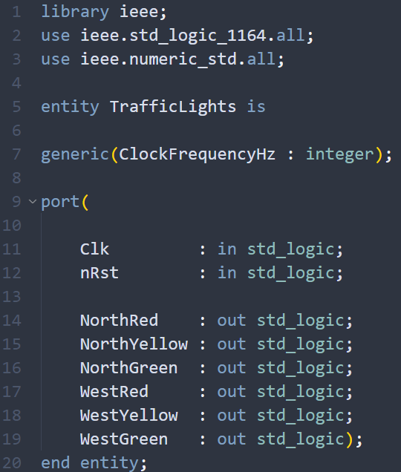
TrafficLights.vhd
In this part of the code, you can see "ClockFrequencyHz", which we define with "generic". We did this to avoid repetitive code blocks and assign a constant value
We also defined the input and output ports. The color signals of the Nort and West traffic lights are defined as the output port
We also defined nRst to focus on the positive edge triggered flip flop with negative reset

Slide 4
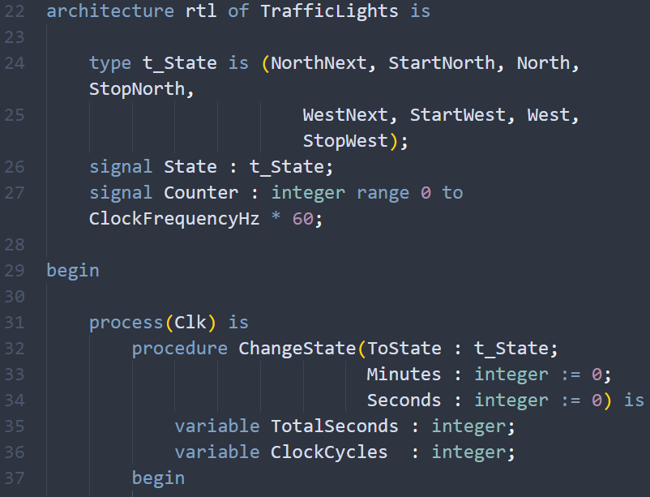
TrafficLights.vhd
As seen in our model before, for a light to turn on and off, it must receive a signal, so we define "state". Our outputs are controlled by this signal.
Also, we defined counter for counting the number of clock periods which passes,1 minute.
Process is sensitive to Clk input. This means that if the Clk is changed ,the process will wake up and the code block bottom is executed. Procedure is for changing state after a given time

Slide 5
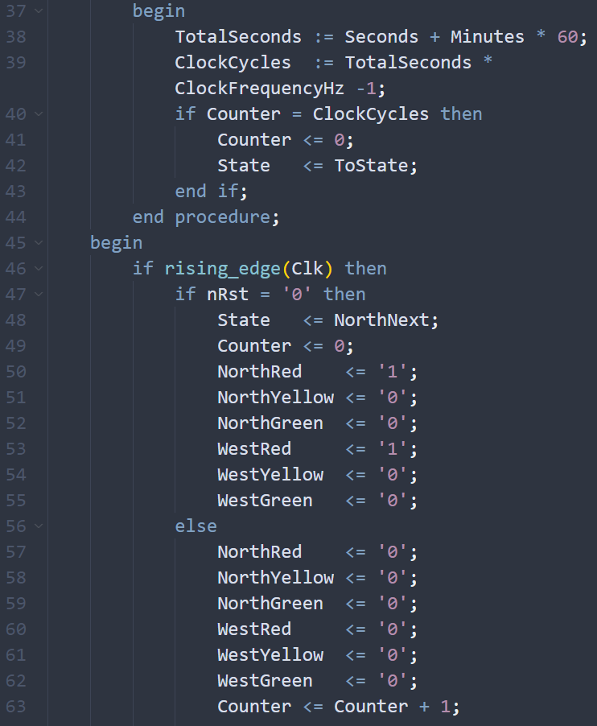
We abstract 1 from the ‘ClockFrequencyHz’ because of the interval begins 0 to x
If the counter reaches ClockCycles value, then we start next state with Counter=0
If block works when block executed when the rising edge of the ‘Clk’ signal arrives
In the when statements we are not assigning "0" to any signal because we assign all of them "0" in here being default value already the last value which is assigned becomes effective
We increment the counter by one every time the rising edge of the Clk

Slide 6
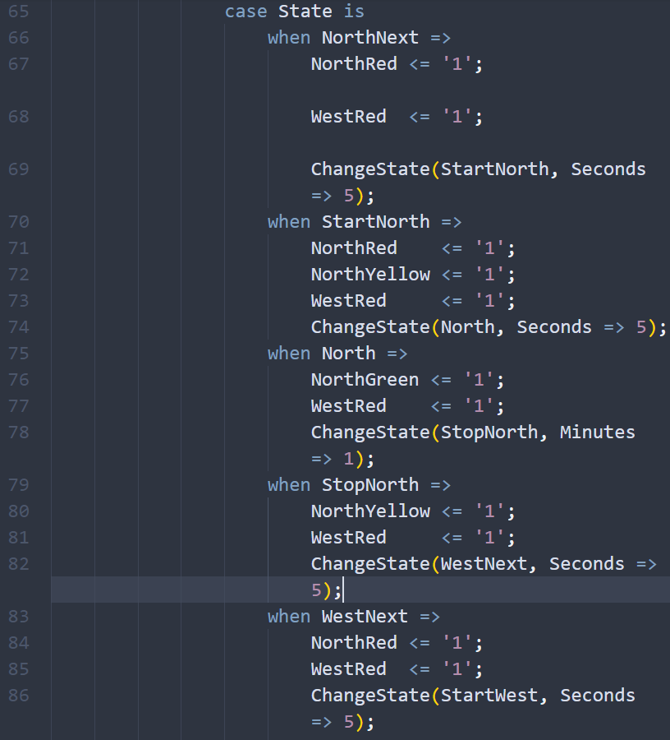
Each of the states, the program take different paths for every ones.
This state is the default one and red light is on in all directions, and it changes after 5 seconds
This state comes after the northNext and it is said to be preparing state for changing directions, yellow light is on in north directions for 5 seconds Cars in the west direction are still stopping because of the westRed is "1«
This state comes after the North state. When this when block execute, NorthYellow becomes "1"for both north direction. This continue for 5 seconds and means that preparing for red light.
This state comes after the StopNorth state.Red light is on in all directions, and it take 5 seconds.

Slide 7
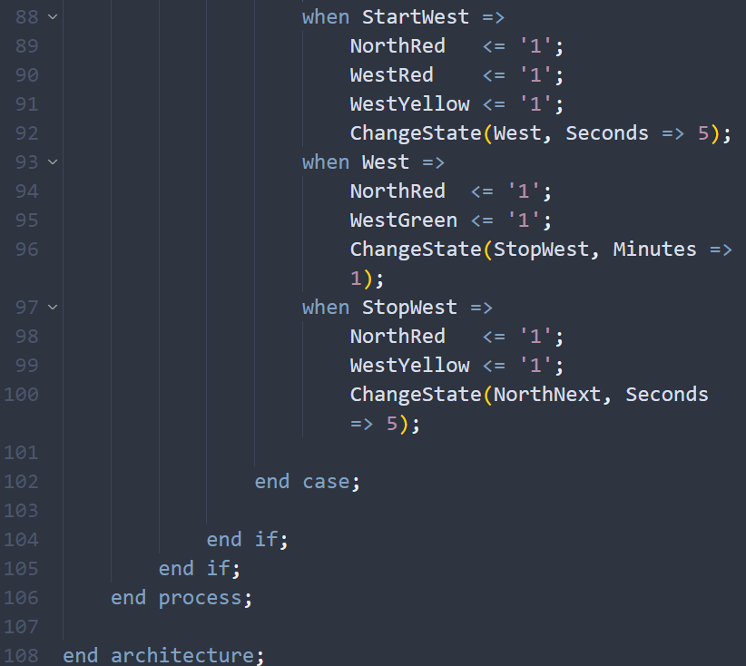
This state comes after the West state. When this when block execute, WestYellow becomes "1" for west direction. This continue for 5 second and means that preparing for red light. After this when statement everything turns the initiate state with ChangeState function takes the NorthNext as input. This allows us to infinite loop for this simulations.

Slide 8

Testbench.vhd
MURAT YILDIRIM 17290132

