Slide 1

Conceptual Modeling for User Story
A Capstone Project for Misk Data Science Immersive Course
Sarah A. AlQahtani
Dec 17, 2020

Slide 2
Outline
Introduction
Approach
Problem Statement
Results & Discussion
Conclusion
Future Work

Slide 3
WHAT IS THE USER STORY?
< As a (....), I want (....), So that (....) >
Role: represent the one who want the functionality.
Means: represent the functionality that the end user ask for.
End: the reason behind the need of the functionality in end user perspective. (optional)

Slide 4
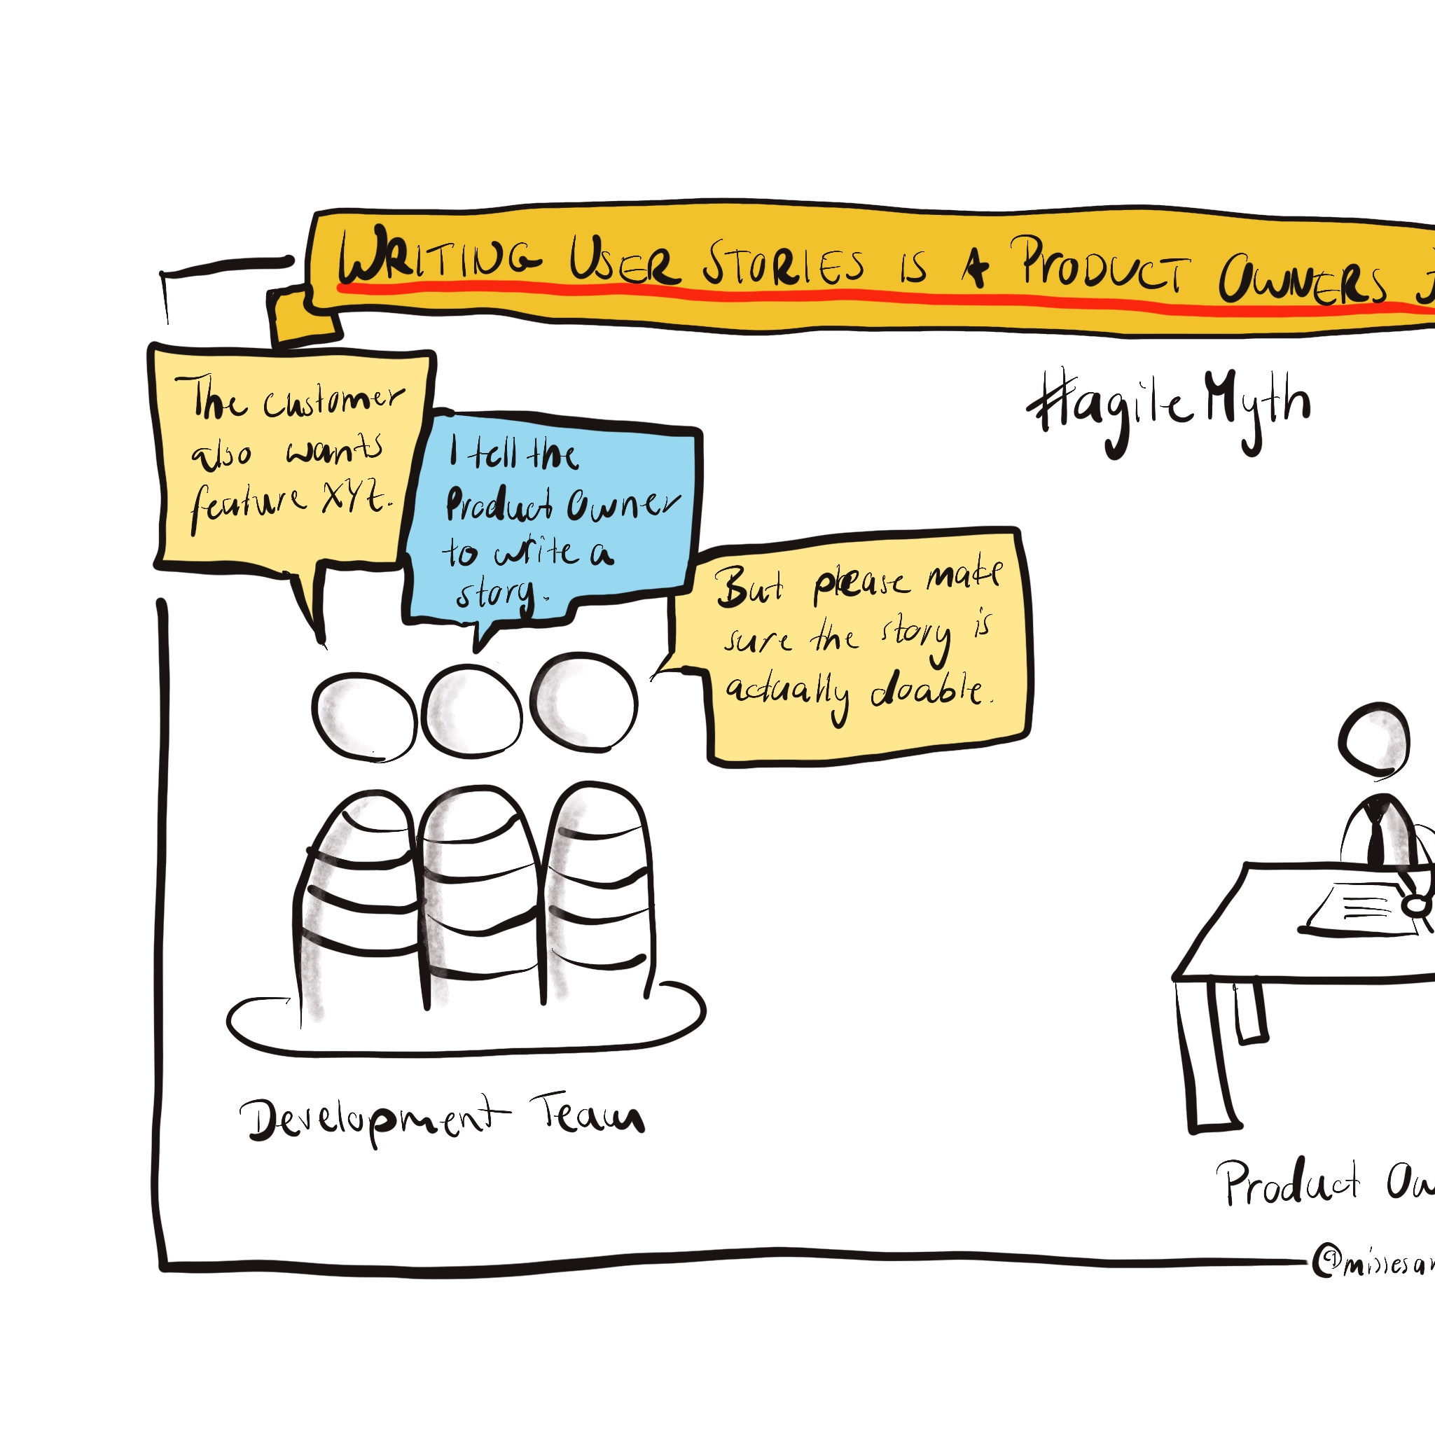
Problem Statement
The misunderstanding of the requierment among the development team, product owner and the stalkhaolders.
The lack of the big upfront design approach

Slide 5

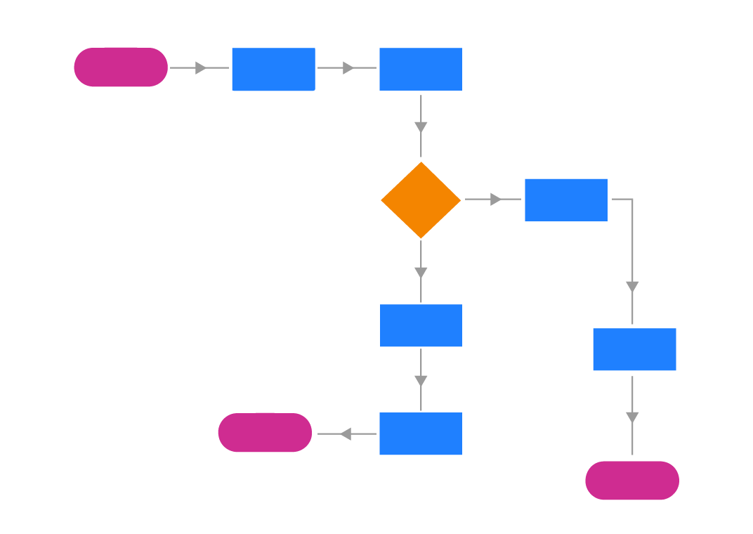
Approach
< As a (....), I want (....), So that (....) >
Common Understanding
Ease of changing and sharing
Notes:
In this project I’m proposing a solution that can be used by the teams to provide efficient communication, which is a tool that can generate a the design diagrams which can take the written requirements as input then generate a diagram that can provide the standardize the understanding and can be automatically changed based on the written requirements changes to go along with the agile flexibility and the on going changes of the requierments.
You may say agile is not about process and tools but I still see the need of the UML or diagrams in general to clear out the relationships and dependencies in a project.

Slide 6


Project Stages
Data Collection
1
Data Muging
2
Data Annotating
3
NER Model Training
4
Diagrams Generation
5
Notes:
- Here are the stages of the project first the data collection then data munging after text annotating then Named entity recognation model then finally the diagrams generation.
- Due to the time limitation, the genration of the diagrams stag has not been acomplished.

Slide 7
Data Desciption
A collection of 22 dataset of more than 50 requierments each a.k.a 'user story'. These were all found online, or retrieved from software companies with a permission to disclose.
Dataset: https://data.mendeley.com/datasets/7zbk8zsd8y/1

Slide 8
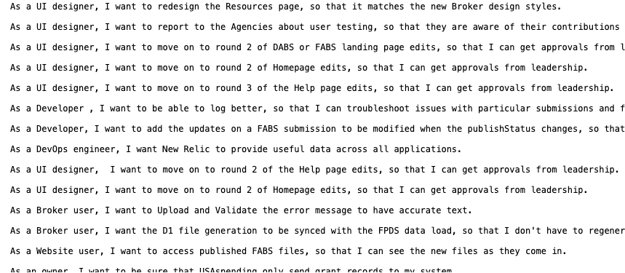
Data Desciption
Each line in each file represent a User Story

Slide 9
Data Munging
Removing non-ASCII characters.
Removing URLs and emails
Removing numbers
Normalizing: converting all letters to lower

Slide 10
Exploratory Data Analysis
 | file_name | us_text | file_len | word_count | us_count | avg_word_len
0 | g25-duraspace.txt | as a repository manager, i want to know all th... | 11420 | 2015 | 99 | 4.667990
1 | g18-neurohub.txt | as a system administrator, i want to run a scr... | 11837 | 2199 | 101 | 4.383356
2 | g26-racdam.txt | as an archivist, i want to apply a license or ... | 11779 | 2122 | 99 | 4.551367
3 | g28-zooniverse.txt | as a user, i want to search and discover music... | 6124 | 1060 | 59 | 4.778302
4 | g23-archivesspace.txt | as a researcher, i want to be able to view a f... | 4931 | 875 | 56 | 4.636571
5 | g03-loudoun.txt | as a public user, i want to search for informa... | 9097 | 1579 | 57 | 4.761875
6 | g12-camperplus.txt | as a camp administrator, i want to be able to ... | 7132 | 1397 | 54 | 4.105941
. . . | . . . | . . . | . . . | . . . | . . . | . . .
19 | g16-mis.txt | as a collection curator, i want to set a date ... | 8926 | 1534 | 67 | 4.819426
20 | g27-culrepo.txt | as a faculty member, i want to access a collec... | 19265 | 3314 | 114 | 4.813518
21 | g04-recycling.txt | as a user, i want to click on the address, so ... | 6617 | 1287 | 50 | 4.142191
2. Statistical Calculation

Slide 11
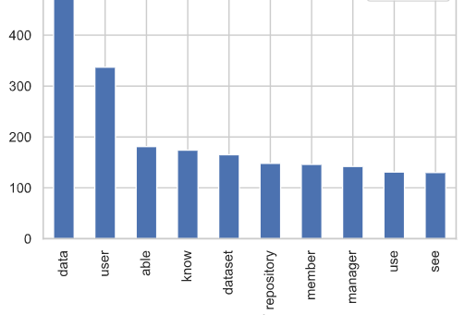
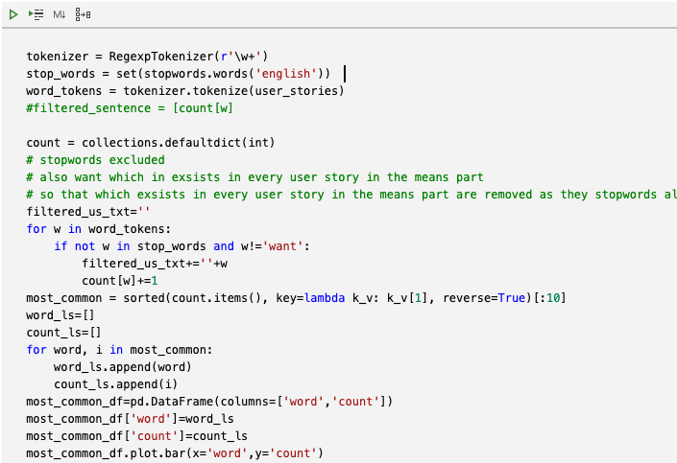
Exploratory Data Analysis
2. Most common words

Slide 12
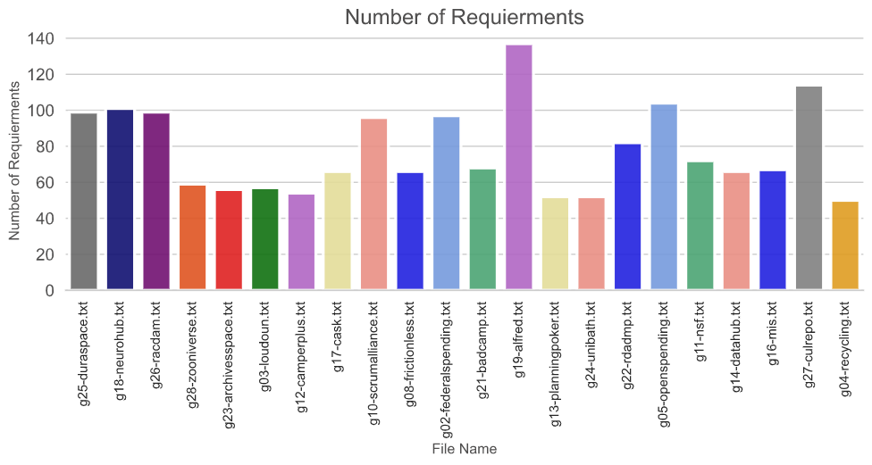
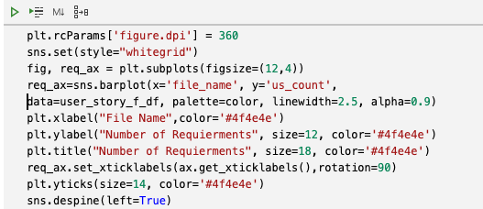
Exploratory Data Analysis
3. How many requirements in each fil?

Slide 13
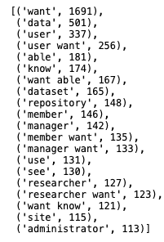
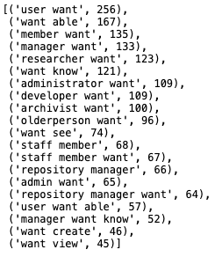
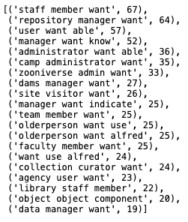
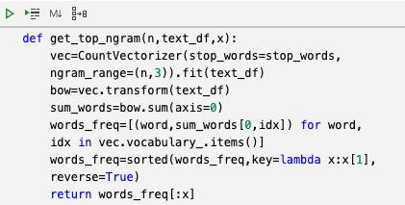
Exploratory Data Analysis
2. Top 20 n-gram

Slide 14
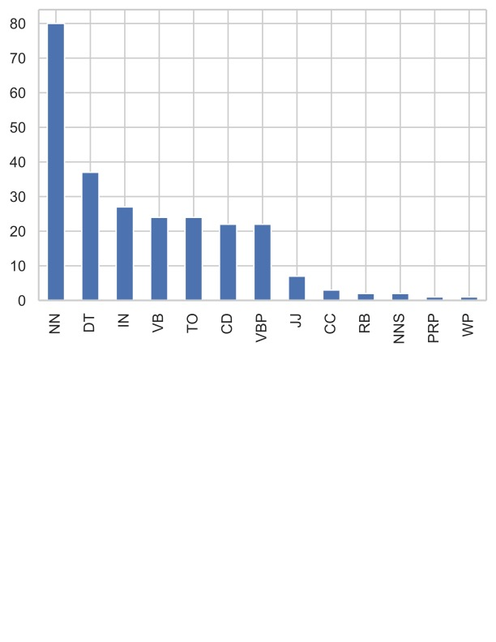

Exploratory Data Analysis
2. Top-20 Part-Of-Speech (POS)
Notes:
Here I extracted the part of speech of each words and find the top 20 using nltk

Slide 15
Cocepts and RelationshiPS
C2. “A common noun indicates a concept.”
C3. “The subject of a sentence is a concept.”
C4. “Noun compounds are taken together to form a concept.”
R2. “A transitive verb indicates a relationship.”
R3. “The verb (phrase) linking the sentence subject and an object forms the relationship between these two.”
R4. “If a verb is followed by a preposition, then the preposition is included in the relationship name.”
R5. “In noun-noun compounds there is a non-hierarchical relationship between the prefix and compound.”
H2. “If there is a noun-noun compound present, the head of the compound is the parent of the compound concept.”

Slide 16
Cocepts and RelationshiPS
R2. “A transitive verb indicates a relationship.”
R3. “The verb (phrase) linking the sentence subject and an object forms the relationship between these two.”
R4. “If a verb is followed by a preposition, then the preposition is included in the relationship name.”

Slide 17
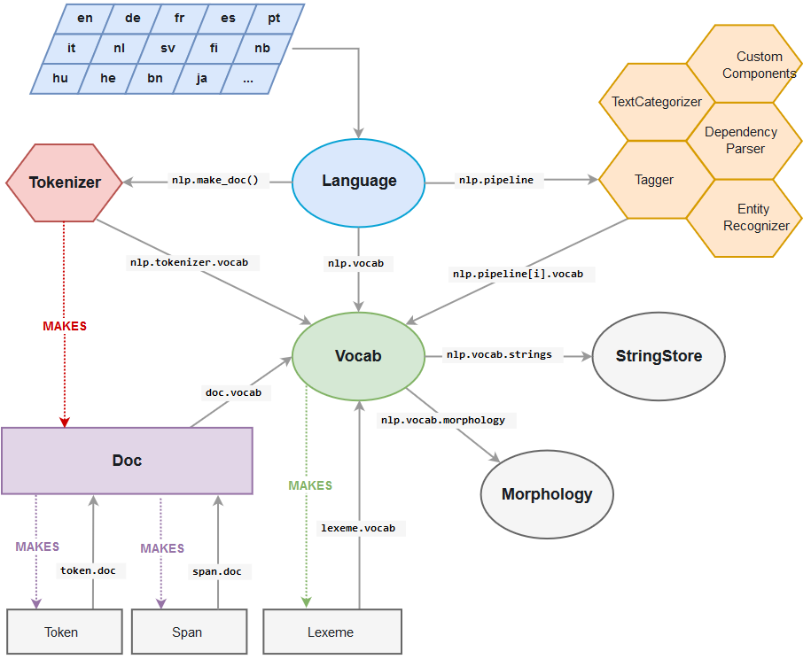
Named-entity recognition (NER)
Named Entity Recognizer: is a model that can do this recognizing task. It should be able to identify named entities like ‘America’ , ‘Emily’ , ‘London’ ,etc.. and categorize them as PERSON, LOCATION , and so on. It is a very useful tool and helps in Information Retrieval.
spaCy has in-built pipeline ner for Named recognition.
spaCy offers the availability of updating and training ner model

Slide 18
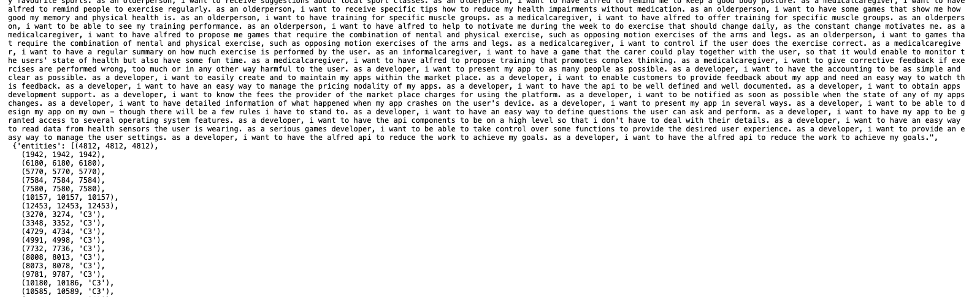
1. Data Format
The datd splitted as 15 files for the training and 7 for the testing
spaCy accepts training data as list of tuples
Tuple of two elements:
Text: in our case is the preprocessed User Story.
Dictionary of Entities: the dictionary consists of list tuples, each one of them consists of the following:

Slide 19

2. Updating NER Model
Load a pre-existing spacy model with an in-built ner component.
Create the Named Entity Recognizer using create_pipe() method .

Slide 20
3. Traing NER Model
30 iterations
Using random.shuffle() function .
Batches using minibatch() function.
For each batch the model is updated by nlp.update().
docs: batches of text and annotations.
gold: annotations
drop: dropout rate
losses: empty dictionary of losses

Slide 21
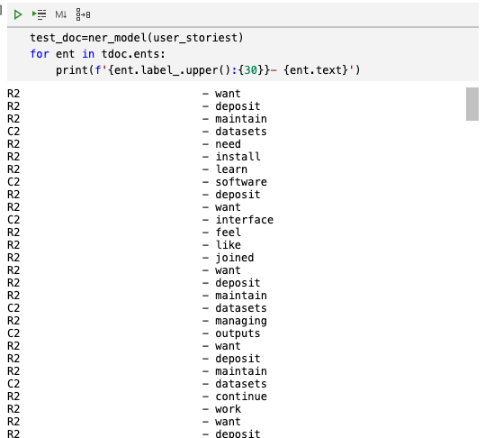
4. predict on new texts
The model recognze the reationships R2 and concepts C2 as below:

Slide 22
Discussion- Challenges
The time limitation
The dataset is very small for the NER model.
spaCy complications when using the rule-based matcher.
Learning a new tool spaCy in a small widow of time.

Slide 23
Results & Discussion- Advantages and Drawbak
Advantage
The ease of implementing the model
Drawback
The need to a complicated and specific format for the training data.
Small data can lead to Catastrophic Forgetting

Slide 24
Conclusion
The need for the Design Diagram after requierments gathering.
Proposal for an approach that use NER model to predict the relationships and concepts.
The project stages: data collection data munging, text annotating, NER model training and diagrams generation.
The model recognize the reationships R2 and concepts C2.

Slide 25
Future Work
Provide a metric evaluation
Improving the annotating functionality.
Semi-supervised approaches
Collecting a larger amount of data
Generalization of the model to be applied also in dataset that not written in User Story pattern.

Slide 26
Refrences
M. Robeer, G. Lucassen, J. M. E. M. van der Werf, F. Dalpiaz and S. Brinkkemper, "Automated Extraction of Conceptual Models from User Stories via NLP," 2016 IEEE 24th International Requirements Engineering Conference (RE), Beijing, 2016, pp. 196-205, doi: 10.1109/RE.2016.40.

Slide 27
Thank you

