Slide 1

Bitcoin 2017
Khalid Said Rashid

Slide 2
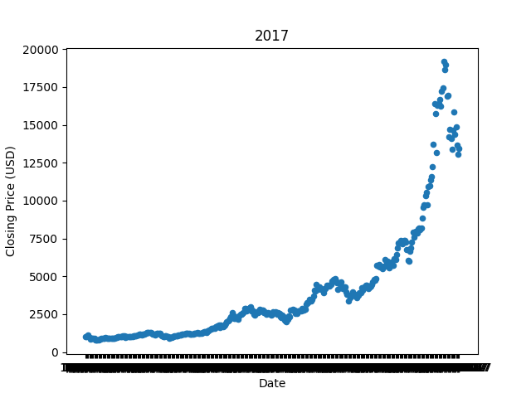
From $900 to $20,000: Bitcoin’s Historic 2017 Price
Bitcoin saw a rise in its price in December 2017

Slide 3
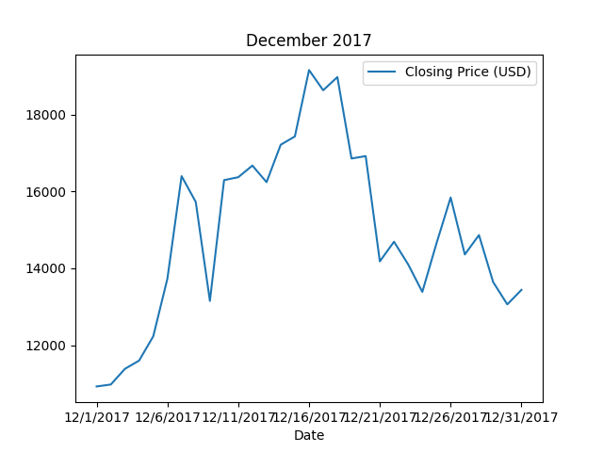
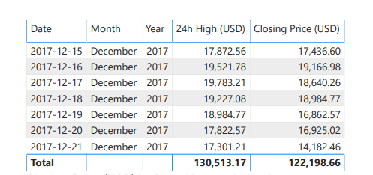

Slide 4
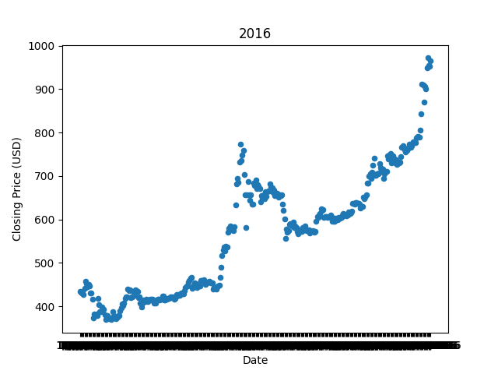

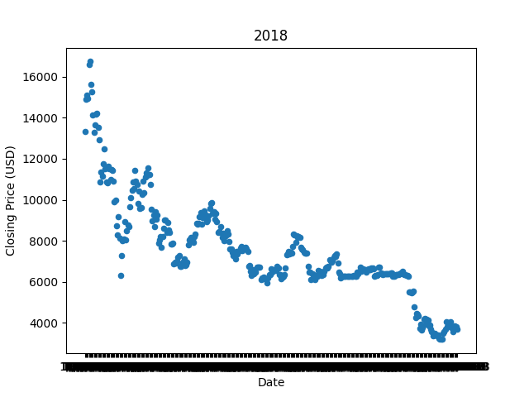
January 28
Closing Price (Low) : $369.13
December 28
Closing Price (High) : $971.65
January 11
Closing Price (Low) : $772.66
December 16
Closing Price (High) : $19,166.98
January 6
Closing Price (High) : $16,735.11
December 15
Closing Price (Low) : $3,194.96

Slide 5
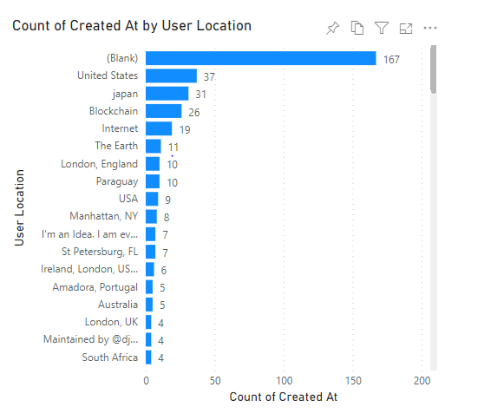
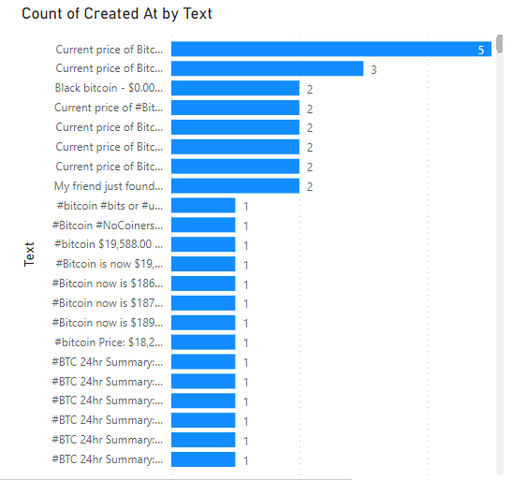
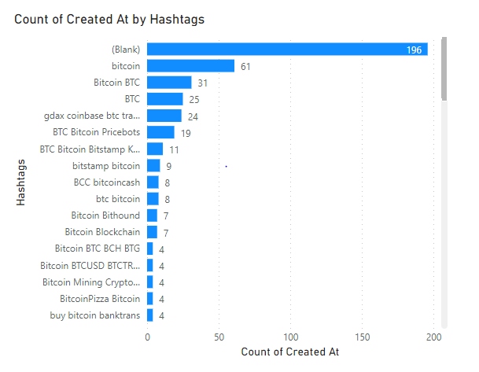
December 16, 2017 - Twitter

Slide 6
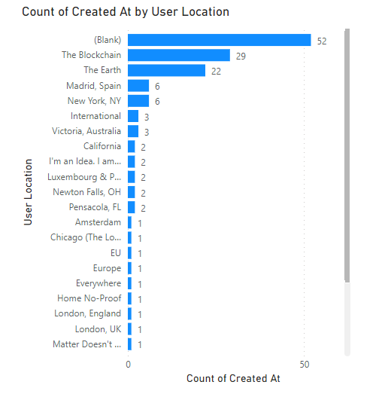
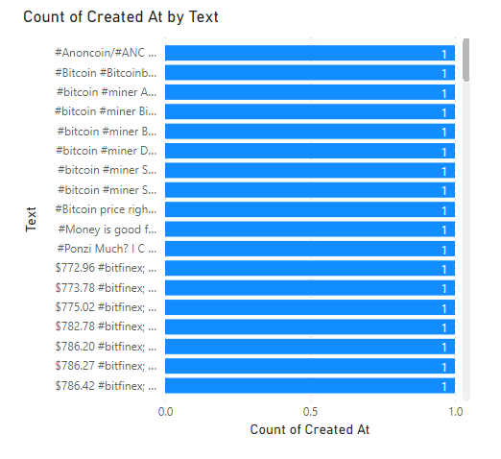
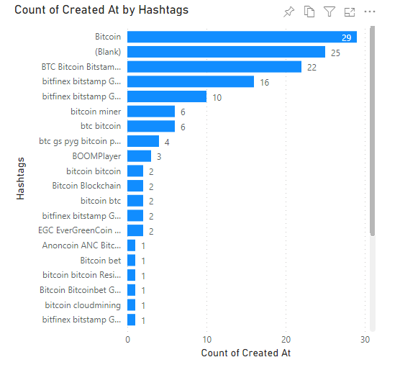
January
11, 2017 - Twitter

Slide 7
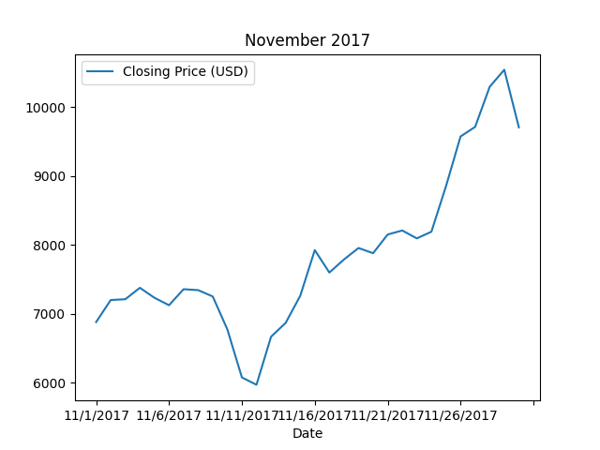
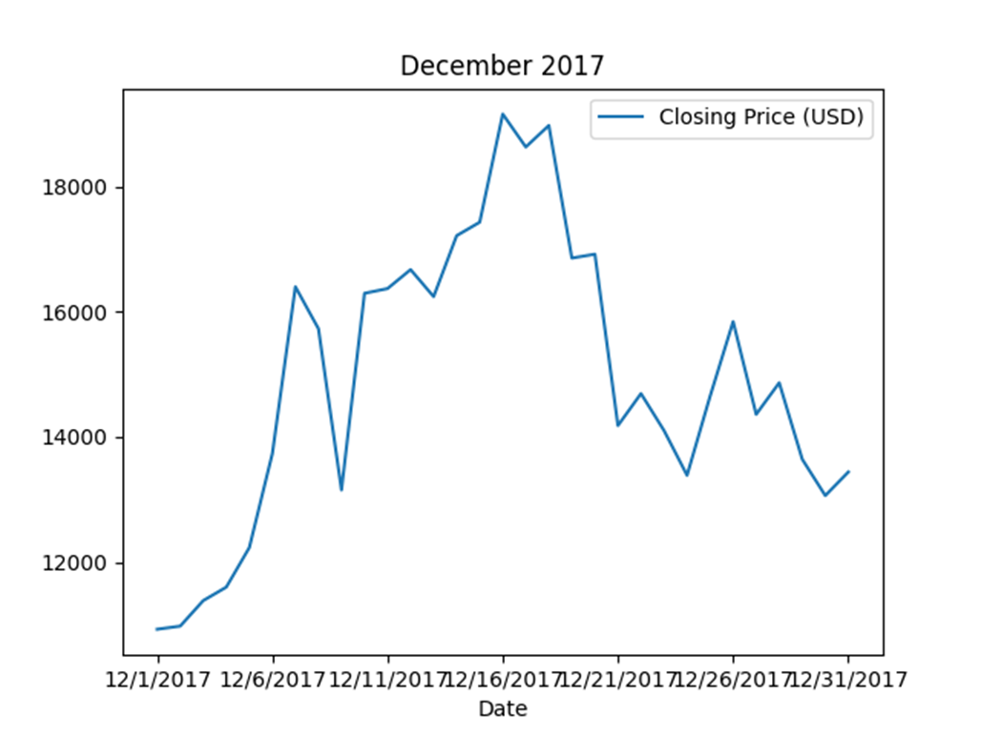
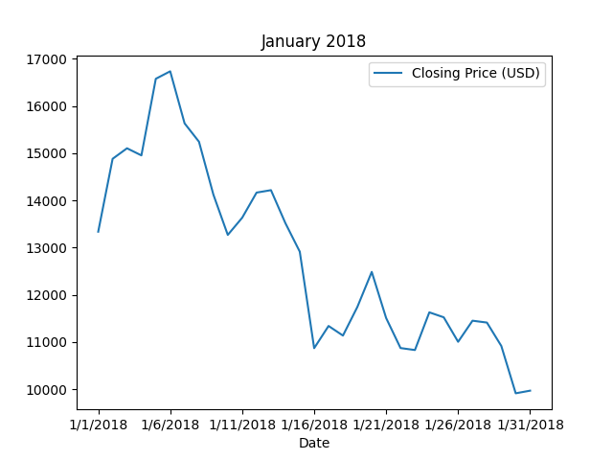
November 12
Closing Price (Low) : $5,969.13
November 29
Closing Price (High) : $10,542.66
December 1
Closing Price (Low) : $10,923.20
December 16
Closing Price (High) : $19,166.98
January 6
Closing Price (High) : $16,735.11
January 30
Closing Price (Low) : $9,914.47

Slide 8
