Slide 1
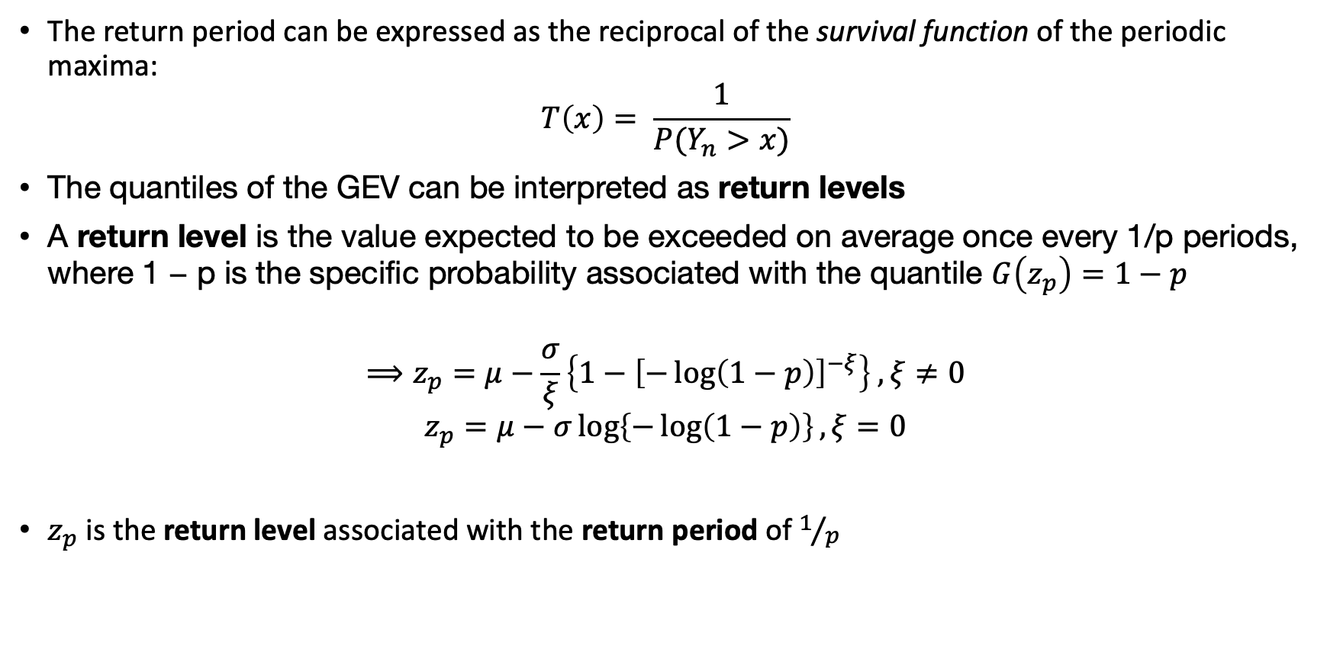
Return Levels & Return Periods
The return period can be expressed as the reciprocal of the survival function of the periodic maxima:
$$T\left(x\right)= \frac{1}{P(Y_{n}>x)}$$
The quantiles of the GEV can be interpreted as return levels
A return level is the value expected to be exceeded on average once every 1/p periods, where 1 − p is the specific probability associated with the quantile $G\left(z_{p}\right)=1−p$
$$⟹z_{p}=μ−\frac{σ}{ξ}\left\{1−{\left[−\log\left(1−p\right)\right]}^{−ξ}\right\} , ξ≠0$$
$$z_{p}=μ−σ\log\left\{−\log\left(1−p\right)\right\}, ξ=0$$
$z_{p}$ is the return level associated with the return period of $1/p$

Slide 2
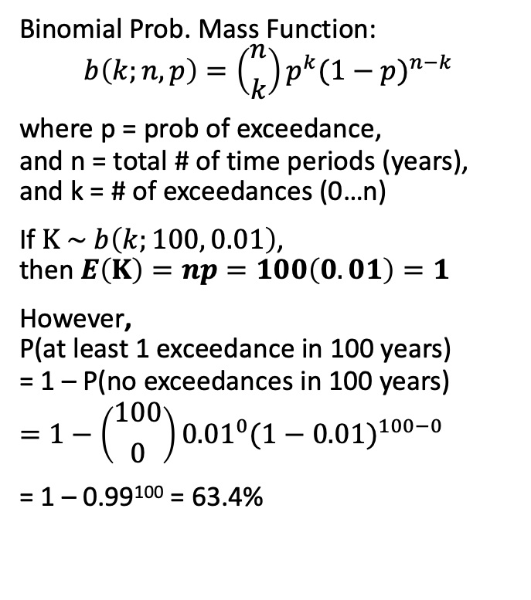
A Note on Return Levels & Return Periods
In the BM method, blocks often have a length of 1 year
Return periods are often incorrectly interpreted in the professional communities as "100-year event is an event which happens only once in 100 years", which may lead to inaccurate assessment of risks.
A more holistic way of looking at this is to consider a time period within which a risk is evaluated.
The Expected number of exceedances in 100 years is 1.
For example, however, a 100-year event with probability of exceedance in any given year of 1% would have a probability of ~63.4% to be exceeded at least once within 100 years.
Binomial Prob. Mass Function: $$b\left(k;n,p\right)=\left({n \atop k}\right)p^{k}{(1−p)}^{n−k}$$
where p = prob of exceedance, and n = total # of time periods (years), and k = # of exceedances (0…n)
If $Κ \sim b\left(k;100, 0.01\right)$, then $E\left(Κ\right)=np=100\left(0.01\right)=1$
However, P(at least 1 exceedance in 100 years) = 1 – P(no exceedances in 100 years)
$$=1−\left({100 \atop 0}\right){0.01}^{0}{(1−0.01)}^{100−0}$$ = 1 – 0.99¹⁰⁰ = 63.4%

Slide 3
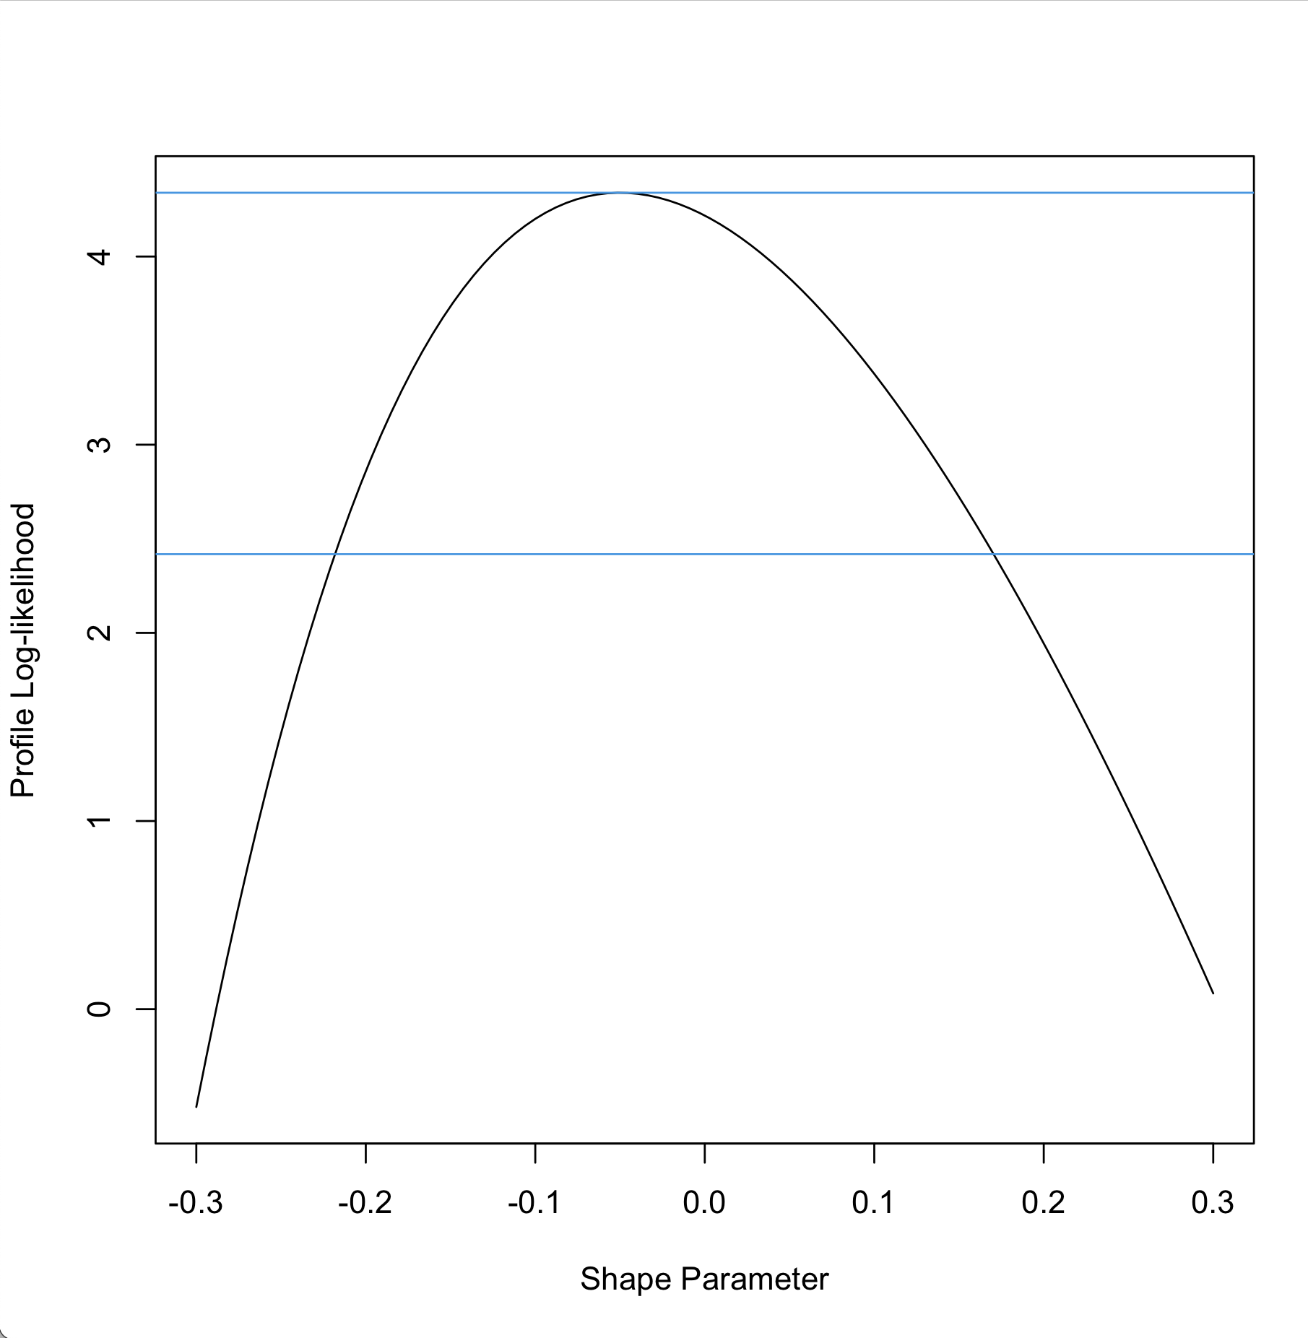
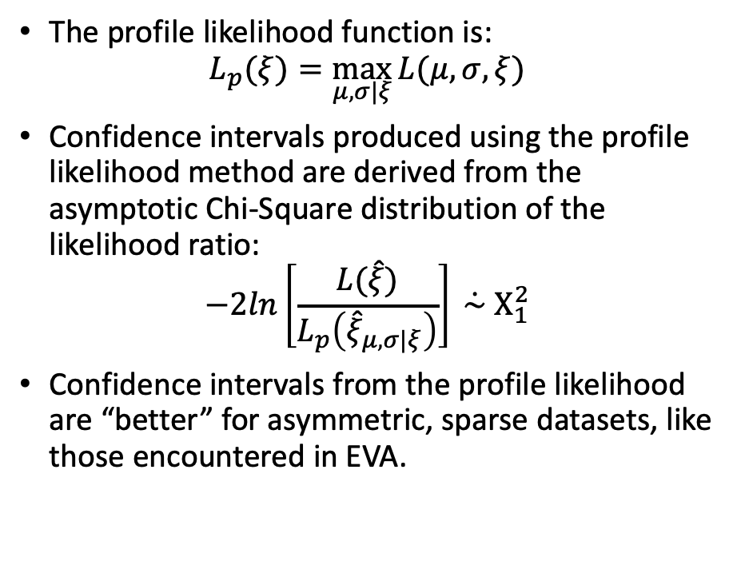
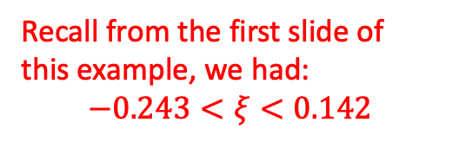

Example 1: Profile Likelihood
gev.profxi(ppfit, -0.3, 0.3)
The profile likelihood function is:
$$L_{p}(ξ)=\max_{μ,σ|ξ}{L(μ,σ,ξ)}$$
Confidence intervals produced using the profile likelihood method are derived from the asymptotic Chi-Square distribution of the likelihood ratio:
$$−2ln\left[\frac{L(\hat{ξ})}{L_{p}\left({\hat{ξ}}_{μ,σ|ξ}\right)}\right]\dot{ \sim }Χ_{1}^{2}$$
Confidence intervals from the profile likelihood are “better” for asymmetric, sparse datasets, like those encountered in EVA.
95%
[-0.21, 0.17]
Recall from the first slide of this example, we had:
$$−0.243<ξ<0.142$$
$$ξ$$

