Slide 1
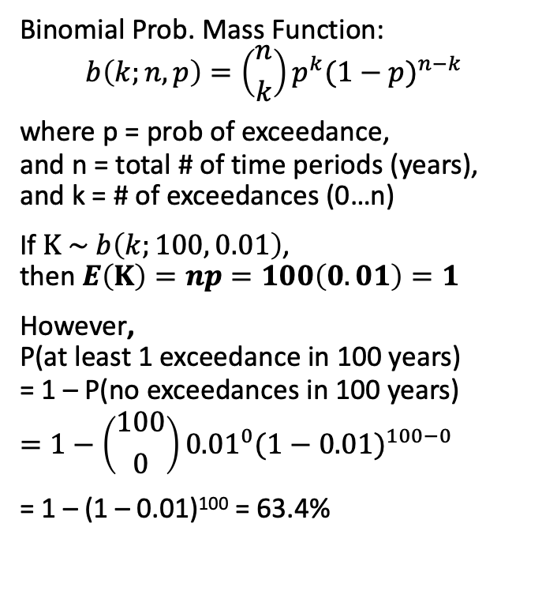
A Note on Return Levels & Return Periods
Binomial Prob. Mass Function: $$b\left(k;n,p\right)=\left({n \atop k}\right)p^{k}{(1−p)}^{n−k}$$
where p = prob of exceedance, and n = total # of time periods (years), and k = # of exceedances (0…n)
If $Κ \sim b\left(k;100, 0.01\right)$, then $E\left(Κ\right)=np=100\left(0.01\right)=1$
However, P(at least 1 exceedance in 100 years) = 1 – P(no exceedances in 100 years)
$$=1−\left({100 \atop 0}\right){0.01}^{0}{(1−0.01)}^{100−0}$$ = 1 – (1 – 0.01)¹⁰⁰ = 63.4%
Return periods are often incorrectly interpreted in the professional communities as "100-year event is an event which happens only once in 100 years", which may lead to inaccurate assessment of risks.
A more holistic way of looking at this is to consider a time period within which a risk is evaluated.
The Expected number of exceedances in 100 years is 1.
For example, however, a 100-year event with probability of exceedance in any given year of 1% would have a probability of ~63.4% to be exceeded at least once within 100 years.

