Slide 1
qualreas
Figures for Examples

Slide 2
Wikipedia’s RCC-8 Example: Input
Road
???
???
Property1
DC|EC
Property2
TPP|NTPP
EC
DC|EC
DC|EC
EC
NTPP
House1
DC
House2

Slide 3
Wikipedia’s RCC-8 Example: After Propagation
EQ
Road
EC|PO
PO|TPPI
EQ
EQ
Property1
DC|EC
Property2
NTPP|TPP
EC
DC|EC
DC
EC
NTPP
House1
DC
House2
EQ
EQ

Slide 4
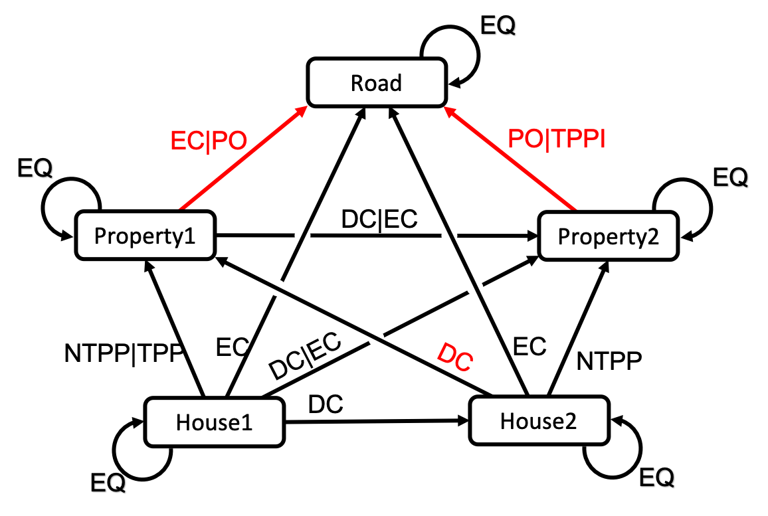
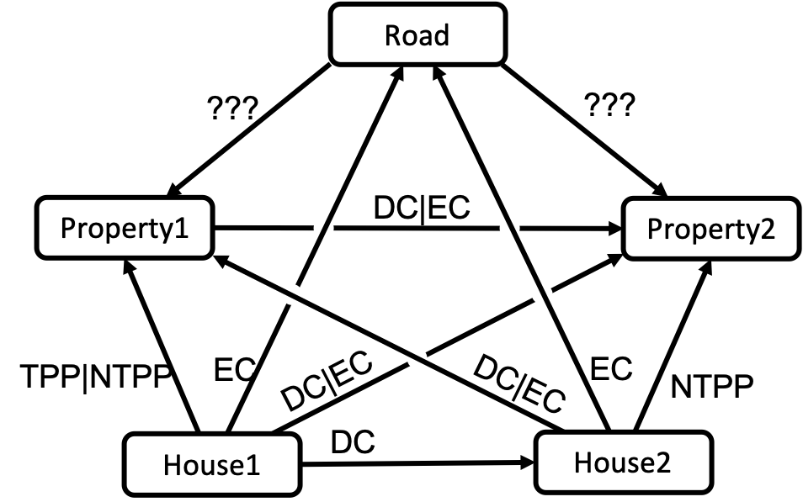
Wikipedia RCC-8 Example
Input
(before Propagation)
After Propagation

