Slide 1
qualreas
Figures for Examples

Slide 2
Wikipedia’s RCC-8 Example: Input
Road
???
???
Property1
DC|EC
Property2
TPP|NTPP
EC
DC|EC
DC|EC
EC
NTPP
House1
DC
House2

Slide 3
Wikipedia’s RCC-8 Example: After Propagation
EQ
Road
EC|PO
PO|TPPI
EQ
EQ
Property1
DC|EC
Property2
NTPP|TPP
EC
DC|EC
DC
EC
NTPP
House1
DC
House2
EQ
EQ

Slide 4
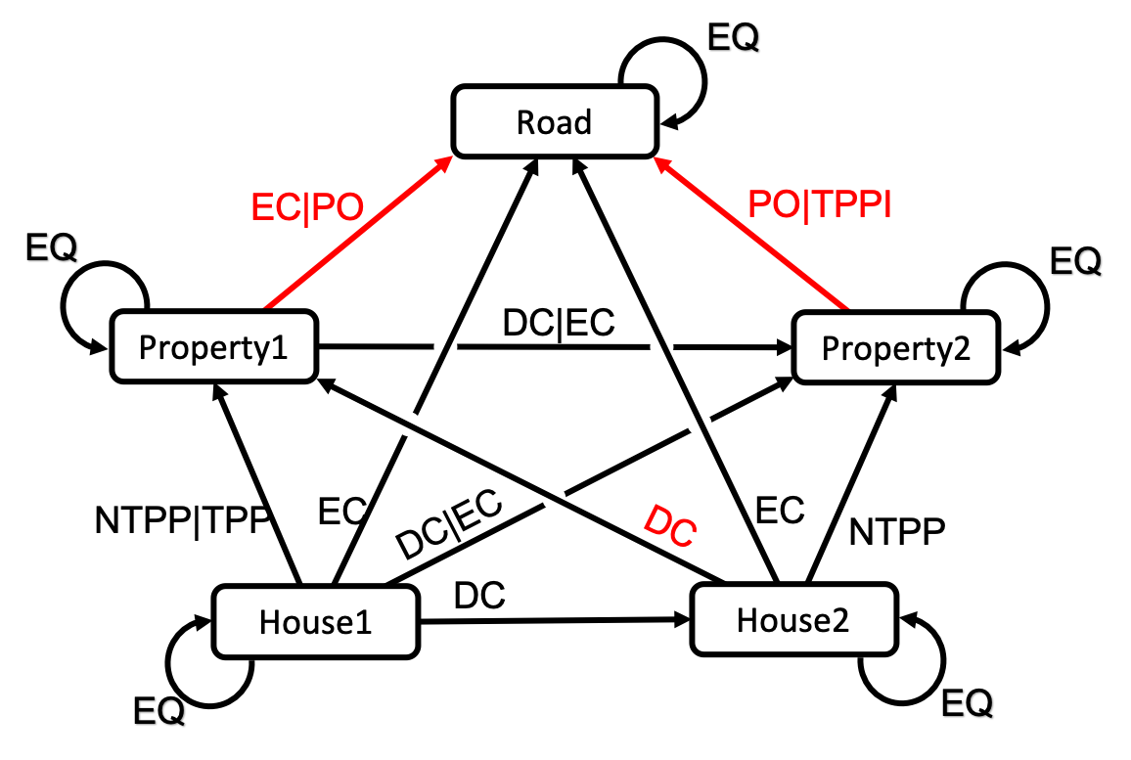
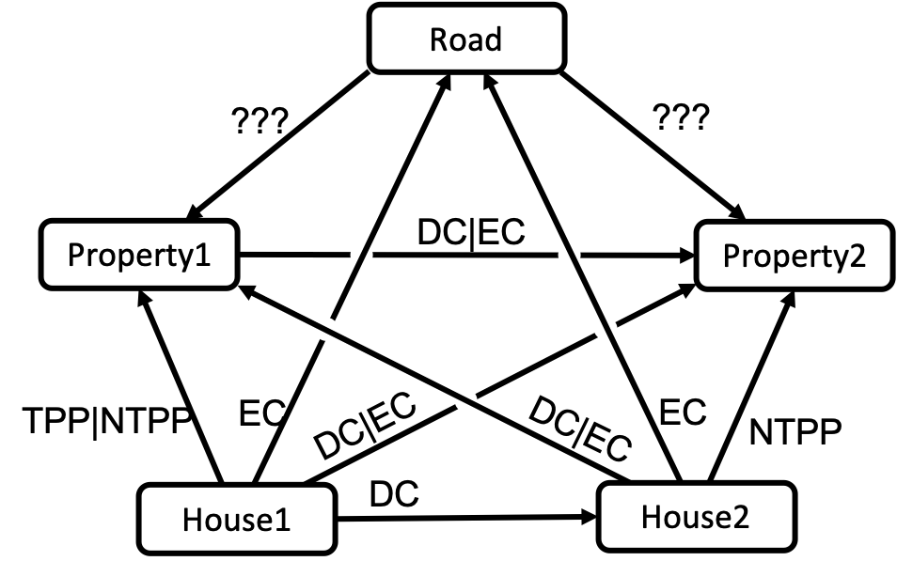
Wikipedia RCC-8 Example
Input
(before Propagation)
After Propagation

Slide 5
Wikipedia’s RCC-8 Example: Singleton Labeling Starting Network
Road
EC|PO
PO|TPPI
DC|EC
Property1
Property2
NTPP|TPP
EC
DC|EC
DC
EC
NTPP
House1
DC
House2

Slide 6
Wikipedia’s RCC-8 Example: Singleton Labeling #1
Road
PO
PO
Property2
Property1
EC
Property1
Property2
House1
House2
#1
Road
TPP
EC
EC
DC
EC
NTPP
House1
DC
House2

Slide 7
Wikipedia’s RCC-8 Example: Singleton Labeling #3
Road
EC
PO
Property1
Property2
EC
House1
Property1
Property2
House2
#3
Road
TPP
EC
EC
DC
EC
NTPP
House1
DC
House2

Slide 8
Wikipedia’s RCC-8 Example: Singleton Labeling #2
Road
EC
TPPI
Property2
Property1
EC
House2
Property1
Property2
House1
#2
TPP
EC
EC
EC
Road
DC
NTPP
House1
DC
House2

Slide 9
Wikipedia’s RCC-8 Example: Singleton Labeling #4
Road
PO
PO
Property2
Property1
EC
House2
Property1
Property2
House1
#4
Road
TPP
EC
DC
DC
EC
NTPP
House1
DC
House2

Slide 10
Wikipedia’s RCC-8 Example: Singleton Labeling #5
Road
EC
PO
EC
Property1
Property2
#5
TPP
EC
DC
DC
EC
NTPP
House1
DC
House2

Slide 11
Wikipedia’s RCC-8 Example: Singleton Labeling #6
Road
PO
PO
DC
Property1
Property2
#6
TPP
EC
DC
DC
EC
NTPP
House1
DC
House2

Slide 12
Wikipedia’s RCC-8 Example: Singleton Labeling #7
Road
EC
PO
DC
Property1
Property2
#7
TPP
EC
DC
DC
EC
NTPP
House1
DC
House2

Slide 13
Wikipedia’s RCC-8 Example: Singleton Labeling #8
Road
PO
PO
EC
Property1
Property2
#8
NTPP
EC
DC
DC
EC
NTPP
House1
DC
House2

Slide 14
Wikipedia’s RCC-8 Example: Singleton Labeling #9
Road
PO
PO
DC
Property1
Property2
#9
NTPP
EC
DC
DC
EC
NTPP
House1
DC
House2

Slide 15
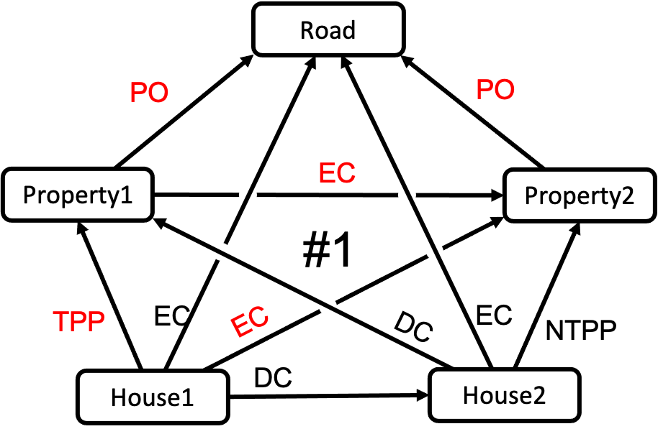
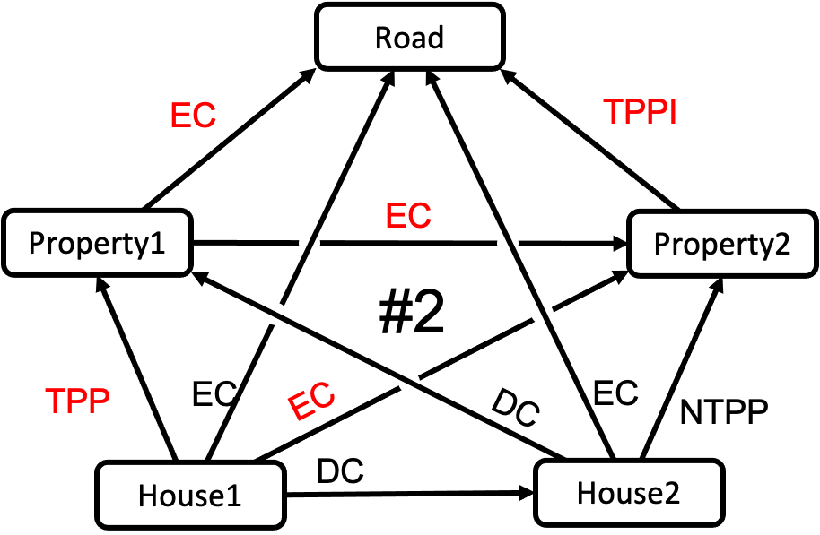
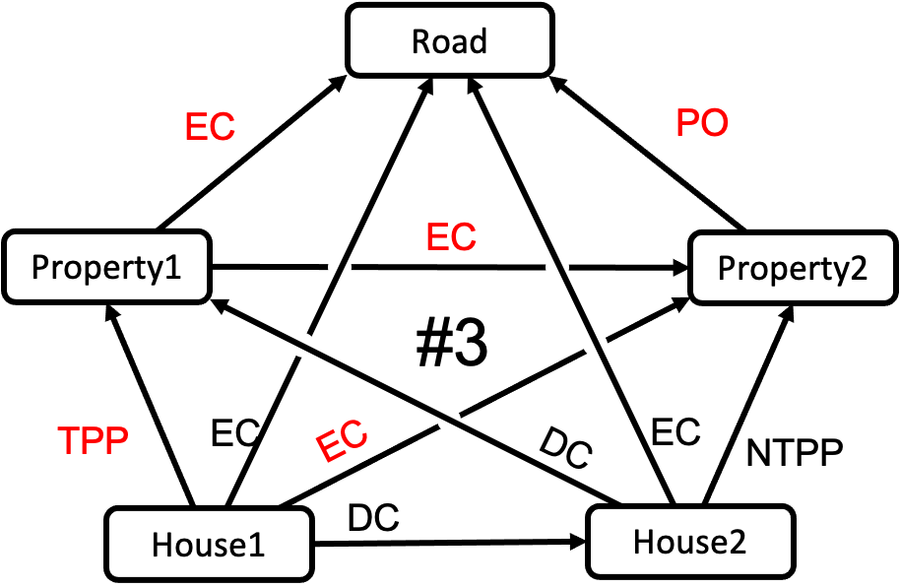
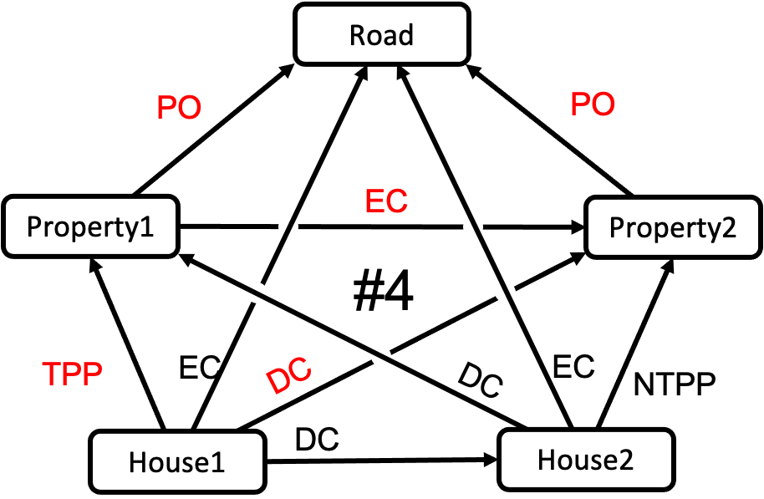
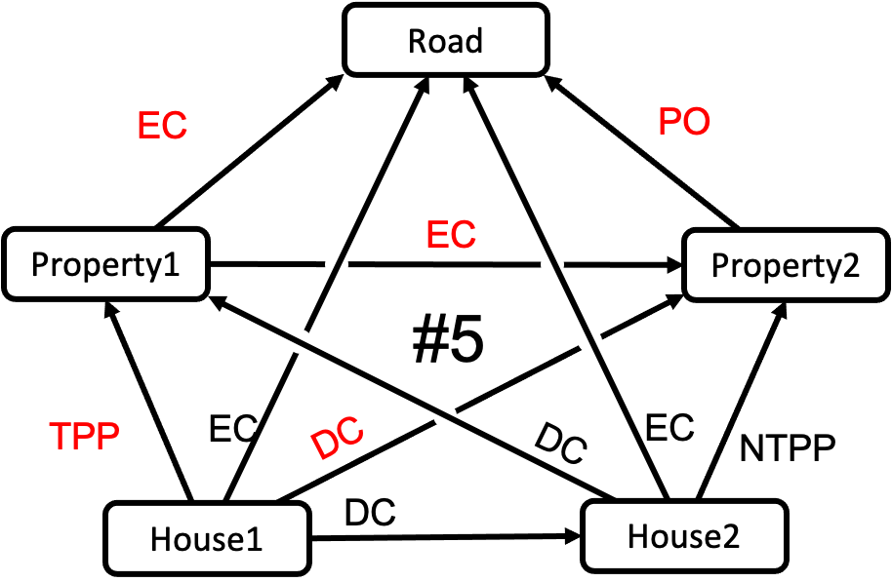
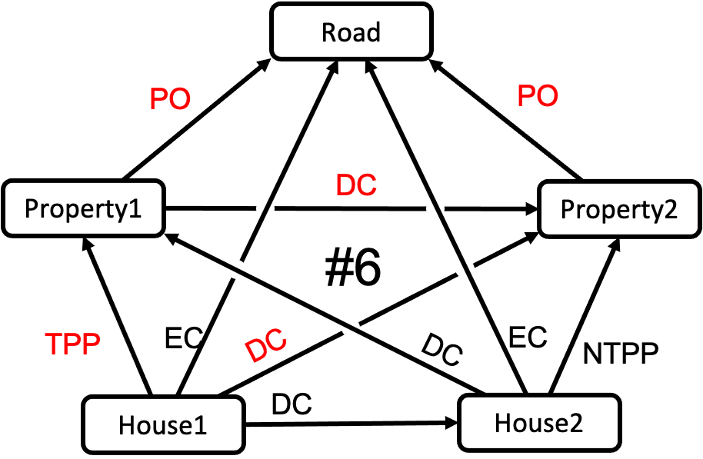
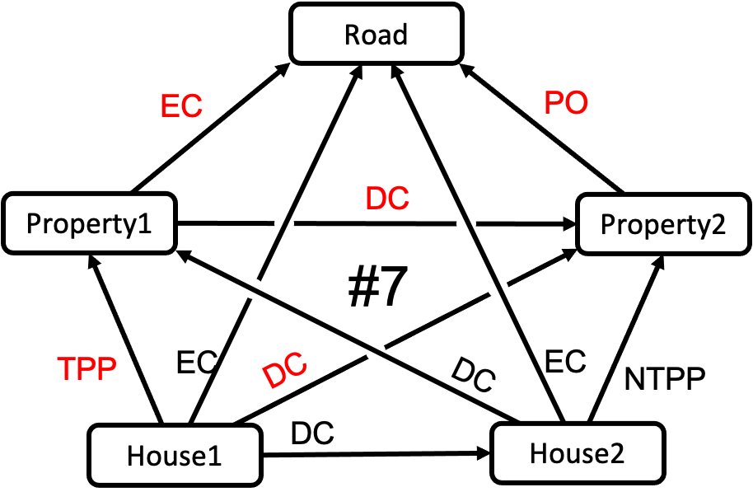
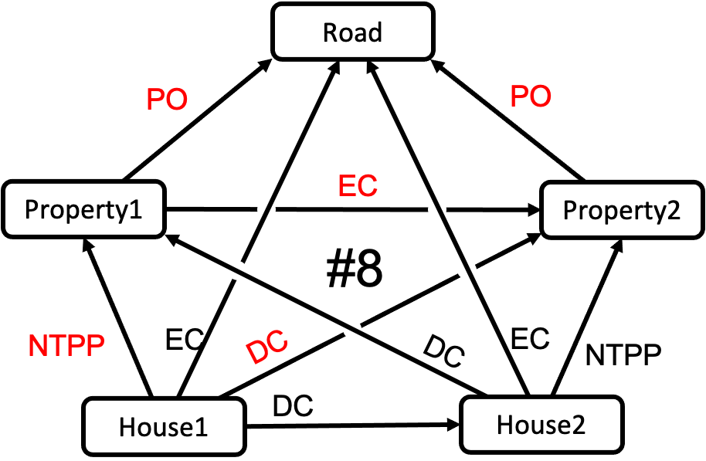
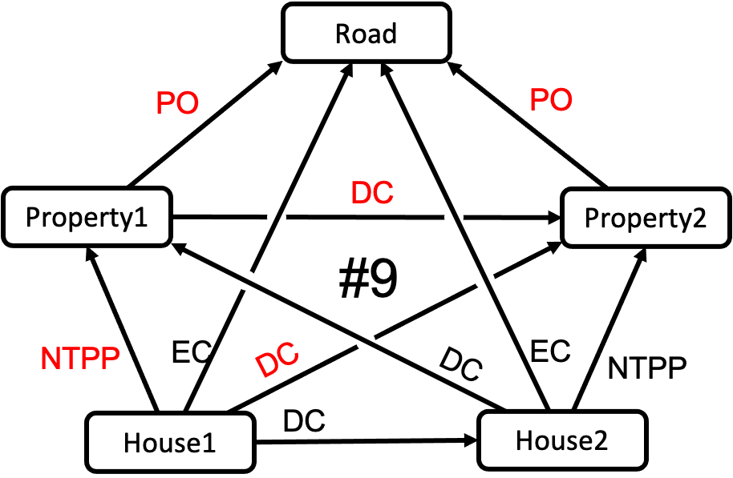
All 9 Singleton Labelings

