Slide 1

Introduction to Linux Administration Day 14
IT Professional Program

Slide 2
Agenda
Review (interactive!)
Ch.8 Initialization, X, and Localization (Part 1)
Lab exercises/tasks

Slide 3
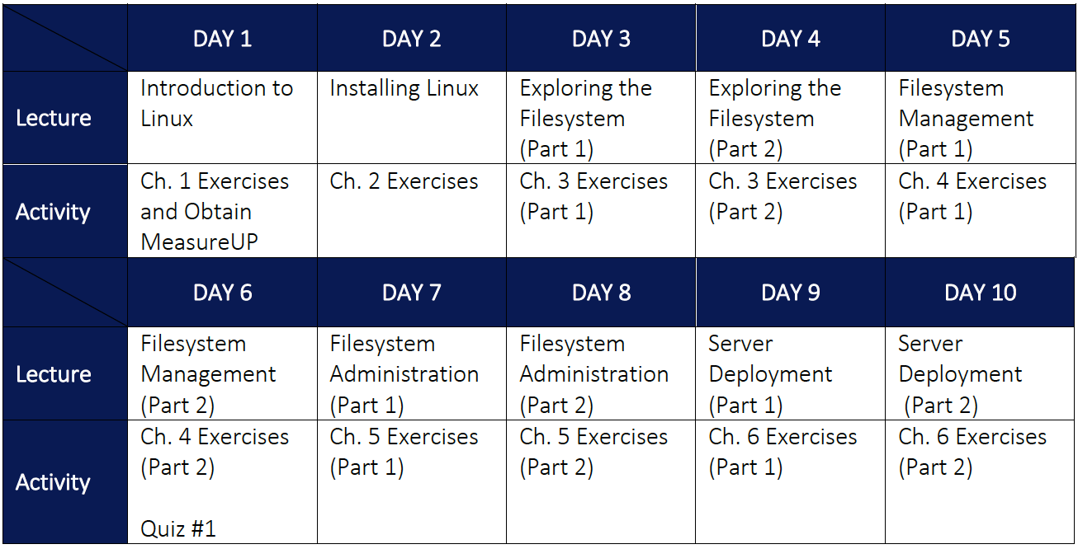

Slide 4
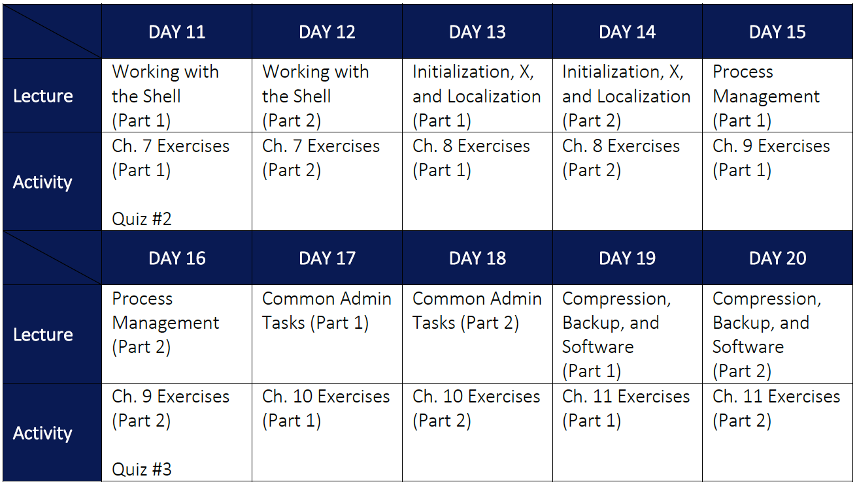

Slide 5
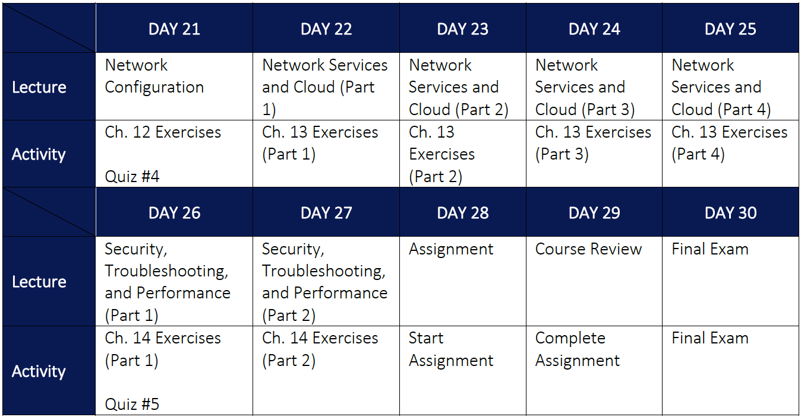

Slide 6
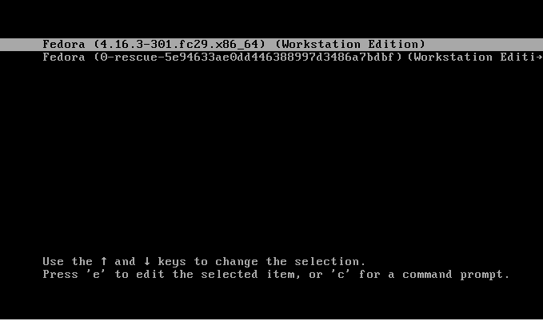
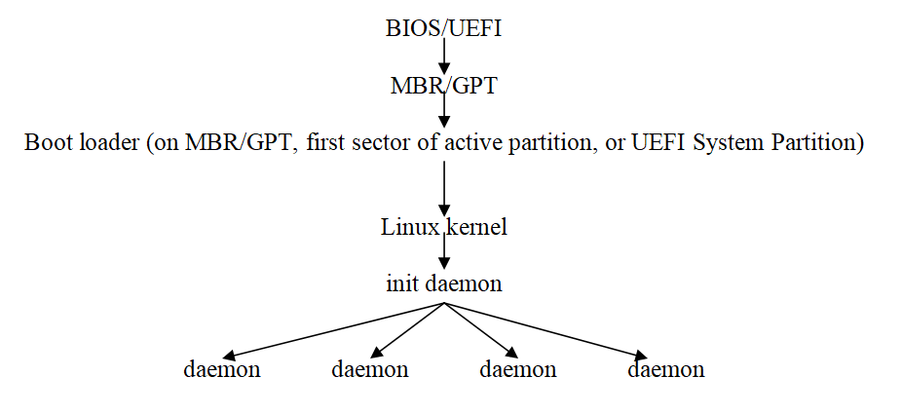
Ch.8 Initialization, X, and Localization (Part 1)

Slide 7
Ch.8 Initialization, X, and Localization (Part 1)
GRUB is the boot loader (starts in 3 stages)
MBR/GPT disk & legacy BIOS?
Stage1 on MBR/GPT (/dev/sda)
Stage1.5 on post-MBR gap OR 1MB BIOS boot partition (GPT)
Stage2 on /dev/sda1 (/boot)
Configuration in /boot/grub2/grub.cfg
UEFI BIOS?
All stages in EFI System Partition, /dev/sda1 (/boot/efi)
Supports secure boot via a Microsoft shim
Configuration in /boot/efi/EFI/fedora/grub.cfg grub2-install <location>

Slide 8
Ch.8 Initialization, X, and Localization (Part 1)
grub.cfg alongside any /boot/loader/entries/* files store all GRUB configuration
These files are automatically built by the system using entries in /etc/default/grub & /etc/grub.d/*
vi /etc/default/grub (common options)
grub2-mkconfig -o /boot/efi/EFI/fedora/grub.cfg

Slide 9
Ch.8 Initialization, X, and Localization (Part 1)
Daemon Initialization (legacy SysV init)
Runlevels (Table 8-1) determined the system state (the default runlevel was listed in /etc/inittab)
runlevel init 3 (or telinit 3)
Start/stop daemons?
/etc/rc.d/init.d/livesys <start/stop/restart/reload/status> /etc/init.d/livesys <start/stop/restart/reload/status> service livesys <start/stop/restart/reload/status>
Start/stop daemons at boot time?
ls -l /etc/rc.d/rc5.d (symlinks to scripts, start with S (start) or K (kill)) chkconfig --list chkconfig --level 35 livesys on

Slide 10
Ch.8 Initialization, X, and Localization (Part 1)
Legacy Ubuntu used a variant of SysV init called Upstart
/etc/init.d/* scripts used to replace /etc/rc.d/rc5.d/* scripts
start/stop/restart/reload/status livesys
update-rc.d instead of chkconfig

Slide 11
Ch.8 Initialization, X, and Localization (Part 1)
Daemon Initialization (Systemd)
Fully backwards-compatible with SysV!
Controls all areas (or “units”) of Linux
Daemons = service units
Runlevels = target units poweroff.target = Runlevel 0 rescue.target = Runlevel 1 (Single User Mode) multiuser.target = Runlevel 2, 3 and 4 graphical.target = Runlevel 5 (the default during boot) reboot.target = Runlevel 6
ll /etc/systemd/system/default.target
ll /etc/systemd/system/graphical.target.wants/

Slide 12
Ch.8 Initialization, X, and Localization (Part 1)
Start/stop daemons?
systemctl start/stop/restart/reload/status crond.service
Start/stop daemons at boot?
systemctl enable/disable crond.service (start/stop in default runlevel)
Unit files = provide Systemd configuration under /etc/systemd/system and /lib/systemd/system
Target units
Service units (starting daemons)
Timer units (scheduling stuff)
Mount units (mounting stuff ←/etc/fstab!)

Slide 13
Ch.8 Initialization, X, and Localization (Part 1)
Other cool stuff you can do with Systemd:
systemctl isolate multi-user.target (change runlevel) systemctl isolate runlevel3.target
runlevel 3 systemctl edit crond.service (e.g. add Environment="MYVAR=cool")
systemctl –a | grep service | less systemctl daemon-reload systemd-analyze blame systemd-mount –A /dev/sda5 /stuff

Slide 14
Lab exercises/tasks
Read Ch.8
Do Hands-On Project 8-1 to 8-4
Ensure you read the changes at https://github.com/jasoneckert/CengageLinux
Leave the optional Discovery Exercises until tomorrow!

