Slide 1

Introduction to Linux Administration
IT Professional Program

Slide 2
Agenda
Welcome to Linux Administration!
Course/Block Introduction

Slide 3
Course/Block Introduction
This block (Network and Linux Administration) is 16 weeks long:
4 weeks of IT Service and Project Management
4 weeks of Network Administration
6 weeks of Linux Administration (this course)
CompTIA Linux+ certification available
2 weeks of Security Fundamentals

Slide 4
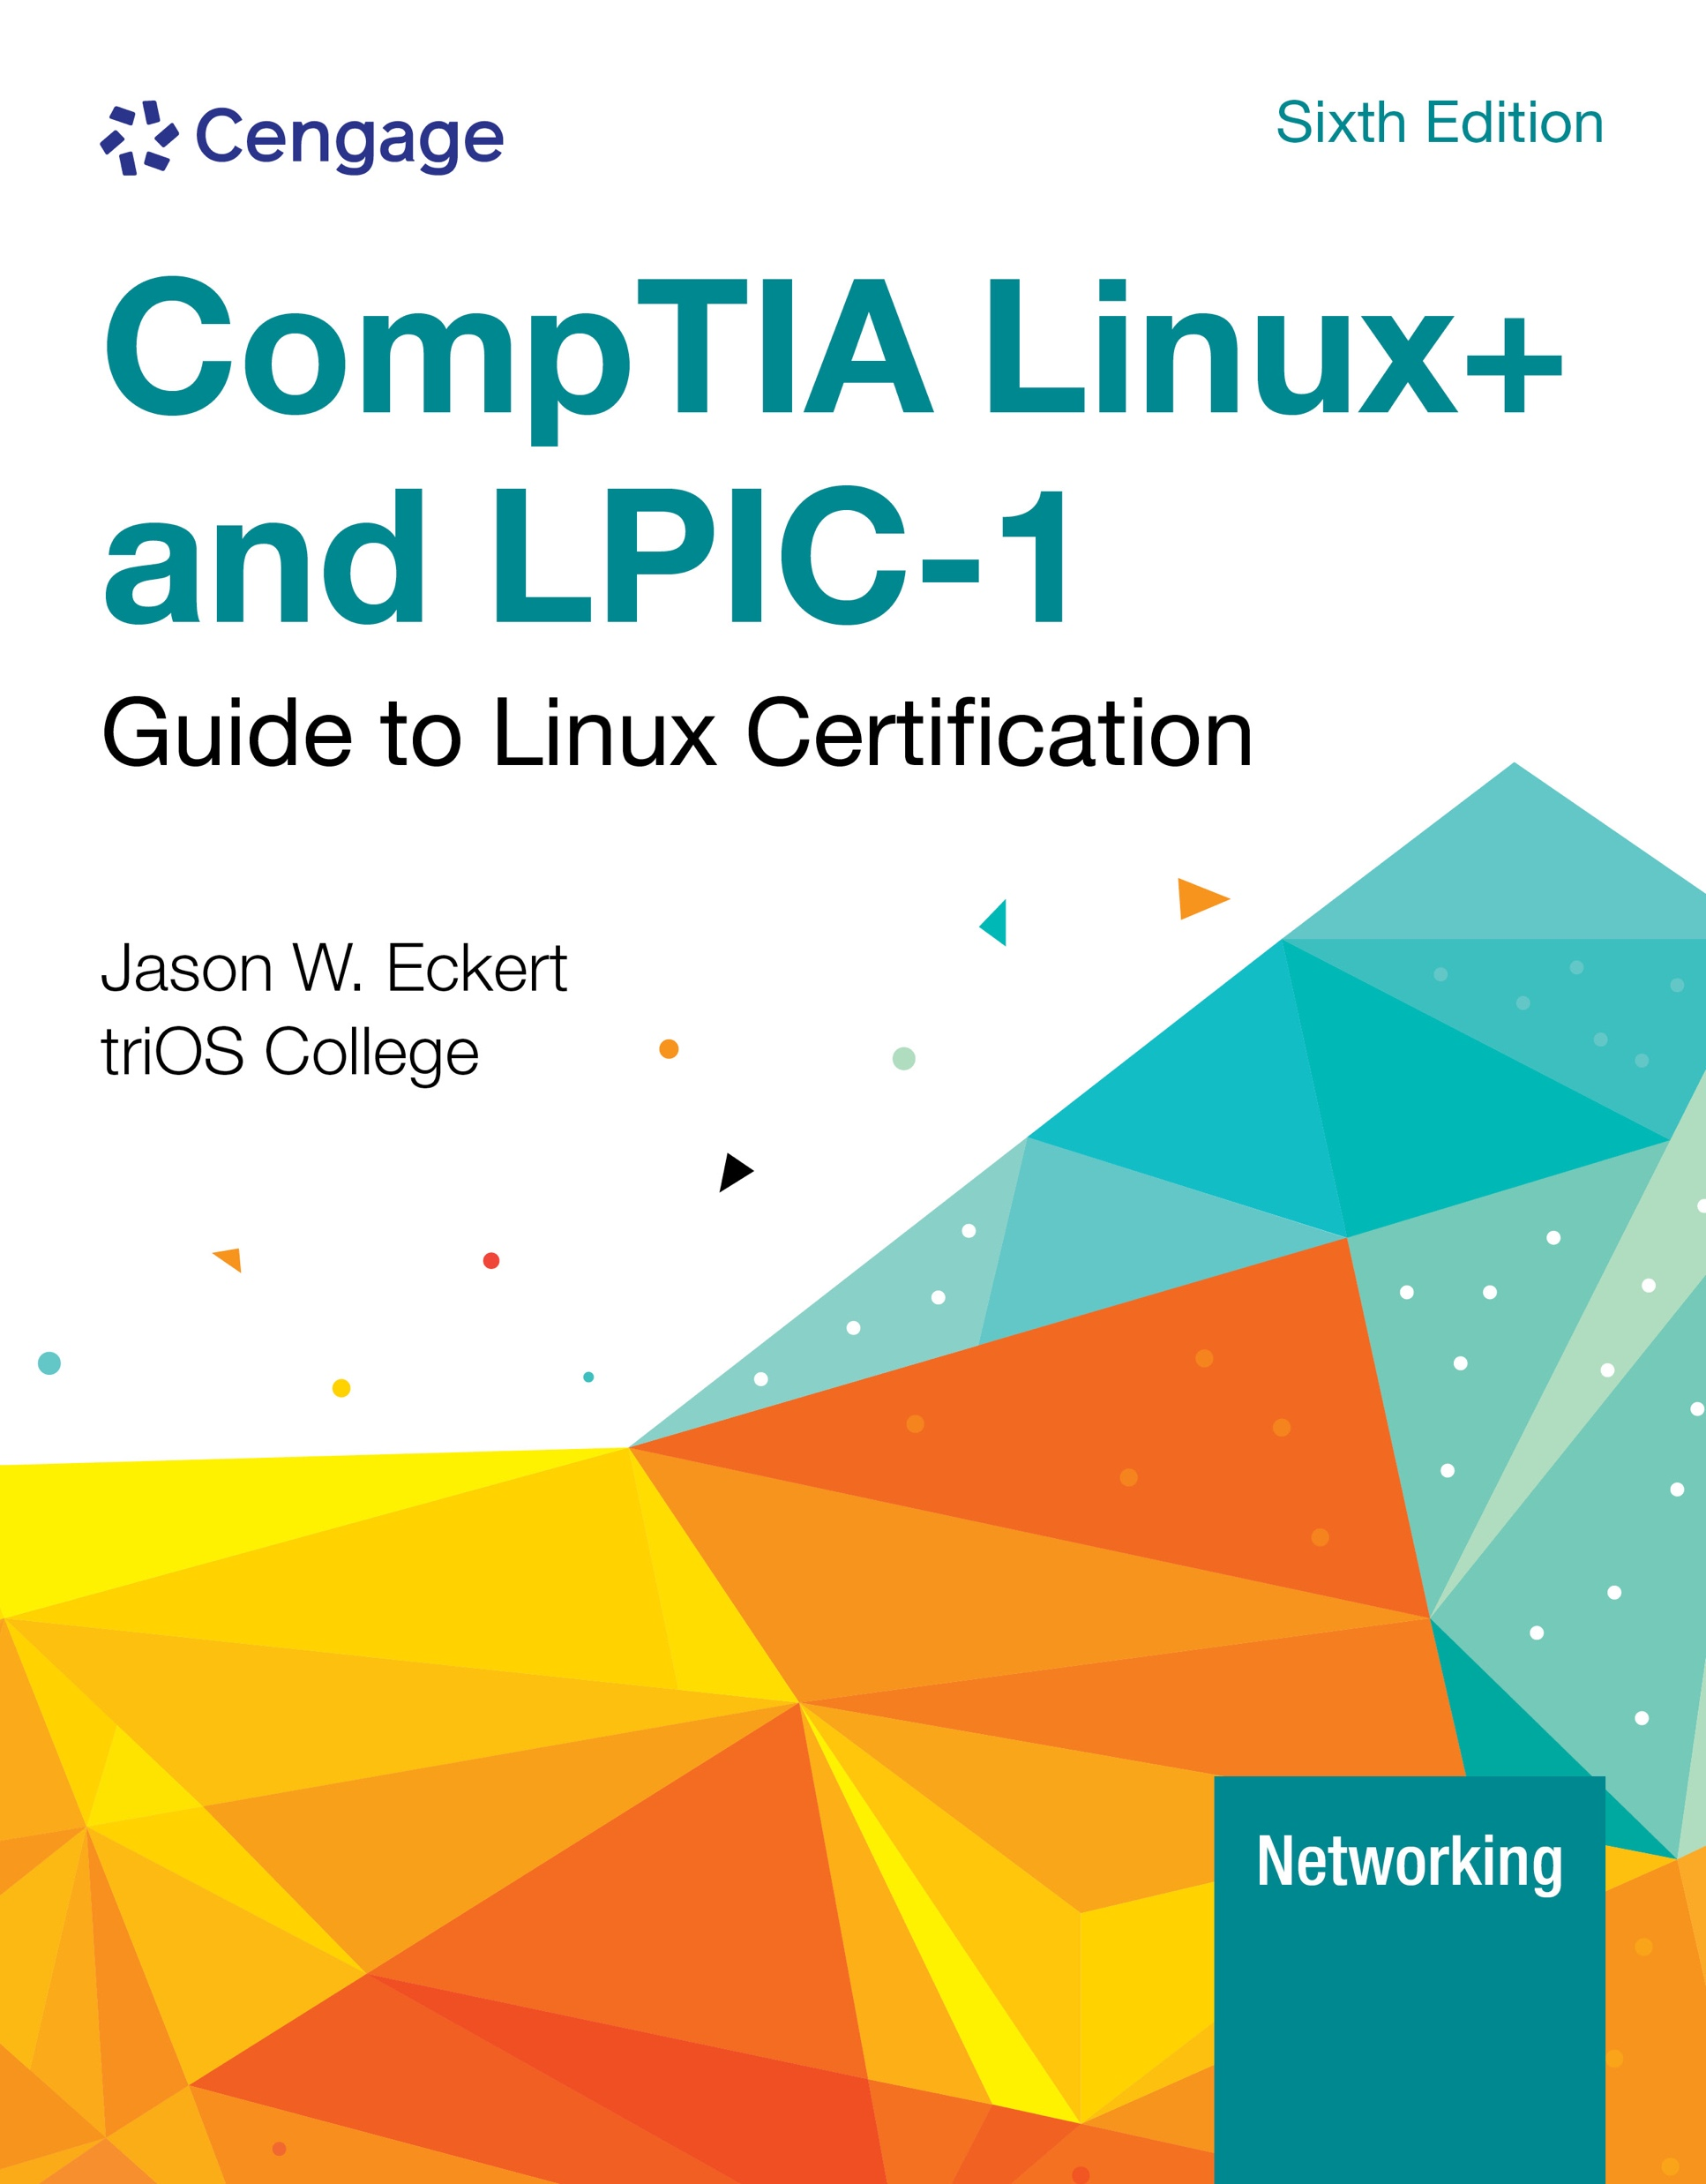
Course/Block Introduction
This course (Linux Administration):
Covers the usage and administration of the Linux operating system (including services and cloud)
CompTIA Linux+ certification available
Book is available in Brightspace:

Slide 5
Course/Block Introduction
Attendance:
Like or reply to the Attendance Role Call <day> post in Teams before 8:00a.m.
If you cannot make it to class, please message me beforehand if possible (email or Teams) and watch the video for that day afterwards.
Marks:
Assignment = 10%
Quizzes = 20% (5 quizzes in total, each Monday)
Final Exam = 60%
Professional Performance = 10%

Slide 6
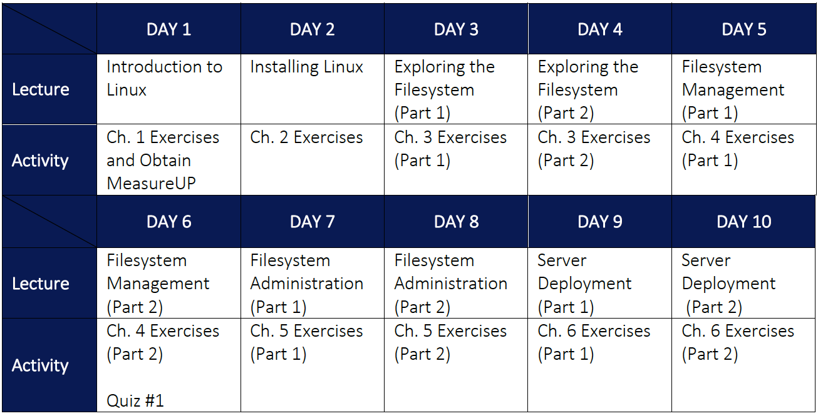

Slide 7
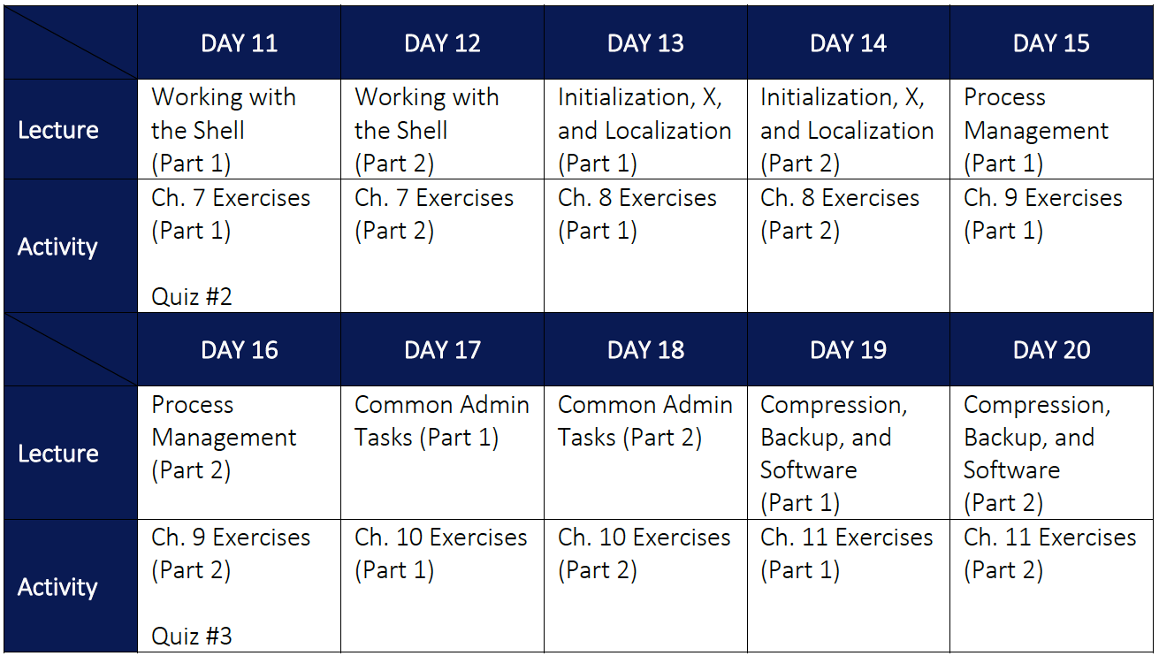

Slide 8
