Slide 1



Deep dive into tech details
Tigran Mkrtchyan for dCache Team

Slide 2
The basics

Slide 3
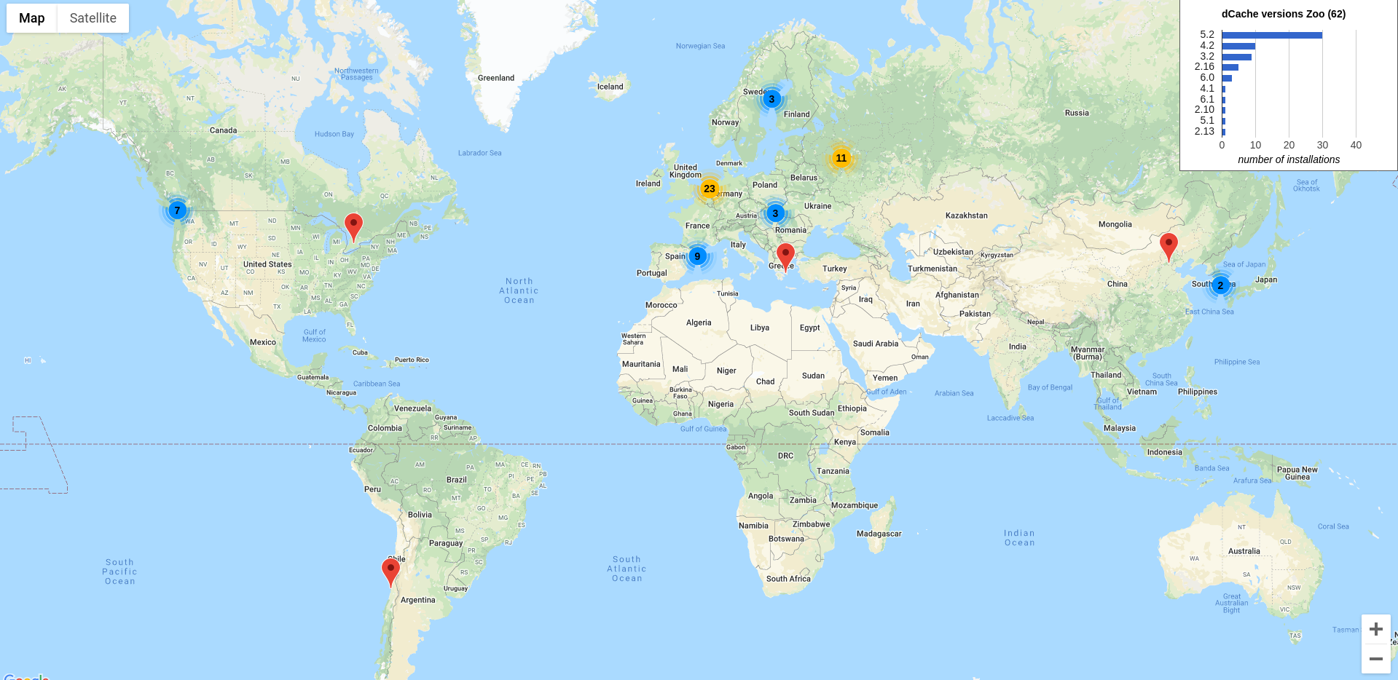
Some Numbers
76 installations for WLCG
~10 no GRID installations
~50% whole LHC data

Slide 4
dCache: Motivation
Data never fits into a single server
  Multiple servers
  Off-load to tape
Growing number of client hosts
  Main frame vs. Linux cluster
Control over HW/OS selection
  Better offers
  Local expertise

Slide 5
The MISSION
“... to provide a system for storing and retrieving huge amounts of data, distributed among a large number of heterogeneous server nodes, under a single virtual filesystem tree with a variety of standard access methods.”
16 Sep. 2000
Michael Ernst, Patrick Fuhrmann, Martin Gasthuber, Rainer Manke

Slide 6
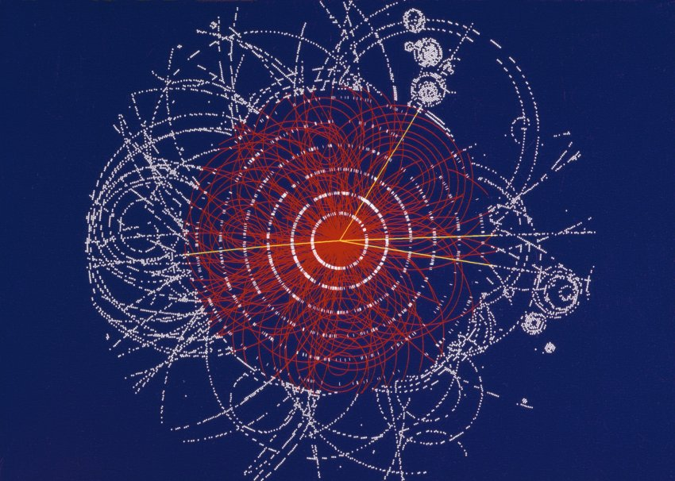
Scientific Data Challenges
Volume
Fast ingest
Chaotic Access
Sharing
Access Control
Persistence & Long term archival
Immutability
Data integrity and protection

Slide 7
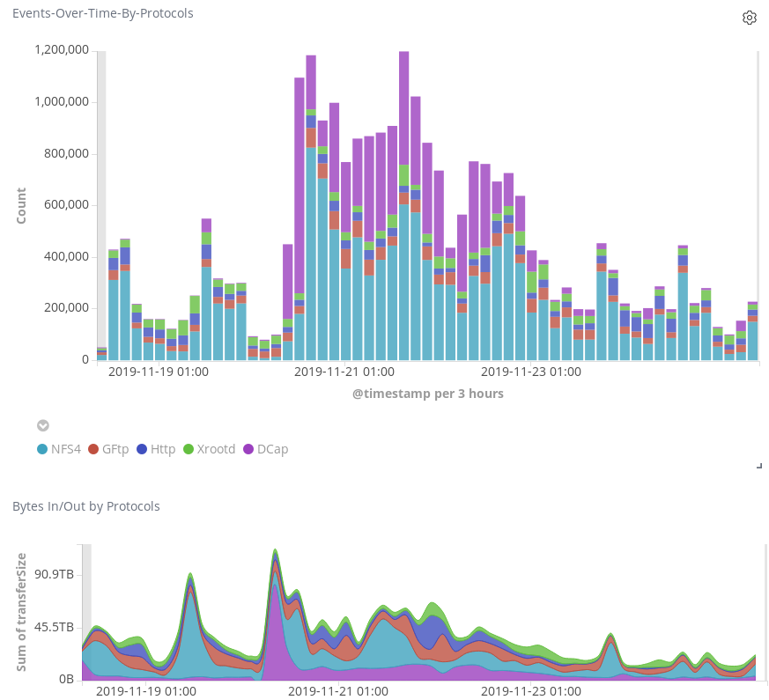
Access Protocols
Standard
  FTP
  HTTP(S)
  NFSv4.1/pNFS
  WebDAV
Exotic
  DCAP ( dCache native)
  xroot
  SRM

Slide 8
dCache Design Coals
Single-rooted namespace, distributed data
Client talks to namespace for metadata operations only
Bandwidth and performance grow with number of Pool nodes
Standard clients (OS native or experiment framework)
The same data available with any protocol independent from Authentication scheme

Slide 9
Technical Design (1)
Set of independent components
  each component does one thing
Multiple instances of the same component can be started for horizontal scalability
Components communicate by sending messages
Nowadays such architecture is called microservices with message queue

Slide 10
Technical Design (2)
Data and metadata strong separation
Data servers know only internal unique IDs
  FileID is independent from the path and remains on rename
  FileID never re-used
Data location can be independently added or removed

Slide 11

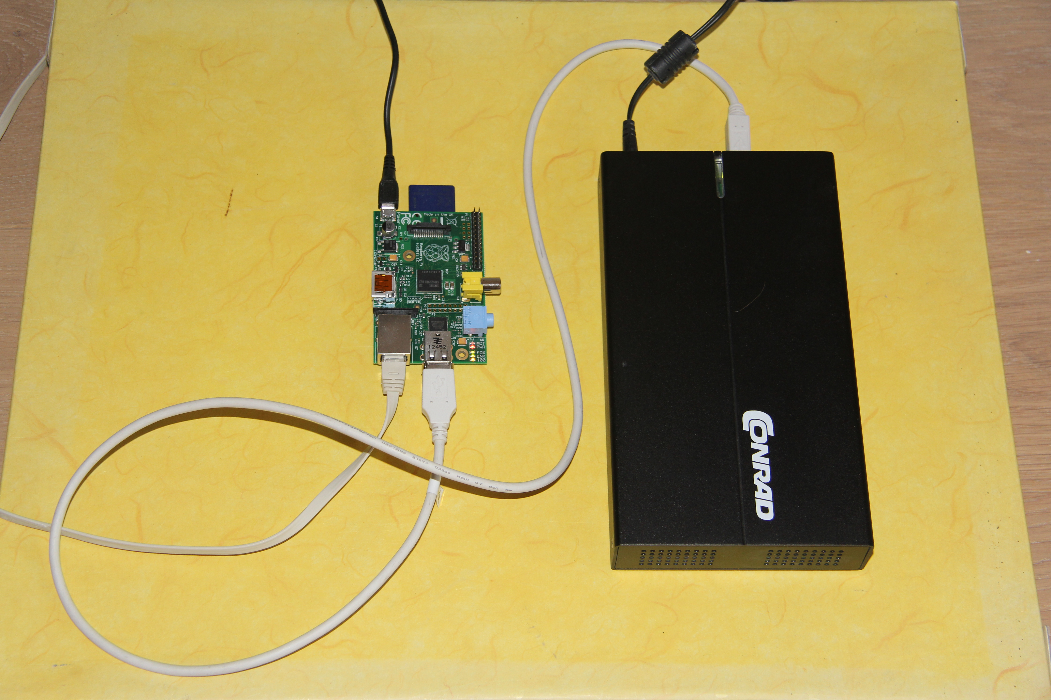
From Tiny to Huge
5 Countries One instance
HPC Center North
Uni of Bergen
PDC
CSC
Uni of Oslo
National Supercomputer Center
700 MHz ARM
512 MB Memory
2 * USB 2
100 MB Ethernet
dCache head node
Nordu Net

Slide 12
dCache on One Slide
JVM
JVM
JVM
Message passing layer
Door
Pool
Manager
NameSpace
Door
Pools
(Data Server)
Pools
Pools
(Data Server)
dcap
http
DBMS
ftp
nfs

Slide 13
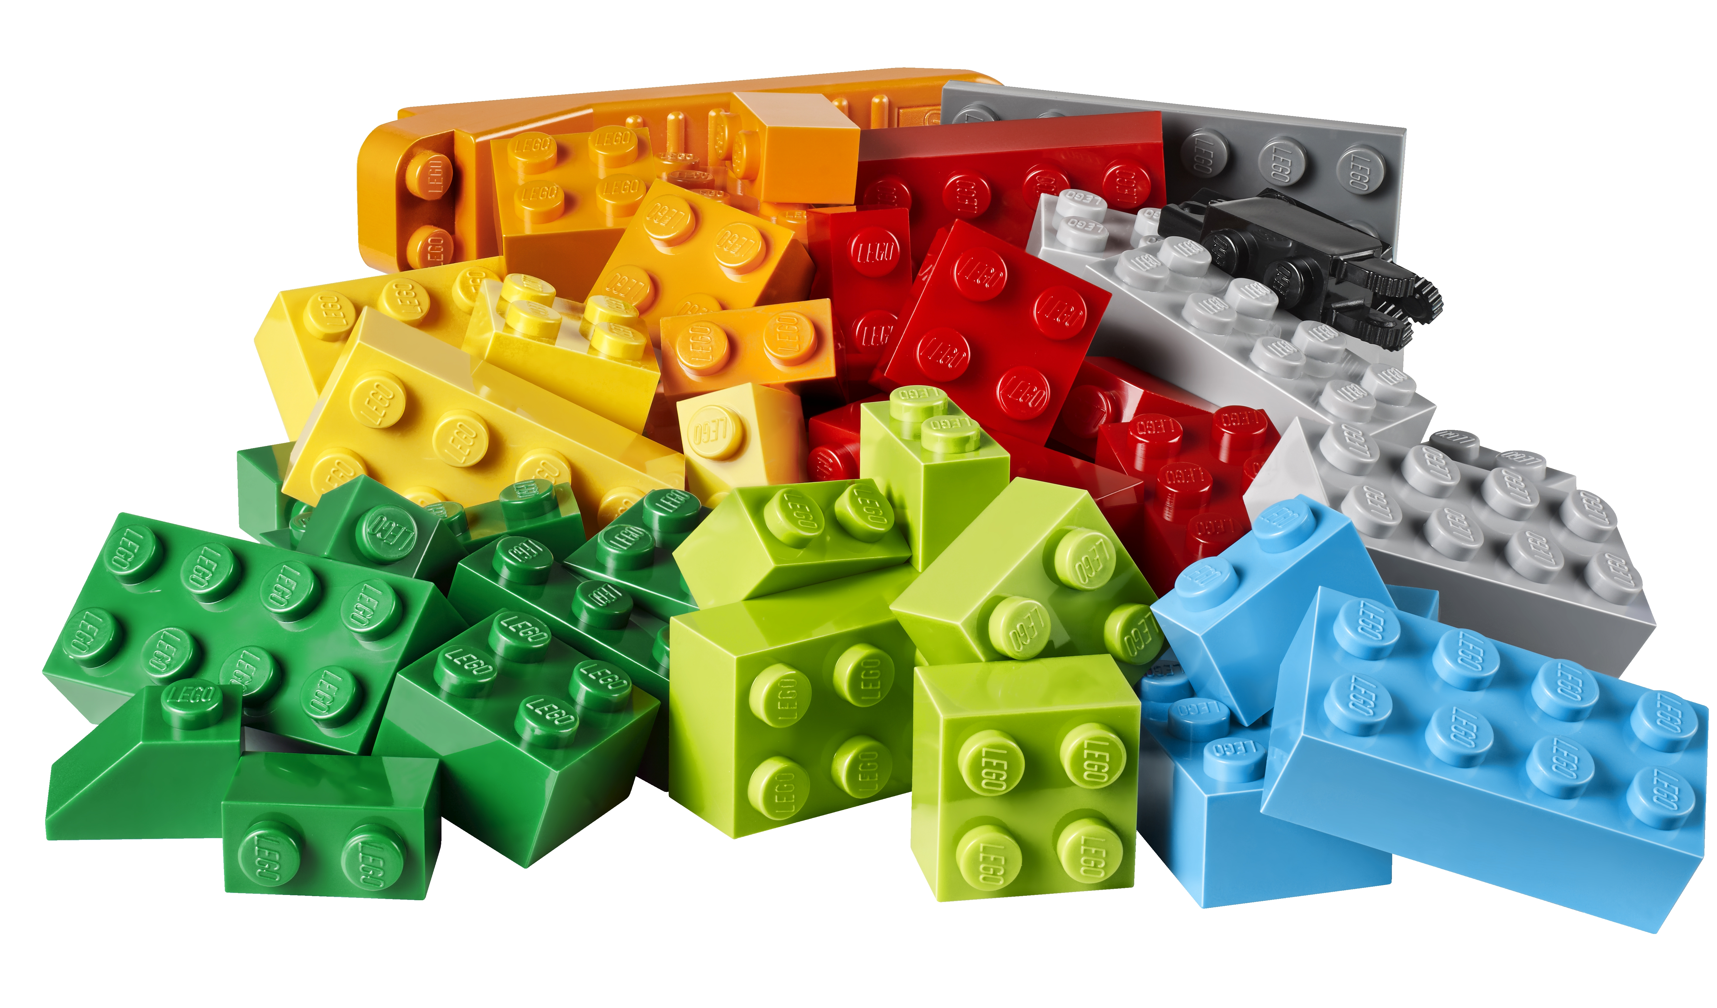
Four Main Components
DOOR
  protocol specific user entry points (DCAP, FTP, HTTP, NFS, XROOT)
POOL
  data storage nodes, talk all protocols
Namespace
  metadata DB, POSIX layer
PoolManager
  request distribution unit

Slide 14




Minimal Setup
Namespace
PoolMgr
Pool-A

Slide 15

Minimal Setup
Namespace
PoolMgr
Pool-A

Slide 16
Minimal Setup
Namespace
PoolMgr
All components are CELLs :
they are independent and can interact with each other (send messages).
Pool-A

Slide 17
Minimal Setup
Namespace
PoolMgr
All components are CELLs :
they are independent and can interact with each other (send messages).
Such architecture today knows as Microservices with message queue.
Pool-A

Slide 18
Grouping CELLs
Namespace
PoolMgr
Single process:
Shared JVM
Shared CPU
Shared Log files
All components run the same version
A process called DOMAIN
Pool-A

Slide 19
Grouping CELLs
Namespace
PoolMgr
In different processes:
Independent JVMs
Shared CPU
Per-process Log file
Pool-A

Slide 20
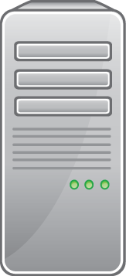
Grouping CELLs
Namespace
PoolMgr
On a different hosts:
Share-nothing option
Components can run different, but compatible versions.
Pool-A

Slide 21
Grouping CELLs
Namespace
PoolMgr
And mix of all options
Most common way of deployment.
Pool-A

Slide 22
Config
[core]
[core/poolmanager]
[core/webdav]
[door]
[door/nfs]
[door/ftp]

Slide 23
Cell Messaging
Star like topology
Selected node configured as a hub called CORE domain
Other domains called SATELLITE
All communication goes through CORE domains
Multiple CORE domains make communication fault tolerant

Slide 24

ZooKeeper as Service Discovery
A central registry of CORE domains
  Similar to DNS or routing table
Master election for single-man operations
  Some actions must be done only once
Must be deployed as a cluster
  Built-in fault tolerance

Slide 25
Service Discovery

Slide 26
Service Discovery
I'm a core Domain, ip:a.b.c.d

Slide 27
Service Discovery
Where are a core Domains?
ip:a.b.c.d

Slide 28
Service Discovery

Slide 29
dCache and CAP
dCache provides consistency over availability.
All client will see the same data at the same time.
A timeout or error will be returned, if consistency can't be guaranteed.

Slide 30

Config
dcache.zookeeper.connection = ...
[core]
dcache.broker.scheme = core
[door]
dcache.broker.scheme = satellite

Slide 31
File Placement
1
Obj. A
2
3
4
5

Slide 32
File Placement
0
Obj. A
5
1
2
hash(A) % 5 = 3
3
4

Slide 33
File Placement
0
Obj. A
5
1
2
random(5) = 3
3
4

Slide 34
File Placement
0
Obj. A
5
1
5
2
random(5) = 3
6
3
A => 3
4

Slide 35
Fault Tolerance
All core services can run multiple instances
Door/pool restart handled by clients
  NFS
  DCAP
  XrootD
Master-slave configuration of namespace database
  dCache detects which node runs in master mode

Slide 36
Request Parameters
Pool Groups
Protocol
Path (store)
Client IP

Slide 37
Request Parameters
Pool Groups
Protocol
Path (store)
Client IP
Link

Slide 38
Request Parameters
Pool Groups
Protocol
Path (store)
Client IP
Link
Operation | Priority
READ | 10
WRITE | 10
CACHE | 5
P2P | 1

Slide 39
Request Parameters
Pool Groups
Protocol
Path (store)
Client IP
Link
Operation | Priority
READ | 10
WRITE | 10
CACHE | 5
P2P | 1
When multiple links match,then a link with highest priority is selected!

Slide 40

Example: (simplified )
... falback-pools
... desy-pools
... extern-pools -dynamic -tags=zone=extern
... desy-net 131.169.0.0/16 2001:638:700::/48
... extern-net 159.93.0.0/16
psu create link desy-link desy-net any-protocol desy-pools
psu set link desy-link -readpref=10 -writepref=10
psu create link extern-link extern-net any-protocol extern-pools
psu set link extern-link -readpref=10 -writepref=10
psu create link default-link any-net any-protocol fallback-pools
psu set link default-link -readpref=1 -writepref=1

Slide 41


Slide 42


Slide 44
AGLT2 – Ann Arbor <=> East Lansing

Slide 45
AGLT2 – Ann Arbor <=> East Lansing

Slide 47
Config
dcache.zone=extern
[${host.name}]
[${host.name}/pool]
pool.name=pool-${host.name}
pool.path=/pool

Slide 48
Zones: Geo-Location
Geo-location aware unit
Dynamically groups services together
Available in replication rules
Network topology aware internals communication
  Always prefer local resources
  Disconnected operation (CAP violation)
set storage unit data:resilient@osm -required=2 -onlyOneCopyPer=zone
create pgroup caching-pools -dynamic -tags=zone=A

Slide 49
Auth-N
&
Auth-Z

Slide 50
Multiple Identities Problem
x509 (grid)
  /C=DE/O=GermanGrid/OU=DESY/CN=Tigran Mkrtchyan
Kerberos
  tigran@DESY.DE
LDAP
  uid=tigran,ou=people,ou=rgy,o=desy,c=de
Unix ID (uid)
  3750

Slide 51
gPlazma – Plugable AuthN
Pam -like system
Allows to combine multiple plugins
  specify plugin wiring
Supports many standard and custom authentication plugins
  from ActiveDirectory to gridmap file

Slide 52
Example: gplazma.conf
# authenticate with username+password
auth optional ldap
# get uid, gids from ldap
map optional ldap
# get home directory from ldap
session optional ldap

Slide 53
Example: gplazma.conf
# authenticate with username+password, or certificate
auth sufficient ldap
auth optional x509
auth optional voms
# get uid, gids from ldap
map optional vorolemap
map sufficient ldap
map sufficient authzdb
# get home directory from ldap
session sufficient ldap
session optional authzdb
If user comes with password
Or x509 certificate and VOMS
If there is a mapping
for DN+VOMS to “user name”
Take it into account
Try local auth-db file

Slide 54
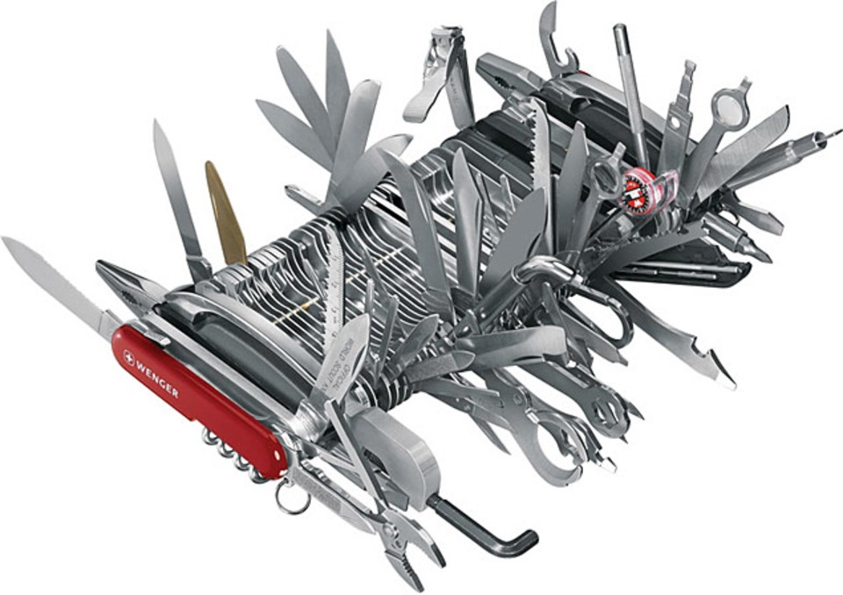
gPlazma Plugins ...
argus
htpasswd
roles
banfile
jaas
multimap
voms
grid
krb5
nsswitch
xacml
gsi
scitoken
fermi
kpwd
nis
ldap
oidc
Plus TLS, RPCSEC_GSS, Macaroons...

Slide 55
HSM Integration

Slide 56
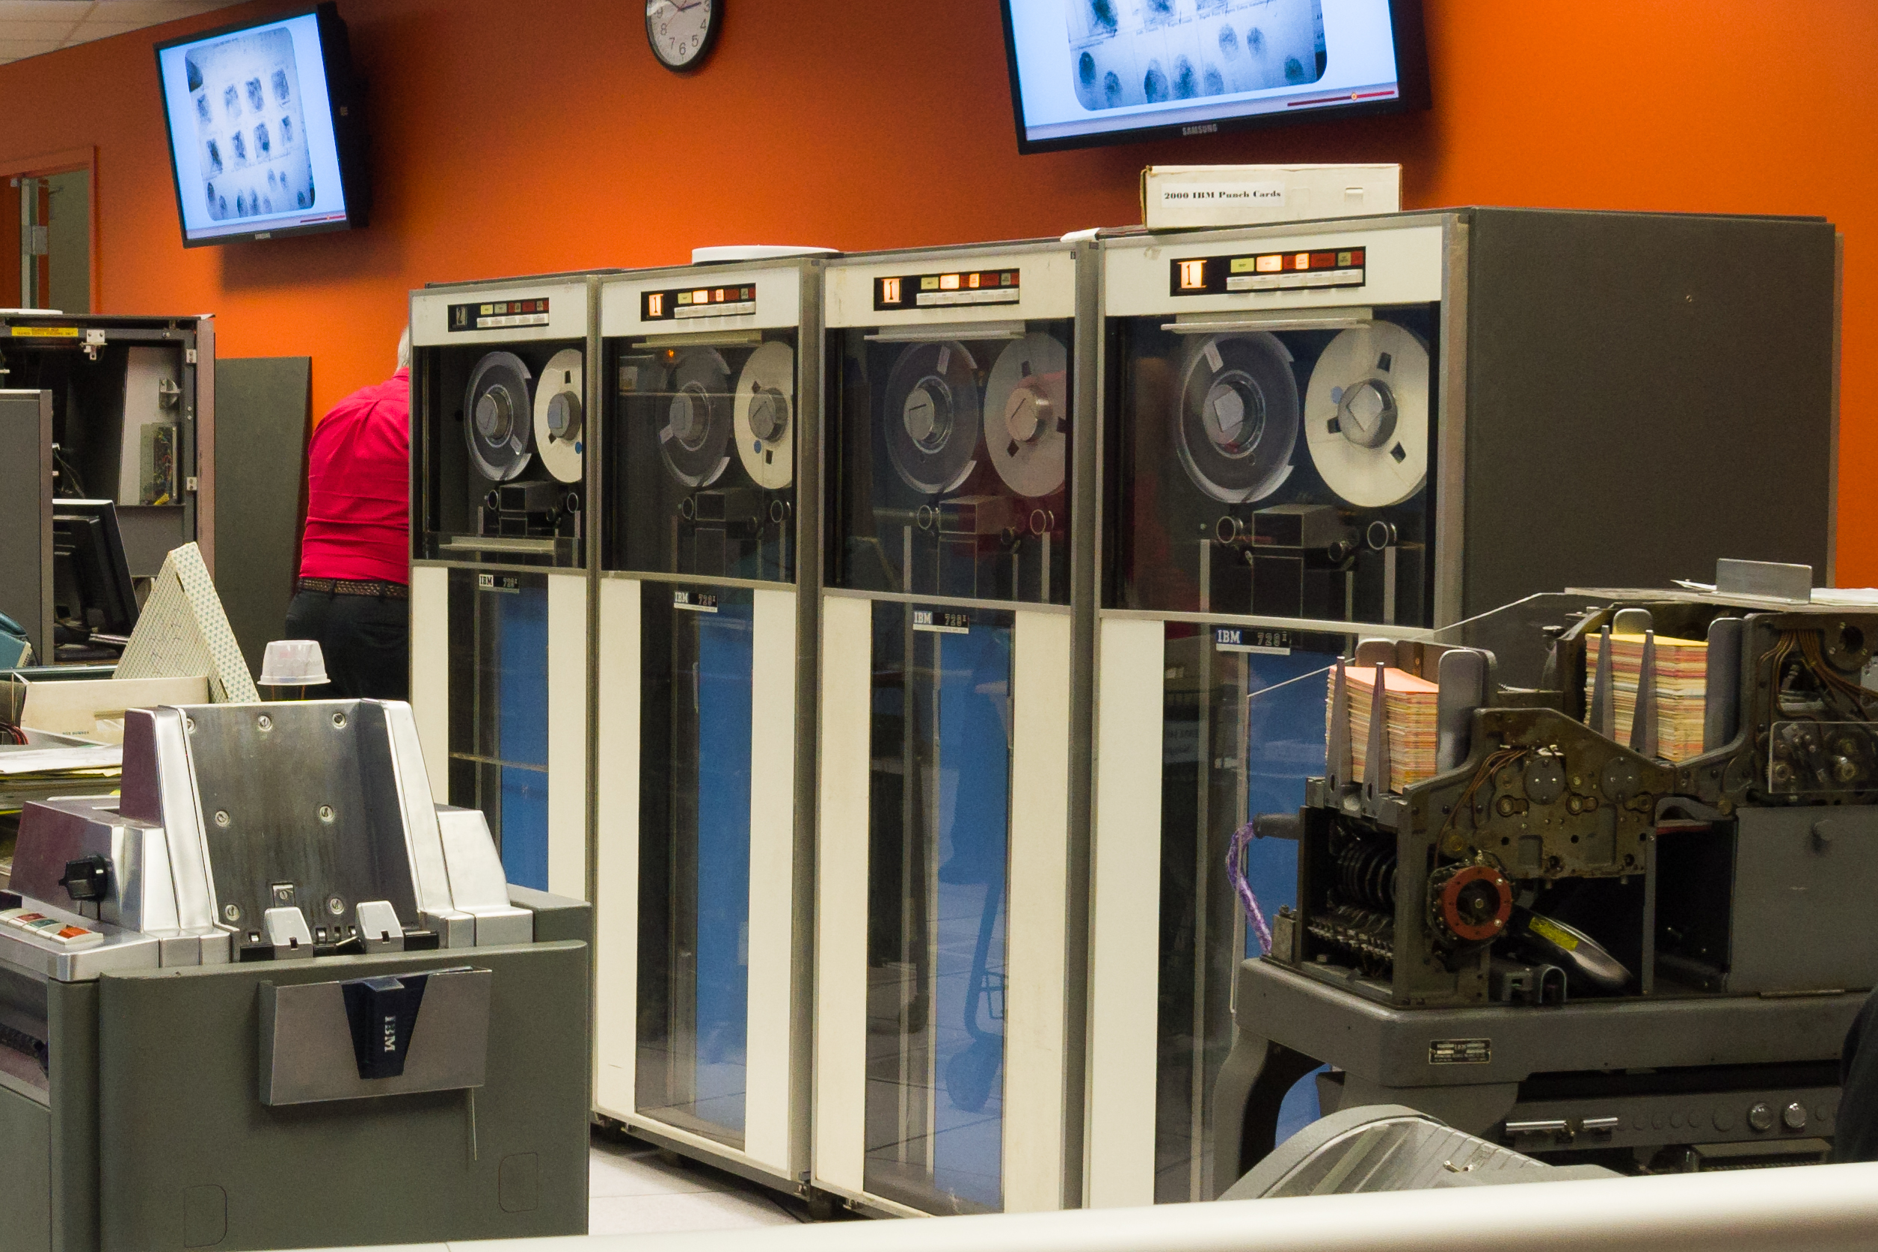
Tape Connectivity
Native to dCache
  The essential part of the original design
Writeback/Readthrough -like behavior
  Transparent for end users
  Hide tape management from the end-users
Stage protection
  user/VO based
  protocol based
Supports multiple HSMs on a single instance
Used with a wide variety of HSMs
Provides full functionality with/without HSM
  Tape and disk files can be mixed on the single data server

Slide 57

Pool-A
(data server)
HSM
(Archival
storage)
Pool-B
(data server)

Slide 58
Two Interfaces to HSM
Plugable Driver API
  Suitable to create smart HSM connectivity
  ENDIT (Efficient Northern dCache Interface to TSM)
External script
  Reference implementation of API
  Stupid, simple and genius

Slide 59
The Script Interface
Call external `copy’ application
  PUT
    Flush local file to the HSM
    A unique URI(s) returned on success
  GET
    URI(s) provided as an argument
    Retrieve file from the HSM
  REMOVE
    URI(s) provided as an argument
    Remove file from the HSM

Slide 60
Example:
$ hsm put \
0000000635D5968A4DD89E29C242185B2D82 \
/pool1/0000000635D5968A4DD89E29C242185B2D82
osm://desy-main/?bfid=3434.0.994.1188400818542
$ hsm get \
/pool1/0000000635D5968A4DD89E29C242185B2D82 \
-uri=osm://desy-main/?bfid=3434.0.994.1188400818542
$ hsm remove \
-uri=osm://desy-main/?bfid=3434.0.994.1188400818542

Slide 61
URI Schema
RFC 2396 conform URI
  <hsmType>://<instanceId>/?<hsmOpaqueData>
Stored as opaque file attribute
  A file may have multiple URIs
Restore sent to a pool (data server) which is connected to the corresponding HSM instance

Slide 62
Non POSIX Back-end
Path to local file provided as URI
  file:///path/on/data/server
    shortcut - /path/on/data/server
Back-end specific access specified as protocol
  backend://…..
    rbd://<ceph pool>/fileid
    s3://<bucket>/fileid

Slide 63
Stupid, Simple – Genius!
Works with every thing that can store data
  OSM
  EnSTORE
  HPSS
  TSM
  SGI DMF
  Amazon S3
  dCache!

Slide 64

Stupid, Simple – Genius!
Works with every thing that can store data
  OSM
  EnSTORE
  HPSS
  TSM
  SGI DMF
  Amazon S3
  dCache!

Slide 65
Nearline Storage API
public interface NearlineStorage
{
/**
* Flush all files in {@code requests} to nearline storage.
*/
void flush(Iterable<FlushRequest> requests);
/**
* Stage all files in {@code requests} from nearline storage.
*/
void stage(Iterable<StageRequest> requests);
/**
* Delete all files in {@code requests} from nearline storage.
*/
void remove(Iterable<RemoveRequest> requests);
...
}

Slide 66
Flush to Tape `rules`
Flush requests grouped by storage group
  storage group (typically) associated with a set of tapes
  Multiple storage group can be flushed in parallel
  Re-use tape mount
  This is per pool decision!
Flush triggered by:
  Max time on disk
  Number of files
  Number of bytes

Slide 67
The Flush Queue

Slide 68
The Flush Queue
Group flush queues by
storage class

Slide 69
The Flush Queue
Queues flushed by policy:
max time
max size
max count
Storage classes can be flushed concurrently, if configured.

Slide 70
The Flush Queue
HSM configuration defines number of concurrent flushes

Slide 71
The Flush Queue
Number of drives limits the number of concurrent transfers

Slide 72
Restore
Appropriate stage pool is selected
  HSM type, load, space
Space allocated on disk
  Never block on space allocation when tape is mounted!
Requests sent to tape

Slide 73
The Restore Queue
No sorting on stage!

Slide 74
The Restore Queue
No sorting on stage:
single storage class is re-called (usually)
request coming sequentially

Slide 75

Nobody expects the Spanish Inquisition!

Slide 76
Triggering Stage/Flush
Each pool makes it’s own decision
  File attributes (retention policy) indicates “tape file”
RESTFull QoS API
  Can trigger stage
  Can promote file to be “tape file”
SRM bring-on-line
NFS & dcap
  magic files

Slide 77
QoS
Let user to specify what they really needs
  Access latency
  Probability of loss
  Budget
Let storage system to provide service without details
  Reliable
    HSM or multiple copies
  Fast
    SSD or multiple copies
  Fast + Reliable
    SSD + tape
Site may decide how to provide required QoS based on know-how, resource and budget

Slide 78

CEHP integration

Slide 79
Disk Distribution(classic)
xFTP
NFS
WebDAV
XrootD
DCAP
DC POOL
DC POOL
DC POOL
DC POOL
RAID 6
RAID 6
RAID 6
RAID 6
HDD
HDD
HDD
HDD
HDD
HDD
HDD
HDD
HDD
HDD
HDD
HDD
HDD
HDD
HDD
HDD
HDD
HDD
HDD
HDD

Slide 80

Disk Distribution(CEHP)
xFTP
NFS
WebDAV
XrootD
DCAP
DC POOL
DC POOL
DC POOL
DC POOL
RADOS+Co.
CEPH POOL
CEPH POOL
CEPH POOL
CEPH POOL
OSD
OSD
OSD
OSD
OSD
HDD
OSD
HDD
OSD
HDD
HDD
HDD
OSD
OSD
OSD
HDD
OSD
HDD
HDD
OSD
HDD
HDD
OSD
OSD
OSD
HDD
HDD
HDD
HDD
HDD

Slide 81
Why CEPH?
Demanded by sites
  deployed as objects store
  used as back-end for OpenStack and Co.
Possible alternative for RAID systems
  no rebuilds on disk failure
  one disk per OSD
  allows to use JBODs and ignore broken disks

Slide 82
How it Works?
Pool still keeps it’s own meta
  File state, checksum, etc.
All IO requests forwarded directly to CEPH
Each dCache pool is a CEPH pool
  resilience
  placement group
Each dCache file is a RBD image in CEPH
  striping
  write-back cache
  out-of-order writes
Notes:
Resilience: You can set how many OSD are allowed to fail without losing data. For replicated pools, it is the desired number of copies/replicas of an object. A typical configuration stores an object and one additional copy (i.e., size = 2), but you can determine the number of copies/replicas. For erasure coded pools, it is the number of coding chunks (i.e. m=2 in the erasure code profile)
Placement Groups: You can set the number of placement groups for the pool. A typical configuration uses approximately 100 placement groups per OSD to provide optimal balancing without using up too many computing resources. When setting up multiple pools, be careful to ensure you set a reasonable number of placement groups for both the pool and the cluster as a whole.
CRUSH Rules: When you store data in a pool, a CRUSH ruleset mapped to the pool enables CRUSH to identify a rule for the placement of the object and its replicas (or chunks for erasure coded pools) in your cluster. You can create a custom CRUSH rule for your pool.
Snapshots: When you create snapshots with ceph osd pool mksnap, you effectively take a snapshot of a particular pool.
Set Ownership: You can set a user ID as the owner of a pool..

Slide 83



Pool Internals
cell communication
mover queue
flush queue
metadata
virtual repository
data
repository
Data Mover

Slide 84
Pool Internals
cell communication
mover queue
flush queue
../meta
metadata
virtual repository
data
repository
XFS/ext4
Data Mover
POSIX
IO
../data

Slide 85

Pool Internals
cell communication
mover queue
flush queue
../meta
metadata
virtual repository
data
repository
Data Mover
librados
RDB

Slide 86
dCache Setup
# layout.conf
pool.backend = ceph
# optional configuration
pool.backend.ceph.cluster = dcache
pool.backend.ceph.config = /.../ceph.conf
pool.backend.ceph.pool-name = pool-name

Slide 87
On the CEPH side
$ rados mkpool pool-name ....
$ rbd ls -p pool-name
0000000635D5968A4DD89E29C242185B2D82
0000001A770D854E41448D87C91822D90F0F
....
$

Slide 88
HSM script
file:/path/to/pnfsid
  shortcut to /path/to/pnfsid
backend://
  rbd://<pool name>/pnfsid
All files accessible in CEPH without dCache

Slide 89
Current Status
Part of dCache since 3.0
Focus on stability and functionality first
  all existing dCache feature set must be available
uses RBD interface
  striping
  write-back caching
  alterable content

Slide 90
Non HPC/HTC workloads

Slide 91
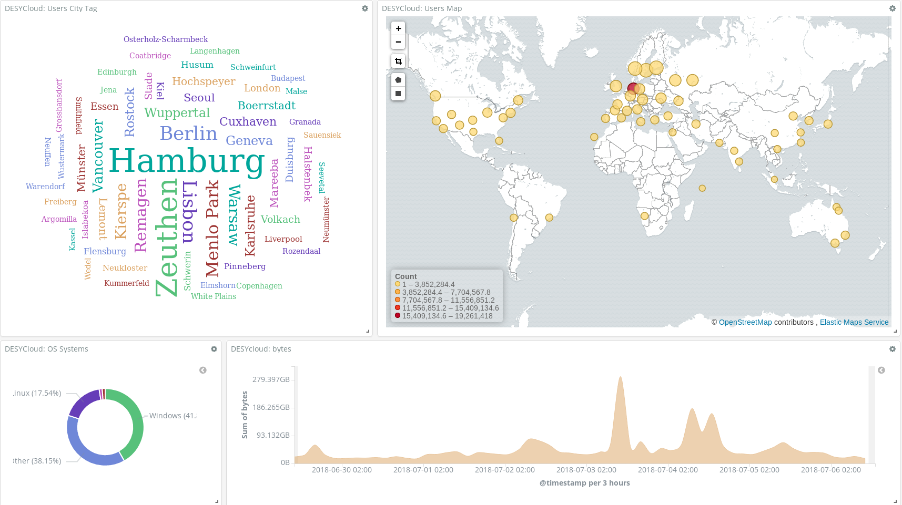
Nextcloud Instance @ DESY
x6 nextCloud front-ends
  Load-balanced with F5
  Two groups on different NFS servers
x2 dCache-NFS doors
x4 Physical data servers
  32 logical servers (dCache pools)
x3 dCache core services
  Hot stand-by namespace-DB replica
300TB installed capacity, 30TB used
  ~ 53M stored files, x2 copies per file
  ~ 95K new files per day ( 50% updates)
  ~ 50K removed

Slide 92








Nextcloud Instance @ DESY
pNFS
core
services
core
services
pNFS
No single point of failure
Notes:
One of the challenges to transparently migrate nfs clients from one server to an other

Slide 93
dCache as a Storage Backend
PB-scale storage system
No changes in Nextcloud required
Unique functionality
  Tape integration
  File ownership preservation
  NFS export to selected users
  Storage events
  Data visible by all protocols and security flavors

Slide 94
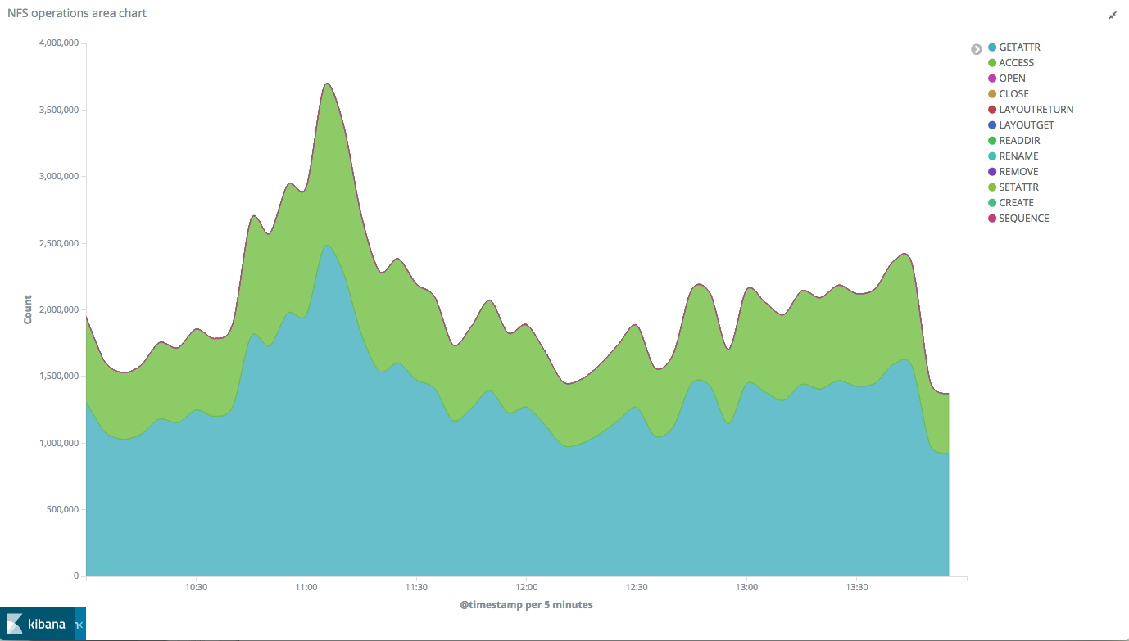
9000 stats per second!

Slide 95
Storage Events
Trigger actions on user activity
  Stop polling, Please!
Storage system becomes a workflow engine
Producer-consumer model
For infrastructure
  Apache Kafka
For individuals
  Server Sent Events

Slide 96
Storage Events in dCache
Kafka stream
  Producer-consumer model
  Kafka consumer is required
  global events
  Consumer keeps track of the last seen event
  Integration with other tools (Spark, ELK, ...)
Server-Send Events (SSE)
  Producer-consumer model
  HTTP connection “for receiving push notifications from a server”
  User specific event stream
  Client keeps track of the “Last-Event-ID”

Slide 97
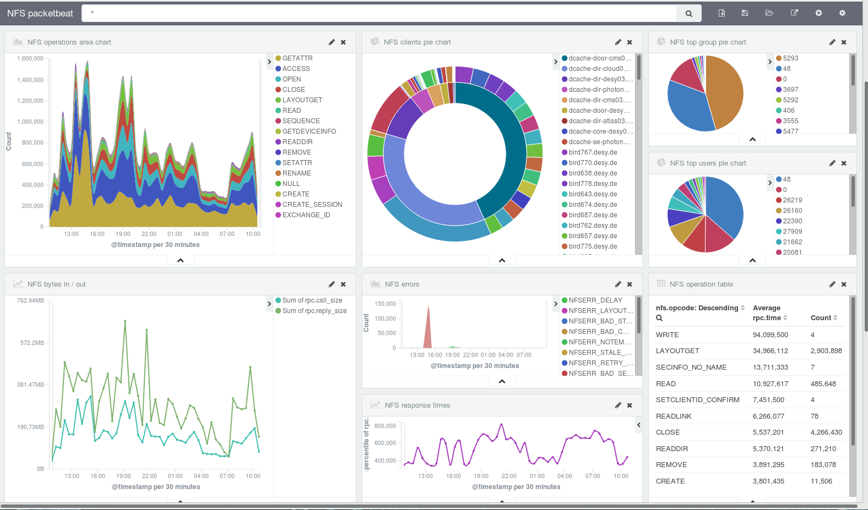




Storage Events
SSE

Slide 98
Workflow Control
Event: new data
create
derived
data
store derived file
extract
metadata
metadata
catalog
update catalog
by Michael Schuh (Data Ingesting and Processing in the EOSC)

Slide 99
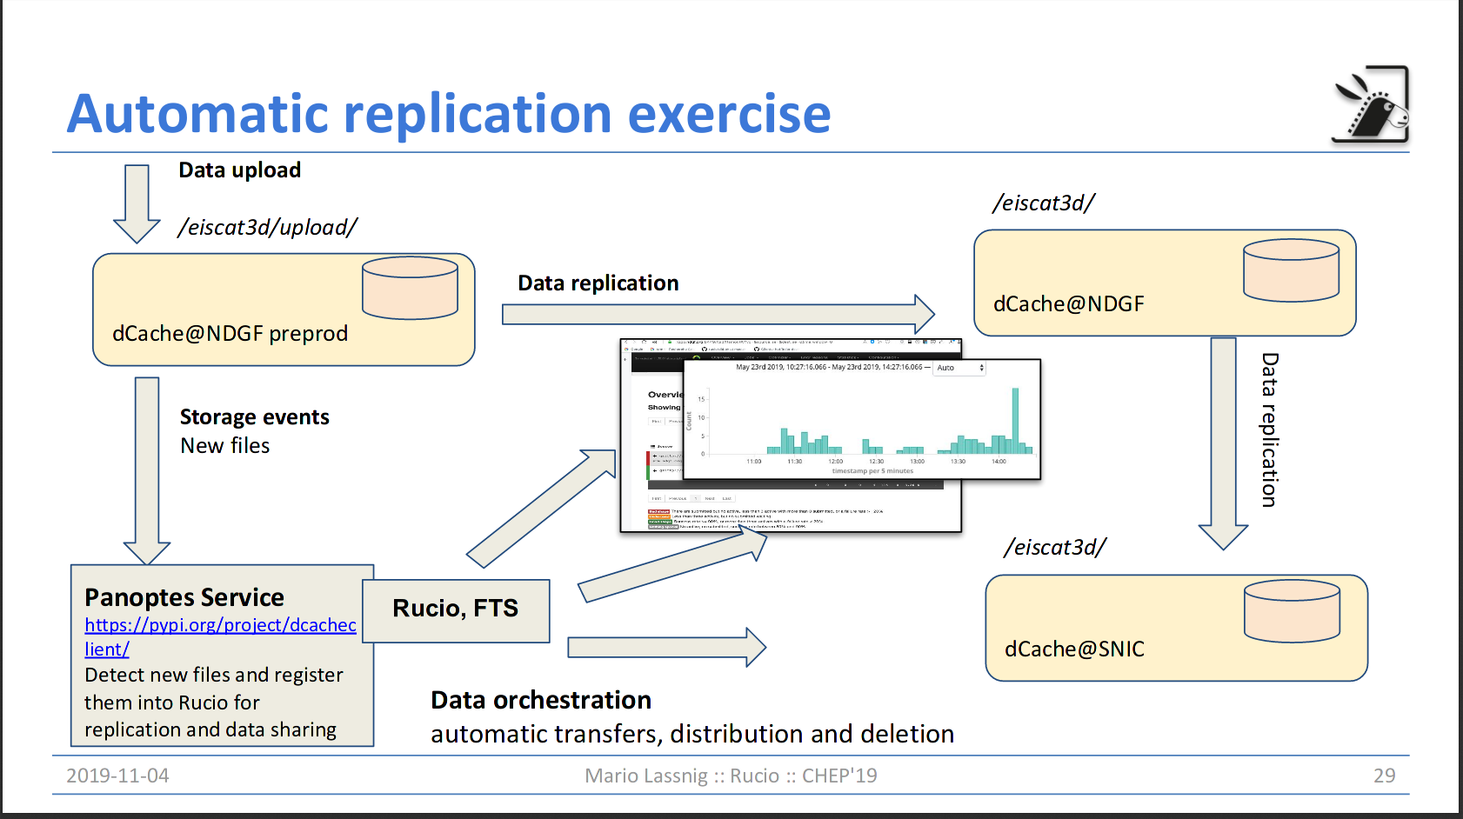
Workflow Integration
Shameless stolen from Maro Lassnig

Slide 100
Standards Everywhere...
HTTP, NFS, FTP
SSE
Clients accessing dCache with standard protocols.
Workflow and processing build on top of widely used (de-facto standard) tools.

Slide 101
Work in progress...

Slide 102





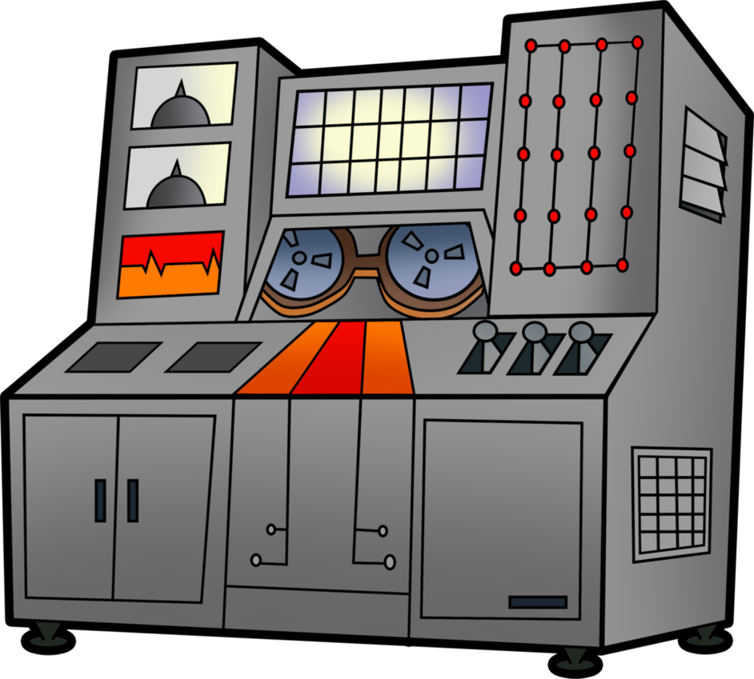

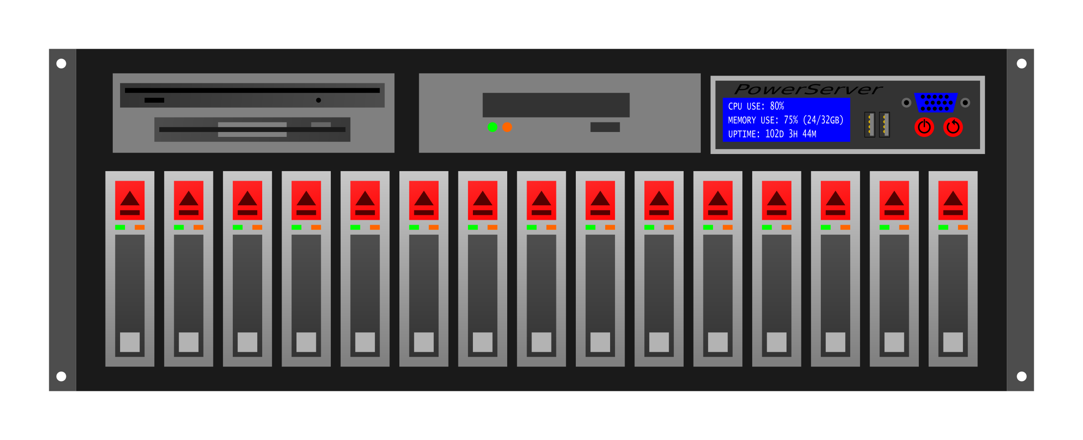

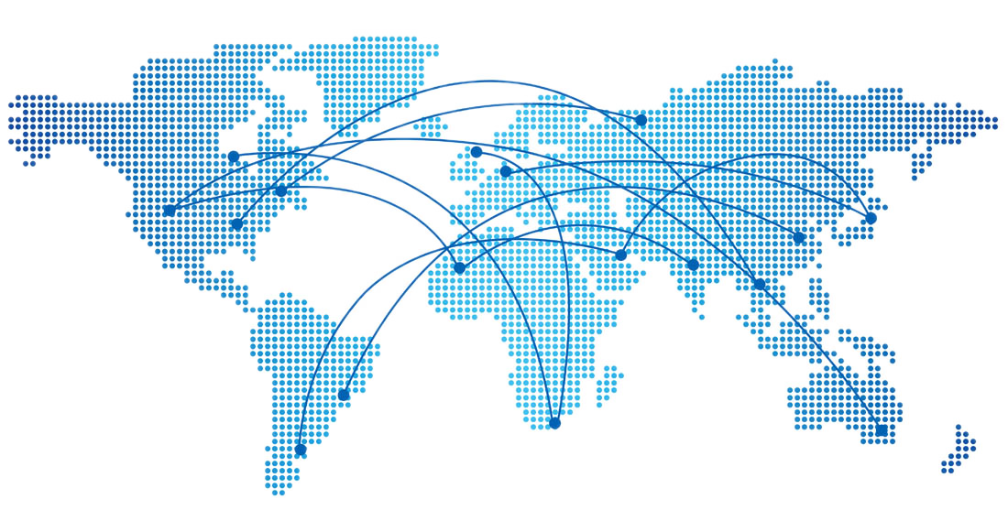
Workflow
integration
POSIX
AuthN
HPC
Friendly
Sync&Share
DOMA
QoS
In-transit
protection
DOMA
TPC
In-transit
protection
POSIX
DOMA
Access

Slide 103
Storage
Events
NFSv4
OAuth2
IODC
Low latency
messages
Macaroons
DOMA
QoS
HTTPS
HTTP-TPC
XROOT-TPC
HTTPS,
KRB5,GSI
NFSv4,HTTP
XrootD,dcap
Smart
caching

Slide 104
User Workflow Shift
More non HEP tools and POSIX access
  ROOT => Jupyter Notebook
  Apache Spark
  HDF5
Grow of interactive analysis
  Analysis Facilities
Industry standard AuthN
  OpenID Connect
  OAuth2
  Federated IDP
Hybrid Clouds
New 3rd-party transfers protocols
Integration with HPC clusters

Slide 105
Work in Progress
Zones
  latency hiding
  disconnected operations
Storage events
Tape handling optimization
  make HSM-driver interface easy to use/implement
Bulk request processing
  like SRM, but different

Slide 106
Development model
and
support channels

Slide 107
Some Numbers
60+ developers/contributor in (almost) 20 years
25 modules
69 production branches (since 01.11.2007)
1144 releases (since 01.11.2007)
~350K lines of code in ~2600 files
~100 external dependencies
RPM, DEB, TAR and Solaris packages

Slide 108
Release Policy
Yearly long-term branch
  2+ years support
Time-based feature released
  ~every 3 mounts
  supported until next LTS release
Weekly maintenance releases
  release for all supported branches

Slide 109
Three Commands to Build a Package
Checkout code
  $ git clone https://github.com/dCache/dcache.git
Change directory
  $ cd dcache
Build
  $ mvn package -am -pl packages/fhs -P rpm

Slide 110
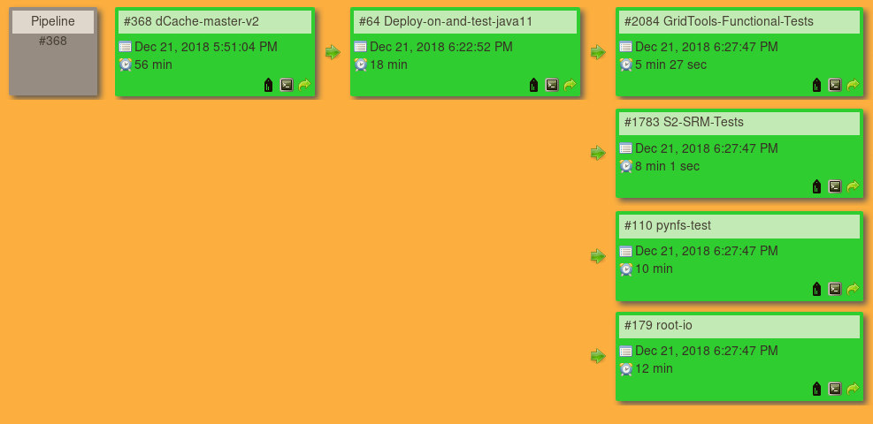
The Build Pipeline

Slide 111
The Build Pipeline (explained)
Compile
Run unit tests
Run code analysis
Build package
Kick-on deployment
Collect and publish results
Can we
build?
Can we
deploy?
Did we
broke it
for users?
Run end-user use cases and tools
Run SRM protocol compliance tests
Run NFS protocol compliance tests
Run Typical (Belle-II) analysis job with multiple access protocols
Install package
Start service
Kick-on external testing
Collect test results

Slide 112
The “Release Process” gives a common framework to get stuff done with a predictable and reproducible result.

Slide 113
Support/Contact Channels
support ըթ dcache.org
  User request tracking system
  Place to ask for a help from developers
  Accessible by all team member
security ըթ dcache.org
  Request tracking system
  To report security issues or incidents
  Accessible by selected people
user-forum ըթ dcache.org
  Mailing list for sysadmins self-help group
  To ask for an advice or share experience
  Used by (almost) all sysadmins and developers
dev ըթ dcache.org
  Shared mailbox
  An email to contact developers. Not for support
  Developers can send e-mail from this address
srm-deployment ըթ dcache.org
  Tier – 1 coordination mailing list
meet.desy.de/xxx
  Weekly Tier 1 support video call
workshop ըթ dcache.org
  Shared mailbox
  An e-mail used to organize workshops
Github issues
  Request tracking system
  To report software defects and feature requests
  Public
Github pull-requests
  Request tracking system
  To provide code changes
  Public

Slide 114
Version Management
Branch 1.0
Branch 1.1
Branch 1.2
Master/trunk
v1.2.0
v1.2.1
v1.1.0
v1.1.1
v1.2.2
v1.0.0
v1.0.1
v1.0.2
v1.0.3
v1.0.4
Golden/LTS
or
Enterprise release
Notes:
Today, we support 4 branches:
2.2, 2.6, 2.7, 2.8
2.6 will be supported yet another year

Slide 115
Re-cap
dCache is a widely used storage system
Flexible architecture allows to deploy system that match your needs
Storage capacity can be dynamically added
Data placement rules can distribute data according network topology
Efficient use of external resources

Slide 116

Thanks!
More info:
  https://www.dcache.org
To steal and contribute:
  https://github.com/dCache/dcache
Help and support:
  support dcache.org
Developers:
  dev dcache.org

Slide 117

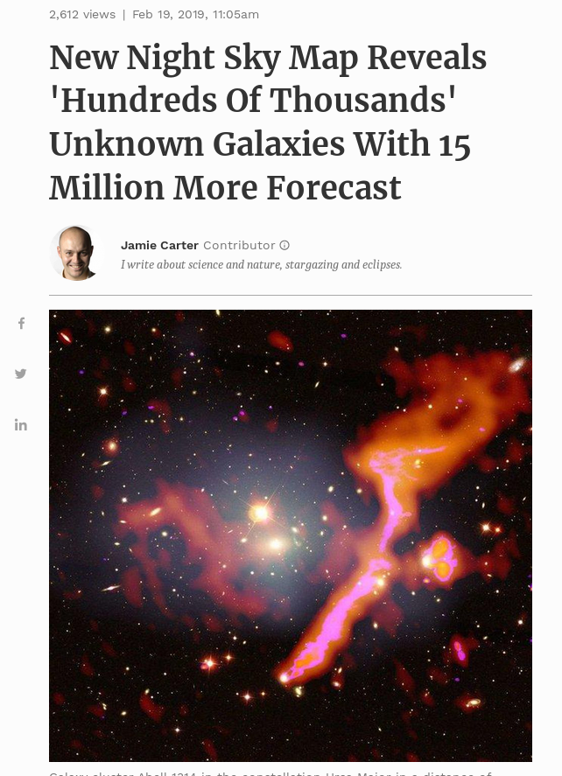
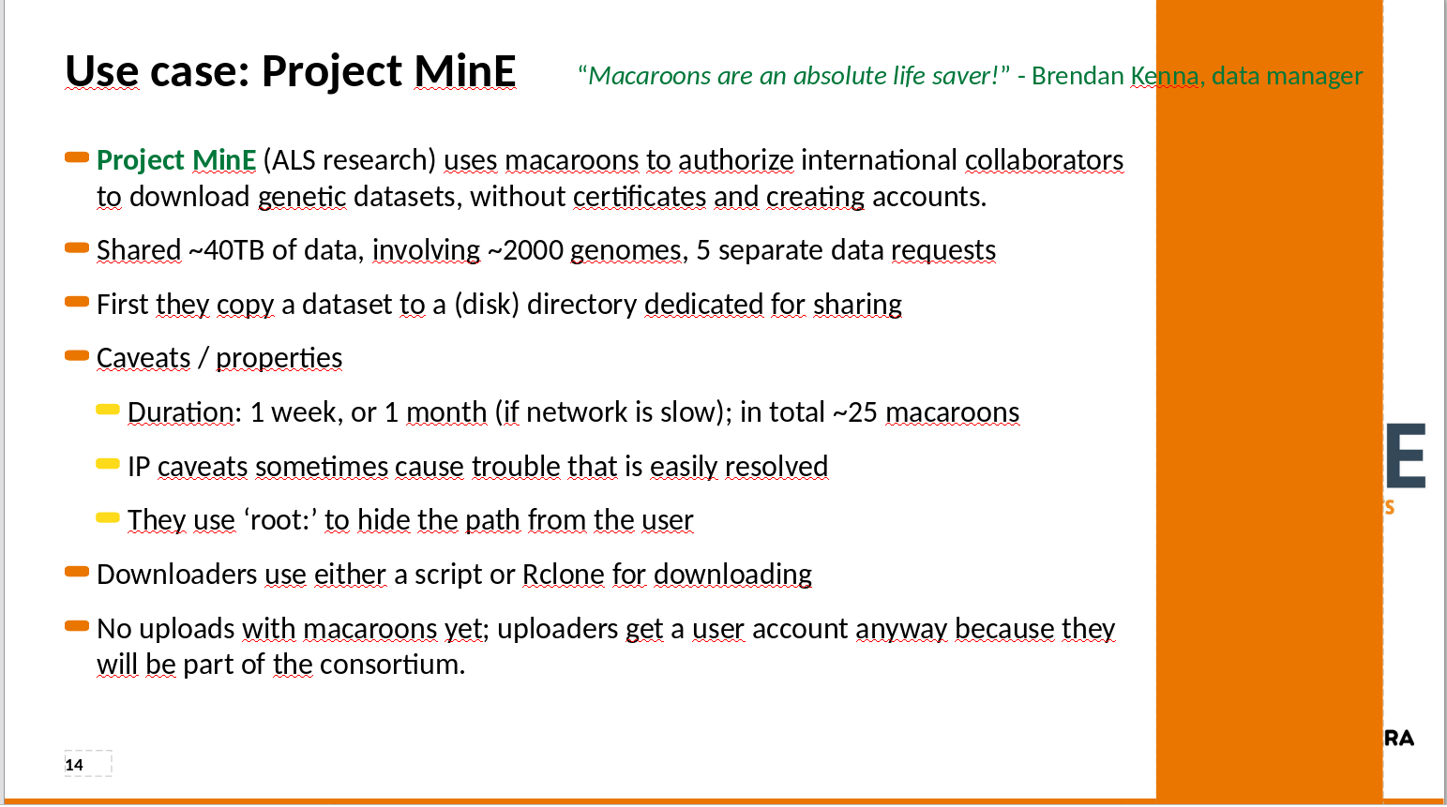

Slide 118
“All this data is stored in the LOFAR Long Term Archive which is located at PSNC in Poznan, FZJ Jülich and with us at SURFsara. All dCache.
In total there is now 44PB in this archive which makes it the largest Astronomy archive in the world at this moment. At SURFsara we have 24PB of LOFAR data.”
Ron Trompert

Slide 119



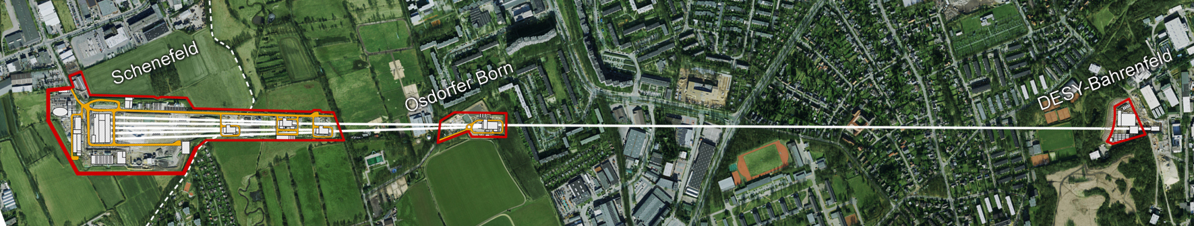
Data life cycle
Beamline
Long term storage
Detector
Train Builder
PC-Layer
Online Storage
Offline Storage
Online
Cluster
Offline
Cluster
Scratch
Online
Scratch
Home

Slide 120
Data management
& workflow control
High Speed
Data Ingest
Batch processing
Interactive analysis
Wide Area Transfers

Slide 121
The Flush Queue
Queues flushed by policy:
max time
max size
max count
HSM configuration defines number of concurrent flushes
Number of drives limits the number of concurrent transfers
Group flush queues by
storage class
Storage classes can be flushed concurrently, if configured.

