Slide 1



dCache News, Status & Roadmap
0xF International dCache workshop

Slide 2
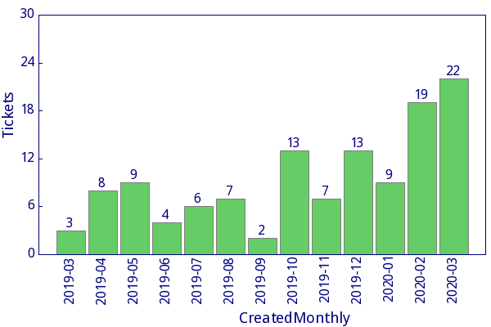
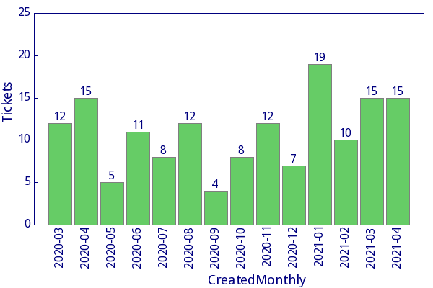
Thanks to All!
Despite pandemic we all

Slide 3










Project Funding & Team
DESY
  Svenja Meyer
  Paul Millar*
  Tigran Mkrtchyan
  Lea Morschel
  Marina Sahakyan
  Sibel Yasar
FermiLab
  Dmitry Litvintsev
  Albert Rossi
NeIC
  Krishnaveni Chitrapu
  Vincent Garonne*
2000
2002
2004
2006
2008
2010
2012
2014
2016
2018
2020
2001
2003
2005
2007
2009
2011
2013
2015
2017
2019
2021

Slide 4







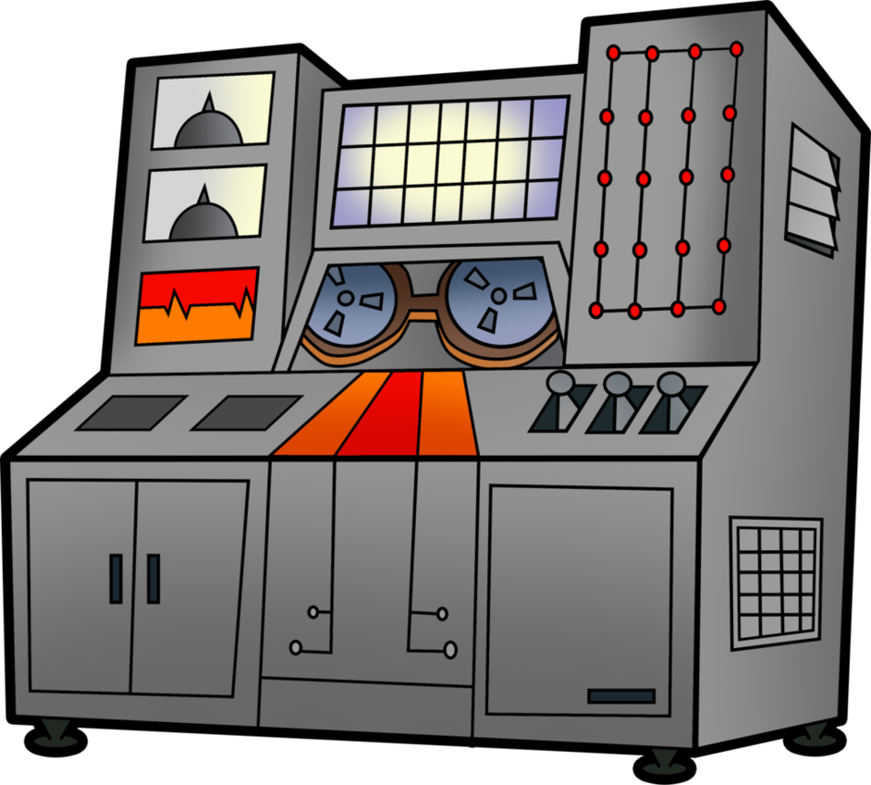

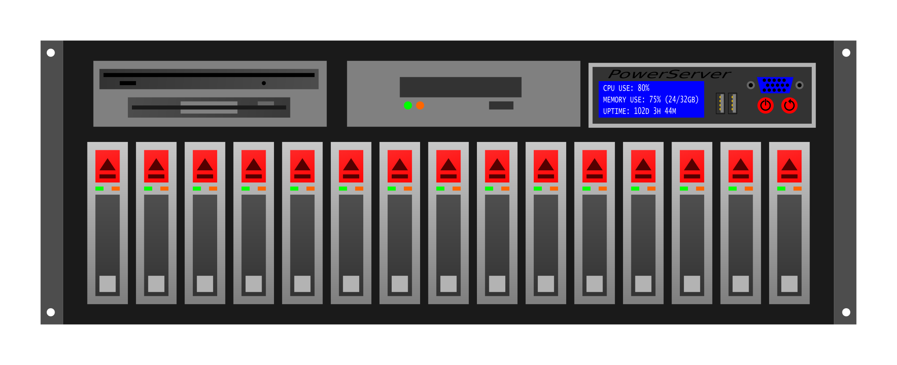

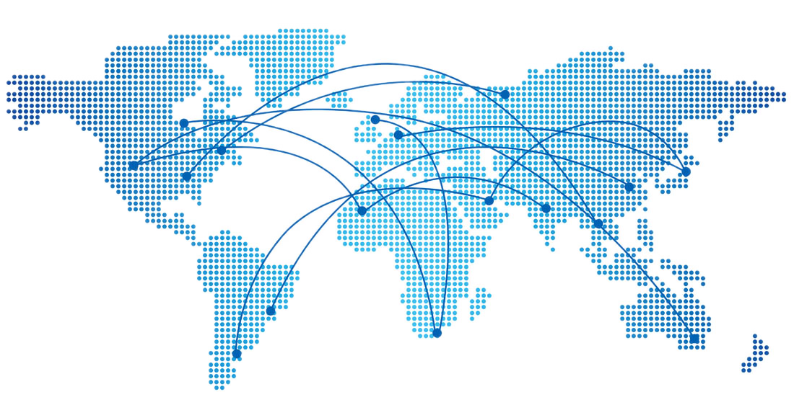
Data management
& workflow control
High Speed
Data Ingest
Batch processing
Interactive analysis
Wide Area Transfers

Slide 5
Strategic Directions
WLCG/HEP
  Almost all sites run dCache for WLCG
EuXFEL/DUNE/Photon Science
  Main on-site customers
Astro- Bio- Life-science
  Almost all sites support non-WLCG communities
Notes:
All three are important:
WLCG distributes confidence in dCache
Local stakeholders support the development
New communities crates opportunities for new challenges

Slide 6
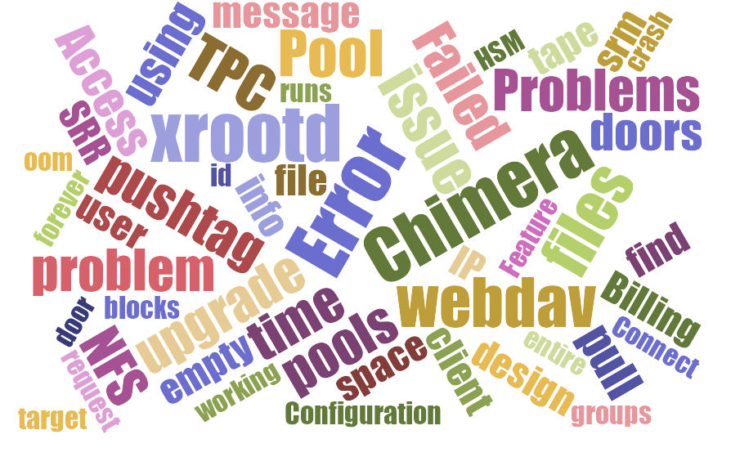
Data Access Paradigm Shift
Non-HEP tool chain
  Active use of Jupyter Notebooks
  Non-root file formats
Industry standard AuthN
  Tokens based authentication
  Federated IdP
Use of private clouds
  Data access from a container
Use of HPC resources

Slide 7
Projects and Funding
Co-progects
RIVA

Slide 8
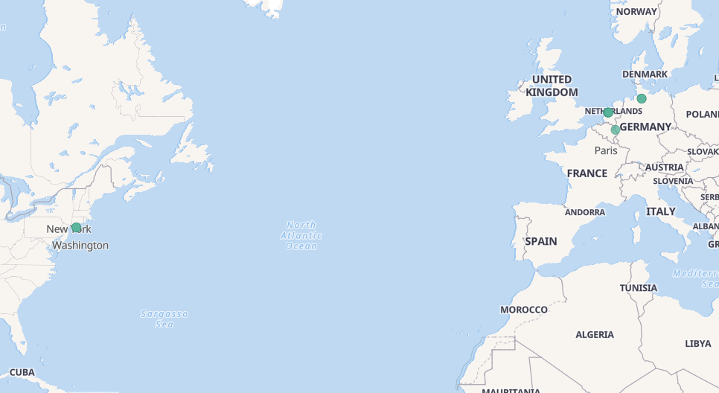
Deployment status
80% of sites run dcache-5.2.x
  Note: the support ends by the end of THIS summer!
6.2.x get slowly adopted
7.1 is on pre-prod instances!

Slide 9
Java-11
Recommended version to use
  We test with OpenJDK, other should work as well
Required starting 6.2
Some errors to ignore:
WARNING: An illegal reflective access operation ...
WARNING: Illegal reflective access by ...
WARNING: Please consider reporting this ...
WARNING: Use --illegal-access=warn to ...

Slide 10
Breaking Changes
Dropped pcells GUI support
  Please use the admin interface in dcache-view
Sys-V -like service files
  Please consider to switch to systemd

Slide 11
systemd Integration
layout.conf
dcache.target
[domainA]
[domainA/serviceA]
[domainA/serviceB]
dcache@domainA.service
[domainB]
[domainB/serviceA]
[domainB/serviceB]
dcache@domainB.service

Slide 12

systemd Service Unit Generator
Generates service units from layout.conf
MUST be executed when:
  Domains added/removed
  Java options have changed
  User is change
Runs automatically on reboot (since Apr 28)
More details: https://indico.desy.de/event/28064/
[domainB]
[domainB/serviceA]
[domainB/serviceB]
[domainA]
[domainA/serviceA]
[domainA/serviceB]

Slide 13
Java Flight Recorder
Available in Java-11
Allows to collect information from running JVM
  Requires JMX or extra enable option:
  (-XX:+StartAttachListener)
$ jcmd <pid> JFR.start duration=60s \ filename=/tmp/dcache.jfr

Slide 14
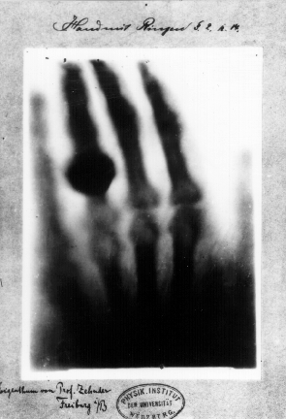
User Metadata Handling
User metadata important (again)
  Data labeling/classification
Can be populated by storage events
  Some automation is required
#Anna Bertha Ludwig
#hand
#1895
#x-ray
Notes:
Wilhelm Röntgen's first "medical" X-ray, of his wife's hand, taken on 22 December 1895 and presented to Ludwig Zehnder of the Physik Institut, University of Freiburg, on 1 January 1896
Anna Bertha Ludwig

Slide 15
User Attribute Support
HTTP(s)
  As query option on upload
  Those attributes are available to the flush process!
POSIX xattrs
  {get/set}fattr over NFS
  Exposes directory tags
File tagging/labeling

Slide 16
Example:
$ curl –upload-file file.txt \ “https://localhost:2881/data/file.txt?xattr.key1=value1”
$ getfattr -L file.txt
# file: file.txt
user.key1
$ getfattr -n user.key1 file.txt
# file: file.txt
user.key1="value1"

Slide 17



Automatic Metadata Population
extract
metadata
Automatic update catalog
metadata
catalog

Slide 18
Metadata Population
extract
metadata
Manual Labeling
Automatic labeling

Slide 19
Labeling in dCache (WIP)
Addling label to existing files
  New table in chimera DB t_labels
Label based virtual read-only directories
  List all files with a given label
dCache rules applies
  Visible through all protocols
  Respect File/dir permissions

Slide 20
HSM & QoS

Slide 21
HSM, Tape, QoS
ATLAS “Tape carousel” => WLCG “Data carousel”
  Bad habits die hard Share the best practices
High data volumes by EuXFEL
  ~1PB/week
High number of small files by Photon Science
  ~4MB, 10^{^6} files per directory
Multi-media copy guarantees

Slide 22
Three Directions to Address
Better HW split on tape/disk pools
  Some nodes can be optimized for tape access only
  A-la QoS for hardware
Tape re-call grouping by tape
  Collect request for a single tape
  Prototype in SRM
Sapphire - small file aggregation
  dCache native HSM driver

Slide 23


Layered Pools Model
P-1
P-1
HSM
(Archival
storage)
P-M
P-N
Client fronting IO layer
Tape access layer

Slide 24

Sapphire (small file plugin)
mongo
pool
pool

Slide 25
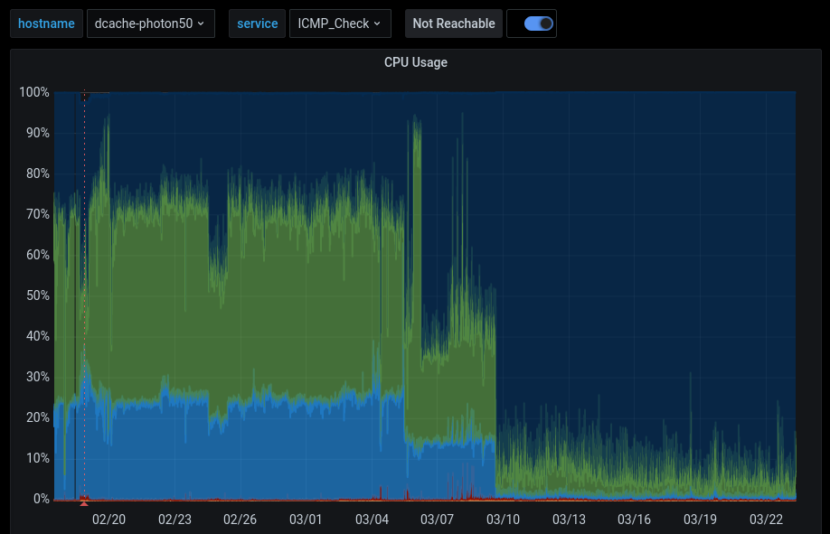
Sapphire
Evolution of Small-file-plugin
  Addresses discovered limitations
In-dCache HSM driver
  Full access to metadata
  No external script
  State full
Better resource utilization
One pool updated
Second pool updated

Slide 26
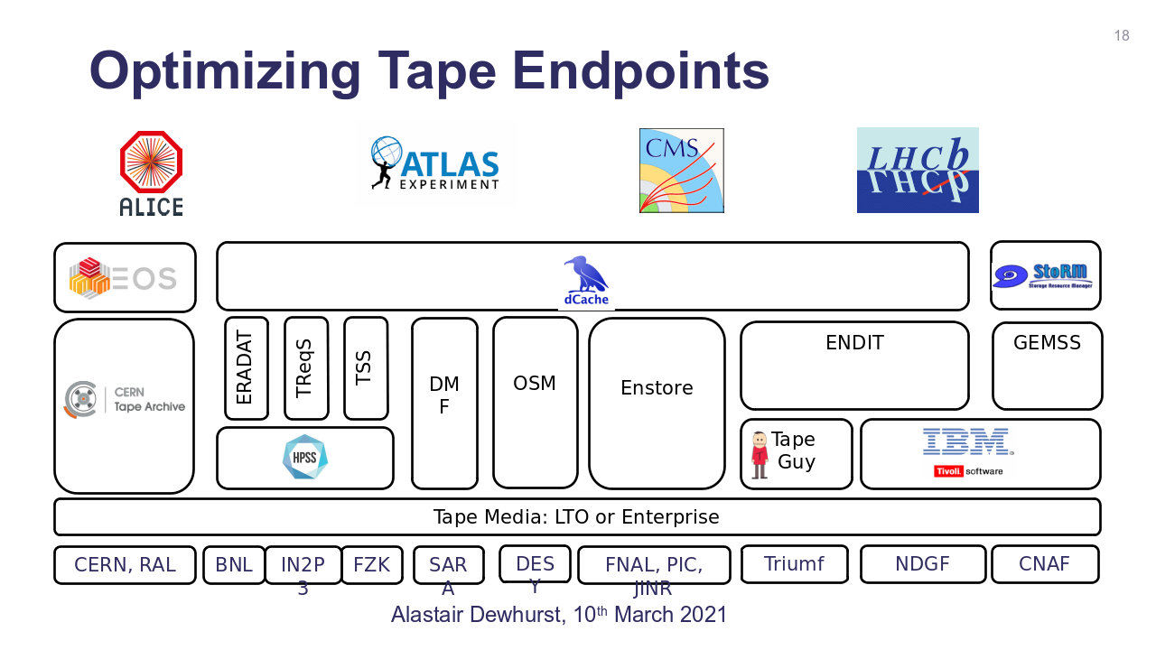
dCache <=> CTA

Slide 27
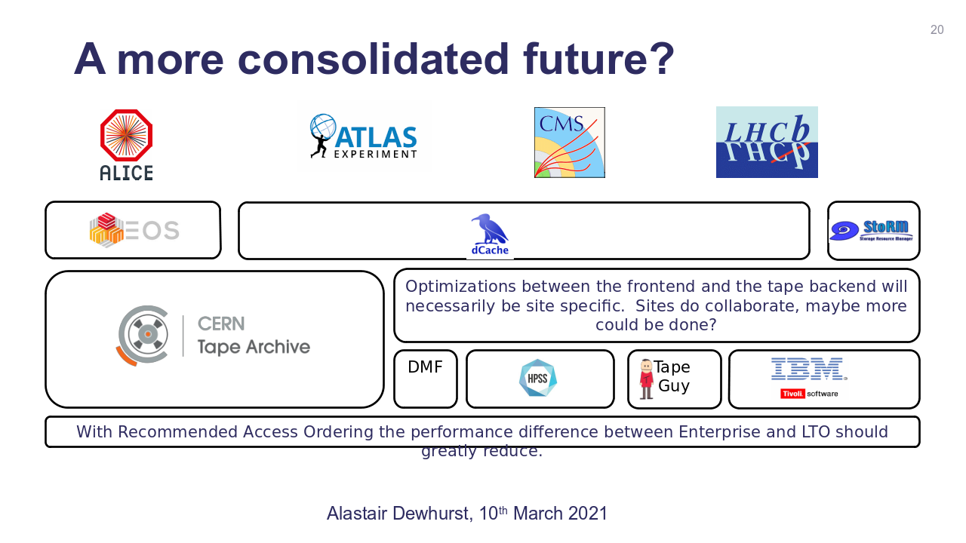
dCache <=> CTA

Slide 28
Integration with Keycloak

Slide 29
Cloud Integration

Slide 30
Tokens
&
IdP Federation

Slide 31
Storage Resource Reporting
(aka SRR)

Slide 32
SRR Problem Statement
"storageshares" : [
{
"name" : "dirA",
"path" : [ "/data/dirA" ],
"totalsize" : 500TB,
"usedsize" : 0,
"vos" : [ "foo" ]
}

Slide 33
SRR Problem Statement
Directory | Available space
/data/dirA | 500 TB
/data/dirB | 500 TB
/data/dirC | 500 TB
Total: | 1.5 PB
/data/dirA
/data/dirB
/data/dirC
500 TB

Slide 34
SRR Solution(?)
Share | Available space
data | 500 TB
/data/dirA
/data/dirB
P-Group: data
/data/dirC
500 TB

Slide 35
SRR Solution(?)
"storageshares" : [
{
"name" : "data",
"totalsize" : 500TB,
"usedsize" : 0,
"vos" : [ "foo" ]
}

Slide 36
SRR Solution(?)
[srrDomain]
[srr/frontend]
frontend.authn.basic=true
frontend.authn.protocol=http
frontend.authz.anonymous-operations=READONLY
frontend.srr.shares=data:/vo1,data:/vo2,archive:/vo1

Slide 37
Tokens

Slide 38
Activities
Globus-online
iRODS

Slide 39
Large Deployments
EuXFEL

Slide 40
Tape Activities
Small-file Aggregation (Sapphire)
ATLAS-Tape Carousel
Integration with CTA

Slide 41
Bulk Service
Design
Impact on WLCG

Slide 42
QoS and Resilience service

Slide 43
TPC

Slide 44
Future Directions

Slide 45
Inter-disciplinary Storage

