Slide 1
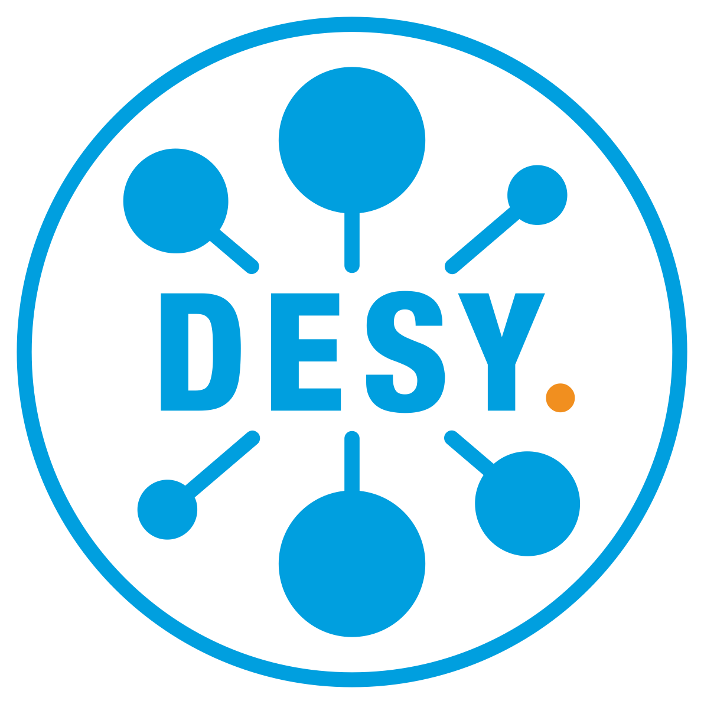


dCache & xroot
TLS, Tokens, Login Protection
Albert L. Rossi (FNAL)
Notes:
Some of this material was presented at the last workshop, but we thought it would be worthwhile to repeat it with updates.

Slide 2
What's new in 2020-2021
TLS in xroot doors and pools (since 6.2)
SciToken support (since 6.2)
NB: not guaranteed to work for third-party copy (TPC). Pending discussion with the SLAC xrootd development team.
Login protection ['ZTN'] (since 7.1)
NB: not guaranteed to work for third-party copy (TPC). Pending discussion with the SLAC xrootd development team.
Notes:
We introduced TLS and SciToken support last spring. There was a lot of work coordinating this with the SLAC development team (and a lot of co-debugging, too). I am grateful to Andy Hanushevsky and Michal Simon for all their help and cooperation.
One thing that still needs to be worked out is how tokens will play out in third-party copy for the pure xroot protocol. I have provisionally tested TPC with tokens and ZTN in strictly dCache to dCache transfers, but the way tokens are managed in that scenario is ad hoc. It is the token obtaining and provisioning that is still up in the air, and we will probably need to make further adjustments as that finally gets hammered out.

Slide 3
dCache xroot: TLS
Should be preferred to signed hash verification (more secure, standard).
Can be enabled for both doors and pools.
CAVEAT: must be enabled to protect tokens (pools included!)
Notes:
Just to remind you. Xroot(d) was originally a protocol not meant for wide area traffic. Since the idea was to do data transfers behind protected networks, it was not urgent to encrypt the session. As time went on, some centers did want to use xroot over a WAN, so a compromise solution –– signed hash verification, using request hashes encrypted with the session key from the Diffie Hellman handshake –– was put in place. This was extended (by me) to third-party copy.
Signed hash verification is not standard and is less secure because the read/write data is not actually included in the hash (and not encrypted to the pools).
TLS should for all intents and purposes replace this.

Slide 4
dCache xroot: TLS
TWO PARTY: dCache does not require token to log in to the pool (uses UUID);
— BUT—
Unfortunately, the token is currently exchanged as part of the URL query included on the transfer path, and the xrootd client sends this to the pool on redirect;
— SO —
If you are using Scitokens, TLS must be activated on both doors and pools.
(dCache has never implemented splitting control from data channels in xroot; we are currently investigating whether the amount of work necessary to do so would be justified.)
Notes:
If you are using tokens, TLS must be enabled on the pools.
This would not be necessary if the xrdcp client removed the token from the URL query when TLS is not requested by the source on redirect. But I don't believe this will happen, because the policy has been for the client not to modify what is referred to as the "CGI" parameters on the URL (it's supposed to be dark data).
There is also the possibility of splitting control and data channels (we have never done this in xroot); but that still wouldn't solve this problem, because the token would still be sent on the control channel and thus require initial TLS even if protection were turned off for the data channel.

Slide 5
xrootd.security.tls and the xrootd protocol
OPTIONAL
STRICT
Protocol (handshake)
require-login
Login + Authn
require-session
Session
require-data
Data
OK if client does
not support TLS
FAIL if client does
not support TLS
Notes:
A version of this diagram appeared in last year's slides. On the right is depicted the xroot protocol sequence of requests (protocol, login, authentication, session). The 'require' properties in dCache control when the TLS handshake takes place. This becomes important in terms of what needs to be protected. I will discuss this a bit further in a moment.
Finally, TLS can be OFF, OPTIONAL or STRICT on both the doors and the pools.

Slide 6
TLS Best Practice (doors)
EXAMPLE FOR DOOR using token authorization
[xrootd-1096-${host.name}Domain]
[xrootd-1096-${host.name}Domain/xrootd]
xrootd.cell.name=xrootd-1096-${host.name}
xrootd.net.port=1096
xrootd.authz.write-paths=/ THESE PATHS DEPEND ON HOW YOU SET UP SCITOKENS
xrootd.authz.read-paths=/
xrootd.security.tls.mode=STRICT DO NOT ALLOW CLIENTS WHICH DON'T SUPPORT TLS
xrootd.security.tls.require-login=true BEGIN THE HANDSHAKE AT LOGIN (TOKEN IS EXCHANGED LATER) xrootd.plugins=gplazma:none,authz:scitokens NO AUTHN MODULE IS NECESSARY; SCITOKENS IS AUTHZ
xrootd.plugin!scitokens.strict=true DO NO AUTHORIZE WITHOUT A TOKEN (NO FALLBACK TO ANONYMOUS)
IT IS NOT STRICTLY NECESSARY TO START TLS AT LOGIN, SINCE THE TOKEN IS EXCHANGED DURING THE FILE OPEN REQUEST; HOWEVER, WITH LOGIN PROTECTION (SEE LATER) THIS IS NECESSARY.
IF YOU ARE USING TLS JUST TO PROTECT THE SESSION/DATA, BUT THE AUTHORIZATION PROTOCOL IS, E.G., GSI, YOU HAVE THE OPTION OF SETTING TLS TO BEGIN AFTER THE AUTHN HANDSHAKE ('session') (see next slide).
xrootd.security.tls.require-session=true
xrootd.plugins=gplazma:gsi,authz:none
Notes:
This example for token authorization turns on TLS at login. As indicated by the arrow on the slide, this is not strictly necessary (one could start it just after login/authentication, at session), but if you decide to enable login protection, then the require-login property should be set to true.
In general, I would say that whenever tokens are used, start TLS at login.
If, on the other hand, you are just interested in protecting the session data but are using GSI to authenticate, then don't turn it on until session; otherwise you will be unnecessarily doubly-encrypting everything during the authentication handshake.

Slide 7
TLS Rule of thumb
GSI
mode = OPTIONAL
required-session=true
SciTokens
mode = STRICT (doors)
required-login=true
Notes:
A recapitulation of what I just stated as a simple rule of thumb, GSI vs tokens.
For SciTokens, the mode on the pools depends on whether your system will require TLS capability from all xrootd clients or not (in other words, are there xroot doors accessing those pools that do not require TLS).

Slide 8
TLS Best Practice (pools)
EXAMPLE FOR POOL using token authorization
I recommend setting these globally in the dcache.conf file, to avoid a misconfiguration allowing an xroot door to redirect to a pool that does not support TLS.
pool.mover.xrootd.security.tls.mode=OPTIONAL OR = STRICT, IF ALL CLIENTS ARE GUARANTEED TO BE TLS CAPABLE
pool.mover.xrootd.security.tls.require-login=true AGAIN, 'LOGIN' NOT STRICTLY NECESSARY EXCEPT WHEN USING ZTN
There are other properties having to do with TLS in xroot, but these are set to reasonable defaults and can usually be left alone.
NOTE: we have refactored 7.2 to use a somewhat more efficient SSL encryption (native pass-through rather than the Java implementation) which should give us a little better performance.
Notes:
The easiest way to set up the pools is to define the mode and require properties globally. However, this may not fit all situations. A careful review of the poolmanager configuration should be made in that case to ensure that you are not redirecting clients from xroot doors where TLS is OFF or OPTIONAL to pools where it is STRICT; if you do, you risk allowing a client to connect to a door but then fail on redirect.
Enabling TLS on the pools of course means the data will be encrypted; but in 7.2 we have refitted dCache to use the native SSL pass-through; this gives us some performance gain. As previously mentioned, possible future work may involve splitting off the data channel and making TLS on it optional (this is provided for by the xroot protocol).

Slide 9
SciTokens configuration
GPLAZMA
This is the same for both xroot and https. In gplazma.conf, add
auth sufficient scitoken
In addition, you will need to define properties for issuers and audience-targets.
Be sure that the root paths on the issuers correspond to the read/write paths set your doors.
gplazma.scitoken.issuer!TEST = https://demo.scitokens.org / org.dcache.auth.UserNamePrincipal:arossi uid:8773
gplazma.scitoken.audience-targets = https://demo.scitokens.org
EXAMPLE XRDCP READ WITH SCITOKEN
xrdcp -f xroot://fndcatemp2.fnal.gov:1096//pnfs/fs/usr/test/data_100mb?authz=Bearer%20<encoded-token> /dev/null
Notes:
SciTokens are configured the same way for both https and xroot.
To use them with xrdcp or xrdfs, you need to include the CGI (query parameter) "authz=Bearer%20<base64 hash>" on the path.

Slide 10
Login protection (ZTN)
This is a login protocol assuring the server that the client is capable of obtaining a legitimate token.
Though it was not strictly necessary for dCache to implement this, we did so simply to conform to the xroot protocol specification.
In essence, a minimal token specifying issuer and audience (sub and scope are not required here) is passed in at login and if the server recognizes these as valid, the user is allowed to continue.
This token is meant as a single use throw-away, and is not treated as fallback for the authorization token to be passed on the request URL.
Notes:
There was concern at SLAC that users would be able to do requests not involving a path without any kind of authentication (since the token is passed on the URL path). So some sort of token-based authentication at login was desirable for them.
Now dCache provides for either allowing or blocking anonymous users on the xroot door, but we thought it best to make this protocol available as well.
A full SciToken can be used for this purpose, but minimally the token should express an issuer and audience.
This token is *not* used to authorize the user in the absence of the SciToken included in the query of the URL.

Slide 11
Login protection (ZTN)
For the xroot client, this login token can be made available by setting the env variable for file location:
BEARER_TOKEN_FILE=/tmp/bt_u8773
ZTN can be enabled on the doors.
xrootd.plugins=gplazma:ztn,authz:scitokens ON THE DOORS, IT IS A GPLAZMA AUTHN MODULE
There is also a module available for the embedded third-party client on the pools, enabled as usual using:
pool.mover.xrootd.tpc-authn-plugins=gsi,unix,ztn
BUT AS MENTIONED EARLIER, HOW THIS WILL WORK WITH TPC IS YET TO BE ESTABLISHED.
Notes:
There is a bit more protection offered by turning this protocol on, and there is no drawback.
How it will work with TPC, however, just as for SciTokens themselves, has not been decided.
(In the dCache prototype currently part of 7.2, I have allowed the embedded TPC client to use the SciToken it received from the door to authenticate at login against a source server requiring ZTN, but this model is undoubtedly limited and may very well be deemed incorrect).

Slide 12
Login protection (ZTN)
Since ZTN is a kind of sub-protocol based on the SciToken specification, to enable it, you must prepare gPlazma as you would to use Scitoken authorization. It would not make much sense, in fact, to use ZTN without enabling SciTokens.
Once again, there are several other properties available for configuration (which reflect attributes or settings specified by the xroot protocol), but these can usually be left alone.
Notes:
You can read a bit further about ZTN in the properties file. A short section on it will be added to the 7.2 Book.

Slide 13
Further Information
dCache, The Book, Chapter on Xrootd, gPlazma
https://dcache.org/old/manuals/Book-7.2/config-xrootd.shtml
https://dcache.org/old/manuals/Book-7.2/config-gplazma.shtml
Documentation in defaults:
pools.properties
xrootd.properties
xrootd-scitoken.properties
xrootd-ztn.properties
Notes:
QUESTIONS?

