Slide 1



The Bulk Service Version 2
and WLCG TAPE API support
Albert L. Rossi (FNAL)
Notes:
Today I want to speak a bit about work on the dCache Bulk service and also about its support for the WLCG tape API. I will conclude with a demo of the REST API.

Slide 2
The dCache Bulk Service (version 2)
The Bulk service was
introduced in 6.2 as a prototype;
intended to add processing of multiple targets to the nascent Tape API making it similar to SRM;
discovered to have a number of issues suggesting it would not scale as written.
Notes:
The Bulk service has actually been in the dCache code base since we released 6.2; we just didn't trumpet its presence largely because we felt it was still a prototype in need of more testing. And indeed, when we finally got around to it, we discovered that the first design had some flaws which did not make it fit for production. This was revealed late last year, so the first order of business this year was to make the service more robust.

Slide 3
The dCache Bulk Service (version 2)
The redesign aims were:
better horizontal scaling;
more reliable persistence of requests and idempotent restarts;
more efficient processing of low latency requests like deletion.
Only internals of the Bulk service proper were affected.
The original REST API for submitting requests remains unmodified (though we also changed it to accept attributes expressed in any of the three forms––camelCase, snake_case, kebab-case).
Notes:
I experimented with two different approaches, one similar to how the QoS verifier works internally (with the request broken up into single targets which are queued and dequeued individually for processing) and one similar to how SRM works ("containers" responsible for an entire request). After extensive testing it was decided that the second offered the most advantages. (Perhaps that is fitting, given Bulk is the intended successor of SRM for the staging functionality.) I also gave the Bulk service full persistent database support, which, among other things, enabled leaving completed targets untouched on unfinished requests when the service is restarted. The original API is unchanged (except for the addition of two attributes: on POST, prestore, which, time permitting, I will illustrate later, and an offset parameter on GET for paging large requests).

Slide 4
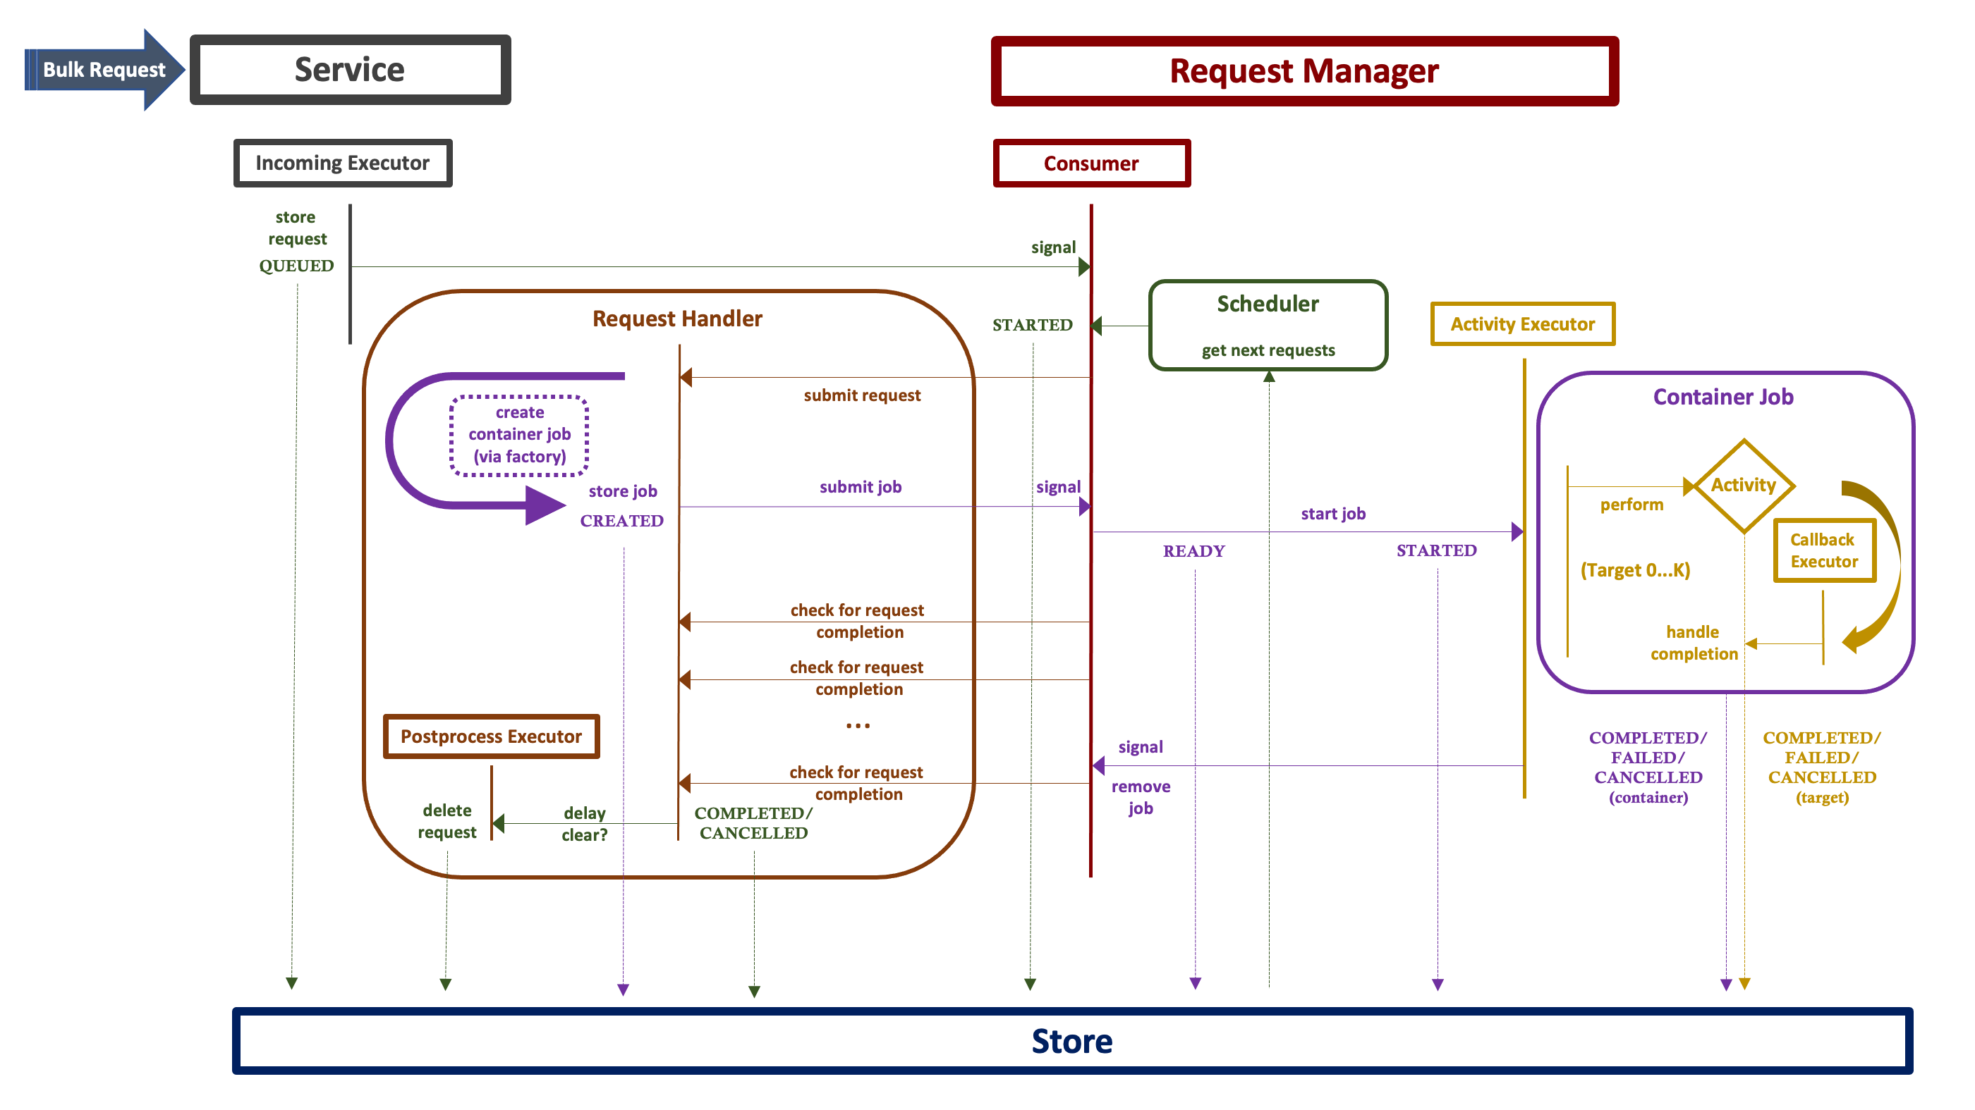
Bulk Request Handling (Submit)
Service receives request message.
Service stores unprocessed request, signals manager.
Consumer retrieves next requests from scheduler.
Request submitted to handler, which creates and stores container job.
Job submitted to manager, which launches it using the activity's thread executor.
Job processes request targets by:
expanding directories (if indicated);
pre-storing targets (if indicated);
performing activity;
processing completion as callback;
storing and/or updating.
Consumer removes completed job from queue.
Consumer checks and updates state of requests. If clear is indicated, deletes request.
Delayed clear is processed (if indicated).
Notes:
This slide is just a demonstration of how a request is processed inside the service. Upon receipt (1) the request is stored (2) and the manager is signaled; the manager uses the scheduler (3) to retrieve the next eligible requests to run. A new request is processed into a container job (4) and then launched by the manager (5); the job is responsible for (6) expansion of directories if recursion is indicated, storing, processing, post-processing and updating each of the targets. When the entire job completes (7) it is removed from the manager queue, and the request itself is updated (8) and optionally cleared from the store either immediately or (9) after the indicated delay.

Slide 5
WLCG Tape REST API
Common interface to
manage disk residency of tape-stored files;
observe the progress of files as they are written to tape.
Implementation-agnostic for tape-backed storage systems in WLCG (dCache, StoRM or EOS+CTA).
Document:
https://docs.google.com/document/d/1Zx_H5dRkQRfju3xIYZ2WgjKoOvmLtsafP2pKGpHqcfY
Notes:
Over the course of 2021, a WLCG working group met regularly to hash out the protocol for a common REST API that would handle staging and the monitoring of tape writes. The inspiration for this was actually dCache's API for the Bulk service. The specification document has now been finalized. THE EOS+CTA implementation I believe is in place, and StoRM is forthcoming.

Slide 6
dCache Implementation
REST resource endpoints:
a) General Bulk requests
https://example.org:3880/api/v1/bulk-requests
b) WLCG TAPE
https://example.org:3880/api/v1/stage
https://example.org:3880/api/v1/release
https://example.org:3880/api/v1/archiveinfo
All are supported by the Bulk service with the exception of archiveinfo, which is implemented in the Frontend service itself.
Notes:
For dCache, implementation of this specific API is layered over the Bulk service. The API is parallel to, but more specific than, the original bulk-request API. One of the WLCG resources, archiveinfo, does not really constitute a bulk operation (it is similar to active transfers or restores, which simply gather information either periodically or on request, from the namespace, Pool Manager and pools), so this resource has likewise been implemented directly in the Frontend service.

Slide 7
RESTful Resource Features
BULK REQUESTS options | WLCG TAPE
cancelOnFailure | FALSE
Cancel request preemptively on first failure.
clearOnFailure | FALSE
Remove request from storage if any targets failed.
clearOnSuccess | FALSE
Remove request from storage if all targets succeeded.
delayClear | UNDEF
Wait in seconds before clearing (one of the clear options
must be true for this to have effect). Defaults to 0.
expandDirectories | NONE
NONE = do not expand directories; TARGETS = shallow
expansion of directories (only take action on its targets
with no further expansion); ALL = full recursion.
Recursion is done depth-first. Defaults to NONE.
prestore | TRUE
Store all targets first before performing the activity on
them. (This applies to recursive as well as non-recursive,
and usually results in significantly lower throughput.)
Notes:
The original API exposes some options which are not relevant to the WLCG TAPE API. This table describes them: options for clearing and canceling the submitted request, for recursion (WLCG requires flat file lists only), and for storing all targets in the database before acting on them, rather than storing them on the fly. Skipping prestorage will significantly increase throughput for low-latency activities like deletion.

Slide 8
RESTful API: Bulk vs WLCG
 |  | BULK | WLCG TAPE
POST* | Pin | api/v1/bulk-requests | N/A
 |  | {"activity":"PIN","arguments":{"lifetime":"1","lifetimeUnit": "DAYS","id":"<id>"},"target":["path",...]}
POST* | Stage to disk | api/v1/bulk-requests | api/v1/stage
 |  | {"activity":"PIN","arguments":{"lifetime":"1","lifetimeUnit": "DAYS","id":"<id>"},"target":["path",...]} | {"files": ["diskLifetime":"P1D","path",...]} (diskLifetime is ISO 8601)
POST* | Unpin | api/v1/bulk-requests | N/A
 |  | {"activity":"UNPIN","arguments":{"id":"<request_id>"}, "target": ["path",...]}
POST | Release | api/v1/bulk-requests | api/v1/release/<request_id>
 |  | {"activity":"UNPIN","arguments":{"id":"<request_id>"}, "target": ["path",...]} | {"paths":["path",...]}
POST* | Change file QoS | api/v1/bulk-requests | N/A
 |  | {"activity":"UPDATE_QOS","arguments":{"targetQos": "<new qos>"},"target":["path",...]}
POST* | Delete | api/v1/bulk-requests | N/A
 |  | {"activity":"DELETE","arguments":{"skipDirs":"<true/false>"}, "target":["path",...]}
(*) The request id is returned with the response.
Notes:
Comparing the two REST APIs, you will notice that there is some redundancy. The PIN activity, for instance, can be used simply to pin files that are already on disk (but will result, according to normal dCache semantics, in the staging of a CUSTODIAL file if it is not on disk). The WLCG API does not have the concept of "pinning" (this is implementation specific), though the specification allows optionally for a disk lifetime to be expressed on the STAGE request. RELEASE similarly means the storage element is free to clean up the disk resources however it sees fit. Notice that the bulk-resources API also includes two activities not relevant to WLCG TAPE (and it is pluggable, so others can be added if the need arises): mass file deletion and QoS transitions (and as a reminder: QoS transitions are heavier than just staging/pinning: they alter the namespace attributes of the file and currently do not expire ... though that may change in the future).

Slide 9
RESTful API: Bulk vs WLCG
To clarify:
Both api/v1/bulk-requests with "activity":"PIN" and api/v1/stage result in the submission of the same kind of request to the bulk service; similarly for api/v1/bulk-requests with "activity":"UNPIN" and api/v1/release, though there are some differences in the JSON content description required.
UNPIN accepts a request for arbitrary files (unpinning all user pins) as well as a specific request id; RELEASE requires the request id.
Notes:
So, to repeat: in dCache both PIN and STAGE are translated into the same kind of Bulk request, as are UNPIN and RELEASE, though the latter requires a specific request id whereas UNPIN does not. Furthermore, if you examine what happens using the admin interface, you will also see that RELEASE is not registered as a new request (it is ephemeral), since it is bound to an existing one, whereas UNPIN does register as a new request.

Slide 10
RESTful API: Bulk vs WLCG
 |  | BULK | WLCG TAPE
PATCH • POST | Cancel | api/v1/bulk-requests/<request_id> | api/v1/stage/<request_id>/cancel
 |  | {"action":"CANCEL","paths":["<path>",...]} | {"paths":["<path>",...]}
 |  | If "paths" is undefined, the entire request is cancelled. | "paths" is required.
DELETE | Clear request | api/v1/bulk-requests/<request_id> | api/v1/stage/<request_id>
 |  | Will fail if request is running. | Will cancel the entire request first if running.
GET | Requests of user | api/v1/bulk-requests | N/A
 |  | ?status=<QUEUED|STARTED|COMPLETED|CANCELLED>[,...]>
GET | Request info | api/v1/bulk-requests/<request_id> | api/v1/stage/<request_id>
 |  | ?offset=<next_seq_no> | Automatically appends by paging to last offset.
POST | File locality info | N/A | api/v1/archiveinfo
 |  |  | {"paths":["<path>,...]}
NB: the paths given to archiveinfo need not belong to a single (or any) request.
Notes:
Several other points of comparison to note. For the bulk-requests API, cancellation is done via PATCH with a "CANCEL" action and an optional set of paths. If there are no paths, the entire request is cancelled. STAGE cancel, on the other hand, is a POST request and requires a specific set of paths. Similarly, the clear request for the bulk-requests API (DELETE) will fail if the request has not been cancelled previously, whereas DELETE for STAGE will atomically cancel the entire request and then delete it. These differences are simply the result of how the two specifications for the API were decided upon. Note, however, that the bulk-requests PATCH cancel has the advantage of not automatically clearing the request, should inspection be desirable. The Bulk API also allows the user via GET on the bulk-requests resource to retrieve all its requests currently stored in the service.

Slide 11
RESTful API: Bulk vs WLCG
NB: The JSON returned for the GET differs somewhat:
Bulk Request
WLCG Stage Request
{
"nextSeqNo" : 6933633,
"id" : "0f8f4102-47f1-4b0a-aeda-e40280c2a769",
"arrivedAt" : 1652712101542,
"startedAt" : 1652712101551,
"lastModified" : 1652712369571,
"status" : "COMPLETED",
"targets" : [ {
"target" : "/pnfs/fs/usr/fermilab/users/arossi/volatile/000/data-2022050912561652118976111376885",
"state" : "COMPLETED",
"submittedAt" : 1652712101670,
"startedAt" : 1652712101670,
"finishedAt" : 1652712101672,
"seqNo" : 6923634
}, {
...
]}
{
"id" : "0f8f4102-47f1-4b0a-aeda-e40280c2a769",
"createdAt" : 1652712101542,
"startedAt" : 1652712101551,
"completedAt" : 1652712369571,
"files" : [ {
"path" : "/pnfs/fs/usr/fermilab/users/arossi/volatile/000/data-2022050912561652118976111376885",
"finishedAt" : 1652712101672,
"startedAt" : 1652712101670,
"state" : "COMPLETED"
}, {
...
]}
Notes:
Another CAVEAT: the request info JSON returned for the bulk-requests API uses different attribute names from what is returned for the WLCG API. The former also includes the "next sequence/offset" number because it is paged (max 10K at a time). Since paging is not specified for WLCG (I believe the practical limit on the flat lists entertained by FTS is 10K), our front end will automatically do any necessary paging and merge the entire result into one response for STAGE GET.

Slide 12
RESTful API: WLCG
The JSON returned for archiveinfo:
[
{"path":"/pnfs/fs/usr/fermilab/users/arossi/tape/517/data-2022050917421652136176137601559","locality":"TAPE"},
{"path":"/pnfs/fs/usr/fermilab/users/arossi/tape/510/data-2022051219311652401861325827866","locality":"TAPE"},
{"path":"/pnfs/fs/usr/fermilab/users/arossi/tape/512/data-2022051300251652419526637081982","locality":"TAPE"},
{"path":"/pnfs/fs/usr/fermilab/users/arossi/tape/512/data-2022051221371652409448251487828","locality":"TAPE"},
{"path":"/pnfs/fs/usr/fermilab/users/arossi/tape/476/data-2022051011361652200575341189653","locality":"DISK_AND_TAPE"},
{"path":"/pnfs/fs/usr/fermilab/users/arossi/tape/498/data-2022050909371652107023763065121","locality":"TAPE"},
{"path":"/pnfs/fs/usr/fermilab/users/arossi/tape/466/data-2022050915191652127595270638001","locality":"DISK_AND_TAPE"},
...
]
Notes:
Note that the locality enum corresponds to the familiar SRM DISK, TAPE, DISK_AND_TAPE, LOST, NONE, and UNAVAILABLE.

Slide 13
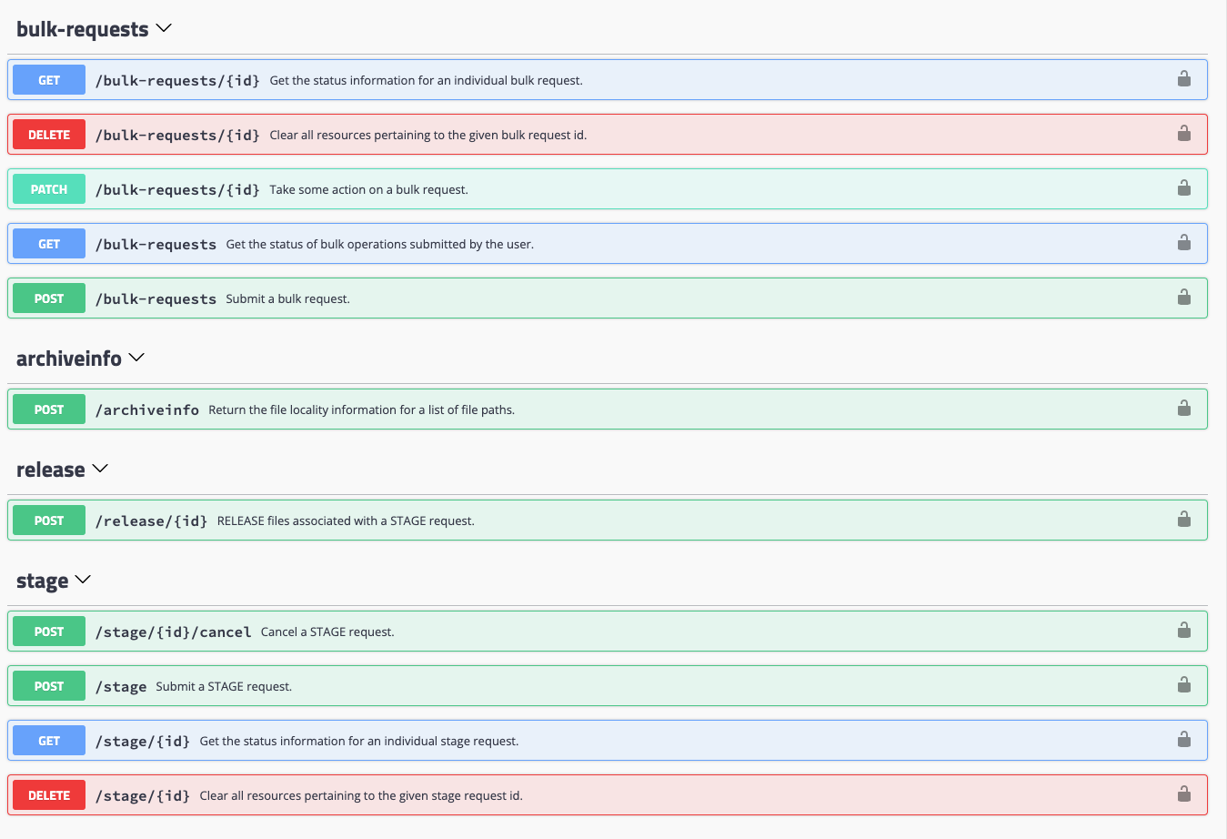
RESTful API: Swagger
https://example.org:3880/api/v1
Notes:
The swagger page is useful to familiarize yourself with the APIs. I would recommend having a look (and also making suggestions as to what information you might feel is missing there).

Slide 14
Bulk/QoS
Refactored Resilience service, called QoS, available in 8.1.
Bulk version 2 (8.2), will communicate with this new service.
See QoS service documentation (The Book) for its design and features.
Bulk QoS updates (UPDATE_QOS) try to maximize throughput to the Pin Manager in order to take advantage of future tape recall optimization.
(Similarly for Bulk STAGE/PIN requests, without the extra hop through an intermediate service like QoS.)
Notes:
A quick look at Bulk QoS transitions. The QoS engine which I presented last year is now in the code base beginning with dCache 8.1. With version 2, the Bulk QoS activity will communicate with that service. Both Bulk and QoS make a best effort to push as many file paths to Pin Manager (when pinning/staging) as is reasonable, in order to take advantage of the tape recall algorithms Lea has implemented and which are being moved from SRM to Pin Manager. The limit is determined by a semaphore for the PIN, STAGE and QoS activities which can be configured using batch.properties. It defaults to 10000.

Slide 15
Bulk/QoS Configuration
Documentation:
See properties files for the various limits which can be adjusted for both.
The Book is also being updated (QoS is done, Bulk will go in with 8.2).
Both services can be run out of the box.
NOTE
There is no requirement to run QoS, especially if you have not been using the Resilience service. Bulk and QoS are independent, though Bulk uses the latter to request QoS transitions.
Notes:
Several bulk properties having to do with user-facing policies, however, can be directly reconfigured via an admin command without domain restart (I will return to them shortly). Note that Bulk and QoS are independent services. If you do not currently run Resilience or do not think you will have need of supporting QoS transitions, you need not run the latter at all.

Slide 16
Example Bulk/QoS Configuration
Bulk Service
Before startup (first time):
createdb -U <user> bulk
Layout:
[bulkDomain]
dcache.java.memory.heap=4096m [bulkDomain/bulk]
bulk.allowed-directory-expansion=ALL
QoS Services
Before startup (first time):
createdb -U <user> qos
Layout:
[qosEDomain]
[qosEDomain/qos-engine]
[qosVDomain]
dcache.java.memory.heap=8384m [qosVDomain/qos-verifier]
[qosSDomain]
[qosSDomain/qos-scanner]
[qosADomain]
dcache.java.memory.heap=4096m [qosADomain/qos-adjuster]
see next slide
Notes:
Both Bulk and QoS require database tables. As usual, before the first startup, create the tables (e.g., using the Postgres createdb command as indicated). Liquibase takes care of the rest. We suggest separate domains for Bulk and the four QoS components, but the latter can all be run in the same domain, provided enough memory is allocated. (Memory allocations for QoS are reduced in comparison with Resilience because of the database). There is also a single cell QoS option which eliminates message passing between components (please consult the Book for more details).

Slide 17
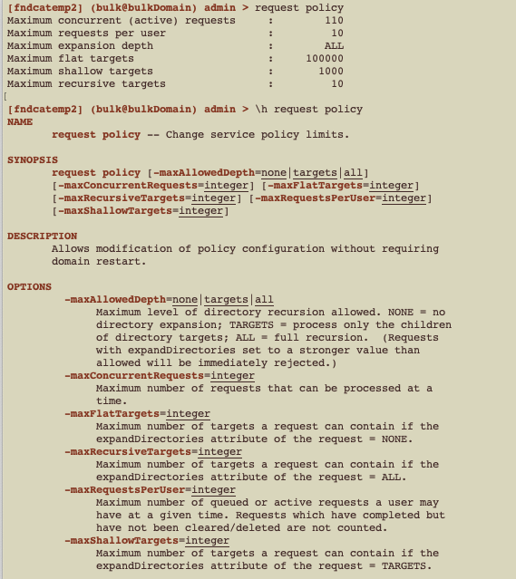
Bulk: Some Properties to Note
# ---- Global setting for directory expansion. # # NONE: do not allow any processing of targets inside a directory (depth 0) # TARGETS: allow only the immediate children of directories to be processed (depth 1) # ALL: allow full recursive processing of directories (depth N) # (one-of?NONE|TARGETS|ALL)bulk.allowed-directory-expansion=TARGETS
# ---- Prevents users from monopolizing the service. # The limit is in terms of the number of submitted requests # which have not yet completed (but not necessarily cleared). # bulk.limits.max-requests-per-user=10 # ---- The maximum number of unexpanded targets which can appear in the bulk request list. # when request expansion is set to NONE. # bulk.limits.max.targets-per-flat-request=100000 # ---- The maximum number of unexpanded targets which can appear in the bulk request list. # when request expansion is set to TARGETS. # bulk.limits.max.targets-per-shallow-request=1000 # ---- The maximum number of unexpanded targets which can appear in the bulk request list. # when request expansion is set to ALL. # bulk.limits.max.targets-per-recursive-request=10
All of these can be controlled by an admin command:
Notes:
These are the user facing properties I mentioned. If you do not want users attempting to do recursive operations at all, this can be globally turned off by the first property. The default is TARGETS, which means directories that figure in the request paths list can be processed in a shallow manner – 1 level down only. With this setting, NONE and TARGETS are permitted, but requests indicating ALL will fail. You can also set the number of requests a user is allowed to have running at a given time (10 is the default; I have no current experience as to whether this is low or high; if you find this default ought to be changed, feel free to make a suggestion on GitHub or User Forum.) The number of targets is also somewhat arbitrary. Once people start using this service we may also adjust these.

Slide 18
REST API Demo
Thank you for your attention.
Questions? ...
Notes:
I would now like to spend the rest of my time demo'ing the APIs. I will be showing the CURL/REST commands but will also use the admin interface to show some information that is only available there.

