Slide 1
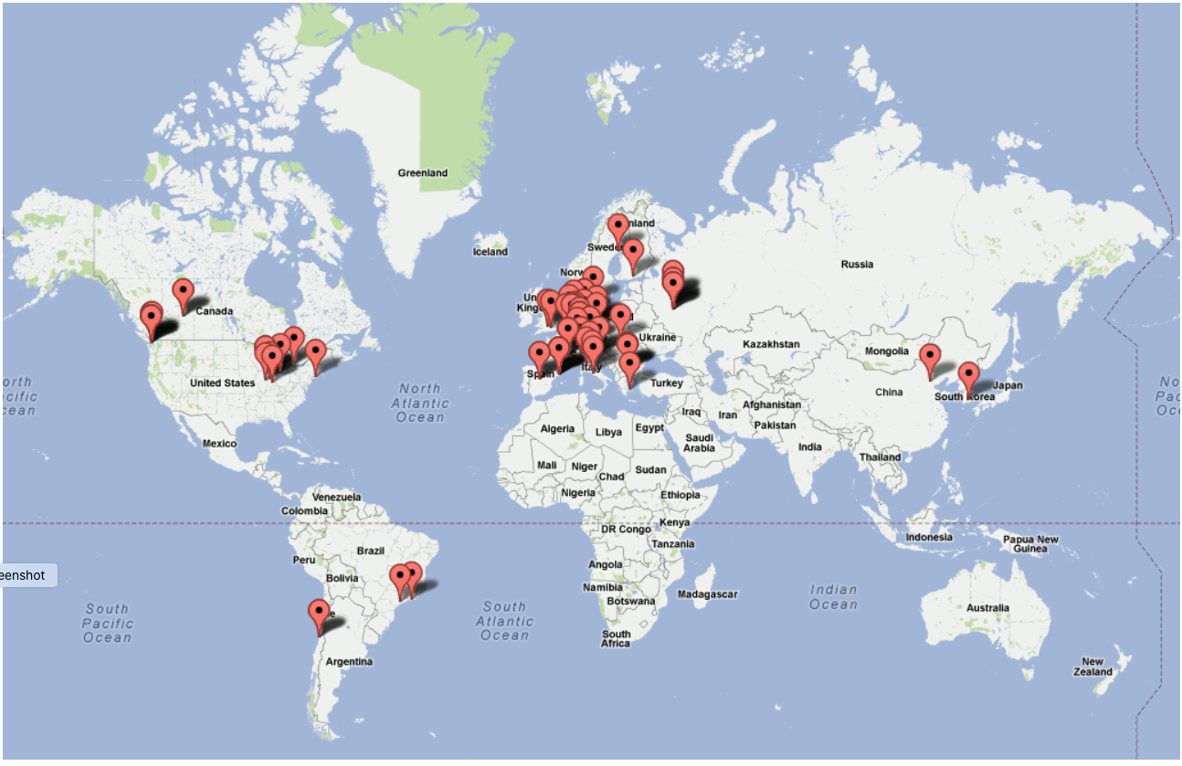



The dCache Implementation
of the Xroot Protocol
Albert L. Rossi (FNAL)
Notes:
I would like to thank Andy for inviting me to give this presentation today. My intention is modest: it is simply to familiarize you with how dCache support for the XrootD protocol has evolved (at least in my hands). I will also point at the end to what is currently missing in dCache.
I have been working on Xroot development in dCache since 2018, but dCache has supported Root/Xroot long before that. I won't go into the earliest period since my understanding of those details is indirect, but I can say that, from the outset, inclusion of the Xroot protocol was driven by the demand of our users, and this continues to drive further development.

Slide 2
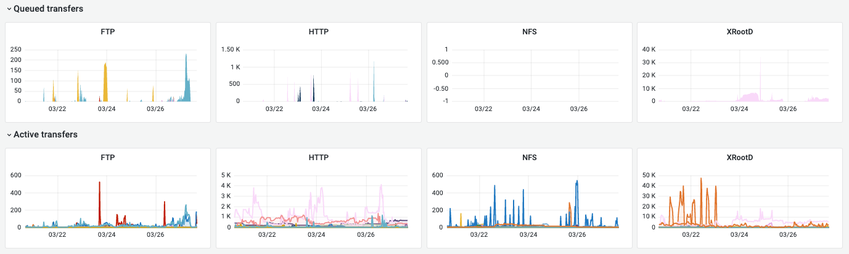
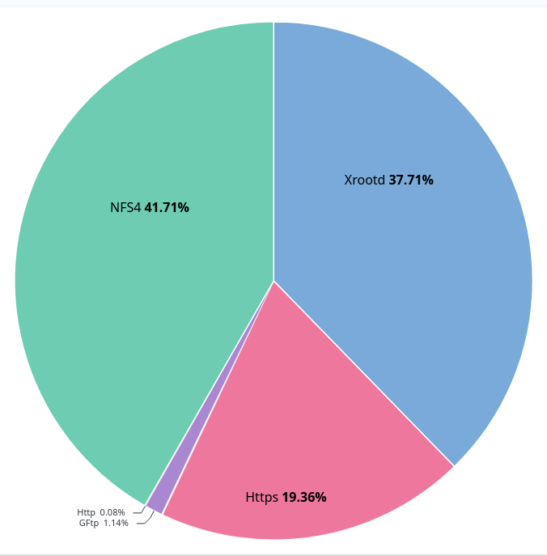
dCache xroot protocol usage
FNAL Public dCache all experiments, 7 days ending 28/03/2023
DESY all experiments, 7 days ending 28/03/2023
Notes:
As you can see from these two examples, Xroot accounts for a fairly sizable portion of dCache usage at both DESY and actually dominates FNAL’s Public dCache System.

Slide 3

dCache on one slide
JVM
JVM
JVM
Message passing layer
Pool
Manager
Pools
Door
Namespace
xroot
http
DBMS
nfs
Notes:
This is just a quick overview of dCache for those unfamiliar with its architecture, and a quick reminder for those already familiar with it.
1. Everything runs in Java virtual machine containers which dCache calls domains; there can be arbitrarily many.
2. Components in those domains (or cells) constitute services which communicate with each other via a messaging layer.
3. Doors are protocol-specific user-entry points.
4. Pools are the data storage nodes; they can be HSM-connected or disk-only; pools support a given protocol via a resident transfer service.
5. The namespace is the filesystem metadata database and provides the POSIX layer.
6. Pool Manager is the "heart" of dCache which selects pools and distributes the data.
To support a protocol such as Xroot, then, one must implement both a door and a transfer service for the pools.

Slide 4
dCache Xroot as XrootD server
Door = server with manager and redirector roles
contacts Pool Manager and receives a pool endpoint for either a read or a write; redirects the client to the pool
requires authentication/authorization (done via communication with a special dCache security service, gPlazma)
Pool = data server
uses a unique id (opaque) generated at the door to identify authorized connections
rejects a connection if the id is invalid or expired
Notes:
Drawing a comparison with the XrootD architecture, we can say that the dCache Xroot door acts as both manager and redirector, while a pool is an Xroot data server.
Authentication and authorization in dCache occur at the door, which contacts a special service called gPlazma. This can be configured using various mapping files according to the needs of the site.
What this means is that if dCache supports x509 credentials or JWT tokens, for instance, the semantics are the same for all doors/protocols.
Since dCache's inception, in order not to effect a second login upon redirection to the pool, the pools do not require full authentication/authorization on their connections, but rather use an internal token to recognize valid transfers; the token is passed as part of the opaque path data.
Grid Pluggable Authorization Manager = gPlazma

Slide 5
dCache Xroot library dependencies
Both the door and pool service are written on top of a Netty layer:
https://netty.io/
- an asynchronous event-driven network application framework for rapid development of maintainable high performance protocol servers & clients; uses Java NIO (Non-Blocking IO) (https://en.wikipedia.org/wiki/Non-blocking_I/O_(Java))
The door and pool service, along with CTA integration, use the xrootd4j library:
https://github.com/dCache/xrootd4j
- maintained by dCache (viz., me for the moment); constitutes all of the xroot protocol implementation in Java which is not specific to dCache (so it has no dCache dependencies)
Notes:
As with most protocol implementations in dCache, the network layer is mediated by the Netty library. This makes the implementation easier to maintain, but does constrain us to read from and write to the network layer in certain ways. Netty also takes advantage of a direct-memory capability in Java which avoids copying between user and kernel space. Connections are largely managed by Netty.
Most of the Java implementation of Xroot is to be found in the xrootd4j library maintained by dCache. The door and pool code in dCache itself implement several handlers that are defined by that library, but the objects which are realizations of the protocol are all in xrootd4j.

Slide 6
dCache Xroot development 2018-2023
Interoperability
dCache Enhancements
Added Third-Party Copy (TPC)
Added GSI TPC proxy management
Expanded Signed Hash Verification
Implemented unix authentication
Regularized error codes/messages
Added checksum CGI handling to door
Added support for tried/rc CGI
Added TLS support to door and pool
Added token authorization support
Added token authentication support (ZTN)
Added query support for TPC on pools
Added support for kXR_fattr, kXR_prefname
Allowed client to reattempt open on pool when I/O stalls
Fixed -P handling: moved upload commit for persist-on-successful-close to the pool
Added authn protocol chaining and multiple (security) protocol door
Changed chunk size to conform with standard (8 MiB) for both server and TPC client
Broke up write into max frame-size chunks
Added ability to proxy transfers through door
Added support for relative paths in URL
Notes:
As one might guess, there are two main categories of code maintenance (aside from fixing regressions) which I have been involved in.
On the one hand, a good deal of effort has been spent on keeping dCache current in terms of relevant protocol changes and new features. I will be going over some of these in a bit more detail momentarily.
On the other, there have been certain areas of dCache-specific functionality which needed improvement or expansion. I will look at the three most important of these a bit later.
In what follows I will try to highlight the more significant implementation challenges I encountered.

Slide 7
Third-Party Copy
Implementation challenges
no dCache xroot stand-alone client
no corresponding objects for request/response types on client-side
had to adjust code to recognize via CGI elements the origin of the connection at the door
had to adjust how file size is determined
had to provide for authentication (next slide)
Notes:
The first task I was given when I started to work on xroot was to add third-party copy capability.
> It would have been a full-time project to implement a full-fledged Java client which one could run as a stand-alone like xrdcopy/xrdcp. Given that the immediate needs dictated the implementation of only that functionality serving TPC, I decided that the easiest route was to create an embedded client that runs in a thread on the destination server (pool) and whose lifetime is coextensive with a single transfer. The client is started during open on the pool and stopped when the transfer completes.
> Prior to this effort, dCache was asymmetrical and did not implement the client-side protocol objects (requests and responses), so those had to be mirrored from the existing server-side versions.
> The door logic had to be adjusted (particularly for the open handler) to accommodate differences between connections from the initiator and those from the TPC client.
> I also soon discovered that one cannot rely upon file size from the initial stat to be passed on to the destination and hence the TPC client, so an extra stat of the source on open in the TPC routine was necessary.
> And of course client-side authentication packages needed to be added.

Slide 8
Changes to GSI
Implementation challenges
GSI package required significant refactoring
Initially, needed to support both local proxies (generated from host certs or distributed as robocerts) and subsequently proxy delegation
Had to rework the implementation of the Diffie-Hellman handshake (as agreed upon)
Notes:
> In terms of GSI (the main protocol at the time), refactoring work was necessary: class hierarchies were changed to support both pre-4.9 and post-4.9 protocols, with the latter accommodating proxy delegation. The appropriate packages are used depending on the version of the connecting client. The support for pre-4.9 clients is still there but could be deprecated in the future when older clients are no longer supported. The code base was in general streamlined, with some new features like the ability to dump the security packets/buckets in binary at the TRACE level (I imitated the xrootd server here).
> For a while (during the WLCG DOMA TPC transition) we had to support the use of robocerts or proxies generated from host certs. This option is still available but I would imagine now largely unused. The delegated proxy in dCache is not stored and fetched from disk but is passed in serialized form from door to pool. The API used in the door was adapted from existing WebDAV code.
> Along the way we encountered some issues with the Diffie-Hellman handshake, particularly what needed to be inside the encrypted buckets. There were also problems with matching what was going on between the Java and C++ security libraries, as well as some Java-specific issues regarding zero-padding of the packets and zeros stripped from the CA cert md5 hash. There were also a couple of signature length issues (P-value) that needed resolution.

Slide 9
Signed Hash Verification (sigver)
Implementation challenges
Was not fully supported by server and there was (obviously) no client-side implementation
An additional problem was getting the xrootd client to turn on sigver to the pool
Required us to implement the xroot "Unix" security protocol
Notes:
Well before TLS, signed hash verification was added, I believe when certain sites were using Xroot over the WAN, in order to provide some minimal protection against man-in-the-middle attacks.
> The dCache door supported this, but only partially. We now also needed to add this to our TPC client.
> One of the dCache-specific problems arising with sigver derives from the fact that login to the pools is unauthenticated. If a site desires sigver protection during data transfer to the pool, however, the client needs to be told to turn it on by the data endpoint. But the client only reacts to this request if it thinks there is an authentication protocol which has been activated.
> Thus we had to create a Unix protocol package to be used by the pool. This was basically a trick (we ignored the Unix credential) used only when the sigver level was > 0. We also had to create a client-side version of the package to be used during TPC. It turns out that this was useful even outside the context of sigver when speaking to an EOS endpoint. Because dCache ignores the Unix credential, it took a couple of iterations to figure out its correct structure so that the Xrootd server end would accept it.

Slide 10
TLS (protocol version 5)
Implementation challenges
Several iterations were necessary to adapt to an evolving specification
Also implemented support in the TPC client for the expect flag
Switched from native Java to Netty implementation of the SSL
Changed returned URL to use hostname instead of IP on redirect to pool (TLS requirement)
Notes:
Sigver is now obviously redundant as TLS should be used instead in most cases.
> Implementing TLS was an interesting process because I tried to adhere as closely as I could to the way things were being done on the XrootD end, and that was something of a moving target for a period of time. On our end, because of the peculiar dCache door/pool interactions, I wrestled a bit with the correct default configurations, to try to reduce the multiplicity of options admins would have to deal with. Understanding how to handle TPC in our environment was also challenging. Final modifications were made to support something like xrootd.tls tpc and to observe the tpc.spr=xroots CGI (the latter resolved some earlier questions about when to turn on TLS in the TPC client).
> The TPC client also sends the expect flags, but the dCache door/pool does not use them.
There were two significant changes to dCache as a consequence of implementing TLS in xroot.
> Instead of using the Java SSL library we switched to Netty's. This gave us the ability to pass through to the native openssl library, giving a modest performance gain. This was applied to other protocols as well.
> Whereas dCache used to return an IP address to the client on redirect to the pool, we switched this to hostname as per the TLS specification.

Slide 11
dCache TLS settings (OPTIONAL, STRICT)
OPTIONAL
STRICT
Protocol (handshake)
require-login
Login + Authn
require-session
Session
require-data
Data
RECENT CHANGE:
=> OFF if client does not support/request TLS
ZTN is not included as possible protocol
Notes:
As a result of implementing a multi-protocol door (which I will return to later), we discovered that a change needed to be made in terms of what we do with clients where TLS is off or unsupported.
Rather than categorically reject the client's connection, we now allow it to try protocols like GSI for which TLS is not required.
This is a friendlier solution for those still using x509 authentication with pre-5 (i.e., pre-TLS) clients (like CMS at the moment) and who find it problematic to update their Xrootd client version.
I will return to this again.

Slide 12
Tokens
Implementation challenges
SciToken/JWT/OIDC modules already existed in gPlazma
More refactoring of GSI package necessary
Question of what to do in the case of TPC
Example of ALICE plugin
Discussion finally converged on ––tpc only with rendezvous token
Notes:
> Luckily, to add token support to the Xroot door was relatively easy; it was facilitated by the fact that the brunt of the token parsing and checking already existed in gPlazma (there already because of WebDAV/HTTPS).
> Once again, security packages in xrootd4j needed to be overhauled to remove some GSI-specific mechanisms from the base classes in order to build a common security library base that could be reused for tokens.
> The stickiest question was tokens with TPC. This was because of the lack of clarity as to how the TPC client should acquire its token.
> My first pass at implementation experimented with the way ALICE uses its own tokens: it tried using –tpc delegate only, which delegates a token by embedding it in the scgi authz attribute; this token would then become the main authz value for the TPC client when contacting the source.
> But after a few rounds of discussion with Andy and Brian, I removed this and just went with the –tpc only + rendezvous token solution, which I believe is still what xrootd itself does. This code path was there in the dCache door from pre-delegation GSI, but it had to be tweaked slightly.

Slide 13
ZTN token authentication
Implementation challenges
Not strictly required in dCache
Originally defaulted to this token if bearer token for authorization was missing from the URL path query
Removed because SLAC was not (initially) doing this
Further discussion by the WLCG group, however, led to a decision to follow that model, so it was restored
Notes:
> When ZTN authentication was first being proposed, it looked like it was largely irrelevant to dCache. I decided to implement it nonetheless just for the sake of conformity.
> As I worked on it, I decided that for the purposes of dCache that it would be useful to default to this token if there were no bearer token included on the path and token authorization was required.
> I removed this when I realized it was not (initially) being done by native Xrootd.
> Then I restored it after the WLCG group had a few more rounds of discussion and decided to go that way.

Slide 14
Previously missing support
Added checksum info to support CGI element and checksum CGI handling to door query
Added missing support for TPC query on pools
Added tried/rc
Added support for kXR_prefname in the kXR_locate request (required by TLS)
Added kXR_fattr request and response to library (outside contributor)
Regularized the error codes and messages returned
Notes:
Before discussing a few of the dCache-specific enhancements I mentioned previously, let me just present here a few other pieces of the protocol which were missing but which I have added. I only want to point out specifically the third on the list: adding support for "tried". We implemented this at the request of one set of users for whom dCache sits under an xrootd redirector. Since the logic governing pool choice and retrying in dCache is internal, we decided that we would only observe the tried list if the corresponding error code relates to an actual hardware issue for which it would make sense to blacklist all pools on that host. We also made this an optional configuration setting. This feature actually required some changes to dCache core (Pool Manager).
Extended attribute support actually added by Christopher Larrieu (Thomas Jefferson National Accelerator Facility).
-------
(The xrdfs client calls kXR_locate before asking for a directory listing. Currently our implementation of doOnLocate simply returns the IP address, without respecting the kXR_prefname option. This was not a problem prior to TLS. But since TLS requires the hostname, not the IP address, directory listing was failing).

Slide 15
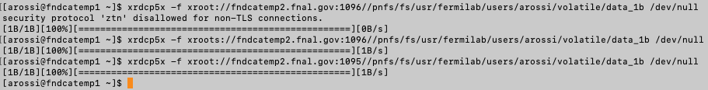
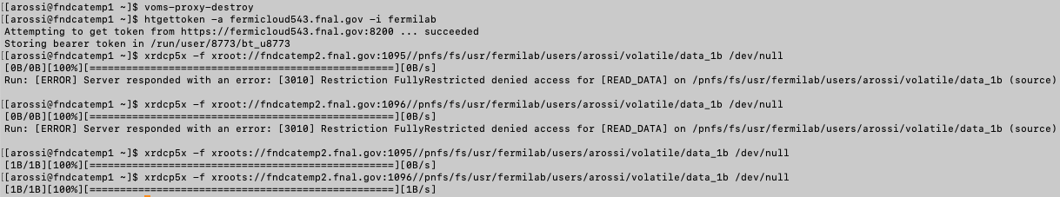
dCache multiprotocol door (issues)
1) Suppressing the TLS warning
1096: ztn,gsi,unix TLS is optional
1095: gsi,ztn,unix TLS is optional
using voms proxy
NOW: checks whether client has activated or is capable of TLS (see slide 11) and omits ztn from the list:
Of course, without xroots, token authentication still fails on the TLS optional doors:
Notes:
I would now like to turn to three features we have recently added to dCache:
1) Support for multiple security protocols in a single door
2) Proxying connections through the door
3) Support for the use of relative paths in the URL
With the multiprotocol door, we encountered the issue of the TLS warning generated by the client. This occurred when using an x509 credential against a door where TLS is optional but ZTN is the first protocol in the ordered list.
This can be solved by reordering the protocols so GSI is given first, but it turns out now that the fix mentioned previously for allowing pre-TLS clients to use this door also fixes this issue.
Of course, if the client is trying to use a token on a TLS optional door without providing the xroots schema, it will fail as it should.

Slide 16
dCache multiprotocol door (issues)
2) Client holds multiple credentials (both x509 and token)
Depending on the order of the protocols, client will always log in with either x509 (for 1095, as above) or token (for 1096, as above)
Can be forced by having the client set the env variable XrdSecPROTOCOL to the comma separated list of protocols the client actually wants to use
Notes:
The second issue was the case when both types of credentials are in the client environment.
> In that case, the client will always be logging in with the credential corresponding to the first protocol in the list it gets from the server, which may not be the expected behavior.
> Andy helped us out here by drawing attention to the XrdSecPROTOCOL env var which can be set to specify which credential to use on the connection.

Slide 17
Proxying transfers through door
Use case: all external connections blocked from internal network on which the pools reside
Door proxy requests a pool source accessible from its address, not the client's
Door proxy must return address to client on basis of its own reachability (i.e., IPv4 vs IPv6)
Internal address for the proxy to use is configurable (like our https implementation)
Notes:
The implementation of proxying through the door was a result of discussions with BNL concerning their specific network requirements, but we have discovered other use cases for which it may be suited.
In essence, the proxy now gives the Pool Manager its own address to match rather than the client's.
It returns to the client its own address in a form that will be reachable.
And the internal network to use (say if the door is dual-stack) can be specified. This seems to be working, though there could obviously be scalability issues in terms of load on the door (remains to be seen).

Slide 18
Use of relative paths
dCache establishes a user root or home
This depends on login authentication used (mapping files, token configurations)
Other protocols express the target in terms of what the user thinks is its root, but dCache xroot has always required the full path from the namespace root
No longer the case (here, /pnfs/fs/usr is the root for arossi):
Notes:
Finally, we decided it would be useful and less confusing to allow Xroot doors to accept relative paths from users the way other protocols like HTTPS do. dCache knows about the user’s home or root from configuration.
Up until now, dCache xroot has always required has always required the full path from the namespace root. The example at the bottom shows that absolute or paths relative to the user root are now both accepted.

Slide 19
Currently not supported by dCache
CLIENT REQUEST TYPES
kXR_gpfile
kXR_prepare
kXR_bind
kXR_pgwrite
kXR_truncate
kXR_pgread
kXR_writev
QUERY REQUEST TYPES
kXR_QStats
kXR_QPrep
kXR_Qspace
kXR_Qckscan
kXR_Qvisa
kXR_Qopaque
kXR_Qopaquf
kXR_Qopaqug
OPEN REQUEST OPTIONS
most of them are ignored and fall over to default behavior
Notes:
This slide lists what I think are the most significant omissions in the dCache implementation of the Xroot protocol. Some of these, such as kXR_truncate, are obviously not supported because dCache's files are effectively unmodifiable.
I have thought it might eventually be useful to implement kXR_bind, especially in order not to have to encrypt data on a connection to a pool which requires TLS. But in practical terms this should not really be the case most of the time because when pools are set to STRICT the intention should be precisely to enforce TLS on the data transfer. However, it remains to be seen if in the future we may consider it desirable to add this feature.

Slide 20

Thank you for your attention.
arossi@fnal.gov
support@dcache.org
https://www.dcache.org
https://github.com/dCache

