Slide 1
Credit Scoring: Machine Learning Techniques
Alireza Jamali
Farshid Eskandari

Slide 2
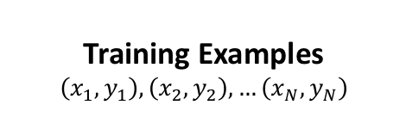
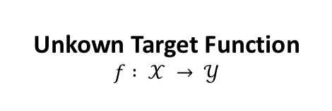

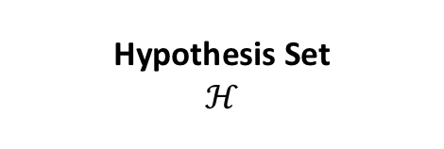
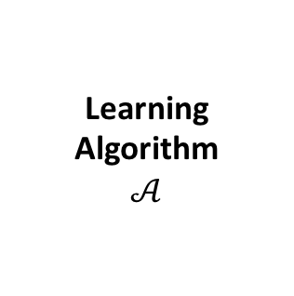
The Learning Problem
Unkown Target Function
$$f : 𝒳 → 𝒴$$
Learning Algorithm
$$𝒜$$
Training Examples
$$\left(x_{1}, y_{1}\right),\left(x_{2}, y_{2}\right),…\left(x_{N}, y_{N}\right)$$
Final Hypothesis
$$g ≈f$$
Hypothesis Set
$$ℋ$$

Slide 3
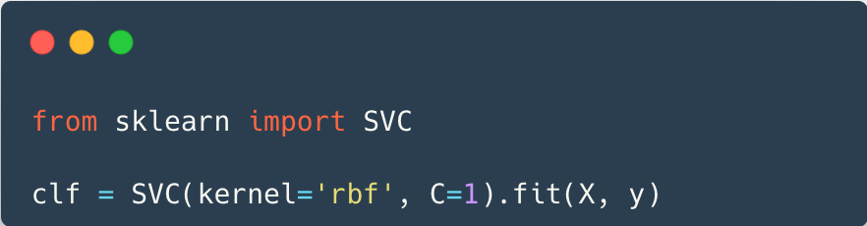
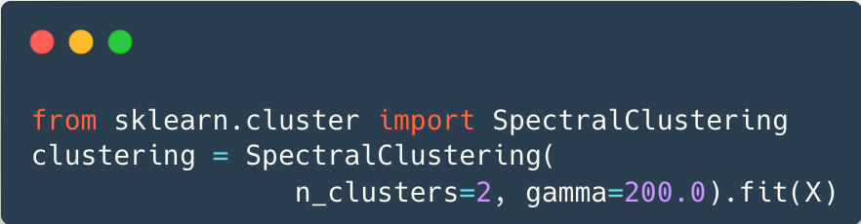
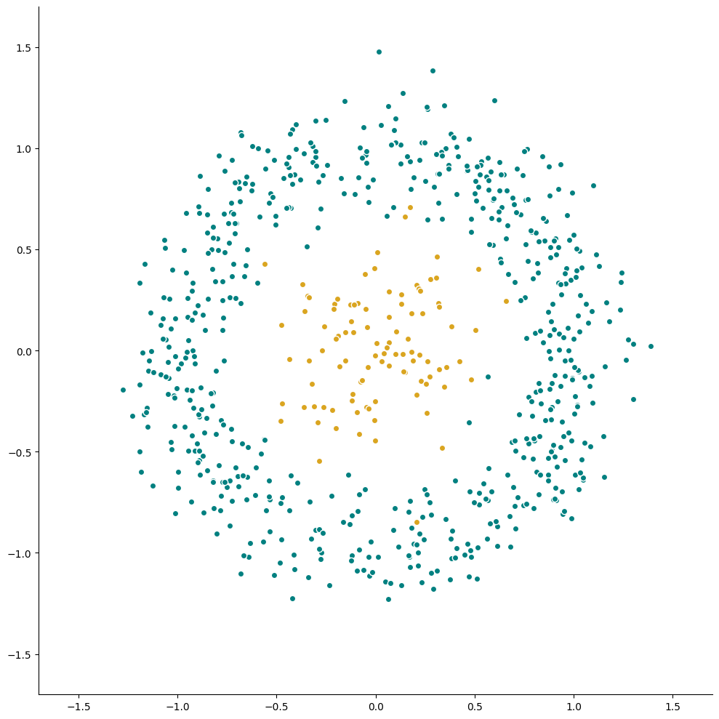
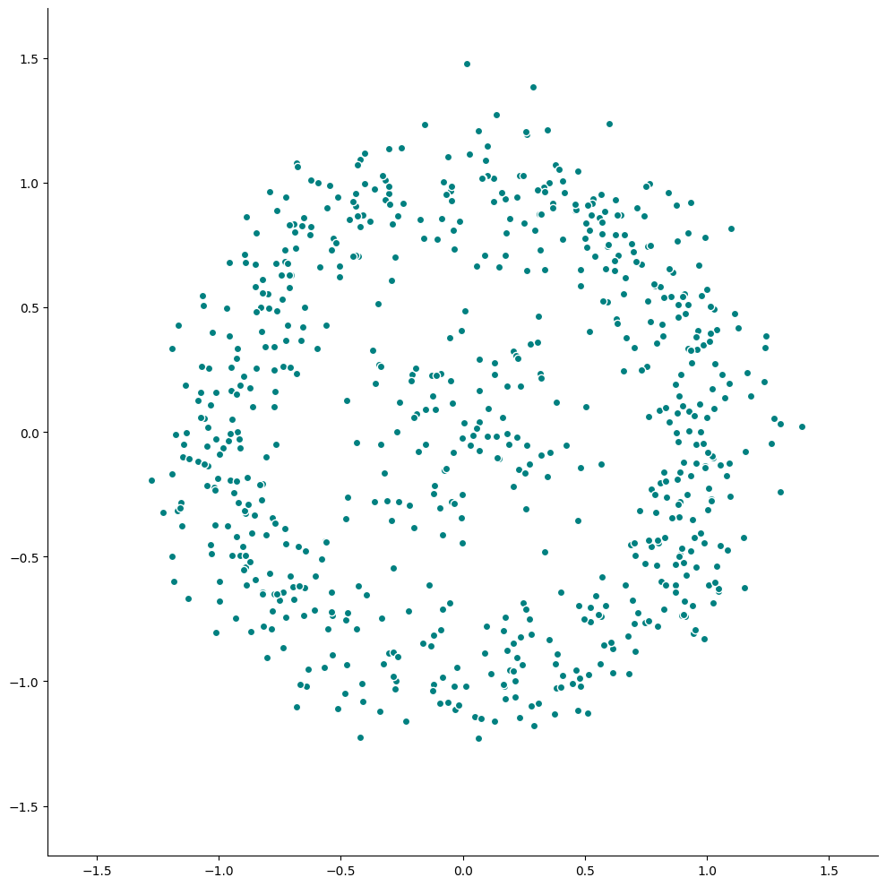


Training Examples _{(Supervised vs. Unsupervised)}

Slide 4

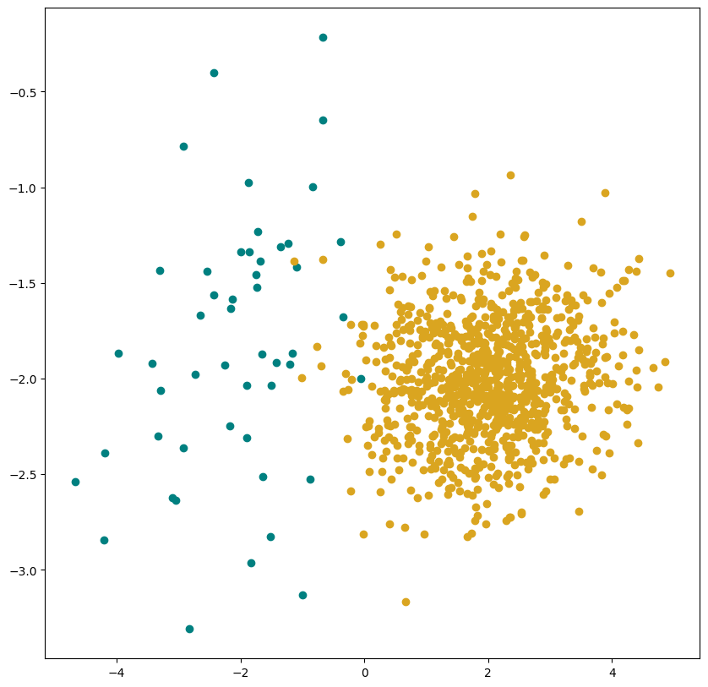
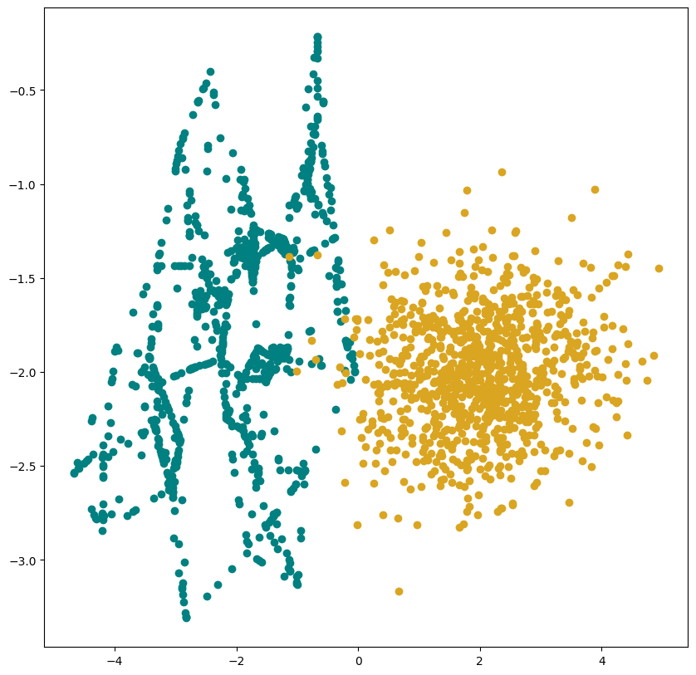
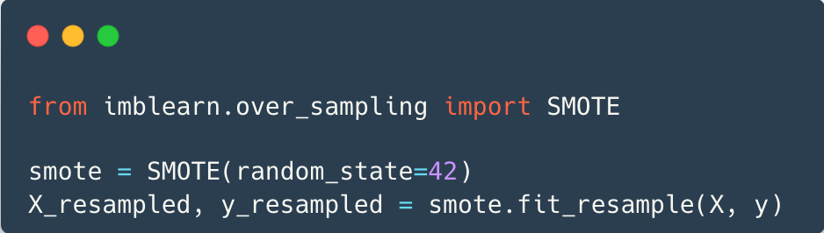
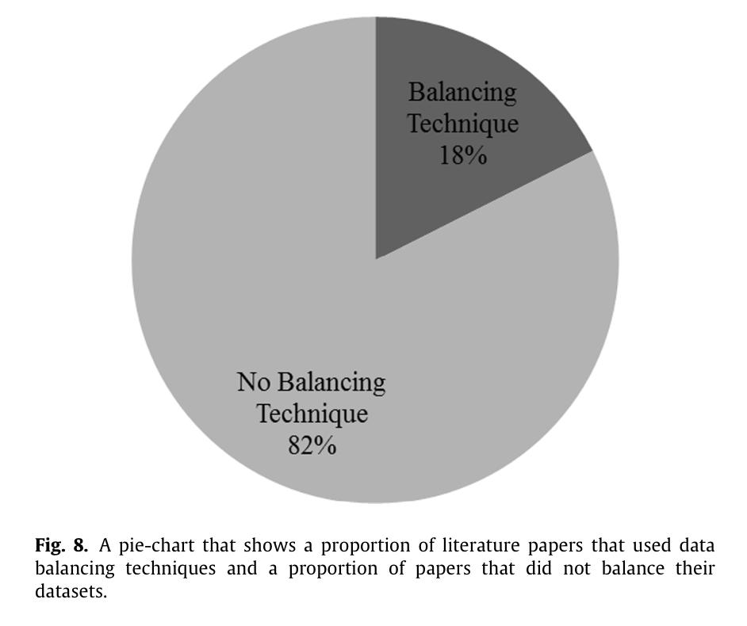
Training Examples _{(Data Imbalance)}
Synthetic Minority Over-sampling Technique (SMOTE)

Slide 5
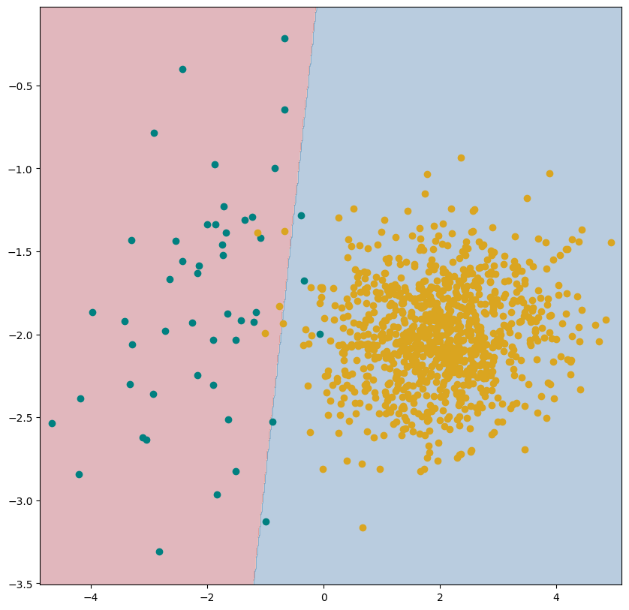
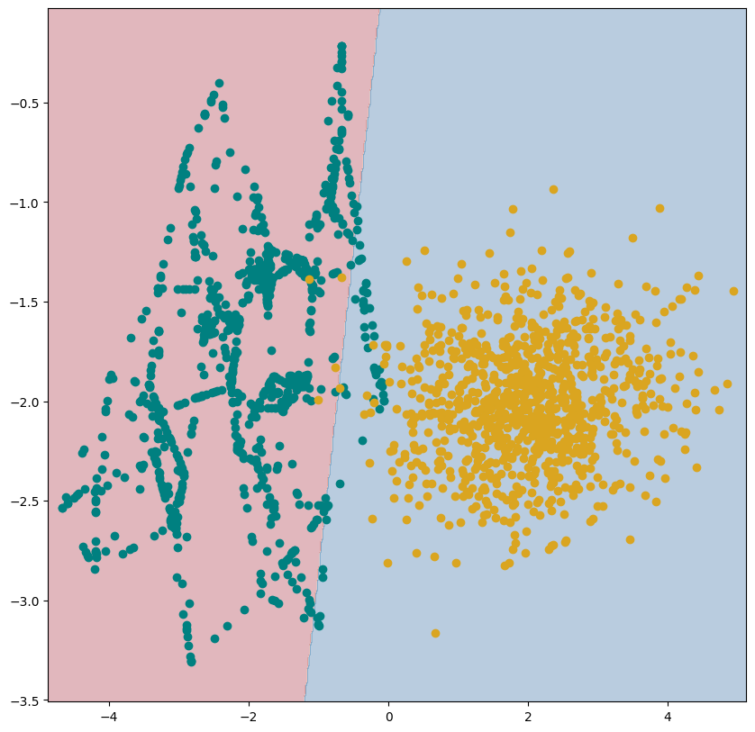

Slide 6
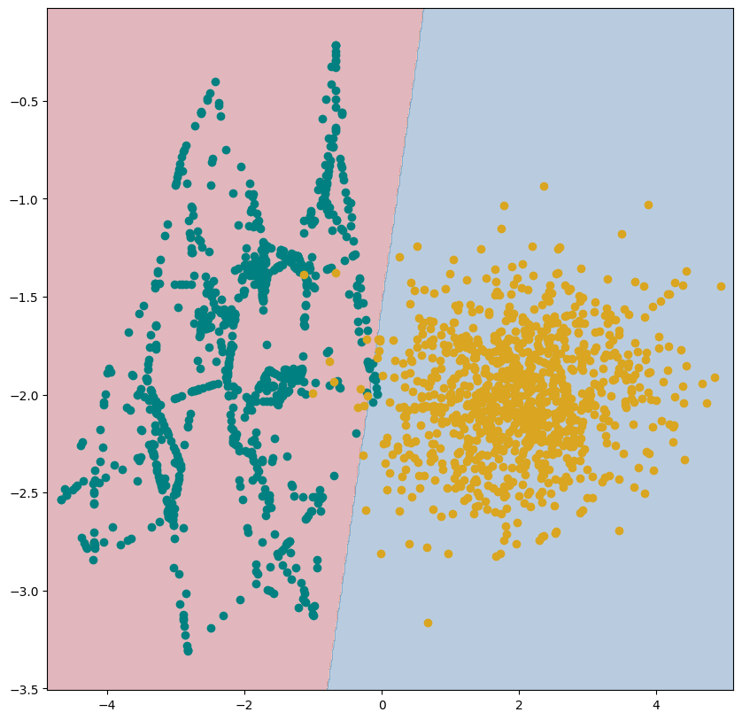
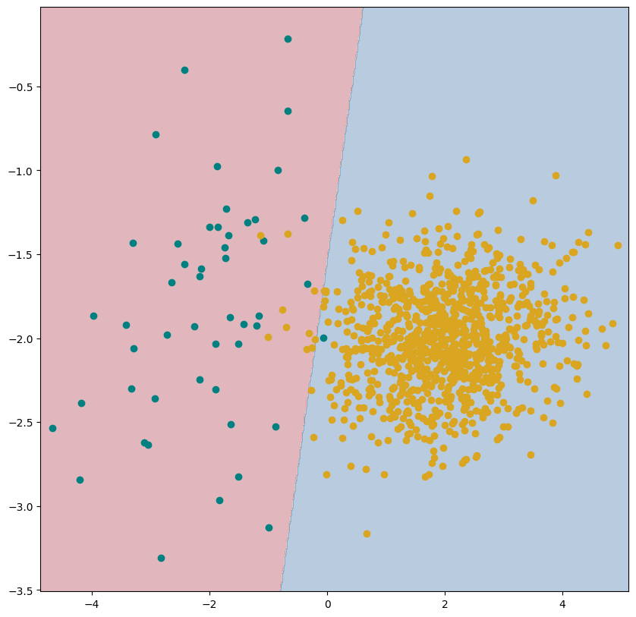

Slide 7
Training Examples (Feature Selection & Engineering)
Filter Methods
F-Score
Rough Set Theory
Wrapper Methods
Stepwise Selection
Genetic Algorithm
Feature Engineering
PCA
Autoencoders

Slide 8
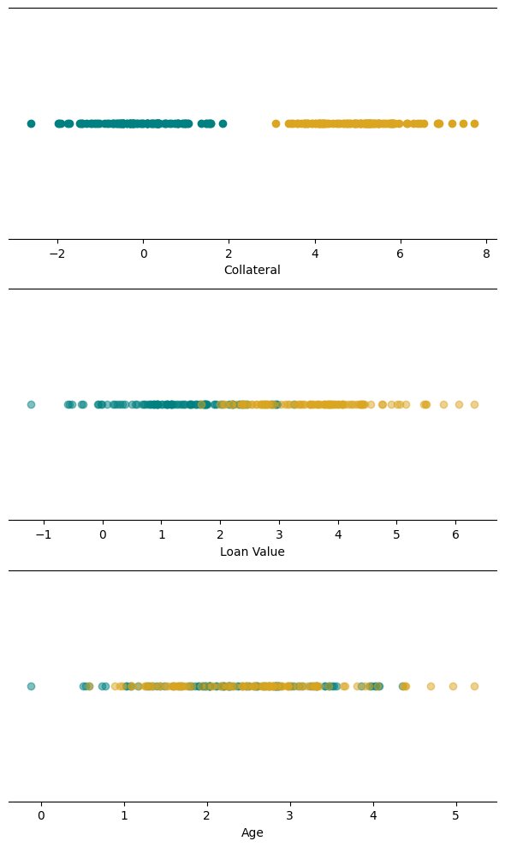
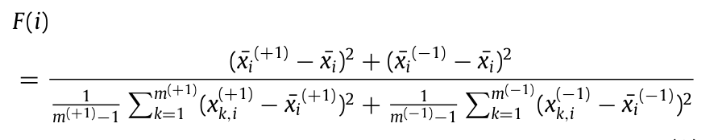
Training Examples (Feature Selection & Engineering)
Filter Methods
F-Score
Rough Set Theory
Wrapper Methods
Stepwise Selection
Genetic Algorithm
Feature Engineering
PCA
Autoencoders

Slide 9
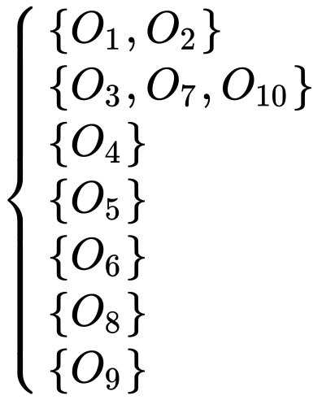

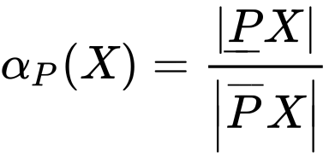
Training Examples (Feature Selection & Engineering)
Filter Methods
F-Score
Rough Set Theory
Wrapper Methods
Stepwise Selection
Genetic Algorithm
Feature Engineering
PCA
Autoencoders
Object | P1 | P2 | P3 | P4 | P5 | Def
O1 | 1 | 2 | 0 | 1 | 1 | 🔴
O2 | 1 | 2 | 0 | 1 | 1 | 🔴
O3 | 2 | 0 | 0 | 1 | 0 | 🔴
O4 | 0 | 0 | 1 | 2 | 1 | 🔴
O5 | 2 | 1 | 0 | 2 | 1 | 🟢
O6 | 0 | 0 | 1 | 2 | 2 | 🟢
O7 | 2 | 0 | 0 | 1 | 0 | 🟢
O8 | 0 | 1 | 2 | 2 | 1 | 🟢
O9 | 2 | 1 | 0 | 2 | 2 | 🟢
O10 | 2 | 0 | 0 | 1 | 0 | 🟢

Slide 10
Training Examples (Feature Selection & Engineering)
Filter Methods
F-Score
Rough Set Theory
Wrapper Methods
Stepwise Selection
Genetic Algorithm
Feature Engineering
PCA
Autoencoders
Forward selection
a. Start with an empty set of features.
b. Evaluate the performance of the model with each individual feature added to the set.
c. Choose the feature that improves the model's performance the most and add it to the set.
d. Continue this process of adding the best features one at a time until no significant improvement is observed or a predetermined stopping criterion is met.
Backward elimination
a. Start with a full set of features.
b. Evaluate the performance of the model after removing each individual feature from the set.
c. Choose the feature that, when removed, results in the least decrease in model performance and remove it from the set.
d. Continue this process of removing the least important features one at a time until no significant improvement is observed or a predetermined stopping criterion is met.
Stepwise selection combines both forward selection and backward elimination. At each step, it considers both adding a new feature and removing an existing feature from the set, based on their impact on model performance. The process continues until no significant improvement is observed or a predetermined stopping criterion is met.

Slide 11
Training Examples (Feature Selection & Engineering)
Filter Methods
F-Score
Rough Set Theory
Wrapper Methods
Stepwise Selection
Genetic Algorithm
Feature Engineering
PCA
Autoencoders
Population
0 | 1 | 1 | 1 | 0 | 0 | 1 | 0 | 0 | 0
…
1 | 1 | 0 | 0 | 0 | 1 | 1 | 0 | 1 | 0
Fitness Function
Selection
CrossOver
0 | 1 | 1 | 1 | 0 | 0 | 1 | 0 | 0 | 0
…
1 | 1 | 0 | 0 | 0 | 1 | 1 | 0 | 1 | 0
Replacement
…
0 | 1 | 0 | 1 | 0 | 0 | 1 | 0 | 1 | 0
…

Slide 12
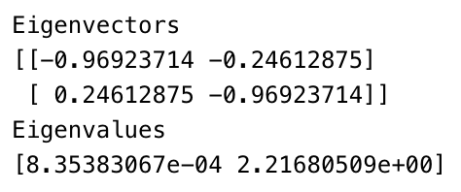
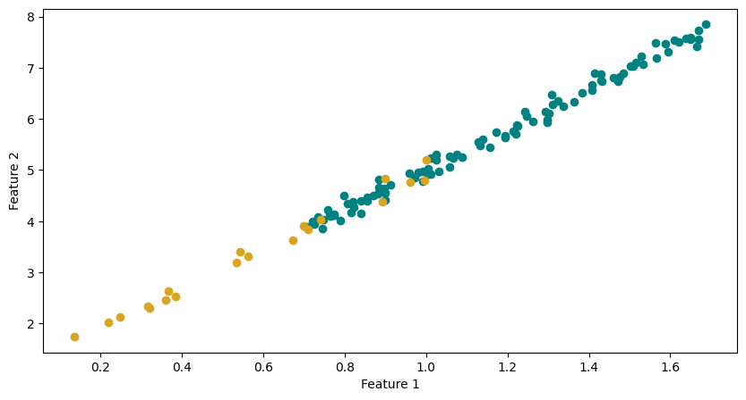
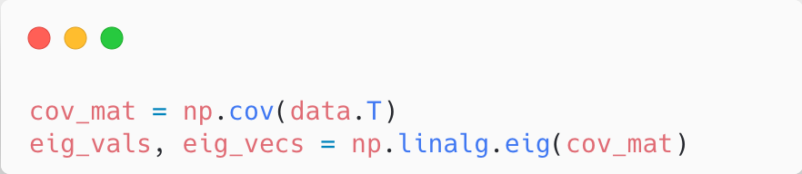
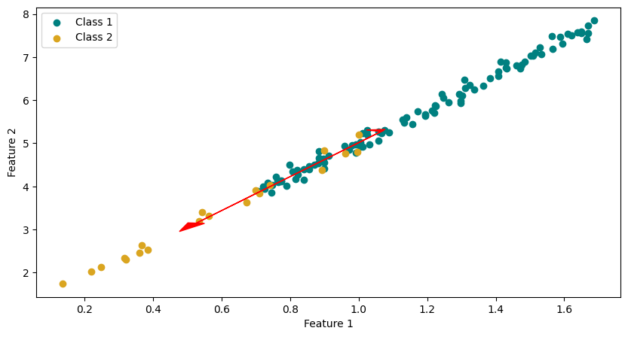
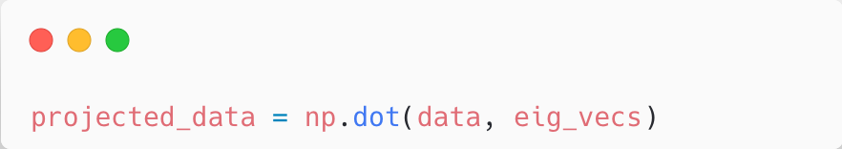
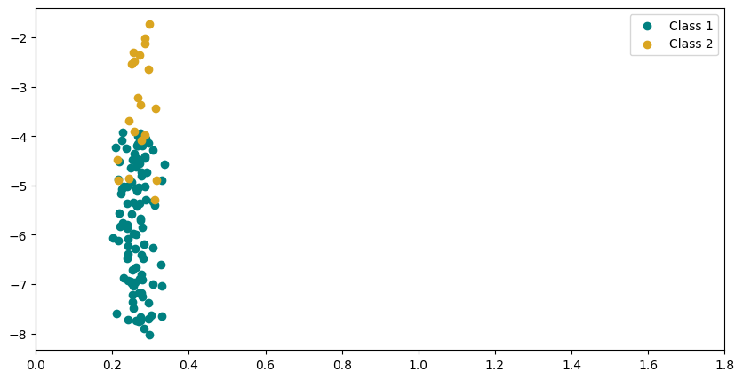
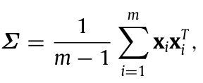

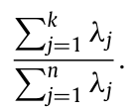

Training Examples (Feature Selection & Engineering)
Filter Methods
F-Score
Rough Set Theory
Wrapper Methods
Stepwise Selection
Genetic Algorithm
Feature Engineering
PCA
Autoencoders

Slide 13
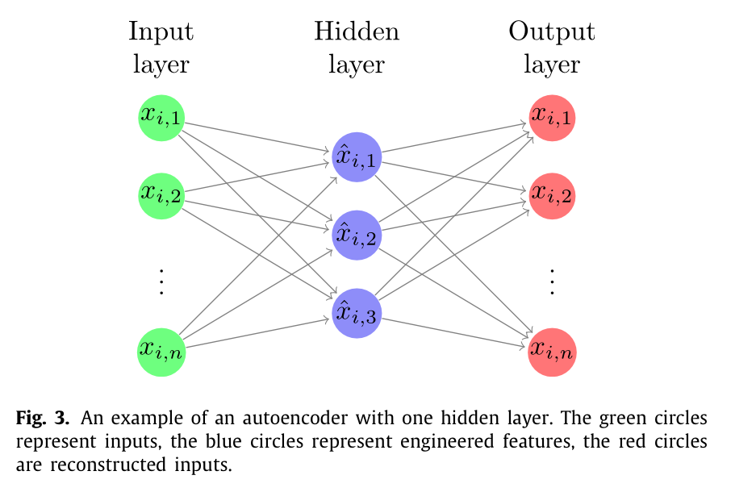
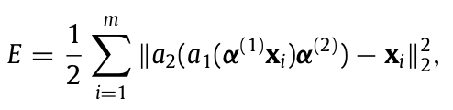
Training Examples (Feature Selection & Engineering)
Filter Methods
F-Score
Rough Set Theory
Wrapper Methods
Stepwise Selection
Genetic Algorithm
Feature Engineering
PCA
Autoencoders

Slide 14
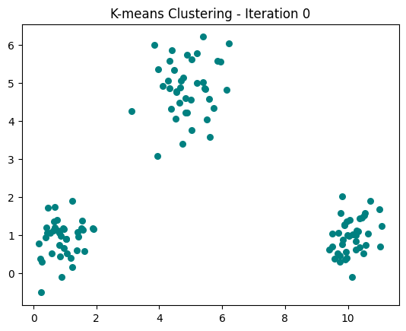
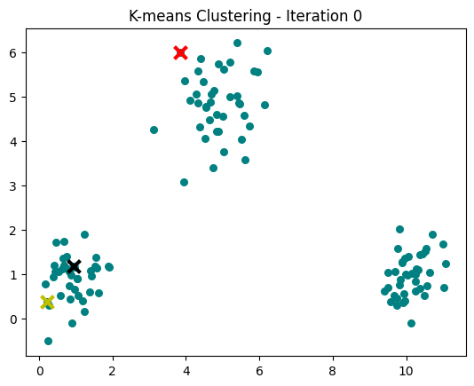
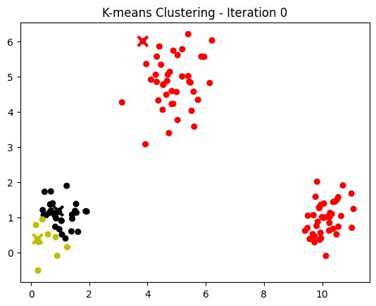
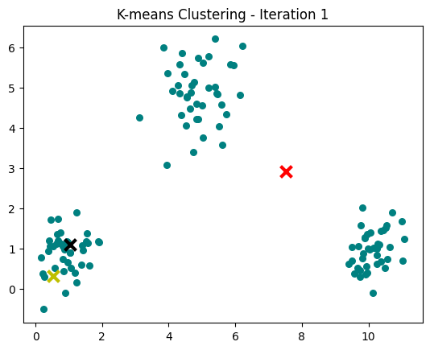
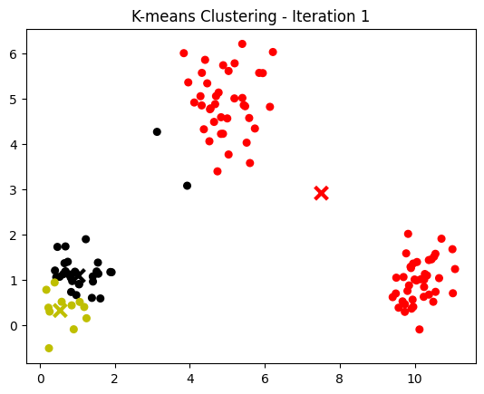
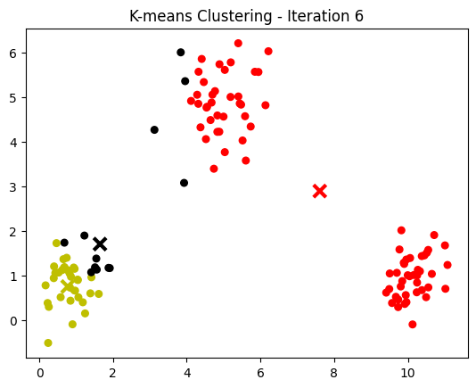
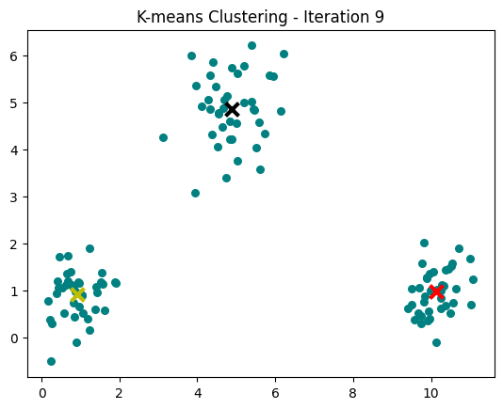
Models
Unsupervised
K-Means
SOM
Supervised
LR
DT
RF
GBDT
SVM
kNN
ANN

Slide 15
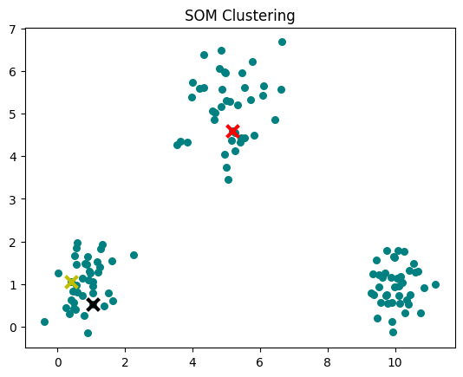
Models
Unsupervised
K-Means
SOM
Supervised
LR
DT
RF
GBDT
SVM
kNN
ANN

Slide 16
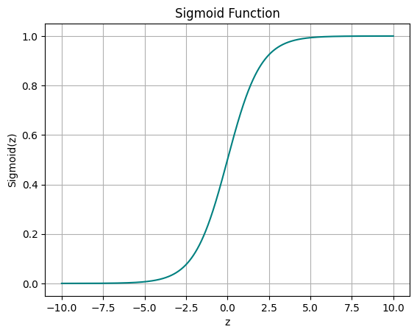


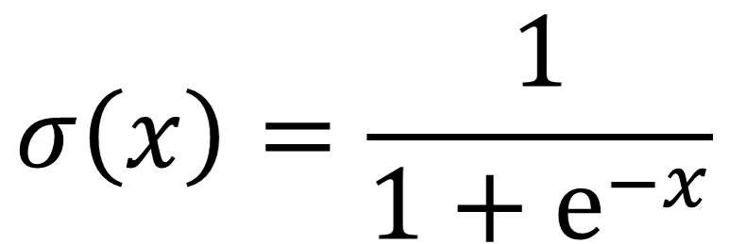

Models
10 Coin tosses:
6 H
4 T
Unsupervised
K-Means
SOM
Supervised
LR
DT
RF
GBDT
SVM
kNN
ANN

Slide 17
Models
Dataset
credit_history > 0
Unsupervised
K-Means
SOM
Supervised
LR
DT
RF
GBDT
SVM
kNN
ANN
Age > 35
Collateral > 100M
…
…
…
…

Slide 18
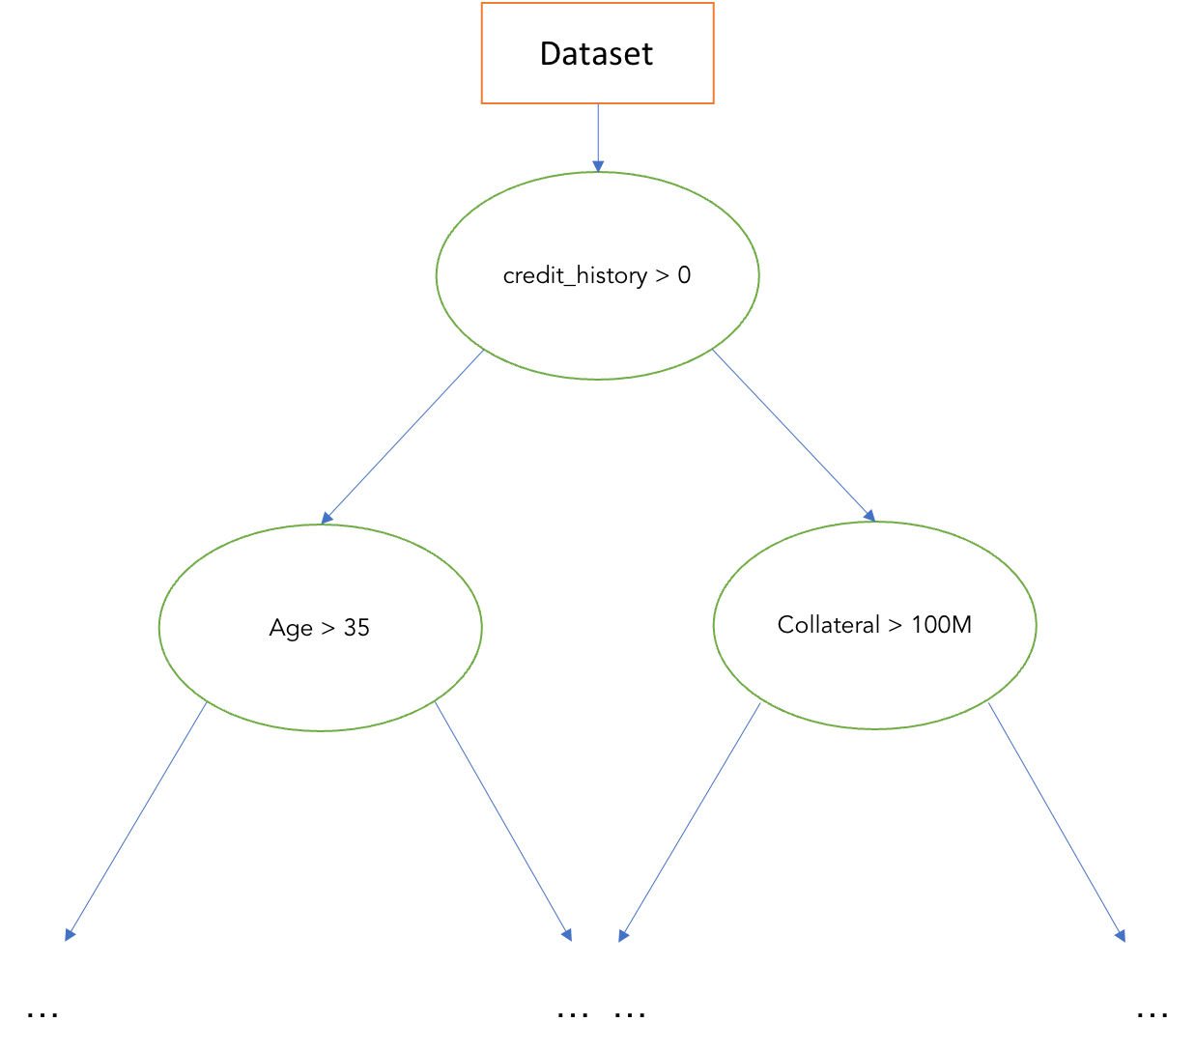
Models
Unsupervised
K-Means
SOM
Supervised
LR
DT
RF
GBDT
SVM
kNN
ANN

Slide 19
Models
Unsupervised
K-Means
SOM
Supervised
LR
DT
RF
GBDT
SVM
kNN
ANN

