Slide 1
Machine Learning Basics
Methods of Classifying Data
by Andrew Sheinberg

Slide 2
What Even is Machine Learning?
Machine learning is a type of artificial intelligence (AI) that provides computers with the ability to learn without being explicitly programmed
Computers can learn on their own using some cool algorithms!
Broken into various types of learning
Supervised
Computer is presented with all information at the start
Unsupervised
The data is not labeled at the start, and the computer finds patterns on its own
Reinforcement
This type of learning is dynamic - meaning as more information is given, the learning algorithm improves

Slide 3
We are going to focus on the machine learning task of classifying data . This is a task that lends itself to supervised learning.

Slide 4
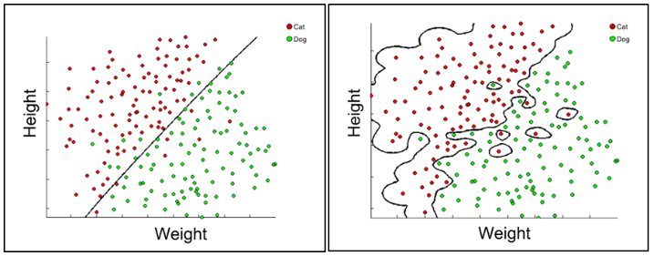
Data Classification
Classifying data can be broken into variables, called features and a result of such variables, called a label
The example below utilizes two features (height and weight) and has two possible labels (cat or dog)

Slide 5
Training and Testing
Data classification is all about being able to make accurate predictions for the future
In order to predict accurately, data classifiers use previous data to generate a model that can be used to test new data
The previous data, used to train the model, is called the training set
The new data, being tested, is called the test set

Slide 6
Three Different Approaches
Naïve Bayes
Support Vector Machines
Decision Trees

Slide 7
Naïve Bayes
Machine
Learning
Our First Approach

Slide 8
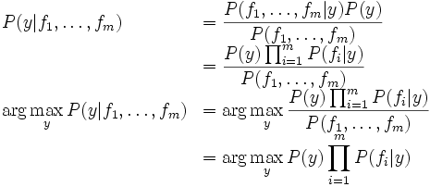
Naïve Bayes: Our First Approach
A method of classification using just a formula and a set of features, F, and labels, Y.
The formula looks quite intimidating, so let’s go through what it means

Slide 9

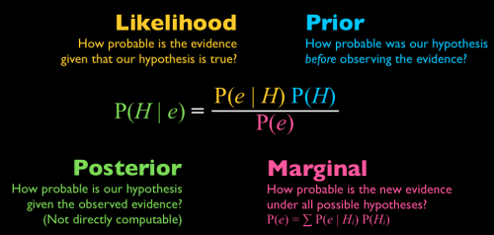

Background on Naïve Bayes
Naïve Bayes is an extension of conditional probability
It is called “naïve” because it assumes the value for each feature is independent of every other feature
This means that the value for each feature is not affected by the value of another feature
Conditional probability = basis for Rev. Thomas Bayes’ Rule, thus the terminology of Naïve Bayes
Definition of conditional probability
Bayes’ Rule

Slide 10
Naïve Bayes: Putting it Together
For each possible label denoted “y”, we calculate its posterior, the probability of the label being true given the set of features “F”, using conditional probabilities for each feature
The label yielding the greatest posterior is assigned to that set of features

Slide 11
Naïve Bayes: An Example (adapted from Wikipedia)
Suppose we were given a dataset containing combinations of heights, weights, & foot sizes, and we want to determine whether each combination is data from a male or a female
Features: Height, Weight, and Foot Size
Labels: Male or Female

Slide 12
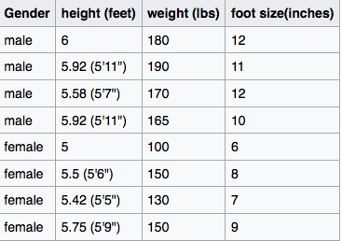

Naïve Bayes: Training the Model
We need a training set to generate our Naïve Bayes model...
This training set will produce the statistics that are needed to calculate the conditional probabilities

Slide 13

Naïve Bayes: Testing the Model
Now, given a test sample, we are able to predict a label
Remember our goal is to choose the label that yields the greatest posterior

Slide 14

Naïve Bayes: Making a Prediction
Based upon the statistics obtained from the testing data, our previous evidence, and our test sample, our new evidence, we can calculate the conditional probabilities
Male
P(male) = 0.5
p(height | male) = 1.58
p(weight | male) = 0.00000598
p(foot size | male) = 0.00131
Posterior Numerator (male) =
0.00000000619
Female
P(female) = 0.5
p(height | female) = 0.223
p(weight | female) = 0.0168
p(foot size | female) = 0.287
Posterior Numerator (female) =
0.000538
Because 0.000538 > 0.00000000619, the Naïve Bayes model will label this sample as female

Slide 15
Naïve Bayes: Wrap Up
So we were just able to predict whether a person was a male or female based upon their height, weight, and foot size!
Real world applications for this method include filtering spam, determining the category of text (weather, sports, politics, etc.), and diagnosing medical problems.

Slide 16
Support Vector Machines
Machine
Learning
Our Second Classifier

Slide 17
Support Vector Machines: Our Second Classifier
Method was published in a landmark paper in 1992 by three computer scientists: Bernhard Boser, Isabelle Guyon, and Vladimir Vapnik
A Support Vector Machine (SVM) is a classifier formally defined by a separating hyperplane.
In other words, given labeled training data (supervised learning), the algorithm outputs an optimal hyperplane which categorizes new examples
The hyperplane is the space that divides the labels
When testing a sample, the algorithm determines which label-plane the sample is in, indicating the predicated label

Slide 18
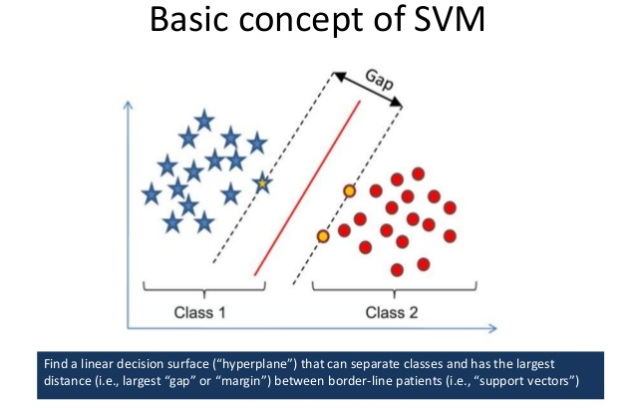

Slide 19
SVMs…Uhh What?
The theory behind SVMs is at a Ph.D. level of comprehension, but, luckily, beginner programmers can make use of SVMs without actually knowing the depth about how they work!
More on this later!
The basic idea is that the method generates a hyperplane that separates data as best as possible
Primary task: to separate the data most accurately (i.e. the highest percentage of labels in their own hyperspace)
*Sometimes with outliers this is not possible
Secondary task: to generate the most margin between the classes so there is room for error

Slide 20
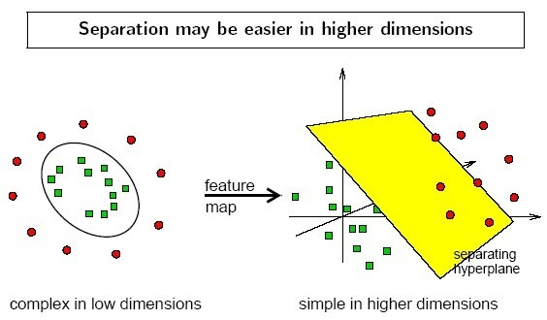
SVMs: Kernel Trick
When the classes can be separated by a line, the hyperplane is simply that line.
However, sometimes data needs to be separated by curves, in which case fancy mathematics is used to transform the data into higher dimensional space, where a plane can be used to separate the classes.
This transformation into higher dimensional space is known is the kernel trick

Slide 21
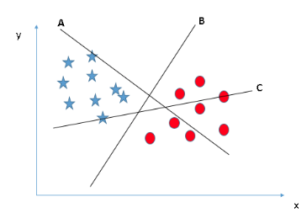
SVMs: Example 1
Support vector B is the best choice – it separates with 100% accuracy

Slide 22
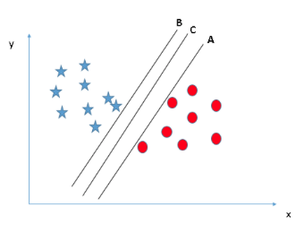
SVMs: Example 2
Support vector C is the best choice – it separates with 100% accuracy AND creates the most margin between classes

Slide 23
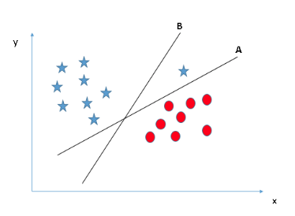
SVMs: Example 3
Support vector A is the best choice – it separates with 100% accuracy

Slide 24
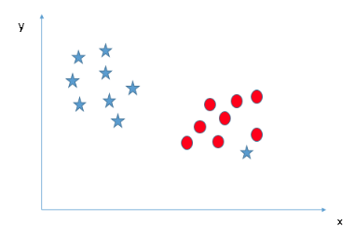
SVMs: Example 4
In this example it is not possible to linearly separate the two classes, and there is no pattern in higher dimensional space, so the blue star in the red section should be counted as an outlier and ignored

Slide 25
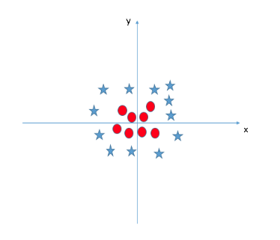
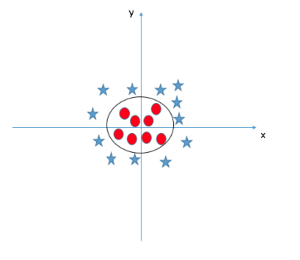
SVMs: Example 5
It is not possible to linearly separate the two classes in this graph; however, there is a pattern which can be then be separated in higher dimensional space, so the kernel trick should be used

Slide 26
So how is it possible that programmers can use Support Vector Machines without understanding the underlying theory???

Slide 27
SVMs: Usability
Many computer languages have built-in functions that allow programmers to use an existing algorithm for their own unique problem
A SVM is a built-in function
In order for the SVM built-in function to be useful, it must be adaptable to any sort of classifying task
The adaptability comes from the function’s parameters, or variables that change from problem-to-problem

Slide 28
SVMs: Parameters
The parameters of the support vector machine function are:
Training Set
Testing Set
C value
Controls the tradeoff between smooth decision boundary and classifying points correctly
A low value creates a smooth boundary, but risks incorrect classification
A high value leads to an accurate boundary, but is rigid
Gamma value
Defines how far the influence of a single training example reaches
A low value means points far away from decision boundary have an influence
Results in a smooth, linear-like boundary
A high value means only points close to the decision boundary have an influence
Results in rigid, wiggly boundary

Slide 29
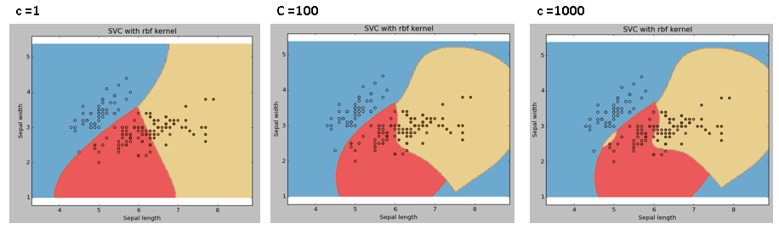
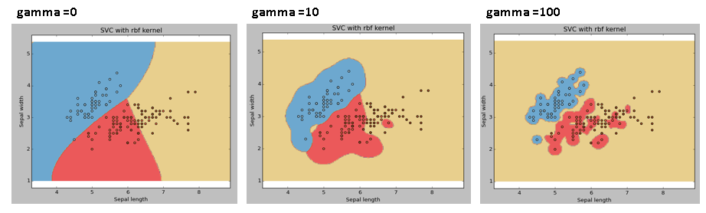
SVMs: Effect of Parameters
C Value
Gamma Value

Slide 30
SVMs: Conclusion
Support Vector Machines are a powerful classifier because of their ability to classify groups by creating non-linear hyperplanes (by using the kernel trick!!!)
Naïve Bayes cannot do this and will most likely fail to classify non-linear patterns
Further, through the use of parameters, SVMs can be adaptable to a programmer’s unique dataset
Common applications for SVMs are image classification, bioinformatics (protein and cancer classification), and hand-written character recognition

Slide 31
Decision Trees
Machine
Learning
A Third Method of Classification

Slide 32
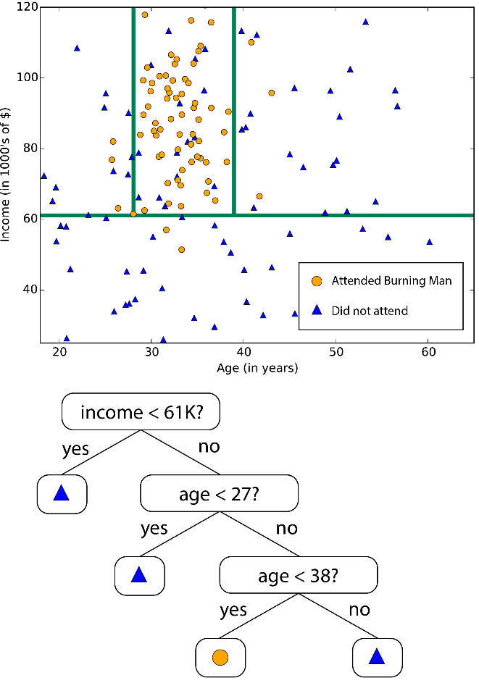
Decision Trees: A Third Method
Decision Trees are useful to classify data that can be separated linearly multiple times
The method creates multiple linear boundaries to classify groups

Slide 33
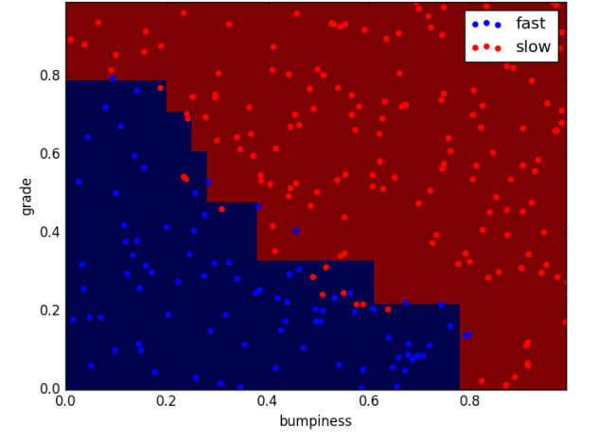
Decision Trees: How Boundaries Are Decided
Boundaries are chosen based upon the entropy of the dataset
Entropy is a measure of impurity in a set of examples
Impurity refers to the contamination of a class labels that do not fit the specified label of a section of the graph

Slide 34

Decision Trees: Calculating Entropy
Calculated on scale from 0 to 1
Entropy = 0 when all examples are in same class
Entropy = 1 when examples are evenly split between classes
Formula:
refers to the fraction of examples in class (aka label) i
The sigma is used to indicate that entropy is summed over all the classes
Entropy is first calculated based on the final label category
This first value is known as the root node
Entropy can also be calculated on each feature category
These are child nodes

Slide 35
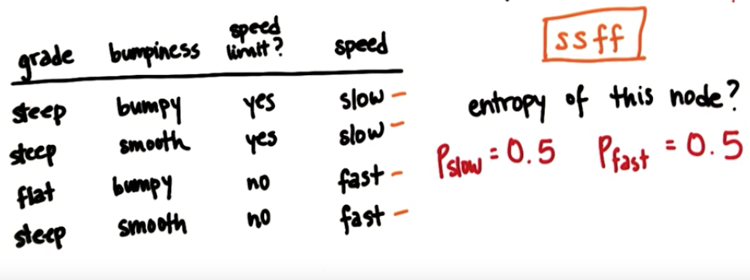
Decision Trees: Entropy Example
Speed is the final category, meaning slow and fast are the possible class labels
Plugging into the formula, entropy = 1. This makes sense because the 2 class labels are evenly split among the 4 examples

Slide 36
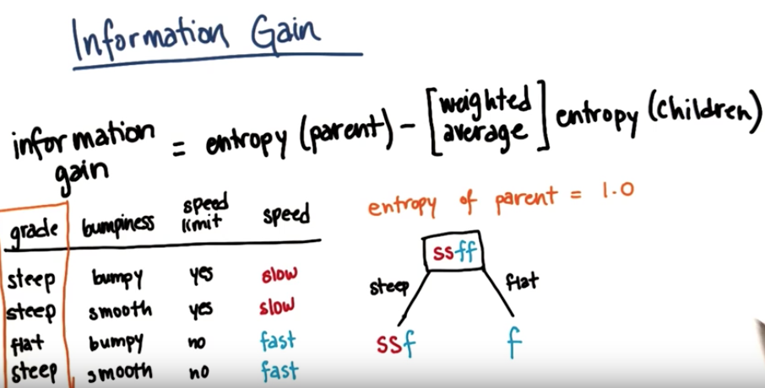
Decision Trees: Information Gain
Calculating the entropy is needed in order to solve for a variable called information gain
Information gain determines the best feature to split by, the example below is en route to calculating the information gain when split by grade

Slide 37
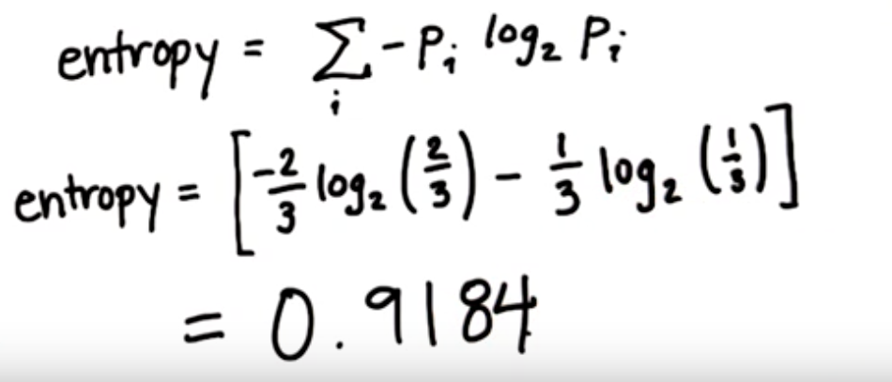

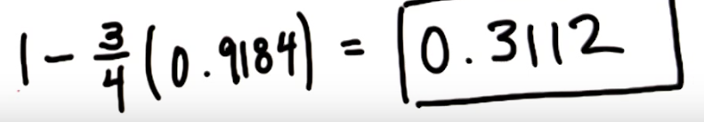
Decision Trees: Information Gain Example
Continuing the previous example, the entropy of each branch (aka the children) needs to be calculated
Calculating the entropy of the left branch:
Entropy of right branch = 0 because there is no impurity
Then, based on how many examples are in each branch, the weighted average of the entropy of children can be determined
Finally, the information gain = entropy(parent) – entropy(children)
Entropy(parent) = 1
So the information gain of splitting by grade is:

Slide 38
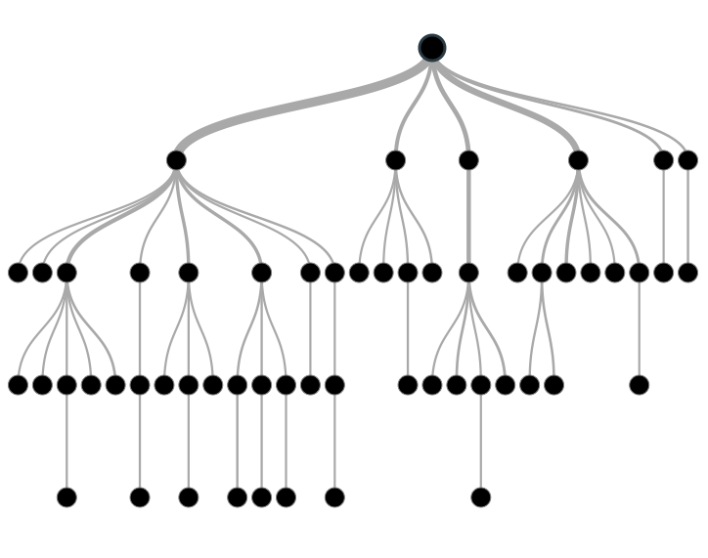
Decision Trees: Making the Tree
The previous example of calculating information gain was just splitting by one feature
In the decision tree method the information gain is calculated by splitting by every feature
The method then creates a decision boundary for the feature with the most information gain
This process of making decision boundaries is repeated, but now the children become the parent nodes

Slide 39
Decision Trees: Summary
Decision boundaries are chosen by splitting by the features with the most information gain
Entropy calculations are necessary to compute the value of information gain
Decision Trees are useful when trying to classify categorical data
Especially valuable when the dataset can be separated by a few linear decision boundaries
A decision tree is also easier to comprehend and analyze than a SVM
A downside, though, is that decision trees are prone to over-fitting
Decision trees can create unnecessary boundaries that work well for the training set, but do not generalize well for testing and predictive purposes

Slide 40
Data Classification Techniques
Machine
Learning
Naïve Bayes
Support Vector Machines
Decision Trees

