Slide 1

Chokro
THE CYCLE
Doing the right thing with your waste should pay you back.
A rewards loop for correct waste disposal that only pays against verified evidence — and a marketplace where those rewards are spent with local green entrepreneurs.
ARNISH LAMPPOST ARNISH@LAMPPOST.ORG.BD
Notes:
Open here. Say the name, then the one-line promise: today, doing the right thing with your rubbish returns nothing to you. Chokro makes it pay — but only when the app can prove it happened. Two halves: verified disposal, and a marketplace where the reward gets spent locally.

Slide 2
THE PROBLEM
Two problems sit next to each other, and nobody solves them together.
The person who does it right
The person making something better
Bangladesh throws out 25,000–30,000 tonnes of waste a day — and only 45–50% of urban waste is formally collected.
Around 100,000 people in Dhaka alone make a living picking through it.
Someone who separates their recyclables and carries them to the right bin gets nothing back. No record, no proof, no reward.
Makers of handmade and recycled goods — often home-based, often women — sell through scattered social media pages.
They compete for attention against mass-produced imports with far better distribution.
Two years of happy customers on one page counts for nothing on the next. Reputation is not portable.
Waste apps reward disposal. Green marketplaces sell products. Neither one knows the other exists.
FIGURES: LIGHTCASTLE PARTNERS, 2025
Notes:
Two sentences per column, no more. Left: the behaviour is invisible, so it cannot be reinforced in a person or counted by a city. Right: being handmade is a disadvantage instead of the point. The punchline is the line at the bottom — these two are always treated as separate products.

Slide 3
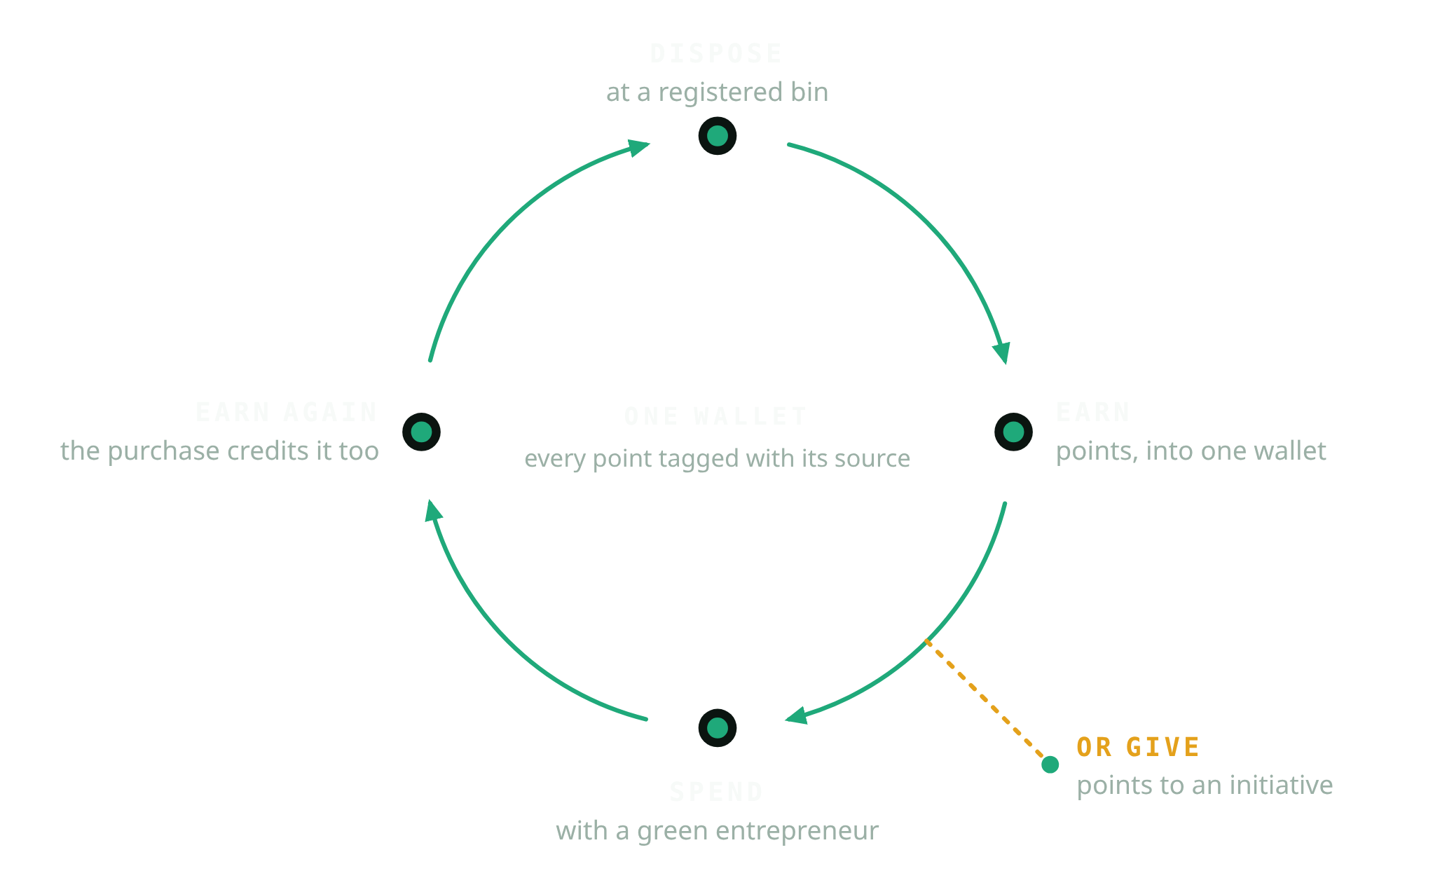
THE IDEA
Chokro means cycle.
Chokro is the Bengali word for a cycle or wheel. Both halves of this are sustainable behaviour, so both credit the same wallet.
The points you earn at a bin get spent on something handmade — and that purchase credits the wallet again. That is what makes this a cycle rather than a pipeline, and it is the one thing to remember from this deck.
EARNED AT A BIN
EARNED ON A PURCHASE
SPENT
50 points per verified disposal
5% of the order, back in points
100 points = Tk 10
Notes:
Draw the circle with your hand while you say it. Dispose, earn, spend with a green entrepreneur, earn again — and the branch off the ring is giving points to an initiative instead of spending them. One wallet, every point tagged with where it came from. If they remember one slide, make it this one.

Slide 4
THE EXPERIENCE
Four steps, standing at the bin.
STEP 1
STEP 2
STEP 3
STEP 4
Scan the code on the bin
Photograph the disposal
Prove you are standing there
Points land, with a receipt
A printed sticker, not a smart bin. That is the whole reason this can actually reach a neighbourhood.
And say what it is and how much. Declaring it is what gives us something to check the picture against.
Location is captured at the moment of the scan and checked against the bin’s own recorded position.
A notification tells you the decision. Every balance change is a line in a ledger you can read back.
+50
VERIFIED
100 points = Tk 10 One disposal is worth about Tk 5 Spent in multiples of ten — the remainder stays in your wallet
Notes:
This is the demo slide — run the real thing here if you can. Four taps, thirty seconds, standing at a bin. The rate matters to a non-technical audience: one disposal is about five taka of spending power, and points are spent in tens so the ledger always reconciles.

Slide 5
WHY THIS IS HARD
A rewards system is worth exactly what its proof is worth.
Five things have to hold before a single point is paid.
1
WHERE
The photo must be taken within a set radius of a registered bin — recomputed on our server against the bin’s own recorded position, never trusted from the phone.
2
WHAT
An automated screen checks that the picture actually shows what the person said they were throwing away.
3
AGAIN
Every photo is fingerprinted, so the same picture submitted twice — at any bin, on any day — is caught.
4
WHEN
Six hours between claims at the same bin, and three approved disposals a day. Enough for a genuine trip; not enough to farm.
5
WHO
Anything uncertain goes to a person, not to a payout.
The system fails toward review, never toward payout. And no phone, ever, decides what it gets paid.
Notes:
Slow down here — this is the slide that separates Chokro from a loyalty app. Say the five in order, one breath each. Then land the closing line twice if you have to: it fails toward review, never toward payout. A sponsor is funding a reward pool; this is what protects it.

Slide 6
WHERE THE POINTS GO
A marketplace where handmade and recycled is the premise, not the handicap.
FOR THE SHOPPER
EARN BACK
5% of every order returns as points
Points come off the bill — up to half of it. They supplement money; they never replace it, so a listing always earns its seller real income.
POINT CEILING
At most half of a bill can be paid in points
FOR THE ENTREPRENEUR
A channel where being handmade or recycled-material is the basis of the market, plus a reputation attached to the person rather than to a page.
MIXED CART
Splits into one order per entrepreneur, automatically
PAYING
Cash on delivery, or bKash / Nagad / card
FOR BOTH
Confirming the delivery is what releases the purchase points. Both sides have to show up before anything is credited.
REWARD VALUES ARE TUNABLE AT RUNTIME, NOT BAKED INTO THE APP
Notes:
The commercial half. Emphasise that points never replace money — at most half a bill — so a Greenpreneur always takes real income from a sale. And the loop closes here: confirming delivery credits 5% back in points, which is why this is a cycle. Reward values are admin-tunable, so a pilot can be tuned without a new build.

Slide 7
THE OTHER EXIT
Or the points go to a cause instead.
Someone who would rather not shop can put what they earned straight into work on the ground.
INITIATIVE 01
INITIATIVE 02
INITIATIVE 03
Waste recovery
Tree planting
Green entrepreneurship
Getting more of what is thrown away back out of the stream.
The most legible thing a small contribution can add up to.
Backing the producers the marketplace exists for.
Choose whole points, see the effect on the balance, confirm once. Retrying a confirmation never gives twice.
Said plainly: online giving through bKash, Nagad and card is built as a complete journey, and in this prototype it moves no real money and collects no card details. Point donations are real point movements; they are not cash and not tax-deductible.
Notes:
Say the honesty panel out loud rather than letting them read it. Volunteering the limitation early is what makes the rest of the deck credible — the payment journeys are complete but simulated, and no real money moves in the prototype.

Slide 8
WHO USES IT
Three kinds of people, one app, one account each.
C
3ZERO CHAMPION
Everyone starts here. Dispose, earn, spend, give — and read about becoming an entrepreneur when they are ready to.
G
3ZERO GREENPRENEUR
Still a Champion too. Lists products, manages stock, moves orders along. Applies through the app; an admin approves.
A
3ZERO ADMIN
Holds all three. Registers bins and prints their labels, works through whatever got flagged, tunes the reward values, suspends abuse, and watches the totals.
You do not juggle three accounts. You switch workspace — and what you are permitted to do never changes with the view you are in.
Notes:
Keep this short — it is orientation, not the pitch. The point that matters technically: switching profile changes the workspace, never the permission. Authorisation is always checked against the stored role on the server, so a switched view can hide capability but never create it.

Slide 9
STATUS
This is not a concept. It runs.
40
2
1,130
41k
FEATURES BUILT
PLATFORMS, ONE CODEBASE
AUTOMATED TESTS
LINES OF PRODUCT CODE
Identity, disposal, points, marketplace, admin, self-reported actions, notifications.
Android and the browser, with no forked logic between them.
616 on the app, 282 on the service, 232 on the security rules.
Plus 15,500 lines of tests behind it.
The app Flutter, one codebase
A trusted service the only thing that can move a point
Automated photo screening with a human fallback
Push notifications on every decision
Printable bin labels high error-correction QR
A ledger every balance reconstructable
A working prototype — and the full earn-and-spend cycle runs end to end, in one continuous demo.
Notes:
Numbers exist to answer one silent question: is this real or a mock-up? Do not read them all — point at 1,130 tests and say the loop is verified by machine, not by hope. Then say the honest word: prototype. What is proven is that the cycle closes end to end in one run.

Slide 10
WHAT'S IN IT FOR YOU
Four different people get four different things out of the same loop.
CITIES & BIN OPERATORS
GREEN ENTREPRENEURS
Attributable, timestamped, location-verified disposal data. Which bins get used, when, and by how many distinct people — which is not measurable today at any price.
A market where their materials are the premise, and a reputation that travels with them instead of living on a page they could lose.
SPONSORS
THE NEIGHBOURHOOD
Rewards you fund are only paid against evidence that survived five checks, and every point of it is reconstructable from a ledger. You can see what your money bought.
Money circulating between residents and small local producers, instead of leaving for mass-produced imports.
Notes:
Pick the one row that matches who is in the room and spend your time there. For a sponsor: rewards are only paid against evidence, and the ledger means every taka is traceable to a verified action. For a city: this is disposal data attributed to people, which they currently cannot buy.

Slide 11
WHERE IT GOES
The next version of this is a pilot, not a feature.
NOW
NEXT
THEN
One neighbourhood
Works with no signal
Real rails, shared data
Register a real set of bins, print and mount the labels, and run the loop with real users and a real reward pool.
A submission composed at a roadside bin should queue and send itself later. Plus a Bangla interface — the app is built for it, it is not translated yet.
Live payment integration in place of the simulated journeys, and disposal data handed back to the city that owns the bins.
The honest boundary: this does not solve waste management, and we will not tell you it does. It makes one link in the chain — a person’s decision at the moment of disposal — measurable and worth something, and it points the resulting value at local producers instead of out of the community.
Notes:
Frame the next step as a pilot, not a feature list — that is what a sponsor is being asked to fund. Then read the honest boundary. Claiming less than you can prove is the reason people believe the rest.

Slide 12
THE ASK
Three things, and the loop starts turning.
BINS
One neighbourhood, one operator willing to let us label their bins and record where they are.
Everything else is built.
Arnish
Lamppost
arnish@lamppost.org.bd
ENTREPRENEURS
A first cohort of makers to open the marketplace with, so there is something worth spending on.
SPONSORSHIP
The reward pool and the pilot’s running costs — the only place real money is needed to prove the loop.
Notes:
Close on the three asks and stop talking. Bins to label, a first cohort of makers, and money for the reward pool and running costs — nothing for engineering, because that part is done. Then hand over your contact and take questions.

