Slide 1
Smart Agriculture Monitoring
IoT Final Project - Virtual Sensors, MQTT, Gateway Processing, and Real-Time Alerts
A complete virtual IoT pipeline designed to satisfy the final-project requirements.
Sensors -> Publisher -> MQTT Broker -> Gateway -> Subscriber
Group X | Editable deck | Replace placeholders before final submission
Temperature
Humidity
MQTT
Alerts
CAI26442 | Smart Agriculture Monitoring | Slide 1

Slide 2
Project Requirements Covered
Mapping the assignment checklist to the implemented solution
Sensors
JSON Data
MQTT
Temperature + Humidity virtual sensor simulation
device_id, two readings, status, timestamps
Public broker + unique raw/processed topics
Gateway
Subscriber
Deliverables
Validation, enrichment, and alert logic
Real-time terminal monitoring output
Report PDF/DOCX, code, screenshots, PPTX
CAI26442 | Smart Agriculture Monitoring | Slide 2

Slide 3
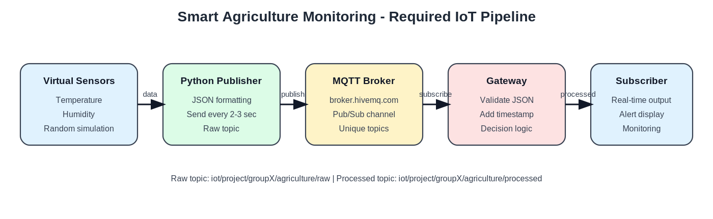
System Architecture
Required pipeline implemented exactly as specified
CAI26442 | Smart Agriculture Monitoring | Slide 3

Slide 4
Data Model and MQTT Topics
What is sent, where it flows, and why it is valid
{ "device_id": "groupX_agri_node_01", "temperature": 33.2, "humidity": 63, "status": "RAW" }
Raw Topic
iot/project/groupX/agriculture/raw
Processed Topic
iot/project/groupX/agriculture/processed
Publisher payload: valid JSON
Gateway Output
Timestamp + status + alert_reason + gateway_id
CAI26442 | Smart Agriculture Monitoring | Slide 4

Slide 5
Gateway Processing and Decision Logic
Validation first, alert classification second
Validation
Alert Rules
Required fields + numeric types + humidity range
Rule 1
ALERT
temperature >= 32 C
Enrichment
Rule 2
ALERT
UTC timestamp + gateway identifier
humidity >= 80%
Rule 3
WARNING
Publish
temperature >= 29 C OR humidity <= 35%
Processed JSON to subscriber topic
Default
NORMAL
No threshold triggered
CAI26442 | Smart Agriculture Monitoring | Slide 5

Slide 6
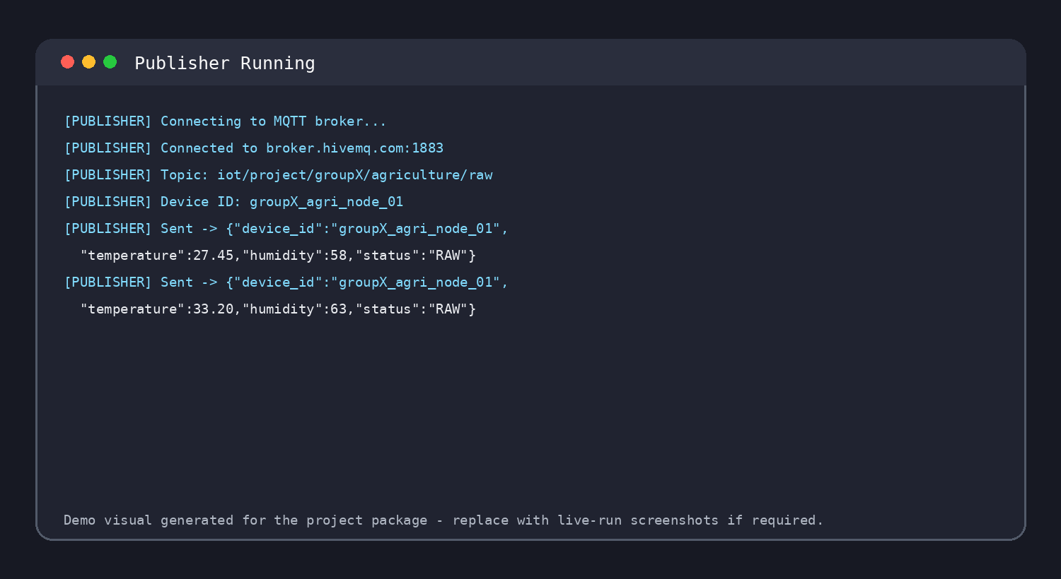
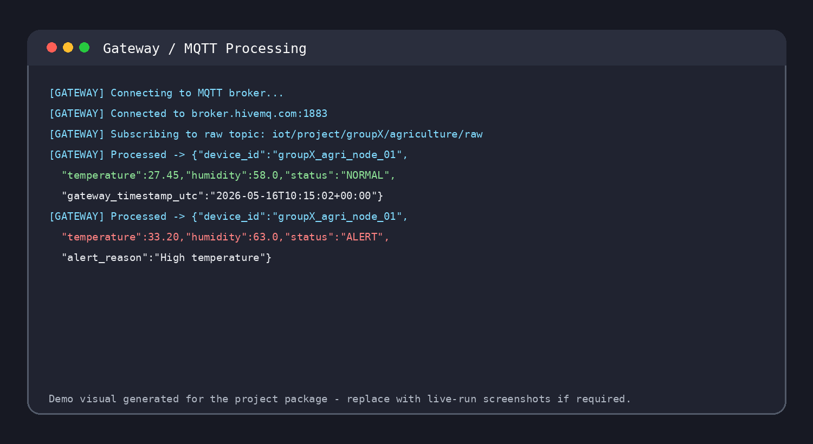
Runtime Evidence: Publisher and Gateway
Screenshots included in the package and replaceable with live-run captures
Publisher: JSON every 2-3 sec
Gateway: validation + status
CAI26442 | Smart Agriculture Monitoring | Slide 6

Slide 7
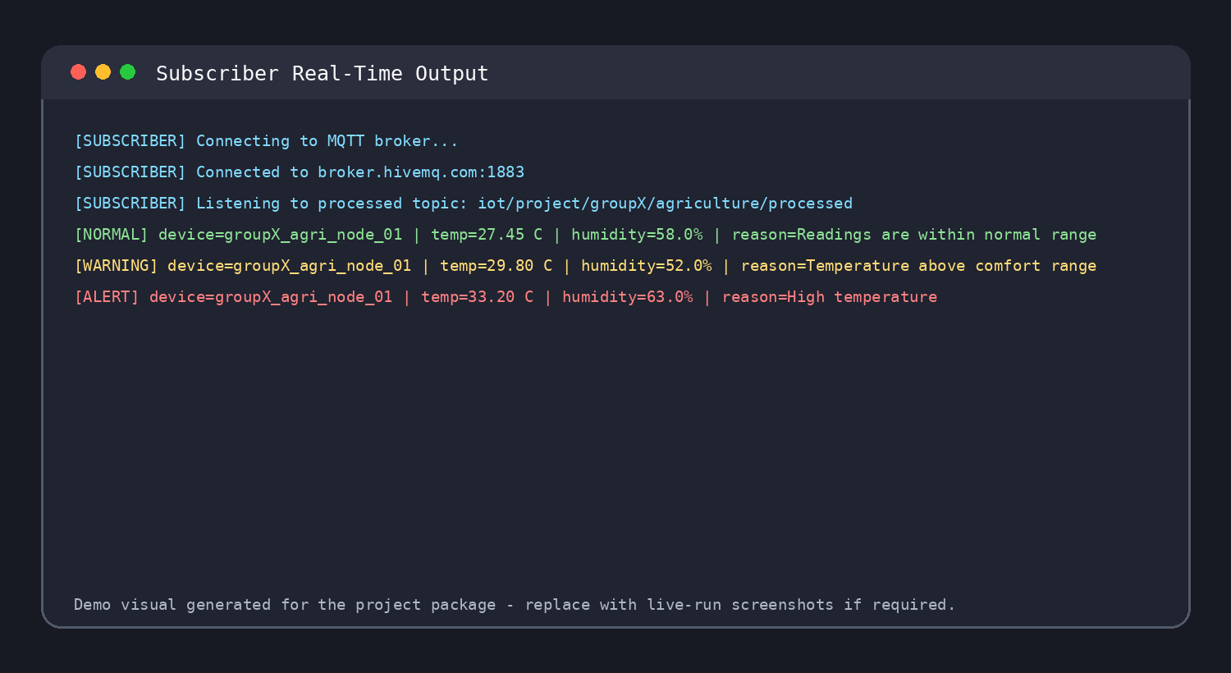
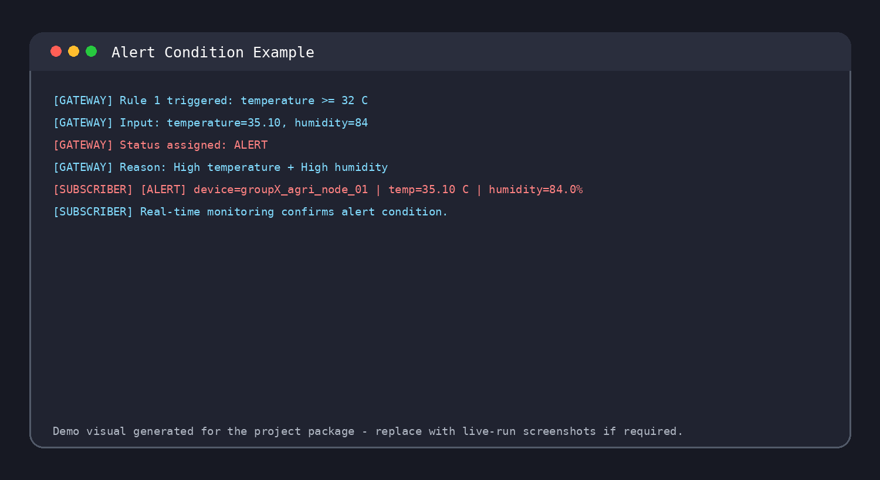
Runtime Evidence: Subscriber and Alert
Real-time monitoring output and threshold trigger
Subscriber monitoring
Alert condition example
CAI26442 | Smart Agriculture Monitoring | Slide 7

Slide 8
Conclusion and Demonstration Flow
A 5-10 minute presentation structure
• The project meets the required virtual IoT architecture.
• Two sensors, JSON modeling, MQTT publish/subscribe, gateway processing, and alerts are implemented.
• The live demo can be shown in three terminal windows: gateway, subscriber, publisher.
• Replace GroupX and member placeholders before submission.
1. Gateway
Start processing layer
2. Subscriber
Start monitoring output
3. Publisher
Generate readings
Ready for demonstration
CAI26442 | Smart Agriculture Monitoring | Slide 8

