Slide 1
Game Engineering Principles
Game Design Process
Albert Danison,
January 2019

Slide 2
GAME DESIGN PROCESS
What is a Game?
Before we get into the game design process, it’s important to define what a game is
Games differ from other types of media in a few ways:
  Games are interactive
  Games have rules
  Games have one or more goals
Let’s examine each one of these and expand upon them

Slide 3
GAME DESIGN PROCESS
Interactivity
A game is something that one or more participants play
Players interact with the system of a game in order to experience the play of the game
Games will contain some form of artificial conflict or contest of powers
  This contest can be solo or multiplayer
  Cooperative or competitive
Since the player exists outside the game, developers have to design systems just to link the player to the game
Graphics, sounds and the user interface presents the gaming experience to the player
One thing game designers can never concretely do is define HOW the player is going to play the game
But they can define what the player can and can’t do

Slide 4
GAME DESIGN PROCESS
Rules/Mechanics
Rules that define the operation of the game are the core mechanics of the game, or the foundations of gameplay
The designer has their vision translated into a consistent set of rules that can be interpreted by a computer
But who actually translates the vision?
  Software developers!
In order words, the mechanics are what the player can and can’t do and how the game works
Game developers write software that best supports the core mechanics, not the other way around
If the core mechanics aren’t sound, you get a poor game

Slide 5
GAME DESIGN PROCESS
Story/Narrative
A game is often made because someone wants to tell a story
Every game can be said to have a story
  Sometimes the game itself is the story
  Sometimes the player creates their own story just by playing
Narrative is a story told by the author or designer to the player
Narrative is often non-interactive and thus can adversely affect gameplay, and another word for it is exposition
  Cutscenes
  Log entries or a codex
  Essentially anytime the player STOPS playing the game to get another piece of the narrative
Sometimes exposition can be blended into gameplay
  An NPC explains things as you play the game
  This can often easily be ignored by the player, however

Slide 6
GAME DESIGN PROCESS
Goals
When we look at goals in a game, we look back at what the player can and can’t do, but more so, we add one question:
  Why play the game?
Different players can play the game for different reasons, so it’s best to give players as many reasons as possible
One of the most common goals is to finish the game
But there can be multiple win and lose conditions
Does a game have to have both a win and lose conditions?
Within the game, there can be multiple objectives
Players can create their own goals or reasons to play
It’s important to look at the different types of players

Slide 7
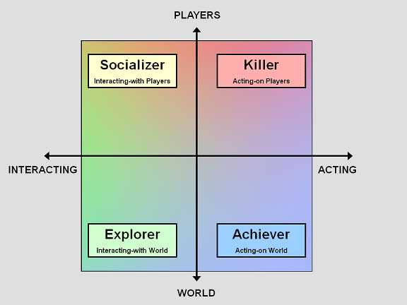
GAME DESIGN PROCESS
Bartle’s Taxonomy
Bartle’s Taxonomy categorizes players into four groups:

Slide 8
GAME DESIGN PROCESS
Bartle’s Taxonomy
Socializers
  Like to interact with players in a peaceful manner through chatting or roleplaying and cooperative gameplay
Killers
  Like to act on players through combat, i.e. they are ones who are competitive and enjoy player-vs-player activities
Achievers
  Like to act upon the world, trying to be the first to acquire items or gain experience as fast as possible
Explorers
  Interact with the world, trying to be the first to explore an area or see as much of the world and narrative as possible

Slide 9
GAME DESIGN PROCESS
Other Considerations
During design, you’ll have to consider other questions. These questions will be asked even in the very early concept phase:
  Who is the game for?
    Who is our target audience?
    Who will buy the game?
  Is the game similar to other games before it?

Slide 10
GAME DESIGN PROCESS
Game Design Tools/Documents
There are several tools that help game designers turn an idea into a concept and then into a detailed design
High Concept
  Identifies the fundamentals of the game
  It is meant to get an audience with a producer or publisher
  We’ll cover this in detail
Game Treatment
  Presents the game in broad outline to those already interested in the idea, i.e. producer or publisher
  Expands on the high concept
  Mock screen shots, character backgrounds, a brief description of the overall story arc, etc.

Slide 11
GAME DESIGN PROCESS
Game Design Tools/Documents
Game Script (Game Design Document)
  Largest and often last document in the design process
  Documents design decisions and is the definitive reference for the structure and organization of the game
  Covers game storyline, characters, user interface, and game rules/mechanics
  Should include technical specifications but does not include the technical design – there’s a technical design doc for that
    TDD is written by lead programmer or tech. director

Slide 12
GAME DESIGN PROCESS
High Concept Document
The HCD should be short, 2-4 pages in length
Begins with a high concept statement, a short and catchy sentence that describes the game in a nutshell
Contains headings for these items:
  The high concept
  The game’s premise, expanding on the high concept
  The game’s typical gameplay
  The game’s overall narrative, if any
  The game’s unique selling points
  The game’s genre (we’ll cover these later)
  The game’s target audience
  The game’s target platforms

Slide 13
GAME DESIGN PROCESS
High Concept Document
Some options items could be:
  Profiles of development team members
    This could help the pitch if you detail relevant past experience
    You’ve got the right team for the right job
  A budget estimate
  A description of any special technologies required

Slide 14
GAME DESIGN PROCESS
Designing a Game
By now, you should be familiar with C++
We can now start looking at how to build a game and its basic elements
For multimedia elements like images and sound, we’re going to use a high-level library called SDL
  Simple DirectMedia Layer
Also has support for easy mouse, keyboard and controllers
Because it’s high-level, all we do is invoke several extra functions and pass parameters and SDL does the rest
But let’s look at a few basic programs

Slide 15
GAME DESIGN PROCESS
Designing a Game
By now, you should be familiar with C++
We can now start looking at how to build a game and its basic elements
For multimedia elements like images and sound, we’re going to use a high-level library called SDL
  Simple DirectMedia Layer
Also has support for easy mouse, keyboard and controllers
Because it’s high-level, all we do is invoke several extra functions and pass parameters and SDL does the rest
But let’s look at a basic game example
What if we were to design a simple number-guessing game between two players

Slide 16
GAME DESIGN PROCESS
Designing a Game
For a bit more context, we will ask two players, in turn, to guess a random number between 1 and 100 inclusive
For feedback, we can tell the guesser if their guess was too low, too high or correct
  If not correct, the next player guesses and it continues
We could ask the player their names for some personalization
Let’s look at the process to develop a program
And together, we can identify some of the important steps

Slide 17
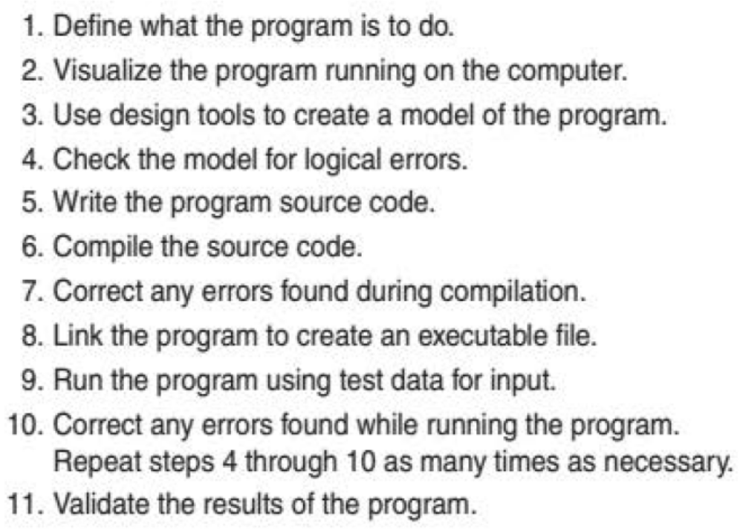
GAME DESIGN PROCESS
Building a Game
Design
Implement
Test

Slide 18
GAME DESIGN PROCESS
Designing a Game
Who is going to play the game?
  This should be obvious
What is the goal of the game?
  Again, not a difficult example to start with
What are some of the rules of the game?
After we identify some key design elements, we can brainstorm some steps that would occur during gameplay

Slide 19
GAME DESIGN PROCESS
Designing a Game
Okay, now let’s look at a potential solution in C++

Slide 20
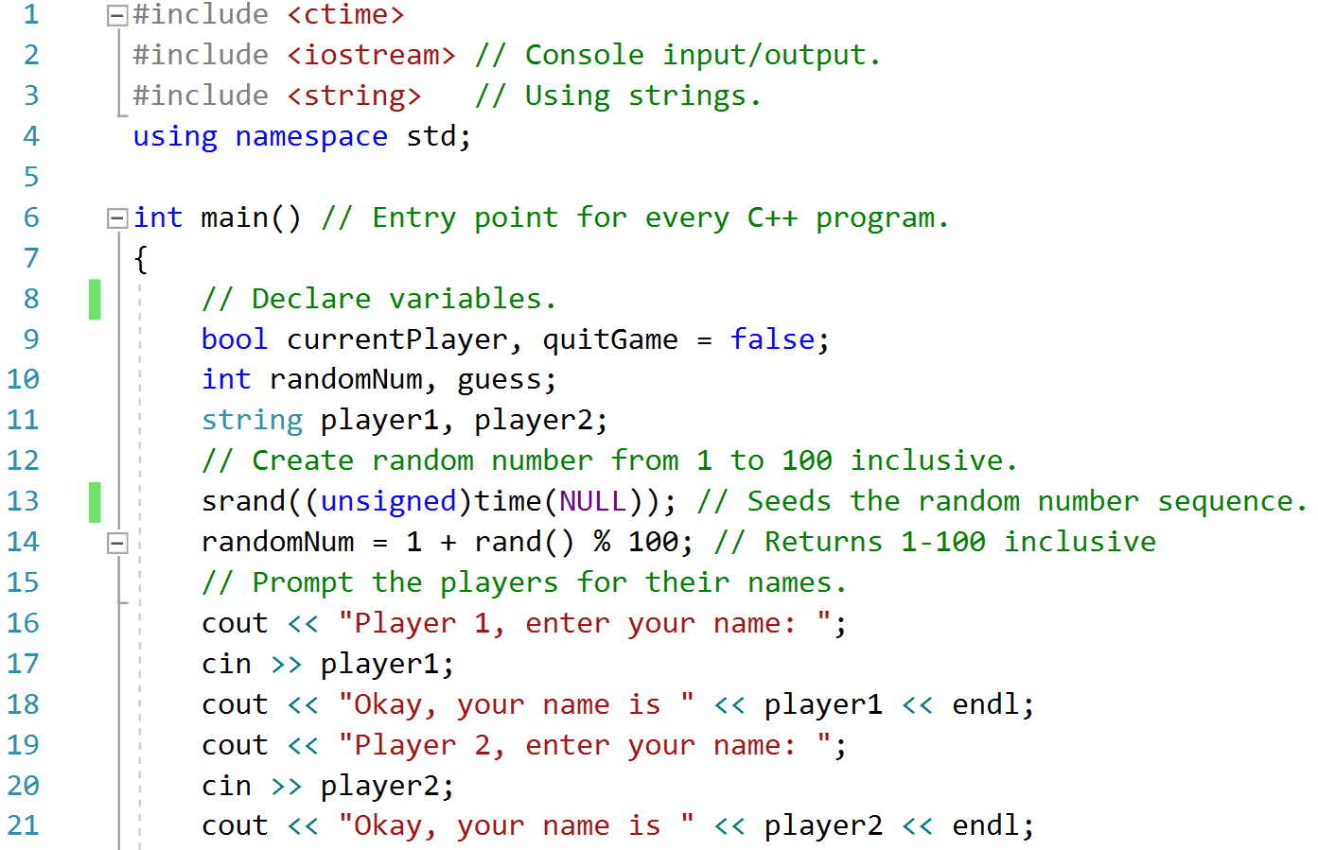
GAME DESIGN PROCESS
Designing a Game

Slide 21
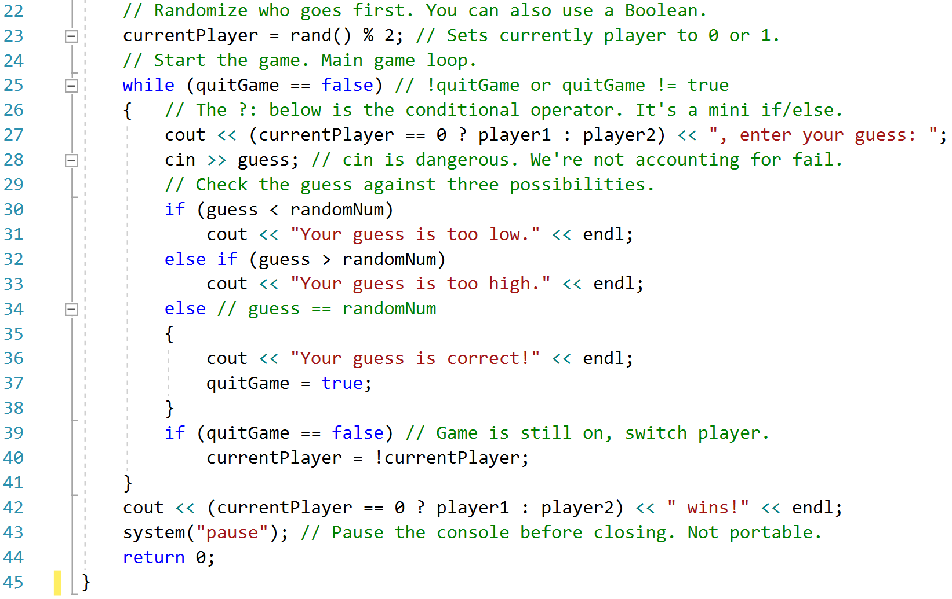
GAME DESIGN PROCESS
Designing a Game

Slide 22
GAME DESIGN PROCESS
Designing a Game
As a developer, you’ll develop a first playable, an alpha, a beta and then the finish product (gold)
Through the process, you’ll analyze potential problems or limitations and fix them
Can you identify some potential problems in our example?
Are we ensuring the user only enters 1 to 100?
Are we handling input that could lead to an input fail state?
As designers, we have to try to predict how the user the play the game in order to prevent undesired results
This is where Quality Assurance and testing comes in
Once developers finish a build, they’ll have a team to test it thoroughly and it’s a repeating process

Slide 23
GAME DESIGN PROCESS
Designing a Game
While the previous example is simple, it does show some of the game elements you’ll commonly find
Every game you make will consist of:
  Some sort of initialization
  A main game loop
    Input operations
    Processing operations
    Output operations
  Some sort of clean-up

Slide 24
return 0;

