Slide 1
Game Engine Physics
Simple DirectMedia Layer

Slide 2
GAME ENGINE PHYSICS
Introduction to 2D Physics
Now that we’ve setup the premise for a basic ship shooter, we can modify it to introduce some simple velocity-based collision
We’ll also add one type of simple 2D collision
  Circle collision
  There’s also AABB (axis-aligned bound box)
  OBB (oriented bounding box)
While we can certainly implement AABB easily, we’ll start with circle collision as it will accommodate some rotation of a sprite but it’s not without its flaws
These collision types are demonstrated in the next slide

Slide 3
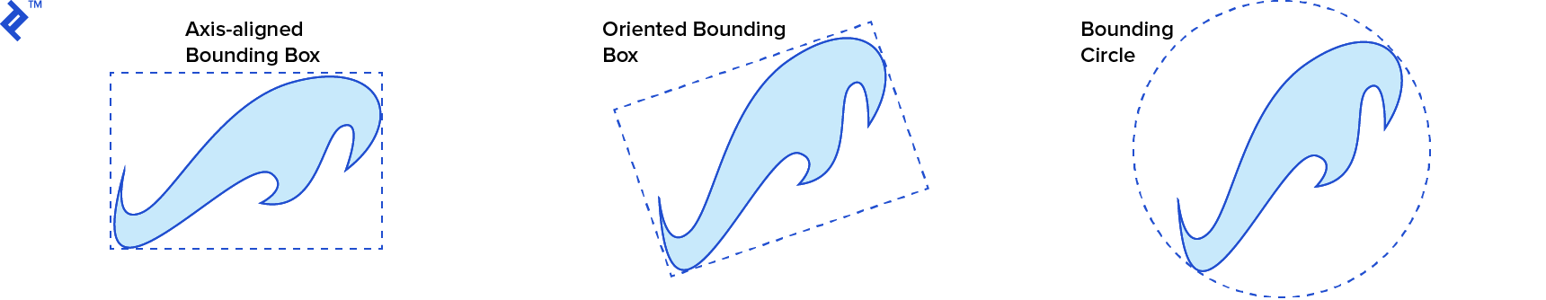
GAME ENGINE PHYSICS
Introduction to 2D Physics
Now that we’ve setup the premise for a basic ship shooter, we can modify it to introduce some simple velocity-based collision
We’ll also add one type of simple 2D collision
  Bounding circle collision
  There’s also AABB (axis-aligned bound box)
  OBB (oriented bounding box)

Slide 4
GAME ENGINE PHYSICS
Introduction to 2D Physics
Axis-aligned is so named because the box is always oriented to the x and y axis (horizontal/vertical)
OBB requires a bit more calculation
While we can certainly implement AABB easily, we’ll start with circle collision as it will accommodate some rotation of a sprite but it’s not without its flaws
Our circle is essentially a radius and we can set it to any size
You’ll see how we add this collision later but first let’s get into the details of our new example

Slide 5
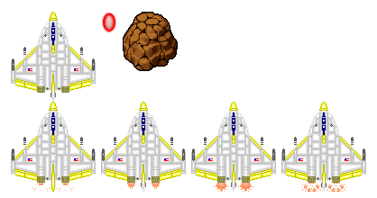
GAME ENGINE PHYSICS
Introduction to 2D Physics
We’re not using missiles anymore because they would be too long for circle-circle collision, so we now have an energy bullet
Here’s our new sprite sheet:
We are animating the player the same way but there is no sprite animation for the bullet and an asteroid obstacle

Slide 6
GAME ENGINE PHYSICS
Shooter Project
This example will have:
  A top-down perspective
  The ship/jet for the player
    The ship moves forward with W
    The ships rotates left/right with A/D
    The ship fires bullets with the left mouse button
  (Optional) The ship animates when moving forward (engine flame)
  There is simple acceleration and deceleration
  What’s most important is to show you how to translate an angle into a change in x and y (deltaX/deltaY) into a movement vector for the player
  And adding velocity onto that vector

Slide 7
GAME ENGINE PHYSICS
Circle Collision
Now we’ll get into adding the circle collision for the player, bullets and asteroids, but first we need the asteroids into our Sprites files

Slide 8
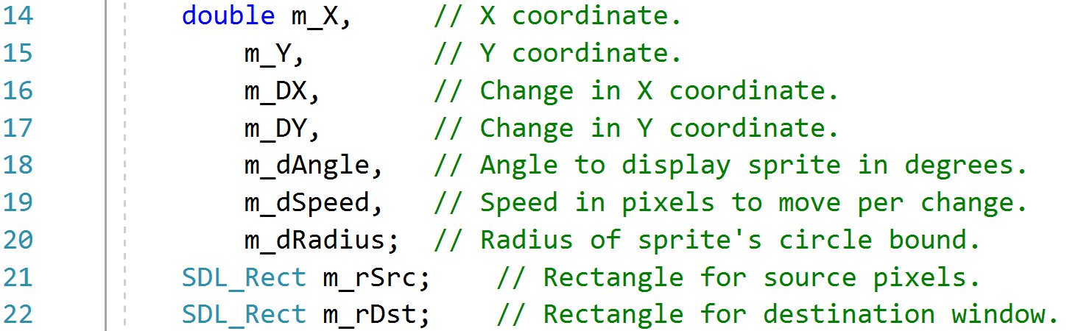
GAME ENGINE PHYSICS
Circle Collision
A double was added for the radius bound to the protected members:
Now that we have that member, we will add a statement to the constructor of each the Bullet, Player and new Asteroid class to set it
There are many different ways we can do it, but I figured the easiest way for now was just to add the line at the end of each constructor
A few getters are added in Sprite that we’ll invoke in the Game engine

Slide 9
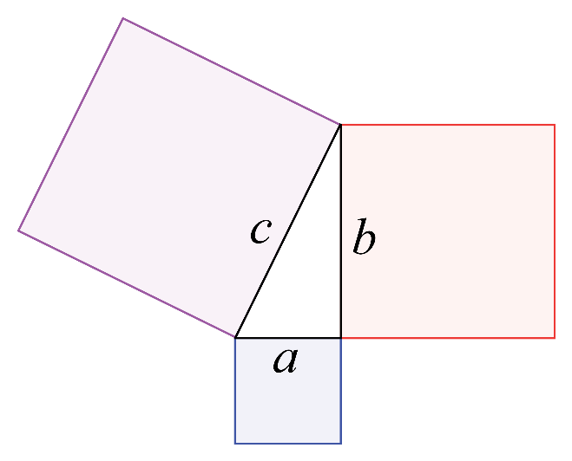
GAME ENGINE PHYSICS
Circle Collision
Wow, that’s short but it gives me lots of room for an explanation
It’s best to look at the equation in the return statement into two parts:
This first part before the < sign, gets the distance between two points
How does it work? Pythagorean theorem of course!
We’ve got a basic equation of:
  c2 = a2 + b2
where c is the distance and
a and b are the changes in axes

Slide 10

GAME ENGINE PHYSICS
Circle Collision
This second part of the equation adds the two radii of the two objects that would be colliding and then there’s the comparison in between
I could also have a <= instead of just a < but in my opinion they’d only be touching and the good stuff doesn’t happen until there’s penetration
And finally, I’m demonstrating the usefulness of a return statement by having all of that good stuff in one line
Finally, we’ll have a look at the changes/additions in Update(), Render() and Clean() and that should be the end of the addendum document

Slide 11
return 0;

