Slide 1

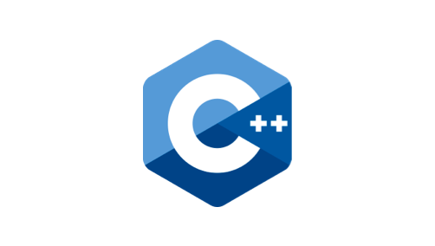




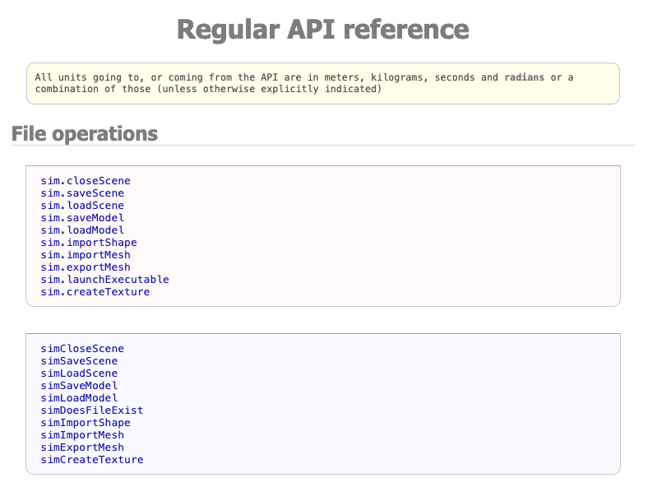
Remote Interaction: Standard Programming
Socket
Buffer
MQ-based API

Slide 2


Remote Interaction: Leveraging LLMs
MCP
Client
MCP
Server
MQ-based API
Socket
Buffer

Slide 3
Remote Interaction: Leveraging LLMs
MCP
Client
MCP
Server
GET Tools, prompts and resources
Response
What joints does my robot have?
What joints does my robot have?
---------------------
Servers Avaiable tools : {‘list _joints’, ..}
User wants a list of the robot joints. Let’s execute the list_joint actions on the MCP server
Remote Procedure Call for list_joints
API Call: simGetObjectsInTree
[ handlers list]
API Call: simGetObject
Structured response: [{‘id’:’m1’, ‘position’:0.234, …},{‘id’:’m2’, ‘position’….}]
[ object]
Chat history (communication context) + Joints list (data context)
You robot has three joints, one called …..

