Slide 1
AI-Powered E-Commerce Sales Forecasting
A ppt submitted to Godavari Institute for BCA degree fulfillment.
By Danish Khan, under the guidance of Prof. Prashant Bahekar.
CLASS: BCA III
ROLL NO: 9

Slide 2
Project Introduction
1
Critical Business Function
2
Comprehensive System
3
User-Friendly Tool
Uses advanced machine learning for accurate predictions,. In today's competitive e-commerce landscape, accurate demand forecasting has become essential for inventory management,
Accessible via web application using Streamlit,making it accessible to users without specialized technical knowledge. The interface allows users to explore historical sales data,By leveraging the XGBoost algorithm
Enables online retailers to anticipate future demand patterns, This project implements a comprehensive forecasting system that uses advanced machine learning techniques to analyze historical sales data.

Slide 3




Algorithm Evaluation Process
Data Collection
Process historical sales data for time series analysis.
Feature Engineering
Create time series features to capture seasonality.
Model Selection
XGBoost chosen for regression tasks.
Performance Evaluation
Use MAE, MSE, RMSE, and R² metrics.

Slide 4
Project Objectives
Accurate Forecasting
User-Friendly Interface
Actionable Insights
Predict e-commerce sales trends with minimal error.
Visualize data and forecasts without technical skills.
Assist in inventory and marketing strategy planning.

Slide 5



Need for the Project
Inventory Optimization
Maintain optimal inventory levels.
Strategic Planning
Make informed decisions about resource allocation.
Marketing Optimization
Enable precise timing of marketing campaigns.
E-commerce projected to reach \$7.9 trillion by 2027.

Slide 6
System Requirement Analysis
Technical Feasibility
Economic Feasibility
Operational Feasibility
Uses open-source technologies like Python and XGBoost.
Leverages cost-effective open-source libraries.
Intuitive web interface for non-technical users.

Slide 7
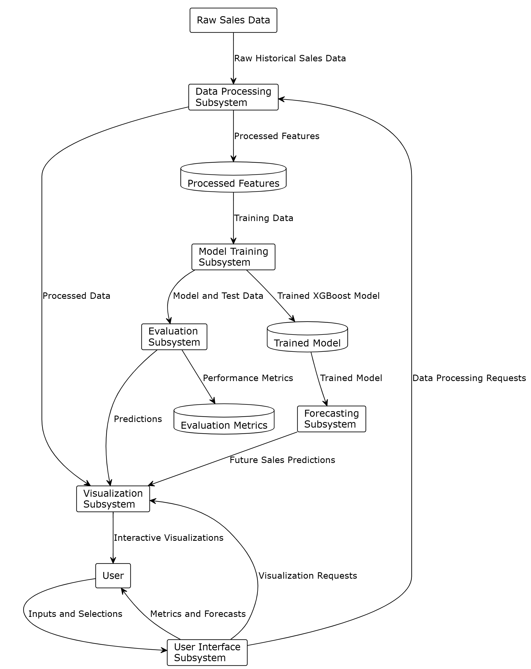
DATA FLOW DIAGRAM :-

Slide 8
Hardware and Software Requirements
Hardware
Software
High-performance server for data processing.
Python (3.7+).
Sufficient RAM for handling large datasets.
XGBoost library for machine learning.
Fast storage (SSD) for quick data access.
Streamlit for web interface.
Robust hardware ensures efficient model training.
Software stack enables scalable and user-friendly forecasting.

Slide 9



Strengths of the System
Predictive Modeling
1
Leverages XGBoost algorithm.
Feature Engineering
2
Implements time-based features.
Visualization
3
Interactive charts.
Provides accurate forecasts and supports business functions.

Slide 10
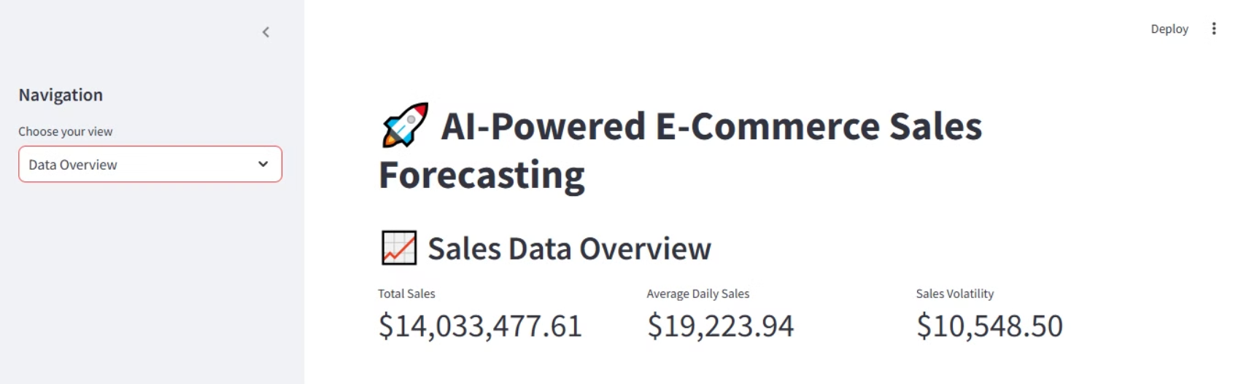
OUTPUT:

Slide 11
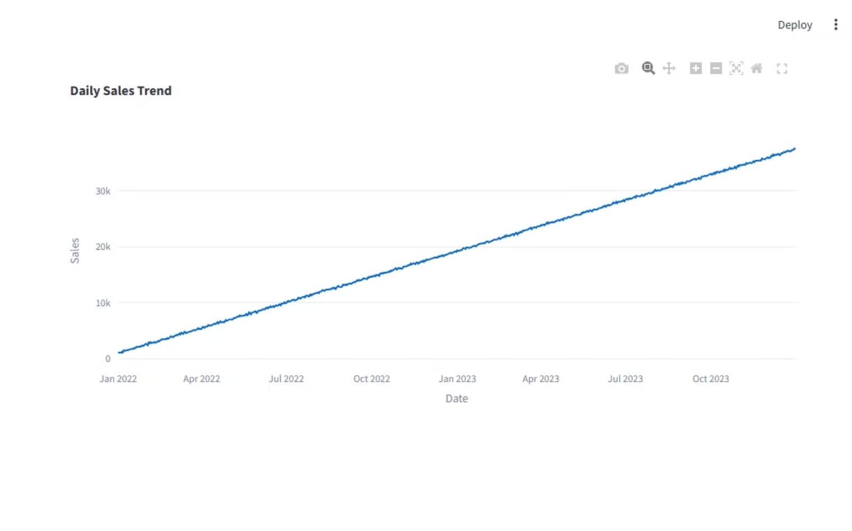

Slide 12
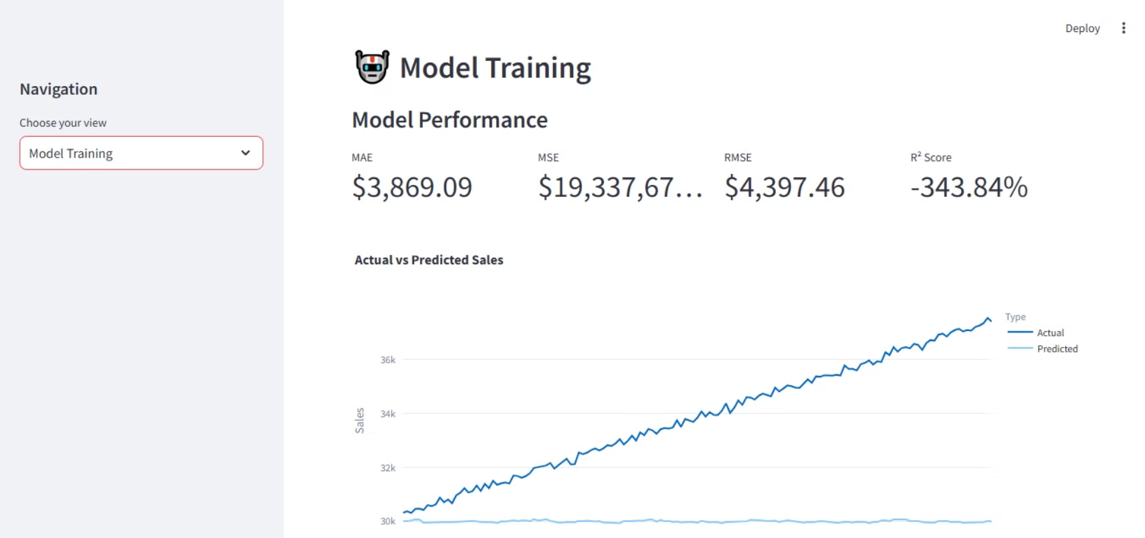

Slide 13
Conclusion
The E-Commerce Sales Forecasting System represents a significant advancement in applying machine learning techniques to solve critical business challenges in the rapidly growing e-commerce sector. By combining sophisticated time series analysis, feature engineering, and the powerful XGBoost algorithm with an intuitive user interface, the system makes advanced forecasting capabilities accessible to business users without requiring specialized technical knowledge.
The implementation demonstrates how carefully designed data preprocessing, including temporal feature extraction and lag variable creation, can significantly enhance the predictive power of machine learning models for time series forecasting. The modular architecture ensures maintainability and extensibility, while the interactive visualizations facilitate data exploration and insight discovery.

Slide 14
Thank You
Thank you for your time and attention.
I hope this presentation was informative.
Presented by:
Danish Khan
Contact:khandanish9637202992@gmail.com
Class: BCAIII

