Slide 1
Database
Dec - 2018

Slide 2
Data & DBMS
Database Collection of data
DBMS is a software used to manage the database
DBMS is a collection of data & set o f progams to access and store these data in an easy & efficient manner
DBMS is a software which is used to manage database

Slide 3
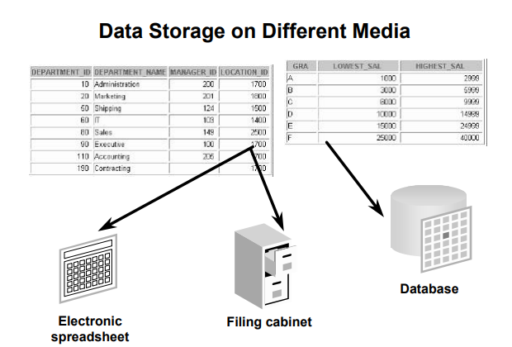

Slide 4
Why we need DBMS
organize data in a manner which allows us to query data, sort data, and manipulate data in various ways
important because it manages data efficiently and allows users to perform multiple tasks with ease. A database management system stores, organizes and manages a large amount of information within a single software application
Why we don’t use file based data data redundancy , Inconsistent,

Slide 6
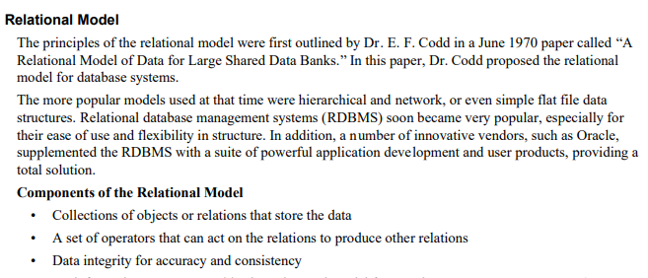

Slide 7
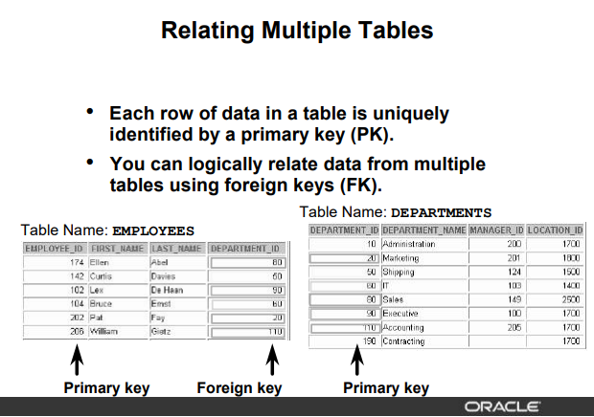

Slide 8
You can not use duplicate values in a primary key.
Primary keys generally cannot be changed.
Foreign keys are based on data values and are purely logical, not physical, pointers.
A foreign key value must match an existing primary key value or unique key value, or else be null.
A foreign key must reference either a primary key or unique key column

Slide 9








Slide 10
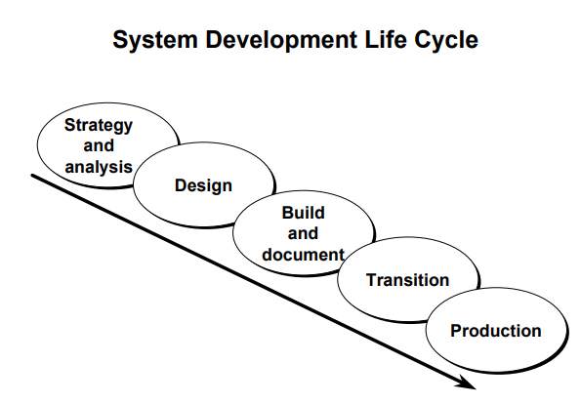

Slide 11
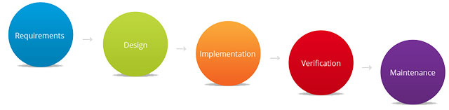
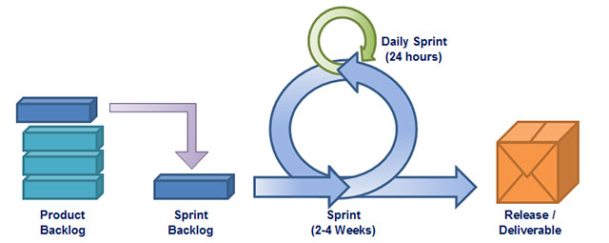
Traditional
Agile

Slide 12
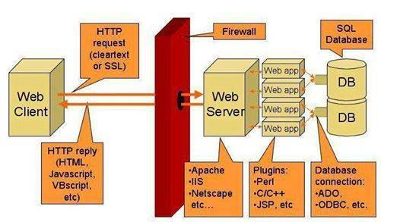

Slide 13
Installation Postgresql
Postgresql.org
For windows
https://www.postgresql.org/download/windows/
PostgreSQL Global Development Group
1989
Automated management
Data Visualization
SQL Database
Hadoop Platform

Slide 14
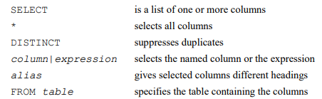
Basic select

Slide 15
MySQL Most Common Data Types
Numeric
Integer (255), Float (2.5), Decimal(02,550)
Date Time
Date(2018-12-8), Datetime (2018-12-8 05:30:00), Timestamp
String
Char(0-255,spaces), VarChar(No Trainling spaces, 65,535 bytes), Blob (Binary)

Slide 16
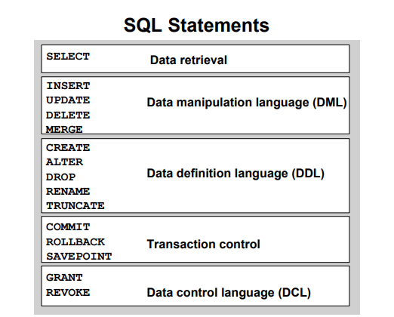

Slide 17
Select
SELECT
[ALL | DISTINCT | DISTINCTROW ]
FROM table_references
WHERE where_condition
SELECT identify what column
FROM identify which table

Slide 18
Select
Select All Columns
SELECT * FROM <Tablename>
Select specific columns
SELECT [list of columns] FROM <Tablename>

Slide 19
Select with Arthimatics
Add, Subtract, Multiply, Divide
SELECT firstname, lastname, salary ,salary +300 FROM employees
Operator Precedance
SELECT firstname, lastname, salary ,12*salary +300 FROM employees
Using Paranthesis
SELECT firstname, lastname, salary ,12*(salary +300) FROM employees

Slide 20
Column Alias
SELECT firstname, as name lastname, salary *12 as “Anuual Salary” FROM employees
Concatenating Operator (||)
SELECT firstname || lastname as “Full NAME”
FROM employees

Slide 21
Eliminating Duplicate Rows
SELECT DISTINCT department_id from employees

Slide 22
Using Where Clause
SELECT firstname, lastname FROM Employees Where department_id=1
SELECT firstname, lastname FROM Employees Where lastname=‘Nafisa’

Slide 23
MySQL Comparison Operator
Name Description
BETWEEN ... AND ... Check whether a value is within a range of values
COALESCE() Return the first non-NULL argument
= Equal operator
<=> NULL-safe equal to operator
> Greater than operator
>= Greater than or equal operator
GREATEST() Return the largest argument
IN() Check whether a value is within a set of values
INTERVAL() Return the index of the argument that is less than the first argument

Slide 24
IS Test a value against a boolean
IS NOT Test a value against a boolean
IS NOT NULL NOT NULL value test
IS NULL NULL value test
ISNULL() Test whether the argument is NULL
LEAST() Return the smallest argument
< Less than operator
<= Less than or equal operator
LIKE Simple pattern matching
NOT BETWEEN ... AND ... Check whether a value is not within a range of values
!=, <> Not equal operator
NOT IN() Check whether a value is not within a set of values
NOT LIKE Negation of simple pattern matching
STRCMP() Compare two strings

Slide 25
Logical Operators
Name Description
AND, && Logical AND
NOT, ! Negates value
||, OR Logical OR
XOR Logical XOR

Slide 26
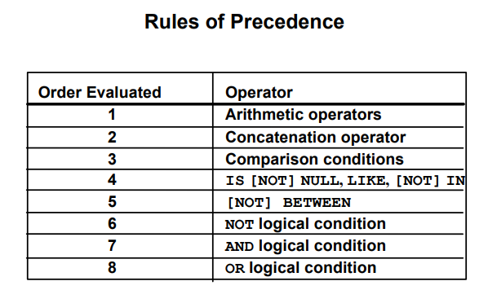

Slide 27
Practice Where
SELECT employee_id, last_name, job_id,salary
FROM employees
WHere salary >=10000
AND job_id like '%sales%'

Slide 28
ORDER BY Clause
* Sort rows with the ORDER By Clause
- ASC : Ascending order (the default order)
- DESC: descending order
*The ORDER BY clause comes last in the SELECT statement
SELECT firstname,lastname, salary
FROM employees
ORDER BY depertment_id asc
SELECT firstname,lastname, salary
FROM employees
ORDER BY depertment_id desc
SELECT firstname,lastname, salary
FROM employees
ORDER BY depertment_id,salary asc

Slide 29
List of Supported Functions in MYSQL
https://dev.mysql.com/doc/refman/8.0/en/func-op-summary-ref.html
INSTR() | Return the index of the first occurrence of substring
LENGTH() | Return the length of a string in bytes
TRIM() | Remove leading and trailing spaces
TRUNCATE() | Truncate to specified number of decimal places
SUM() | Return the sum

Slide 30
YEAR() WEEK() DAY()
CURTIME() | Return the current time
DATE() | Extract the date part of a date or datetime expression
CURDATE() | Return the current date
FLOOR() | Return the largest integer value not greater than the argument
ABS() | Return the absolute value
CONCAT() | Return concatenated string
LOWER() | Return the argument in lowercase
COS() | Return the cosine
UPPER() | Convert to uppercase
COUNT() | Return a count of the number of rows returned
MAX() | Return the maximum value

Slide 31
MD5() | Calculate MD5 checksum
POW() | Return the argument raised to the specified power
POWER() | Return the argument raised to the specified power
PASSWORD() | Calculate and return a password string
SHA1(), SHA() | Calculate an SHA-1 160-bit checksum

