Slide 1
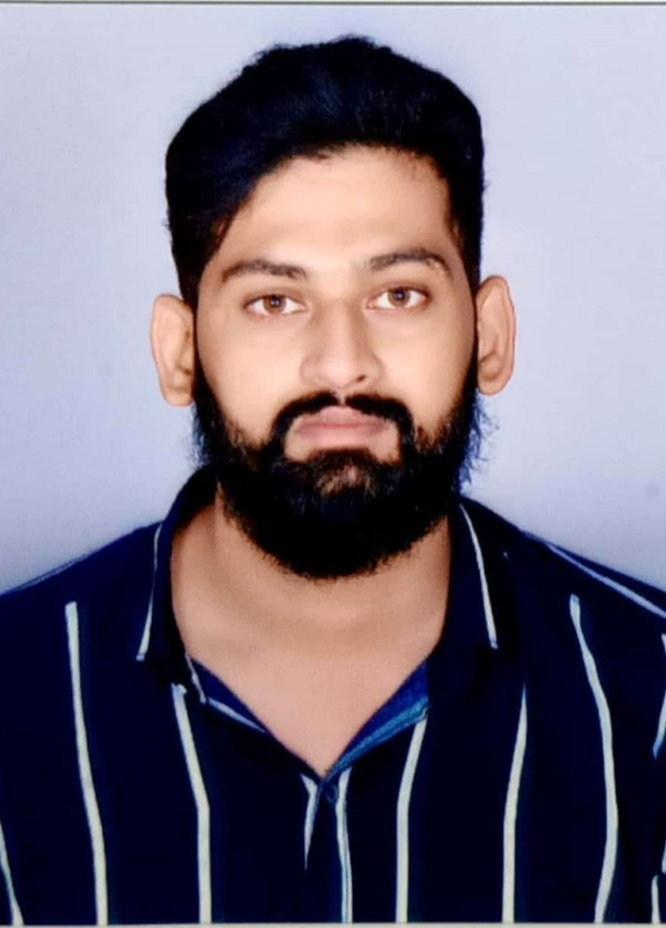
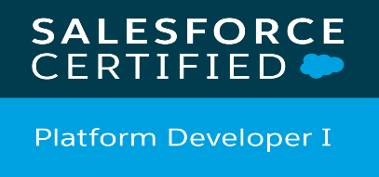
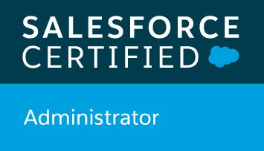

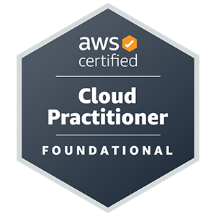
Vinay Alsa– Salesforce Developer
Relevant Experience
Salesforce Developer at Cognizant Technology Services, Hyderabad, India
Implemented multiple integration APIs to retrieve data from external sources, provided live service support, particularly in the insurance industry project (DLG-Direct line group), And used Tools like Jira, GitHub, and Visual Studio code.
Responsible for implementing component-based security by configuring user permissions, record type permissions, and field-level security within the Salesforce org, Debugging and troubleshooting issues raised by users, and ensuring the smooth functioning of the Salesforce applications.
Developed a user-friendly digital UI web-based signup form for onboarding new regions, seamlessly integrating LWC Framework with Apex and triggers. Ensured robust communication between systems through REST and SOAP APIs, deploying the new functionality within the existing platform framework.
SFDC developer & Admin at LTIMindtree Ltd, Hyderabad, India.
Developed Apex classes, triggers, Visualforce pages, components, and controller extensions to create custom functionality and user interfaces within the Salesforce platform, including public-facing websites using Force.com Sites.
Set up Marketing Campaigns, Campaign Hierarchies, Lead Queries, Assignment rules, Web-to-Lead and Auto-Response rules, Configured Campaign Management, Campaign Influence, and Lead Conversion.
Managed user accounts, roles, profiles, and sharing rules to define access levels, and permissions, implemented data management processes, including data migration using the Data Loader tool, and configured security settings like tab permissions, record type permissions, field-level security, and sharing rules to control access and data visibility.
Used Visualforce Templates and Placeholders to encapsulate page elements to be reused across several Visualforce pages, Tab permissions, Record Type permissions, and Field Level Security to implement Component-based security.
Implemented Data migration using Data Loader, Created/added, and managed Users, Roles, and Profiles, and set up sharing rules.
Involved in Salesforce.com Application Setup activities and customized the apps to match the functional needs of the organization Worked with standard Salesforce objects like Accounts, Contacts, Leads, Cases, and Opportunities
Created Custom Visualforce components and attributes to override the look and feel of standard Visualforce components.
Executive Summary
Salesforce Administration: Custom and standard objects, fields, page layouts, record types, validation rules, schema builder, flow Builder, Process Builder, workflow rules, approval process, permission sets, Org, and object level security, OWD, Data Management.
Salesforce Development: Apex programming language, Asynchronous and Synchronous Apex, Batch Apex, Triggers, SOQL, SOSL, triggers, DML, Visualforce, Lightning Web Components Framework, Integration, REST API, SOAP API.
Salesforce Clouds: Sales Cloud, Service Cloud, Community Cloud.
Programming Languages and Database: C++, Python, MySQL, SQLite
Web Development: HTML, CSS, JavaScript, Bootstrap, GitHub.
Tools and software: Agile Methodology, Software Development Lifecycle, Jira, Microsoft Visual Studio, Deployment tools.
Soft Skills: Leadership, Communication, Time management, Teamwork, Problem-solving, Work ethic, Creativity.
Experience Summary
Lightning | Sales | Service& Community | CPQ
2.5 years | 1.1 years | 2 years | 1.2 years
Education
MS, Computer Engineering, Auburn University, Montgomery, AL
Functional Expertise
CRM Consulting
Troubleshooting
Solution Development
Technical Document
Development
Industry Sectors
Finance
Banking
Retail
Technical Expertise
Sales Cloud
Salesforce Lightning
Integration
Admin/Configurations
Methodologies
Agile
Waterfall
Languages Spoken
English
Hindi
Telugu

