Slide 1
Fat32 notes
Van Kelly
Linux hexdump is your friend!!

Slide 2
Some FAT Terminology
Partition = one entire file system
sector/block = native unit of data on drive
2 ways to specify a block
CHS = cluster-head-sector addressing (packed bit fields)
LBA = logical block addressing (this is what we use)
boot sector = first sector of partition
cluster = group of blocks allocated as one unit
FAT = file allocation table (linked list)
FAT and partition meta-data are NOT in clusters!!
Clusters start after the last FAT table!!

Slide 3
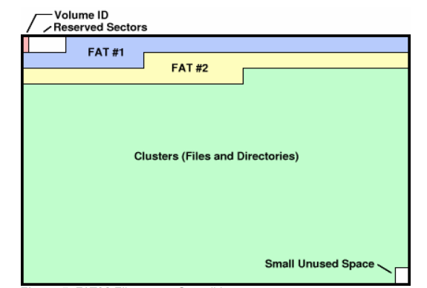



FAT32 Partition Layout
Volume ID
Reserved Sectors
FAT #1
FAT #2
cluster #02
Clusters (files and directories)
small unused space

Slide 4
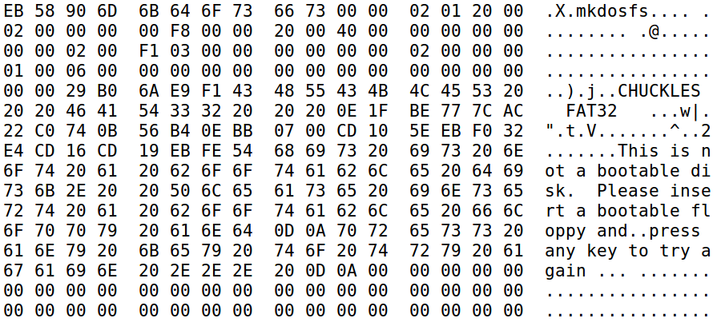

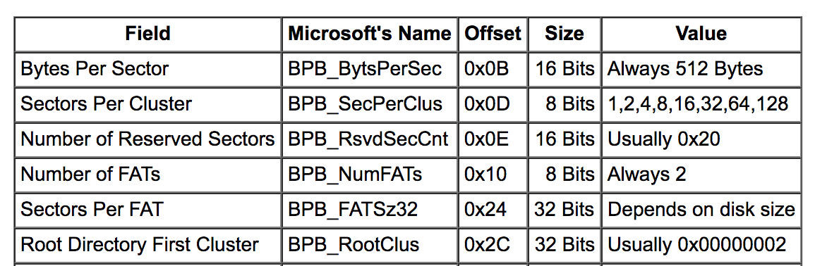
Hex Dump of Boot Sector
sectors per cluster
# of FATs
bytes per sector
sectors before FAT #1
sectors per FAT
cluster # of root directory

Slide 5
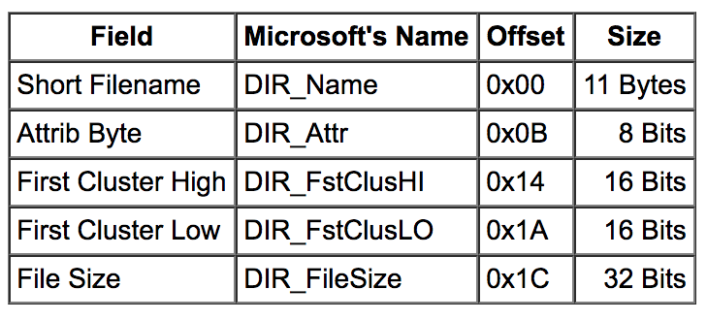
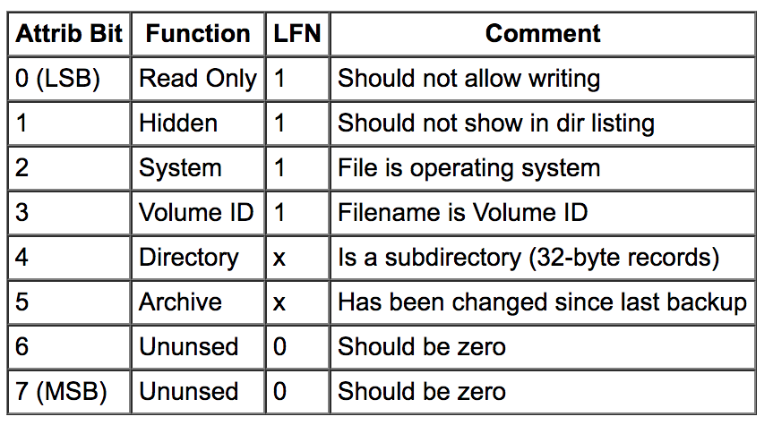
FAT32 Directory Layout
Cluster Cluster
Short Name(8+3) Attrib. High Low Size
32-byte directory layout; short filename version
if attrib = 0x0F, 0x1F, or 0x2F you can ignore this entry

Slide 6
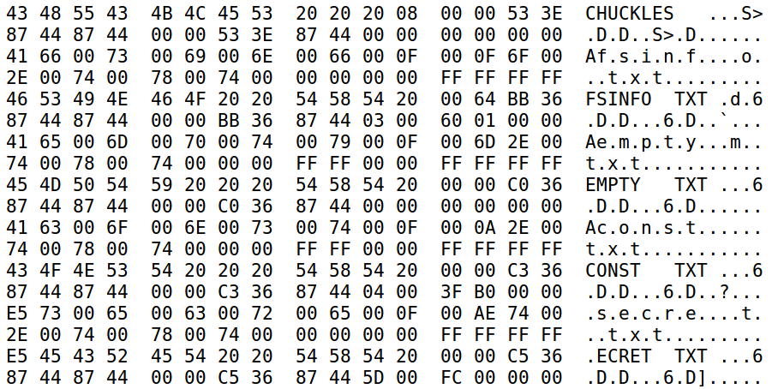
Hex Dump of Root Directory
Attrib.
???
First Clusters
File Sizes

