Slide 1
Abnormality Detection of Upper Extremity X-Rays
Gargee Jagtap, Ali Rivera, Anne Louise Seekford
Notes:
gargee

Slide 2
Musculoskeletal Radiographs
Motivation
“The AAMC (Association of American Medical Colleges) predicts there will be a shortage of 17,000 - 42,000 radiologists in the next decade”
Radiologist shortage
1.7 billion people worldwide are affected by musculoskeletal conditions
X-Rays are the most common diagnostic technique
Radiology imaging delays were an independent predictor of the length of a patient’s hospital stay

Slide 3
Data
Body part
Abnormality Label
Image Info
Elbow
Finger
Forearm
Hand
Humerus
Shoulder
Wrist
Each image is labeled as either:
0: Normal
1: Abnormal
patient No.
study No.
label
image No.
Notes:
9,045 normal and 5,818 abnormal

Slide 4
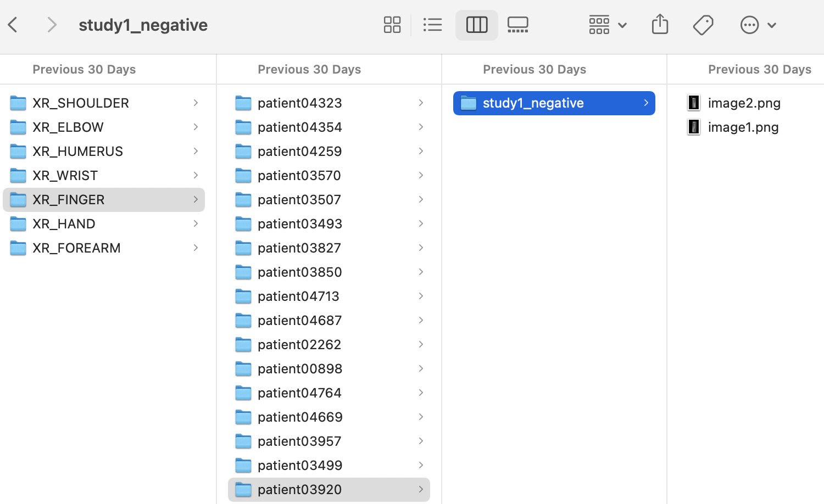
Data Preprocessing
Cleaning
Transformations
Nested folders
Labels located in image file name
Resized: 256x256
Random Horizontal Flip
Normalized :
(μ,σ) = (0.5, 0.5)

Slide 5
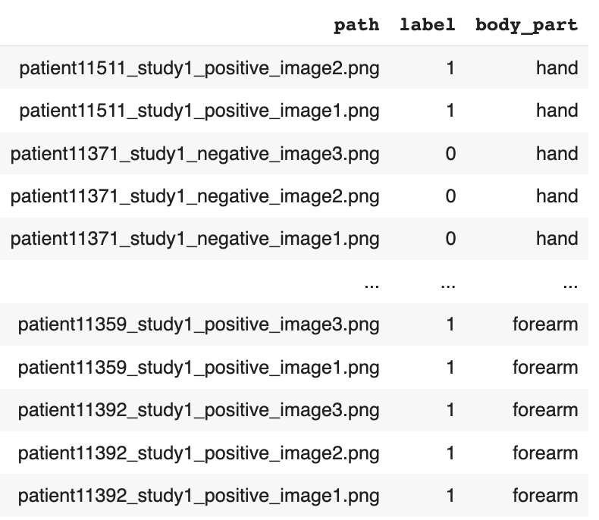
Train
Validation
Test
29,583 images (74%)
3,197 images (8%)
7,395 images (18%)

Slide 6
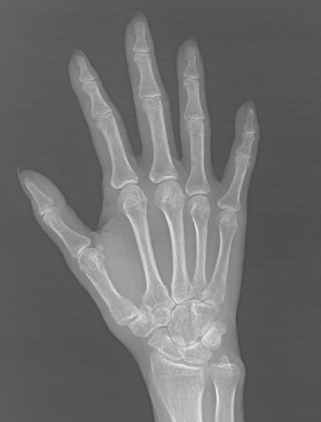
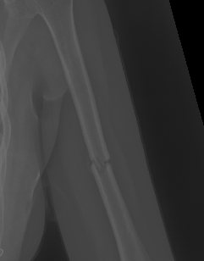
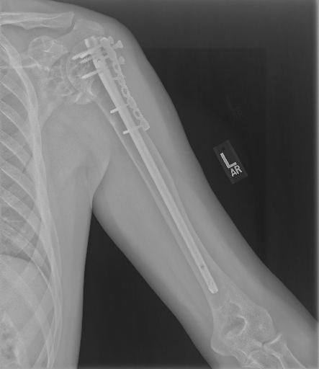
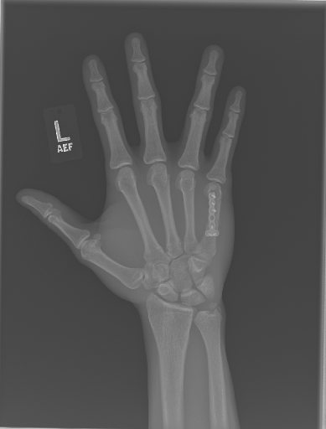
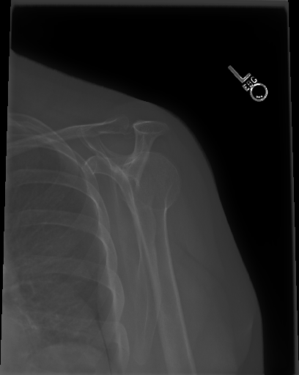
Model Pipeline
Stage 1
Stage 2
Body Part Classification
Normal/Abnormal Classification
HUMERUS
HAND
SHOULDER
0: NORMAL
1: ABNORMAL

Slide 7
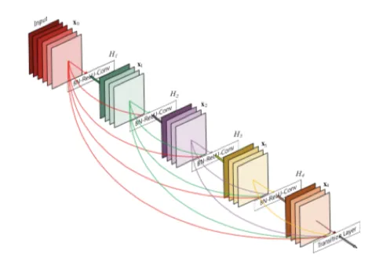
Stage 1
Shoulder
Humerus
Pretrained: DenseNet121
Linear Layer input: 2048
No. of predicted classes: 7
Optimizer: Adam
Loss Function: Cross Entropy
Learning Rate: 0.001
15 Epochs
Elbow
Forearm
Wrist
Finger
Hand

Slide 8
Stage 2
Pretrained: DenseNet121
Linear Layer input: 2048
No. of predicted classes: 2
Optimizer: Adam
Loss Function: Cross Entropy
Learning Rate: 0.001
15 Epochs
0: NORMAL
1: ABNORMAL

Slide 9
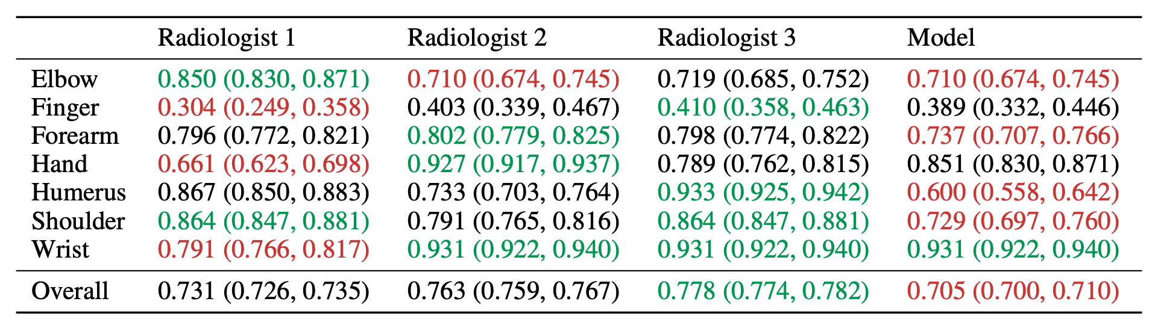
Previous Results
Agreement Measured using Cohen’s Kappa Statistic
Notes:
6 radiologists - 3 make ‘true label’, other 3 to compare performance
Kappa stat measures reliability or agreement, taking into consideration probability of agreement by chance
Review performance for each part

Slide 10
Results
Stage 1 Accuracy:
97.8%
Stage 2 Accuracy:
Body Part
Elbow
Finger
Forearm
Hand
Humerus
Shoulder
Wrist
Accuracy
81.5%
76.6%
72.1%
79.9%
73.4%
76.6%
83.1%

Slide 11
Conclusion
Compare Performances:
 | Their Model: | Our Model:
Best Performance: | Finger, Hand, Wrist | Wrist, Elbow
Worst Performance: | Forearm, Humerus, Elbow | Forearm, Humerus
Future Steps:
Get more data for body parts
Further customize models for each bodypart

Slide 12
References
Alkoby. (2023, January). Alkoby/bone-fracture-detection: Bone Fracture Detection Using Deep Learning (RESNET50) - final project in the fourth year of the degree. GitHub. Retrieved April 17, 2023, from https://github.com/Alkoby/Bone-Fracture-Detection
Alzubaidi, M. S., Shah, U., Zubaydi, H. D., Dolaat, K., Abd-Alrazaq, A. A., Ahmed, A., & Househ, M. (2021). The Role of Neural Network for the Detection of Parkinson’s Disease: A Scoping Review. Healthcare, 9(6). https://doi.org/10.3390/healthcare9060740
American Academy of Orthopedic Surgeons. (2017, June). X-rays, CT scans, and MRI scans. OrthoInfo. Retrieved March 15, 2023, from https://orthoinfo.aaos.org/en/treatment/x-rays-ct-scans-and-mris/#:~:text=X%2Drays%20(radiographs)%20are,get%20an%20X%2Dray%20first
MetaAI. (n.d.). Papers with Code - MURA dataset. Papers With Code. Retrieved March 15, 2023, from https://paperswithcode.com/dataset/mura
Mina S. Makary, M. D., &; Noah Takacs, B. S. (2022, January 20). Are We Prepared for a Looming Radiologist Shortage? Diagnostic Imaging. Retrieved March 15, 2023, from https://www.diagnosticimaging.com/view/are-we-prepared-for-a-looming-radiologist-shortage-
Rajpurkar, P., Irvin, J., et al., (n.d.). MURA: Large Dataset for Abnormality Detection in Musculoskeletal Radiographs. Stanford ML Group. Retrieved March 15, 2023, from https://stanfordmlgroup.github.io/competitions/mura/
Tsang, S.-H. (2018, November 25). Review: DenseNet - Dense Convolutional Network (Image Classification). Medium. Retrieved March 15, 2023, from https://towardsdatascience.com/review-densenet-image-classification-b6631a8ef803
Wang, X., Peng, Y., Lu, L., Lu, Z., Bagheri, M., &; Summers, R. M. (2017, December 14). Chestx-Ray8: Hospital-scale Chest X-ray Database and Benchmarks on Weakly-Supervised Classification and Localization of Common Thorax Diseases. arXiv.org. Retrieved March 15, 2023, from https://arxiv.org/abs/1705.02315
World Health Organization. (2022, July 14). Musculoskeletal health. World Health Organization. Retrieved March 15, 2023, from https://www.who.int/news-room/fact-sheets/detail/musculoskeletal-conditions#:~:text=Musculoskeletal%20conditions%20are%20typically%20characterized,form%20of%20non%2Dcancer%20pain

Slide 13
Thanks!
Do you have any questions?
wra2jv@virginia.edu
wat6sv@virginia.edu
bng3be@virginia.edu

