Slide 1
Text mining project I.
Session II. – Text preprocessing
Mór Kapronczay
Data Scientist @ Starschema Ltd.

Slide 2
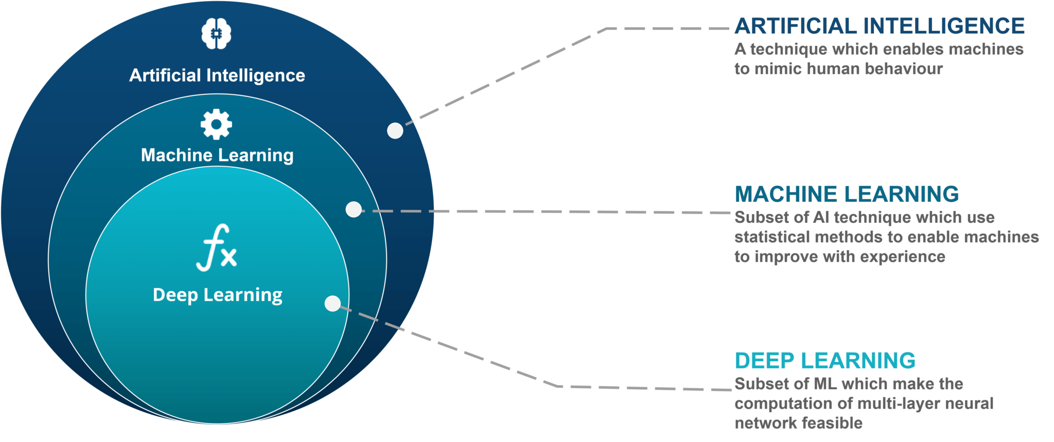
AI, Machine Learning, Deep Learning…

Slide 3
AI, Machine Learning, Deep Learning…
Hardcoded expert rules are not ML. Are they AI?
Every ML that is not a multi layer NN is ML but not DL

Slide 4
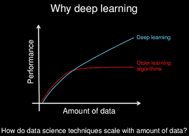
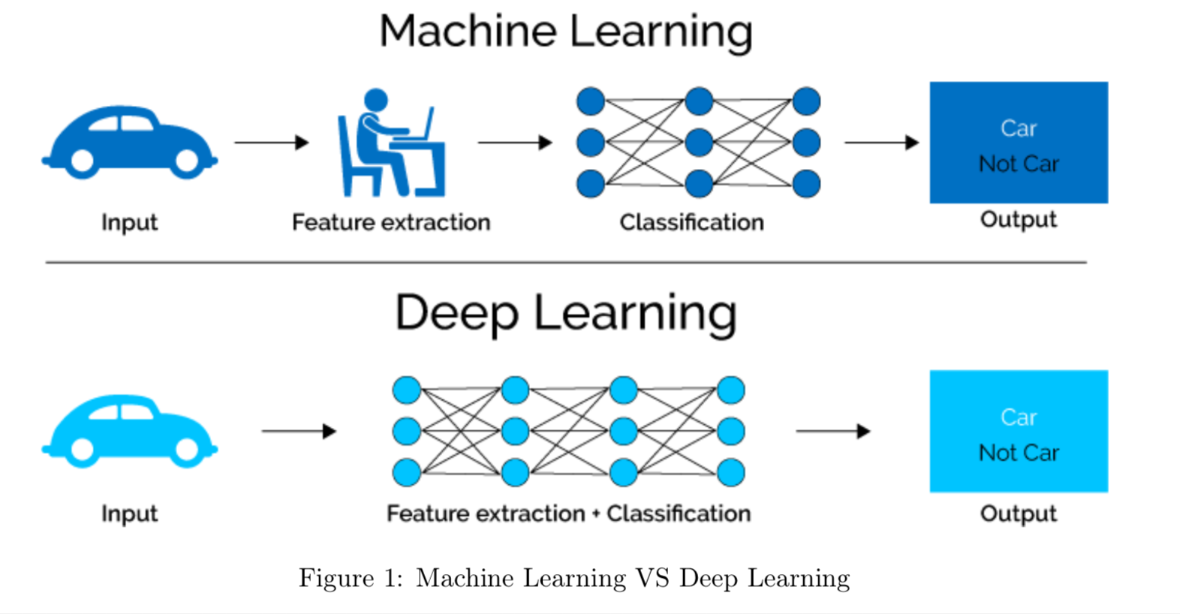
Why Deep Learning?
Even the representation can be learnt, and these pretrained models can be transferred to other problems as well! For more refer to: VGG, Inception, MobileNET (ComputerVision - Images), OpenAI GPT-2, ELMO, BERT (text)

Slide 5
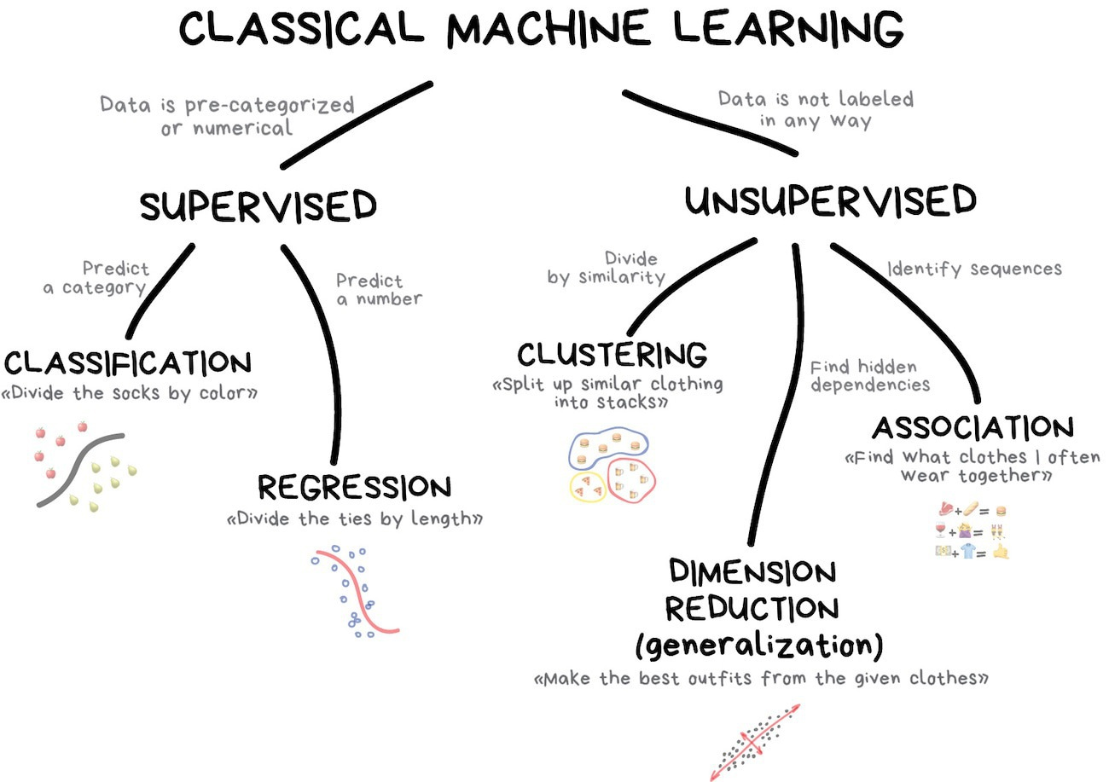
What is machine learning?

Slide 6
What is machine learning?
This is dumb.
That’s what we’re gonna do!

Slide 7
A machine learning project
Understanding the problem Involves business AND technical understanding
Data profiling Getting familiar with the data we have
Feature engineering Create the features to learn from (text to data!)
Modeling Learn the relationship between feature and target

Slide 8
A machine learning project
Understanding the problem Involves business AND technical understanding
Data profiling Getting familiar with the data we have
Feature engineering Create the features to learn from (text to data!)
Modeling Learn the relationship between feature and target
This session will be about this one!
Next session will be about this one!

Slide 9
A machine learning problem
We have a feature set: X (practically a matrix, rows are observations, columns are features)
We have a target variable y* (most frequently a vector, but not necessarily!)
We try to learn F* mapping so that F*(X) = y*
At a point during the algorithm F(X) = y is assumed to be optimal. We need to measure the goodness of this mapping: a loss function!
We try to minimize loss(y*, y) through making F as close to F* as possible.
Prediction is the name of the game! Our F have to generalize well, to give correct predictions for observations (or samples) have not seen during training!
Feature engineering
Modeling

Slide 10
Let’s continue with a text mining application!

Slide 11
The project
We have news headlines and quasi leads, around 2-3 sentences each. 10,000 element random sample from initial 200,000 observations.
These news are categorised into 42 categories, which is reduced to 35
We aim to create a classification model
This is a hard task! Not too many text, many categories…
How do we do that?

Slide 12
From text to data
We aim to create a matrix that represents the information in the text, so that our algorithms can work.
How to do that?

Slide 13
Bag-of-words
Corpus: A collection of texts – the dataset in this case
Document: 1 text – an observation (a sample)
Documents\Words | Word1 | Word2 | … | WordP
Doc1 | Count(1,1) | … | … | Count(1,P)
Doc2 | … | … | … | …
… | … | … | … | …
DocN | Count(N,1) | … | … | Count(N,P)
What information are we losing?

Slide 14
Can it be better?

Slide 15
Can it be better?
TF-IDF: Term Frequency – Inverse Document Frequency There are many variants: https://en.wikipedia.org/wiki/Tf%E2%80%93idf
The idea is to weight term frequencies negatively with their frequency in other documents.
This way tf-idf scores became better identifiers of documents in the corpus. If a word is frequent in all texts, it is not a great feature.
This whole process was text VECTORISATION.

Slide 16
Exploding dimensionality
The resulting text vector is going to have an extremely large number of columns.
Why is that?

Slide 17
Exploding dimensionality
The resulting text vector is going to have an extremely large number of columns.
Why is that?
Dimensionality reduction is achieved through text-preprocessing!
Text-preprocessing ~ Data cleaning in text mining

Slide 18
Text-preprocessing
Framework of Denny & Spirling (2018):
Punctuation (#, markups …)
Numbers (addresses, references…)
Lowercasing (Rose, House)
Stemming or lemmatizing (different meaning-same stem vs hard-to-create)
Stopword Removal (domain specificity)
N-gram inclusion (combinatorial explosion vs. meaning)
Infrequently used terms (vocab size vs information thrown away)

Slide 19
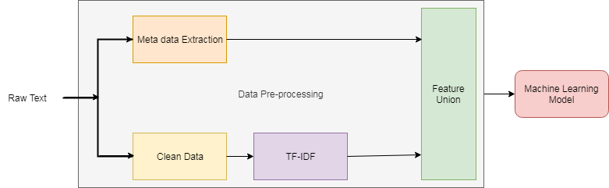
Feature Union concept

Slide 20
Hands-on!
Lets see that in practice!

