Slide 1
Text mining project II.
Session III. – Modeling
Mór Kapronczay
Data Scientist @ Starschema Ltd.

Slide 2
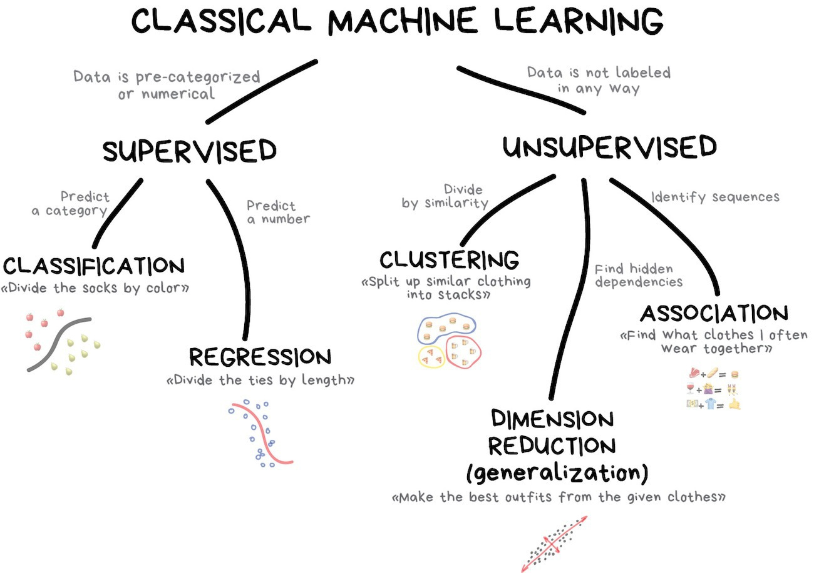
What is machine learning?
This is dumb.
That’s what we’re gonna do!

Slide 3
A machine learning project
Understanding the problem Involves business AND technical understanding
Data profiling Getting familiar with the data we have
Feature engineering Create the features to learn from (text to data!)
Modeling Learn the relationship between feature and target

Slide 4
A machine learning project
Understanding the problem Involves business AND technical understanding
Data profiling Getting familiar with the data we have
Feature engineering Create the features to learn from (text to data!)
Modeling Learn the relationship between feature and target
This was last session!
This session is about this one!

Slide 5
A machine learning problem
We have a feature set: X (practically a matrix, rows are observations, columns are features)
We have a target variable y* (most frequently a vector, but not necessarily!)
We try to learn F* mapping so that F*(X) = y*
At a point during the algorithm F(X) = y is assumed to be optimal. We need to measure the goodness of this mapping: a loss function!
We try to minimize loss(y*, y) through making F as close to F* as possible.
Prediction is the name of the game! Our F have to generalize well, to give correct predictions for observations (or samples) have not seen during training!
Feature engineering
Modeling

Slide 6
Modeling
Train-test partition
Fit algorithm on training set using cross validation
Evaluate algorithm by creating predictions on test set
Examine confusion matrix to see how are we wrong

Slide 7
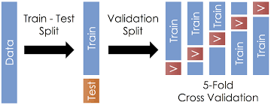
How to make a general model?

Slide 8
The algorithm to fit
We have to understand 3 concepts:
Decision tree
Bootstrapping
Bagging

Slide 9
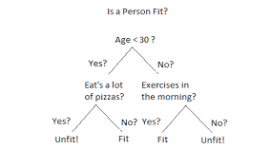
1. Decision Tree
Fast fitting
Interpretable
Prone to overfitting if not constrained!!!
I suggest using the „min_samples_split” parameter in sklearn
Decision node
Leaf node

Slide 10
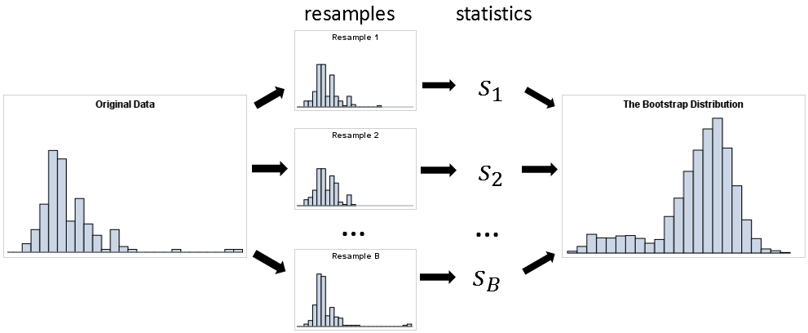
2. Bootstrapping

Slide 11
3. Bagging
It stands for bootstrap-aggregating.
2 stories:
Guess the weight of the cow!
Condorcets Jury Theorem

Slide 12
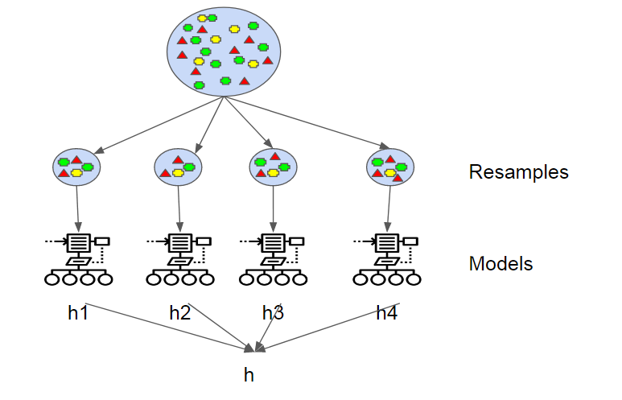
3. Bagging
Create Bootstrapped samples
Fit model on each sample (the less correlated the better!)
Aggregate predictions
Hence, a strong predictor from a lot of week predictors.
This is ensemble learning!

Slide 13
Can you guess the algorithm now?

Slide 14
Can you guess the algorithm now?
Random Forest it is!

Slide 15
Hyperparameter optimization
Random Forest algorithm has hyperparameters that control the algorithm.
n_estimators: how many tree to build
min_samples_split: how many samples a leaf have to contain to consider splitting
max_features: what proportion of features are randomly assigned to each tree
There are others as well, but we take care of these.
How to decide the values?

Slide 16
Hyperparameter optimization
Random search. Try a number of different parameter sets and choose the best. Can be OK, but not good enough.

Slide 17
Hyperparameter optimization
Random search. Try a number of different parameter sets and choose the best. Can be OK, but not good enough.
Grid search. Create a 3D grid of possible values for the 3 parameters, and try all of them. The sun will burn out while doing so.

Slide 18
Hyperparameter optimization
Random search. Try a number of different parameter sets and choose the best. Can be OK, but not good enough.
Grid search. Create a 3D grid of possible values for the 3 parameters, and try all of them. The sun will burn out while doing so.
Let’s do something Bayesian!

