Slide 1
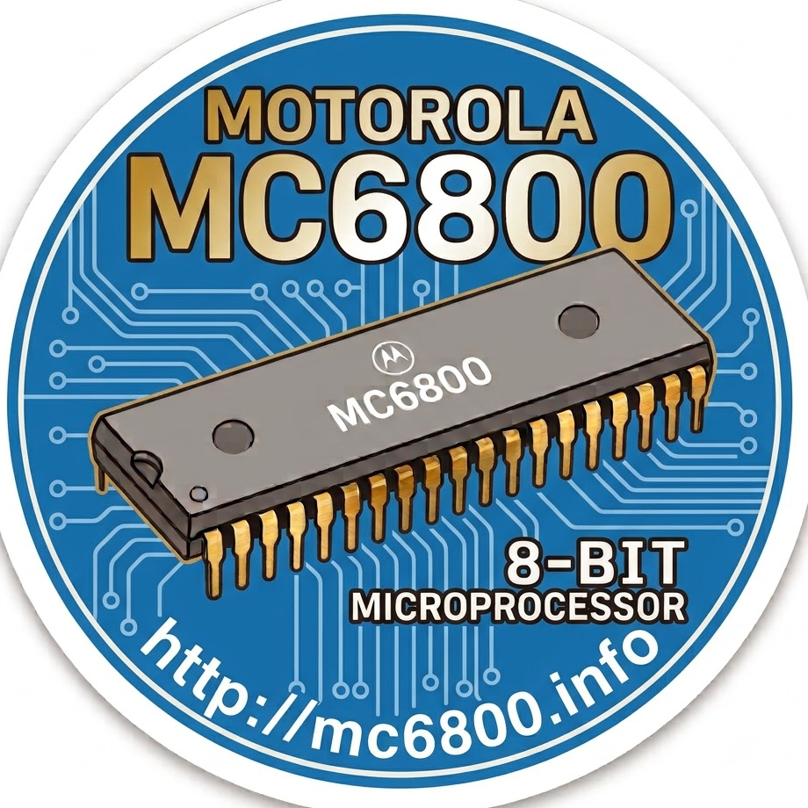
MEX6816-22D 16K Dynamic RAM Micromodule
MEX6800-1 M6800 MPU Module
MEK6800D2 Development board
Demonstrator equipment for
the 6800 microprocessor
M68MMCC10 Card Cage
(10 Cards)
M68MM16 Memory-I/O-Timer Micromodule
M68MM15C High Level
D/A Micromodule

Slide 2
M68MM15BEX Low Level
Expander Micromodule
M68MM15B Low Level A/D Micromodule
M68MM15A High Level 16
Channel A/D Micromodule
M68MM12 GPIB Interface Micromodule
M68MM04A ROM/EPROM Micromodule
Full ASCII Keyboard inc.
Keyboard Enclosure
HEP EducatorKit-II
inc. Power Supply

