Slide 1
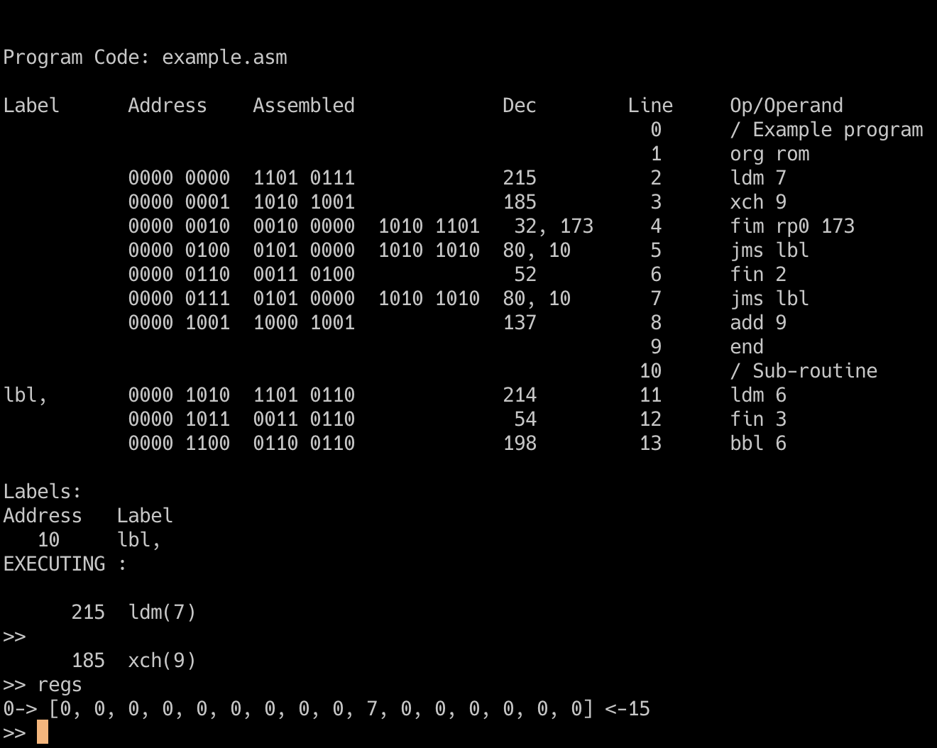
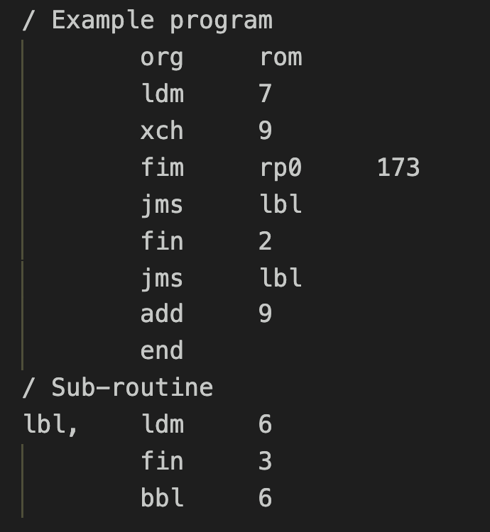

Slide 2
0 0 0 1 C₁ C₂ C₃ C₄
A₂ A₂ A₂ A₂ A₁ A₁ A₁ A₁
If C₁C₂C₃C₄ is true:
A₂A₂A₂A₂ PM A₁A₁A₁A₁ PL
PH unchanged if C₁C₂C₃C₄ is false: (PH) PH
(PM) PM
(PL + 2) PL
C₁ C₂ C₃ C₄
If the indicated Condition Bit is = 1:
Jump if the 4004 Test Signal is = 0
Jump if the Carry Bit is = 1
Jump if the Accumulator = 0
Invert ALL the other conditions
JUMP = C₁ * ((ACC = 0) * C₂ + (carry = 1) * C₃ + TEST * C₄ +
C₁ * (((ACC <> 0) + C₂ ) + ((carry = 0) + C₃ ) * (TEST + C₄ )

Slide 3
Reset
9
8
Sync-Out
PINS
Test
10
7
Clk Phase 2
9
8
Memory
Control
Output
CM-ROM
Clk Phase 1
10
7
11
6
11
6
V_{DD}
12
5
V_{SS}
12
5
i4004
13
4
CM-RAM3
13
4
D3
3
14
D2
15
2
CM-RAM2
14
3
Memory
Control
Outputs
Data
Bus
I/O
16
1
CM-RAM1
15
2
D1
CM-RAM0
16
1
D0

