Slide 1
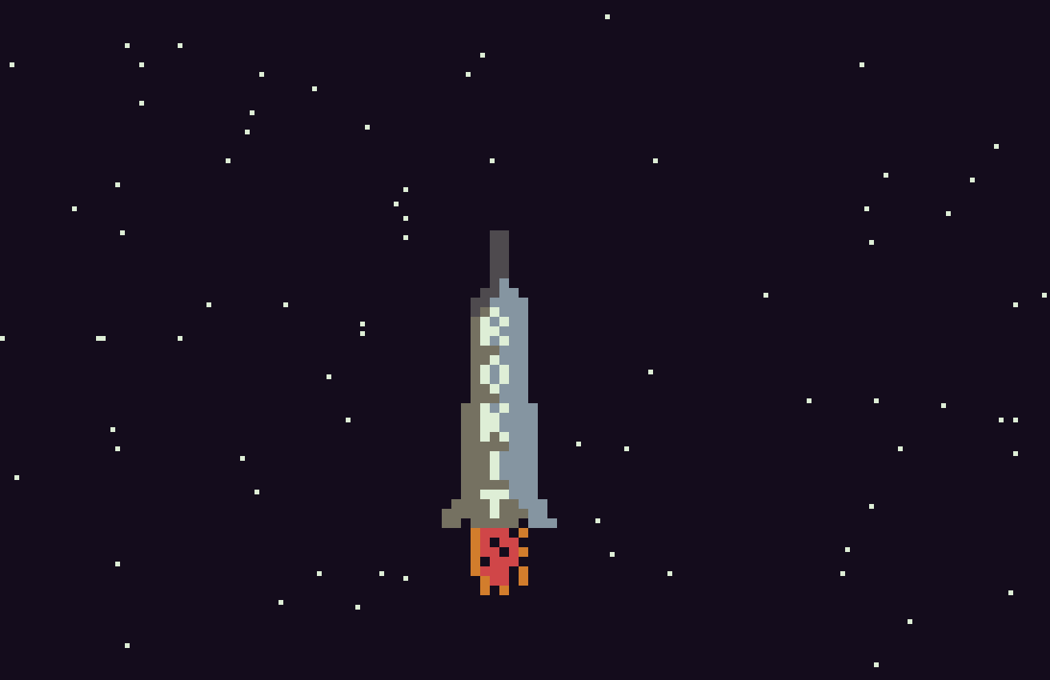

Slide 2
To Do
Make starfield start blank, then steadily increase the amount of stars
Show launchpad
Allow rocket to drop back when no button is pressed (along with a corresponding delay to the starfield)
Show fuel
Show heat
Show score (height – only counts if finger on button)
-------
Add power-ups
Possibly add left and right steering…..
Save game ?
Music
Planets
Different rockets
Sky colour - STARTED
When rocket dropping back, fuel stops, but when it hits the bottom of the screen, it should explode…..

Slide 3
Bugs
When power is not applied. heat should drop back – think this works.
Heat
heatframe = 0
heat – each frame increase heatframe by1 – check if button is pressed
if button is pressed, add 1 to heatcounter
if button is not pressed, subtract 1 from heatcounter
each 60 frames (n is 60 per second – if check required, set heatframe to zero), check to see if heatcounter >= 60
if heatcounter >= 60 then increase level by heatuse and set n and heatcounter to zero.
else decrease level by heatuse and set n and heatcounter to zero.
NOTE THAT 60 will be variable once this works…..

Slide 4
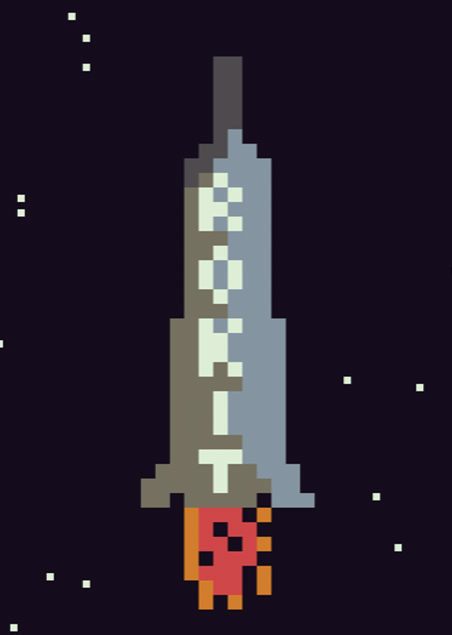
https://www.1001fonts.com/homoarakhn-font.html#styles

