Slide 1
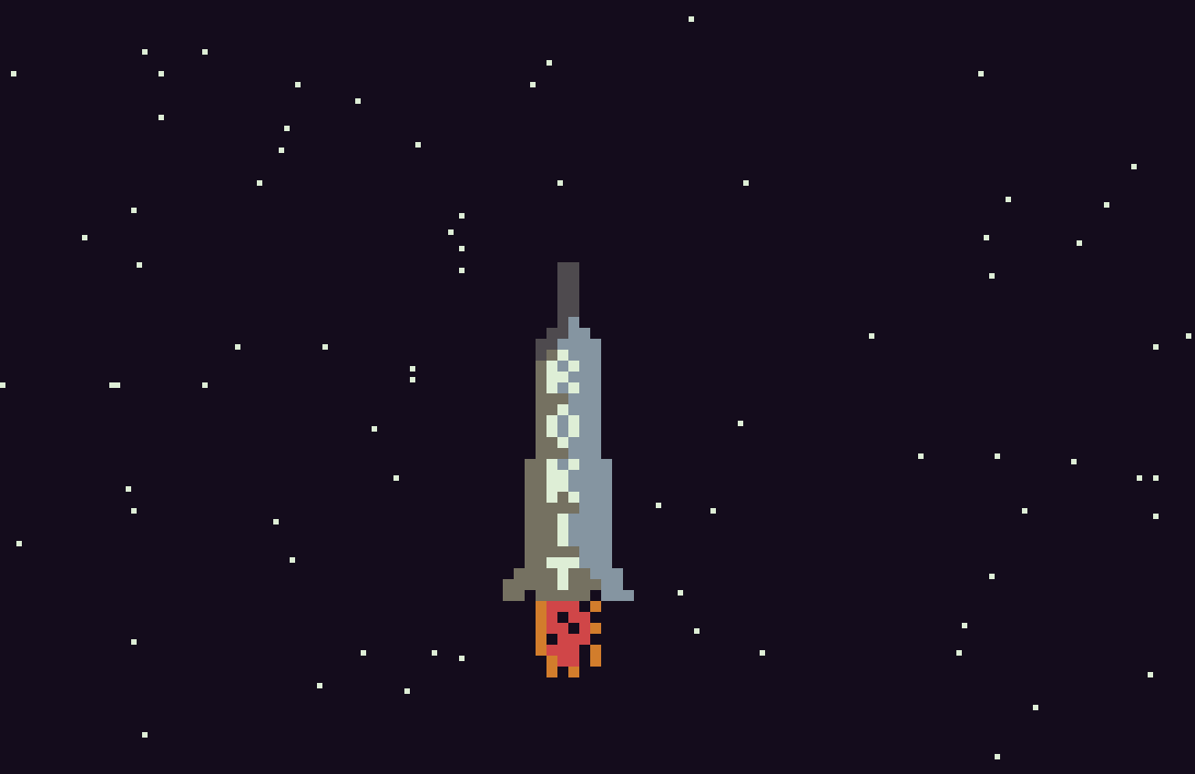

Slide 2
To Do
Show score (60 ticks =10 metres – only counts if finger on button)
Explosion for end game
Sky colour – STARTED
Finish start screen with skyrokit logo and copyright image
Make starfield start blank, then steadily increase the amount of stars
Make rocket able to go higher on the screen
-------
Add power-ups
Add things to bump into and kill you or hurt you
Possibly add left and right steering…..
Save game ?
Music
Planets
Different rockets

Slide 3
Done
Show launchpad
Allow rocket to drop back when no button is pressed (along with a corresponding delay to the starfield)
Show fuel
Show heat
When rocket dropping back, fuel stops, but when it hits the bottom of the screen, it should explode…..

Slide 4
Bugs
Launchpad needs to disappear correctly when rocket takes off
When power is not applied. heat should drop back

Slide 5
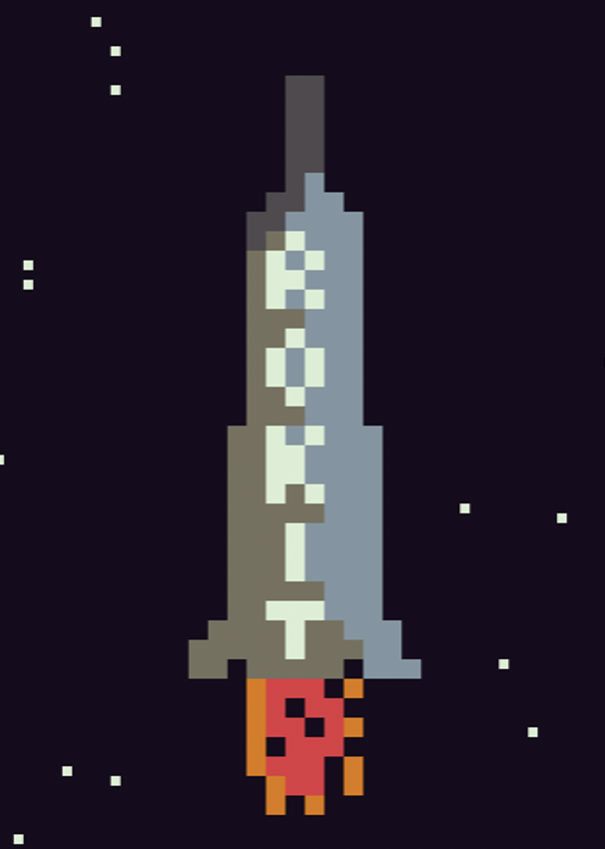
https://www.1001fonts.com/homoarakhn-font.html#styles

