Slide 1
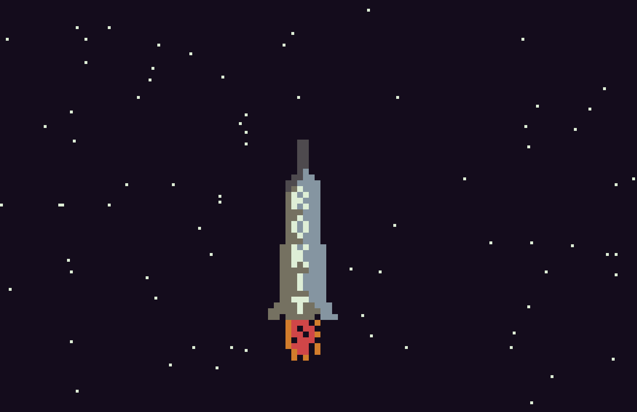
SKY
ROKIT
for tic-80

Slide 2
To Do
Allow rocket to drop back when no button is pressed (along with a corresponding delay to the starfield)
Make starfield start blank, then steadily increase the amount of stars
Show launchpad
Show fuel
Show heat
-------
Add power-ups
Possibly add left and right steering…..
Save game ?
Music
Planets
Different rockets
Sky colour - STARTED
When rocket dropping back, fuel stops, but if it hits the bottom of the screen, it explodes…..

