Slide 1
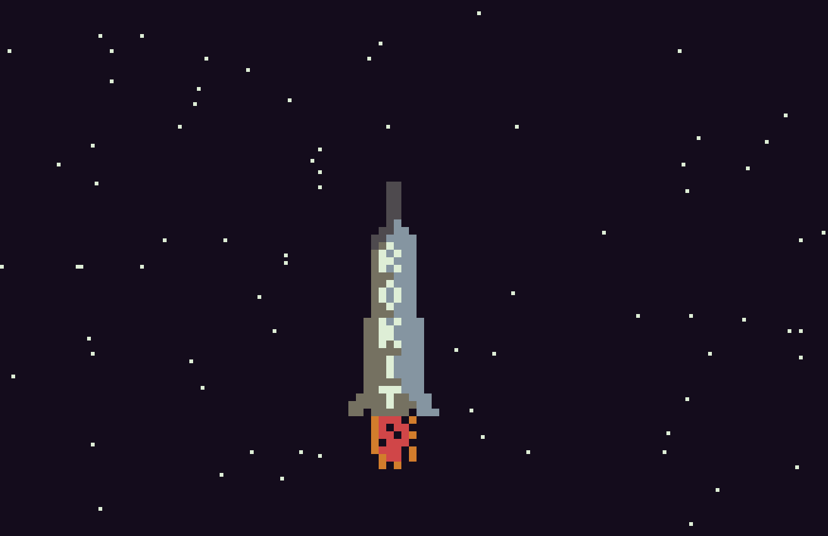

Slide 2
To Do
Show score (60 ticks =10 metres – only counts if finger on button)
Explosion for end game
Sky colour – STARTED
Added facility for coloured stars (on/off)
Music
-------
Mission
Remove wings on takeoff
Deploy payload
Allow retros to fire and release landing legs
Add power-ups
Add things to bump into and kill you or hurt you
Possibly add left and right steering…..
Save game ?
Add random comets flying across the screen as you get higher
Planets
Different rockets
http://educationmusicale.ac-besancon.fr/wp-content/uploads/sites/42/2015/10/Piano_Copland.pdf

Slide 3
Done
Show launchpad
Allow rocket to drop back when no button is pressed (along with a corresponding delay to the starfield)
Show fuel
Show heat
When rocket dropping back, fuel stops, but when it hits the bottom of the screen, it should explode…..
Finish start screen with skyrokit logo and copyright image
Redid launch pad
Make starfield start blank, then steadily increase the amount of stars
Make rocket able to go higher on the screen

Slide 4
Bugs
Launchpad needs to disappear correctly when rocket takes off
When power is not applied. heat should drop back

Slide 5
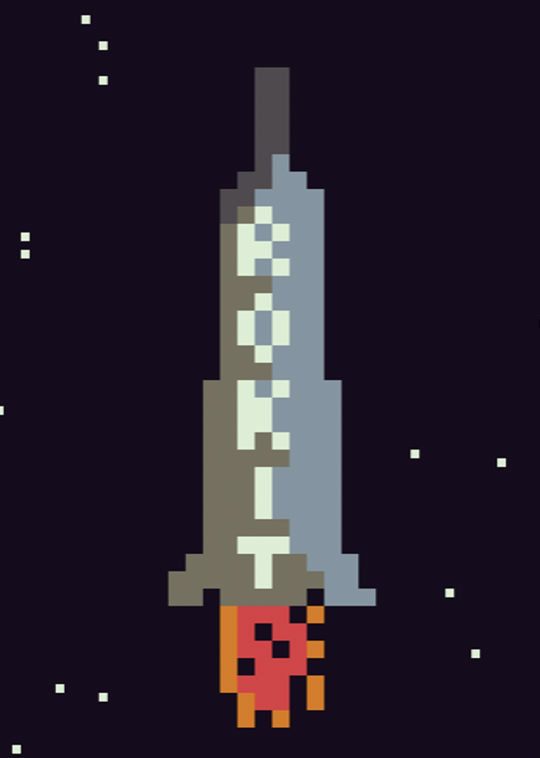
https://www.1001fonts.com/homoarakhn-font.html#styles

