Slide 1
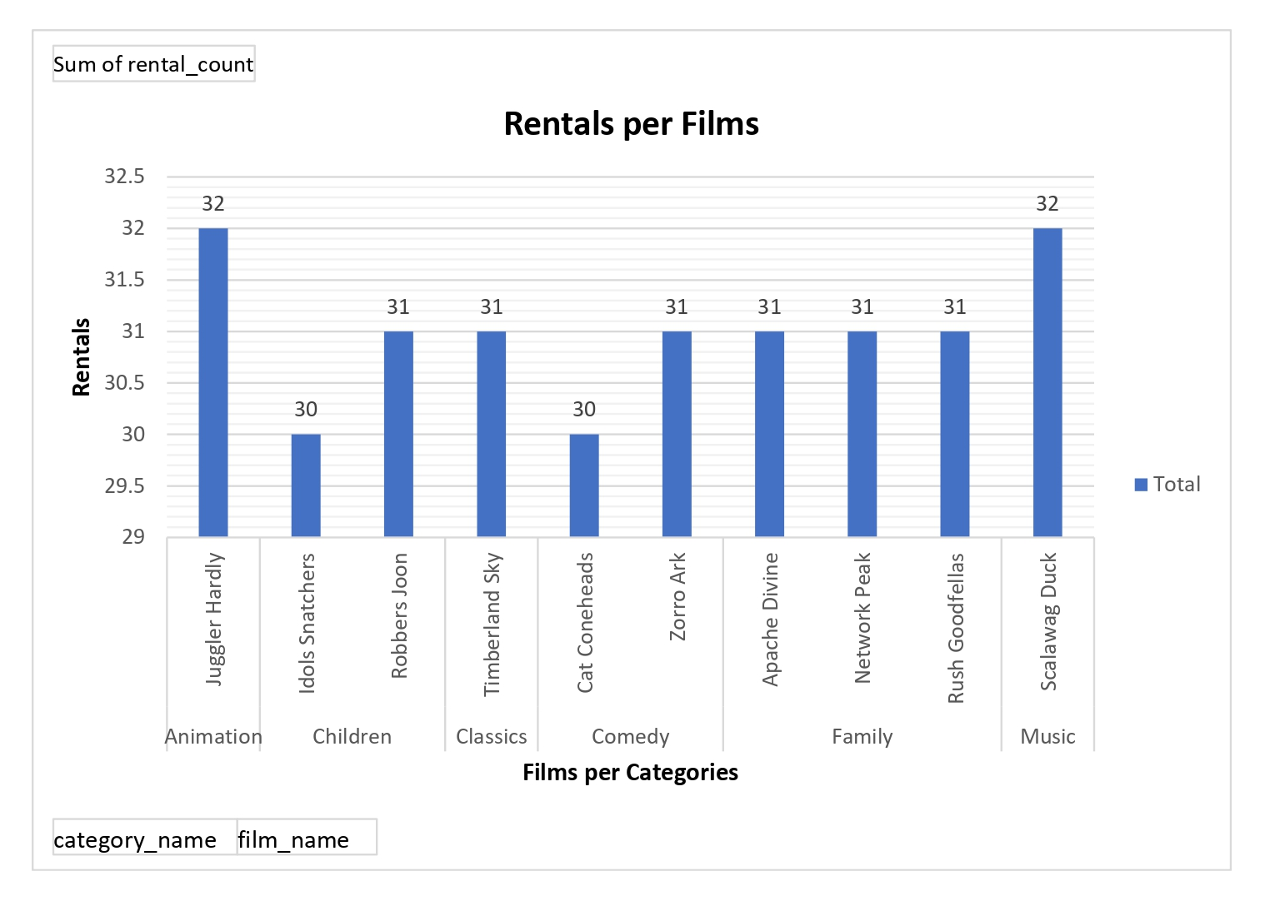
How many rentals were made for top 10 rented out films?
This chart visualizes the rental frequency of top 10 family-friendly movies across different categories. The x-axis represents the film names, while the y-axis shows the number of times each movie has been rented.

Slide 2
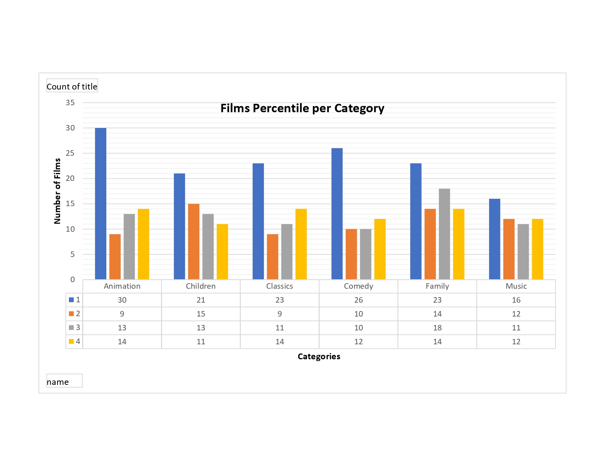
How does the rental duration of family-friendly movies vary across different categories based on their quartile distribution?
This chart compares the rental duration of family-friendly movies to the overall rental duration distribution of all movies. The x-axis represents film categories (Animation, Children, Classics, Comedy, Family, and Music), while the y-axis shows the number of films within each category. Each bar is divided into four quartile levels based on the 25%, 50%, and 75% percentile thresholds of rental duration.

Slide 3
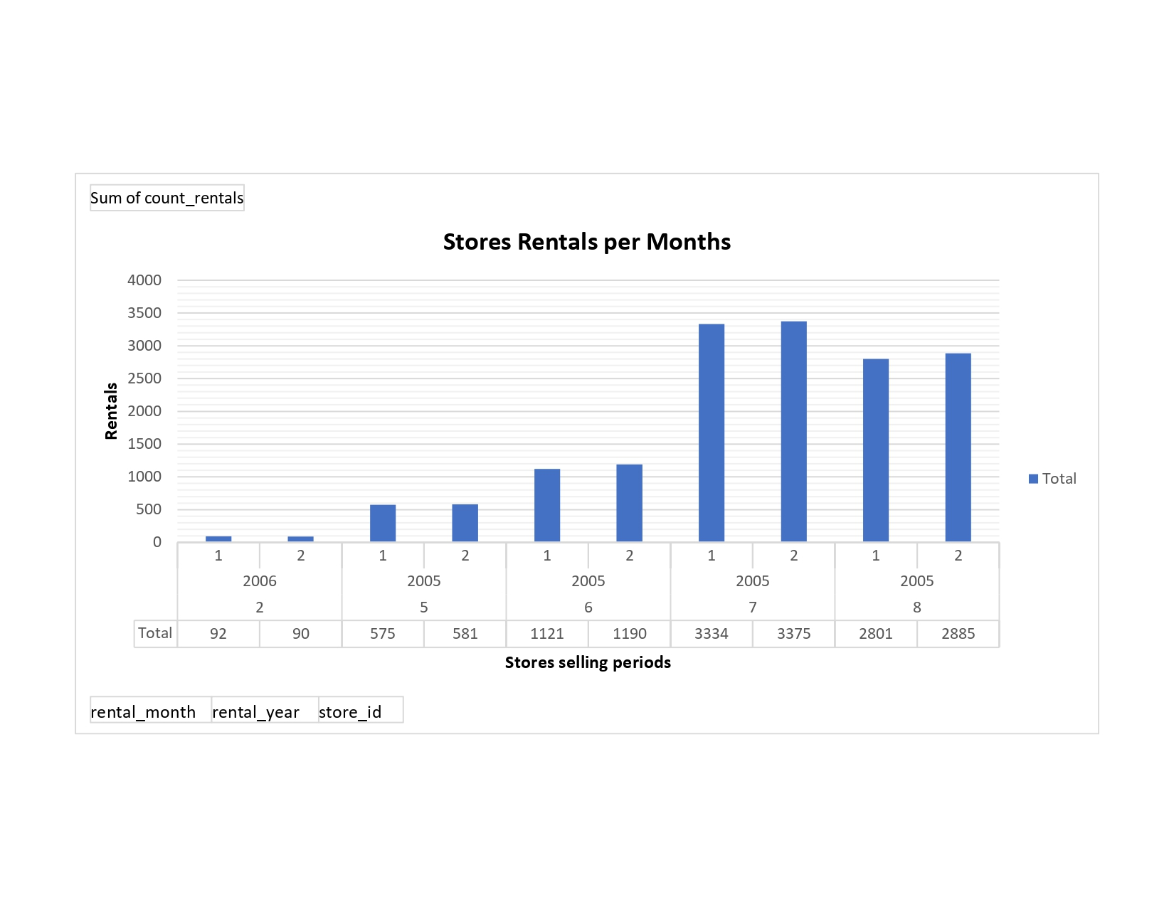
How do rental trends between Store 1 and Store 2 change over time?
This chart compares the number of rental orders fulfilled by Store 1 and Store 2 across different months and years. The x-axis represents rental months across multiple years, while the y-axis shows the total number of rentals fulfilled. Each store is represented by a different color, allowing for a clear visual comparison of rental trends between the two stores. The chart helps identify fluctuations in rental activity over time, showing which store had higher rental counts during specific periods.

Slide 4
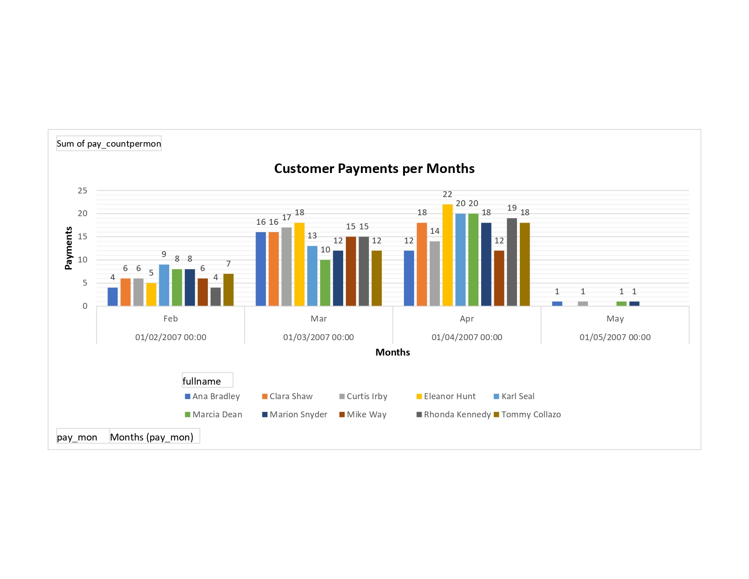
What is the total payments made by the top 10 customers each month?
This chart highlights the top 10 paying customers and their monthly payment trends in 2007. The x-axis represents the Payments times for each customer in the four months, while the y-axis shows the total payment times. Each customer is represented with a unique color, making it easy to track their monthly spending patterns.

