Slide 1
What is Machine Learning?
Lesson 1.1 | Stage 1: Classic Machine Learning
AI Basic Training
From Rules to Learning — A Security Perspective

Slide 2
What We’ll Cover
Traditional programming vs machine learning
The three types of ML
How a model learns — the training loop
The ML workflow and exploratory data analysis
Meet the dataset: handwritten digits
Python tools and getting started

Slide 3
01
Traditional Programming
vs Machine Learning

Slide 4
Two Approaches to Problem Solving
Traditional Programming
You write explicit rules:
if "free money" in email: spam
if sender_unknown: spam
Problem:
Attackers learn your rules
Change one word, bypass the filter
Rules don’t scale to millions of signals
Machine Learning
You provide labelled examples:
10,000 emails tagged spam / legit
Model discovers the patterns itself
Advantage:
Catches subtle signal combinations
Adapts when new data arrives
Scales across entire organisations

Slide 5
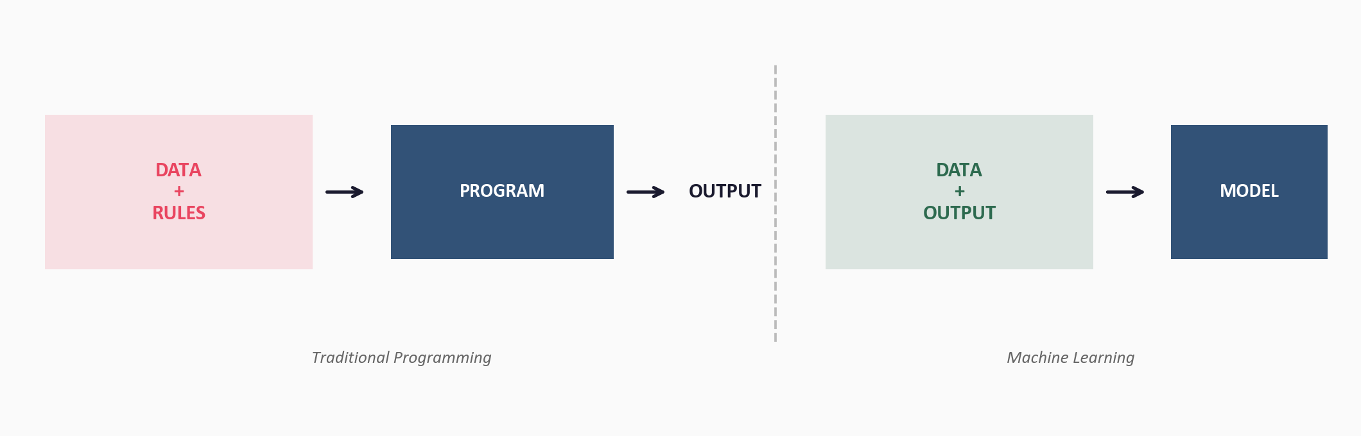
The Fundamental Difference

Slide 6
Why This Matters for Security
Already deployed in production:
Email filters — 99.9% spam blocked before inbox
Endpoint detection — behavioural analysis
SIEM — anomaly scoring on log streams
Network IDS — traffic classification
Traditional rules are reactive.
ML models are predictive.
Attackers constantly change
tactics, but their statistical
patterns persist across
campaigns.

Slide 7
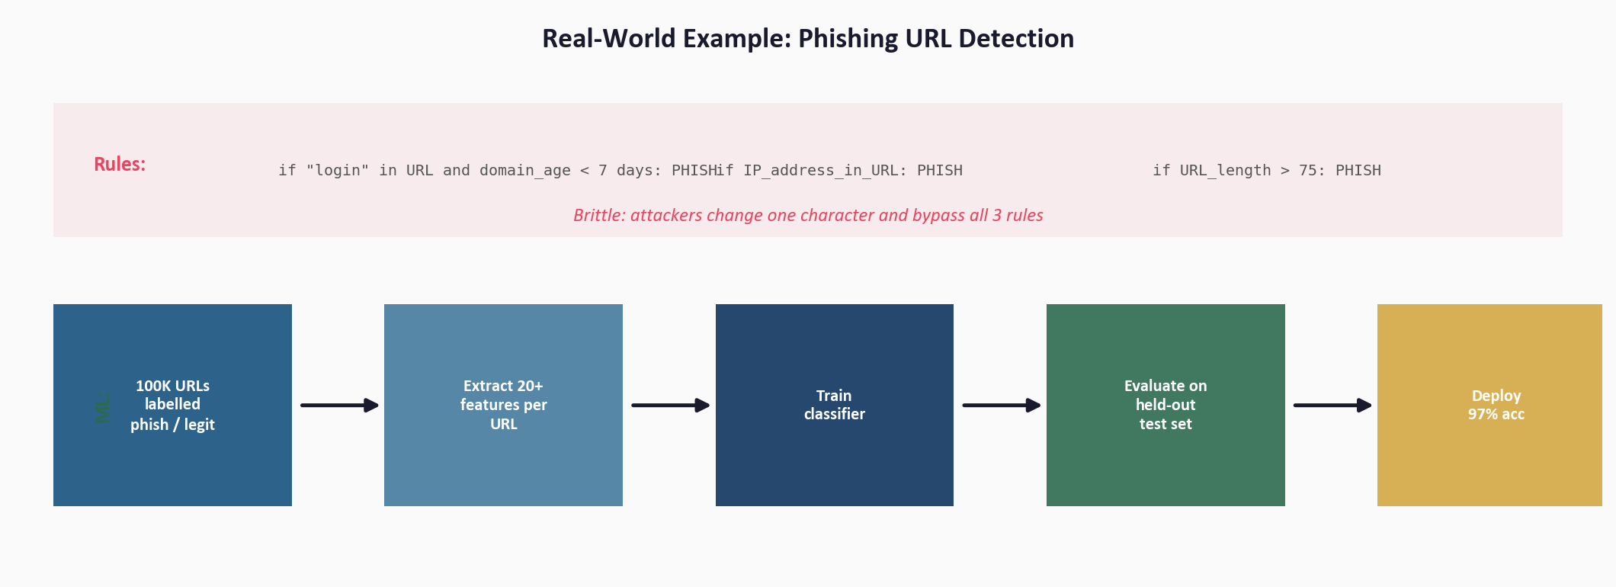
Real-World Example: Phishing URL Detection

Slide 8
02
The Three Types of
Machine Learning

Slide 9
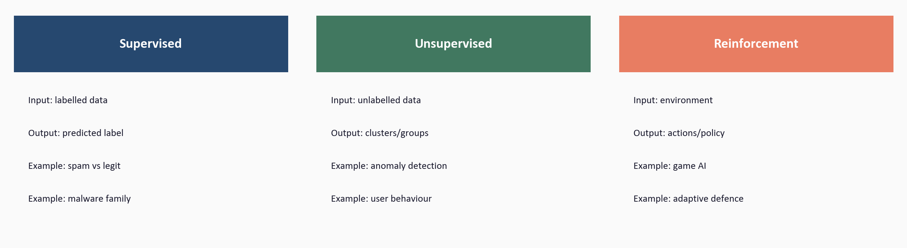
Supervised, Unsupervised, and Reinforcement Learning

Slide 10
03
How a Model
Actually Learns

Slide 11
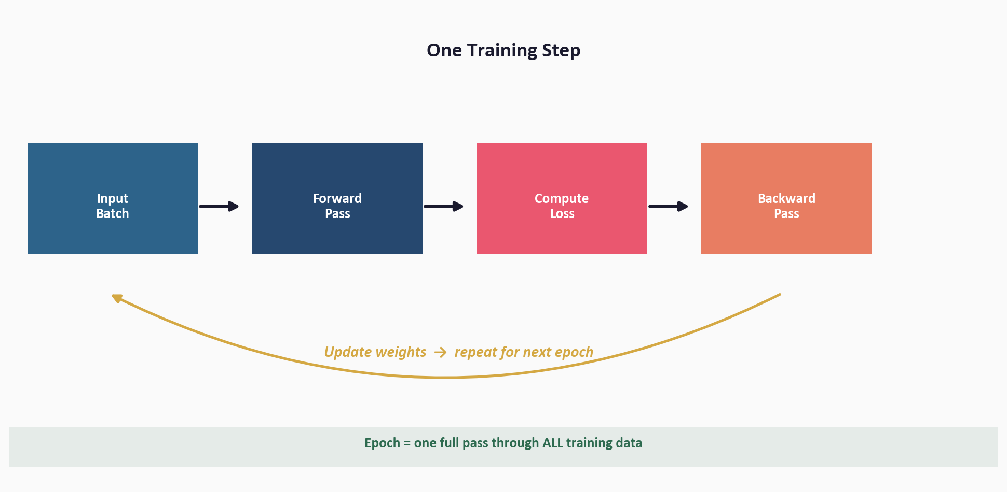
The Training Loop

Slide 12
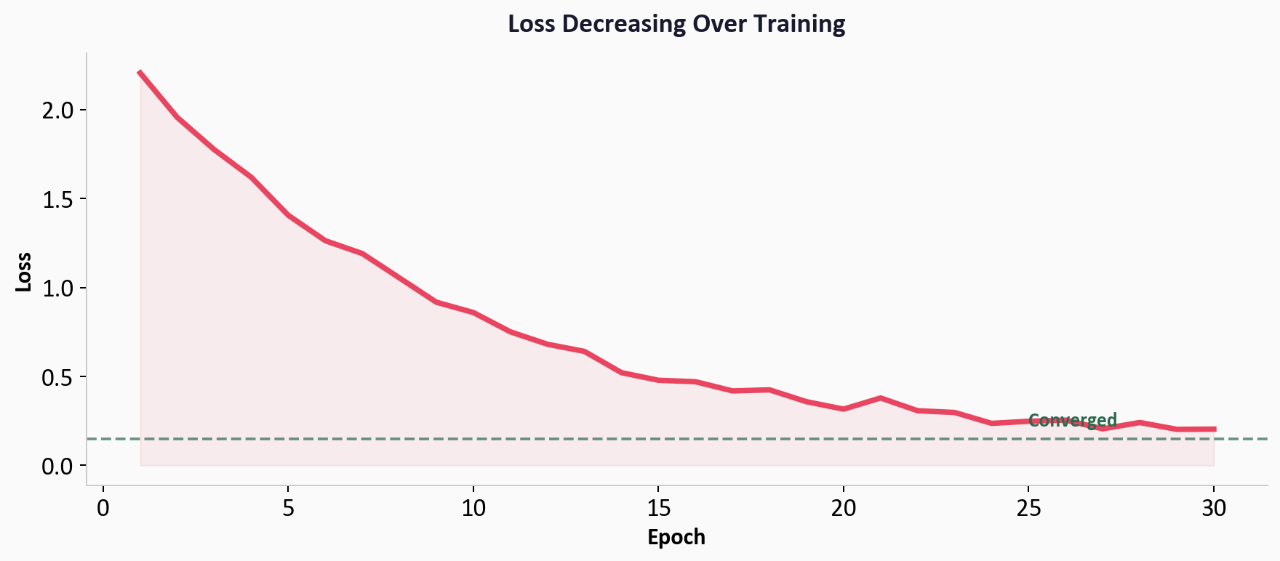
Loss Decreases as the Model Learns

Slide 13
The Key Concepts
Weights
Numbers inside the model
Adjusted each training step
Loss
How wrong the predictions are
Training = minimise loss
Epoch
One full pass through all data
Typical: 10–100 epochs to converge
The model finds patterns
across dozens of subtle
signals that no human
would write as rules.

Slide 14
04
The ML Workflow
and EDA

Slide 15
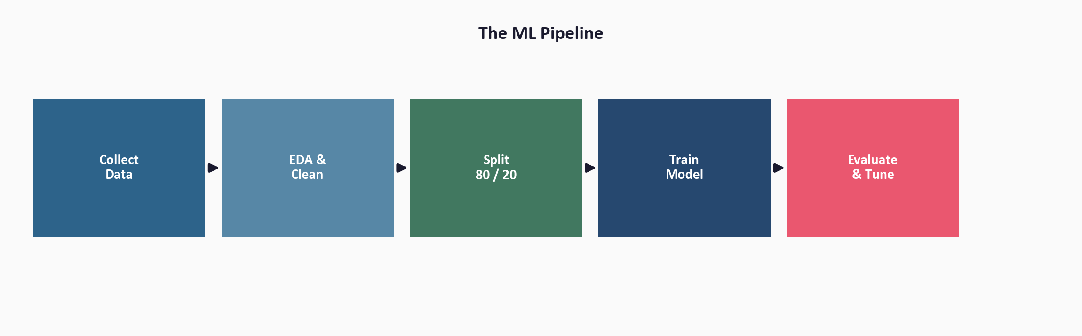
Every ML Project Follows This Pipeline

Slide 16
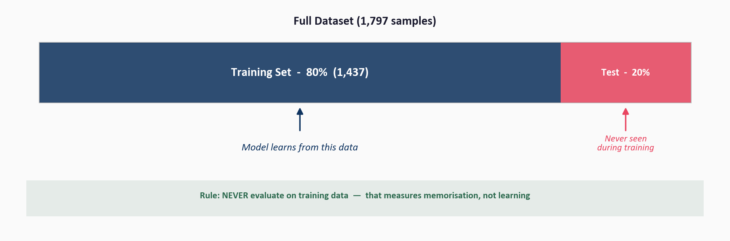
The Train / Test Split

Slide 17
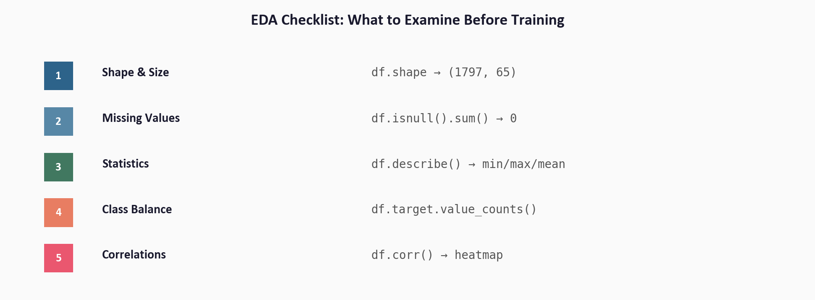
EDA: Examine Data Before Training

Slide 18
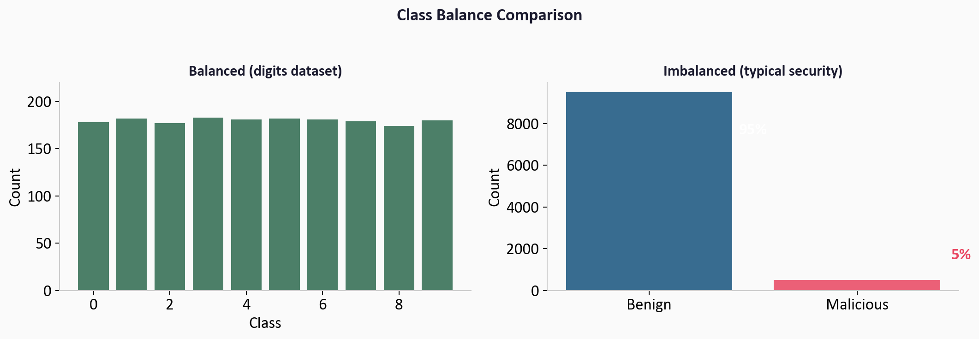
The Class Imbalance Problem

Slide 19
05
Meet the Dataset:
Handwritten Digits

Slide 20
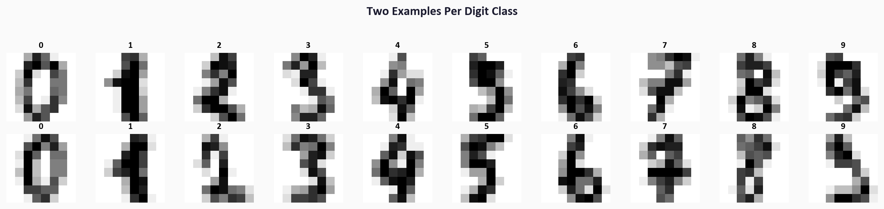
1,797 Images — 10 Classes — 64 Features Each

Slide 21
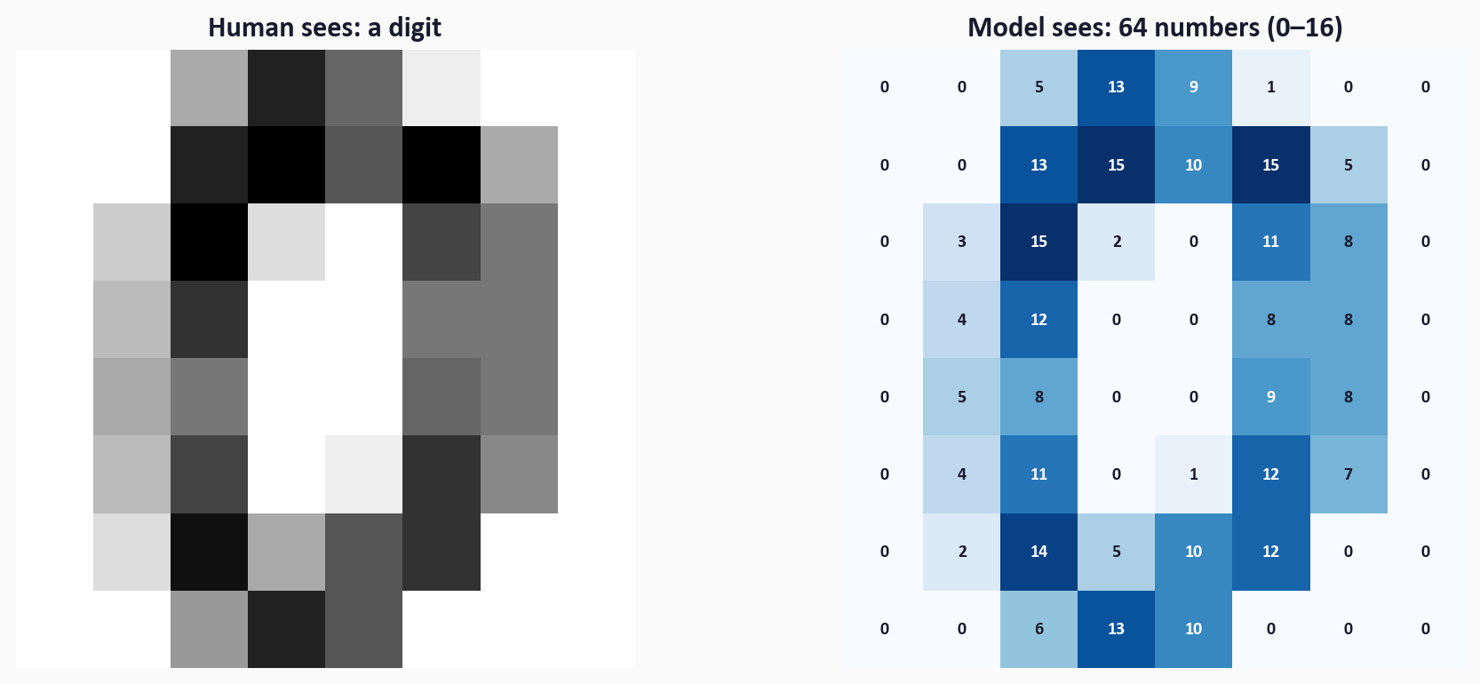
What the Model Actually Sees

Slide 22
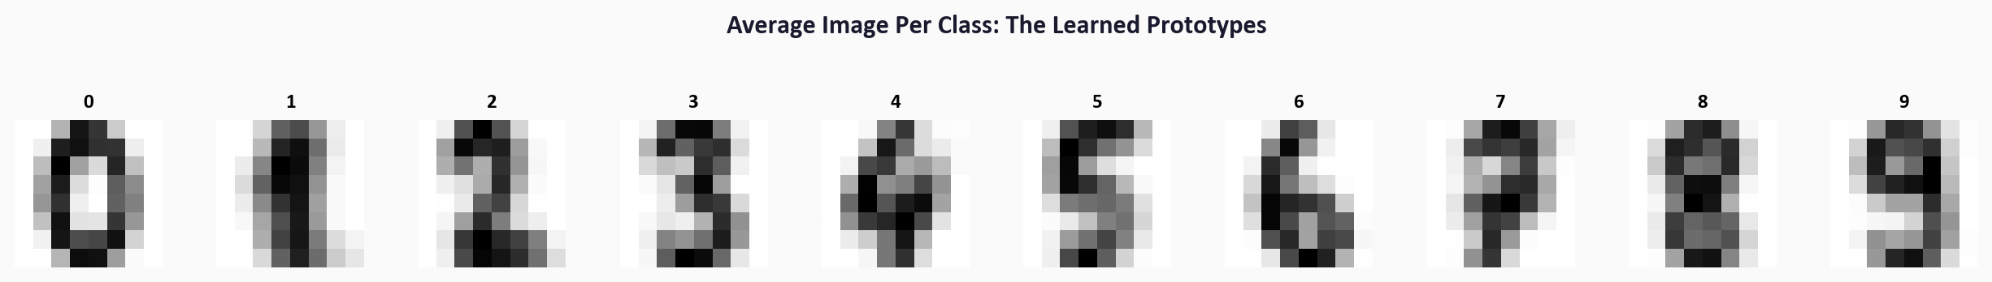
Average Image per Class: The Learned Prototypes

Slide 23
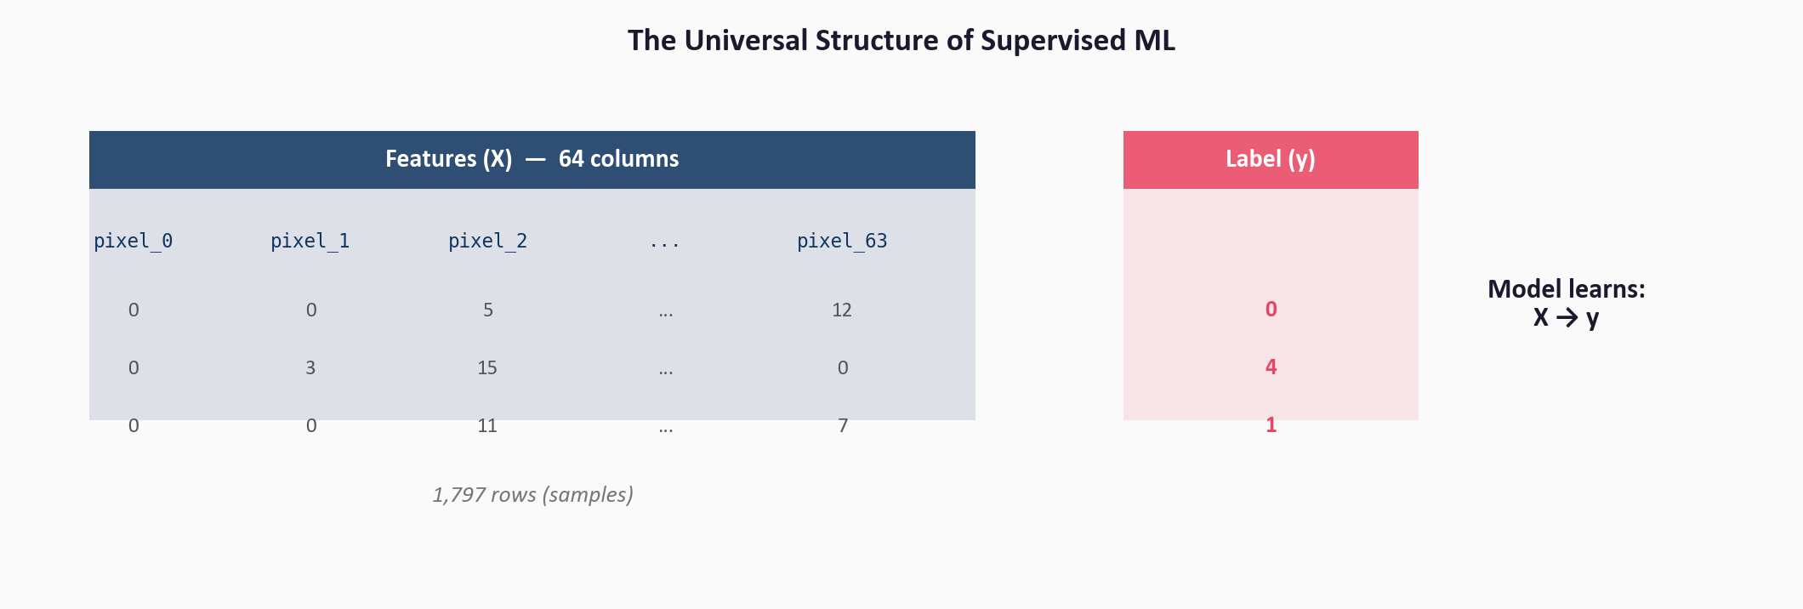
Features (X) and Labels (y): The Universal Structure

Slide 24
06
Python Tools
and Getting Started

Slide 25
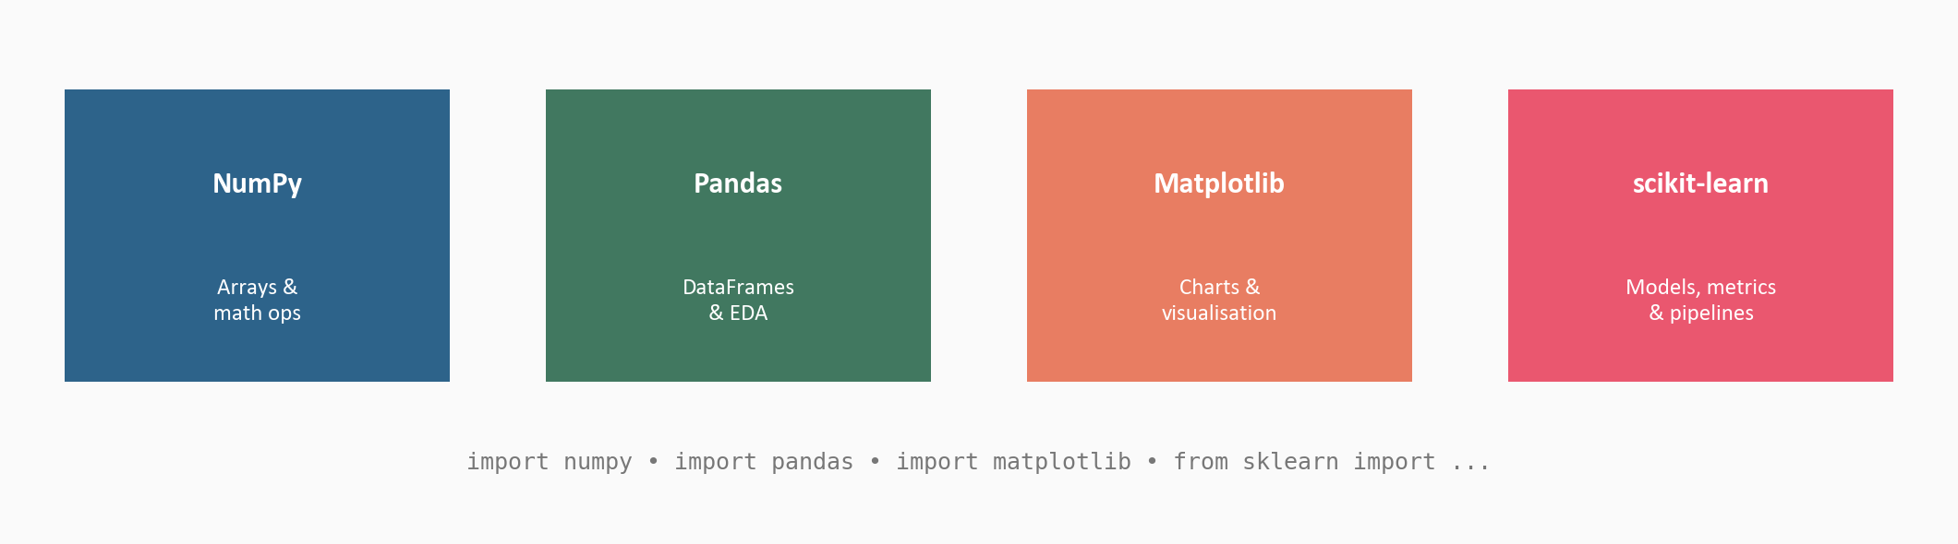
Four Libraries You’ll Use in Every Lesson

Slide 26
Key Vocabulary
Feature
One measurable input value
Label
The answer to predict
Sample
One row of data
Training set
Data used for learning
Test set
Data reserved for evaluation
Model
The learned function f(X) → y
Weights
Adjustable internal parameters
Loss
Prediction error (lower is better)
Epoch
One complete pass through data
Overfitting
Model memorised, didn’t learn
Underfitting
Model too simple for the patterns
Class imbalance
Labels are heavily skewed

Slide 27
Workshop: 5 Hands-On Exercises
Exercise 1: Load the digits dataset into a DataFrame
Exercise 2: Shape, statistics, and missing values
Exercise 3: Class balance and the accuracy trap
Exercise 4: Visualise samples and average prototypes
Exercise 5: What the model sees — numbers and correlations
Each exercise: lecture.md (concept) + handson.md (build it yourself)
Solution files provided to check your work

Slide 28
Key
Takeaways
ML finds patterns from examples — no hand-crafted rules
Supervised learning (X → y) is the most common type in security
Training = adjusting weights to minimise loss over epochs
Always: collect → EDA → split → train → evaluate → tune
Never evaluate on training data — it measures memorisation
Class imbalance is everywhere in security — accuracy misleads

Slide 29
What is Machine Learning?
Next: Lesson 1.2 — Linear Regression

