Slide 1
Linear Regression
Lesson 1.2 | Stage 1: Classic Machine Learning
AI Basic Training
Your First Trained Model - Predicting Server Response Time

Slide 2
What We'll Cover
Regression vs classification - predicting numbers
The equation: y = coefficient x x + intercept
Fitting a model to server performance data
Evaluation metrics: R-squared, RMSE, MAE
Security application: anomaly detection baseline
Limitations and what comes next

Slide 3
01
Regression
Fundamentals

Slide 4
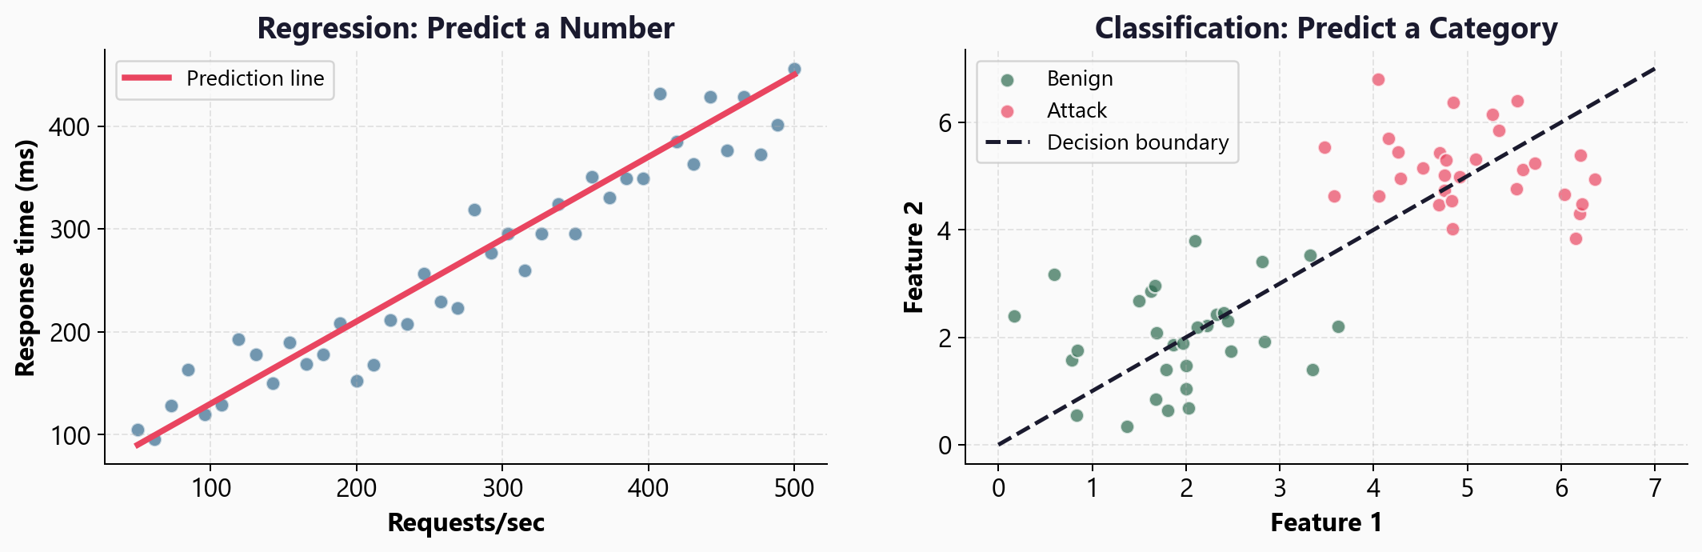
Two Types of Prediction

Slide 5
Regression vs Classification
Regression
Output: a continuous number
Response time: 247.3 ms
Bandwidth: 14.2 Mbps
Risk score: 0.73
Question: 'How much?'
Classification
Output: a category / label
Attack or benign
Phishing or legitimate
Malware family A, B, or C
Question: 'Which one?'

Slide 6
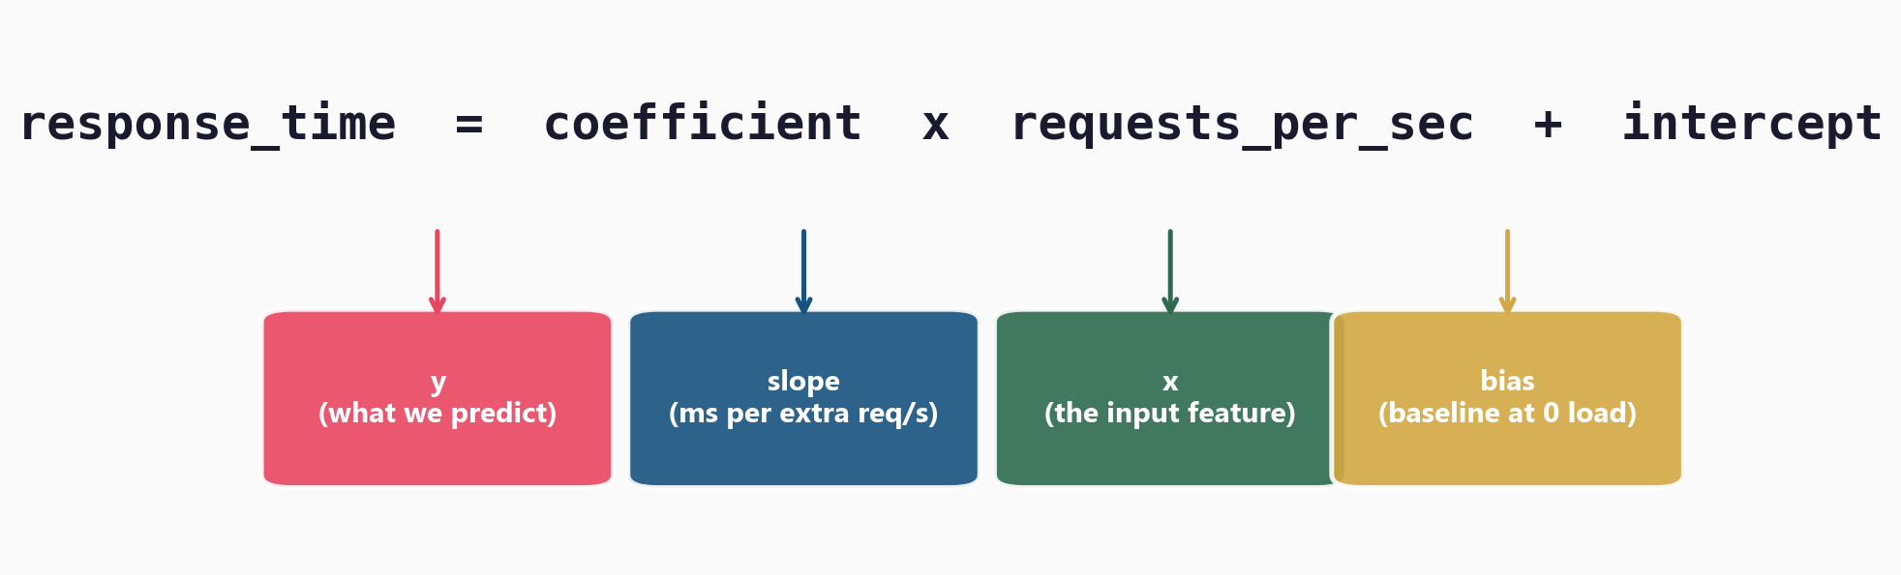
The Linear Regression Equation

Slide 7
02
The Scenario:
Server Response Time

Slide 8
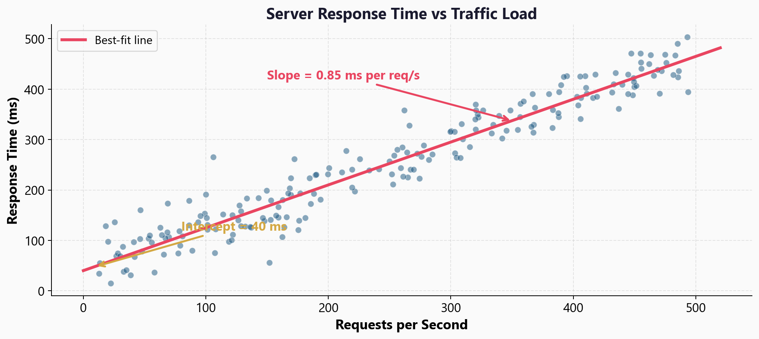
Fitting a Line Through 200 Server Measurements

Slide 9
Reading the Model's Output
Coefficient (slope) = 0.85
Every extra req/s adds 0.85 ms
Intercept (bias) = 40 ms
Baseline latency at zero traffic
To predict at 300 req/s:
0.85 x 300 + 40 = 295 ms
The coefficient and intercept
are the only two numbers
the model learns.
Everything else follows
from these.

Slide 10
03
Fitting the Model
and Measuring Results

Slide 11
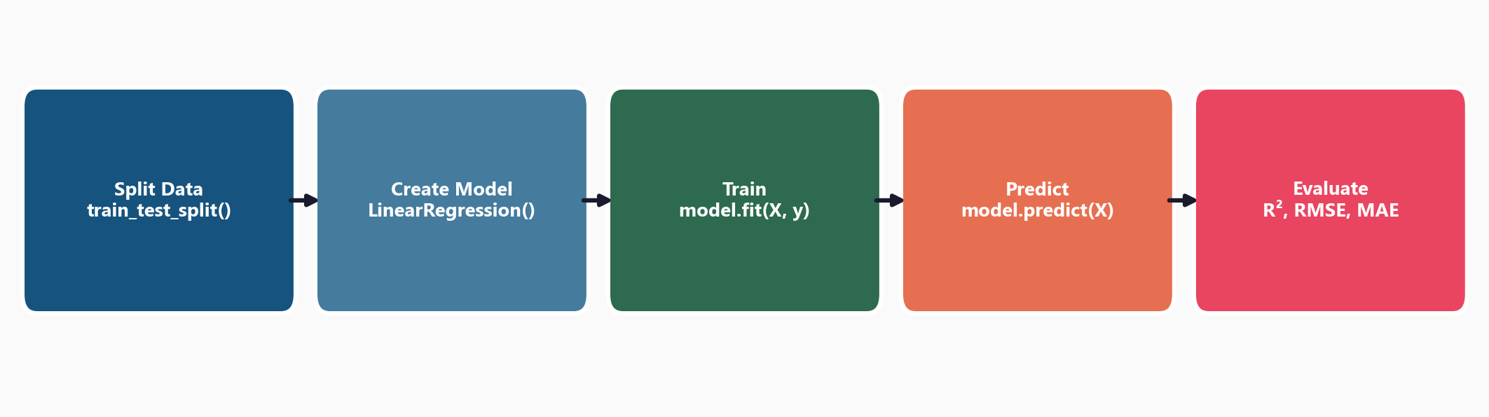
The sklearn Pipeline - Five Steps

Slide 12
The Code - Four Lines That Do Everything
X_train, X_test, y_train, y_test = train_test_split(X, y, test_size=0.2)
model = LinearRegression()
model.fit(X_train, y_train) # learn slope + intercept
y_pred = model.predict(X_test) # predict on unseen data
print(model.coef_) # the learned coefficient
print(model.intercept_) # the learned intercept

Slide 13
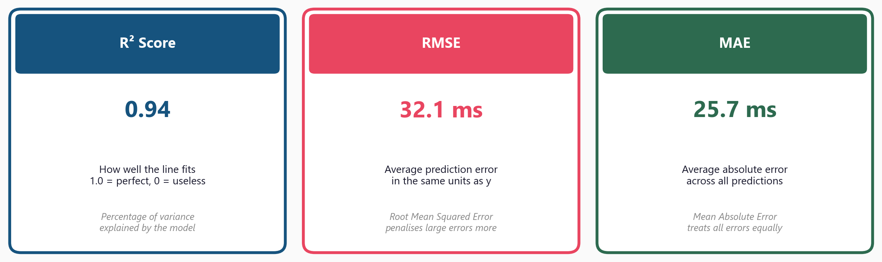
Three Evaluation Metrics

Slide 14
04
Security Application:
Anomaly Detection

Slide 15
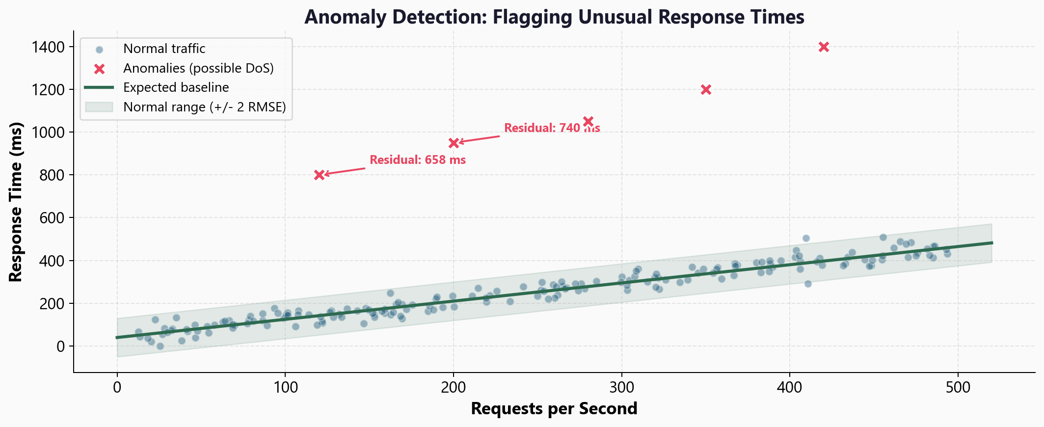
Using the Regression Line as an Anomaly Baseline

Slide 16
How the Anomaly Baseline Works
1. Train on normal traffic only
2. For each new connection:
predicted = model.predict(req_per_sec)
residual = actual - predicted
3. If residual > threshold: FLAG
Threshold = 2 x RMSE works well
Residual of 700ms when expected 250ms
= clear anomaly
This is the foundation
of anomaly detection:
build a baseline of
'normal', then flag
deviations.

Slide 17
05
Limitations
and Next Steps

Slide 18
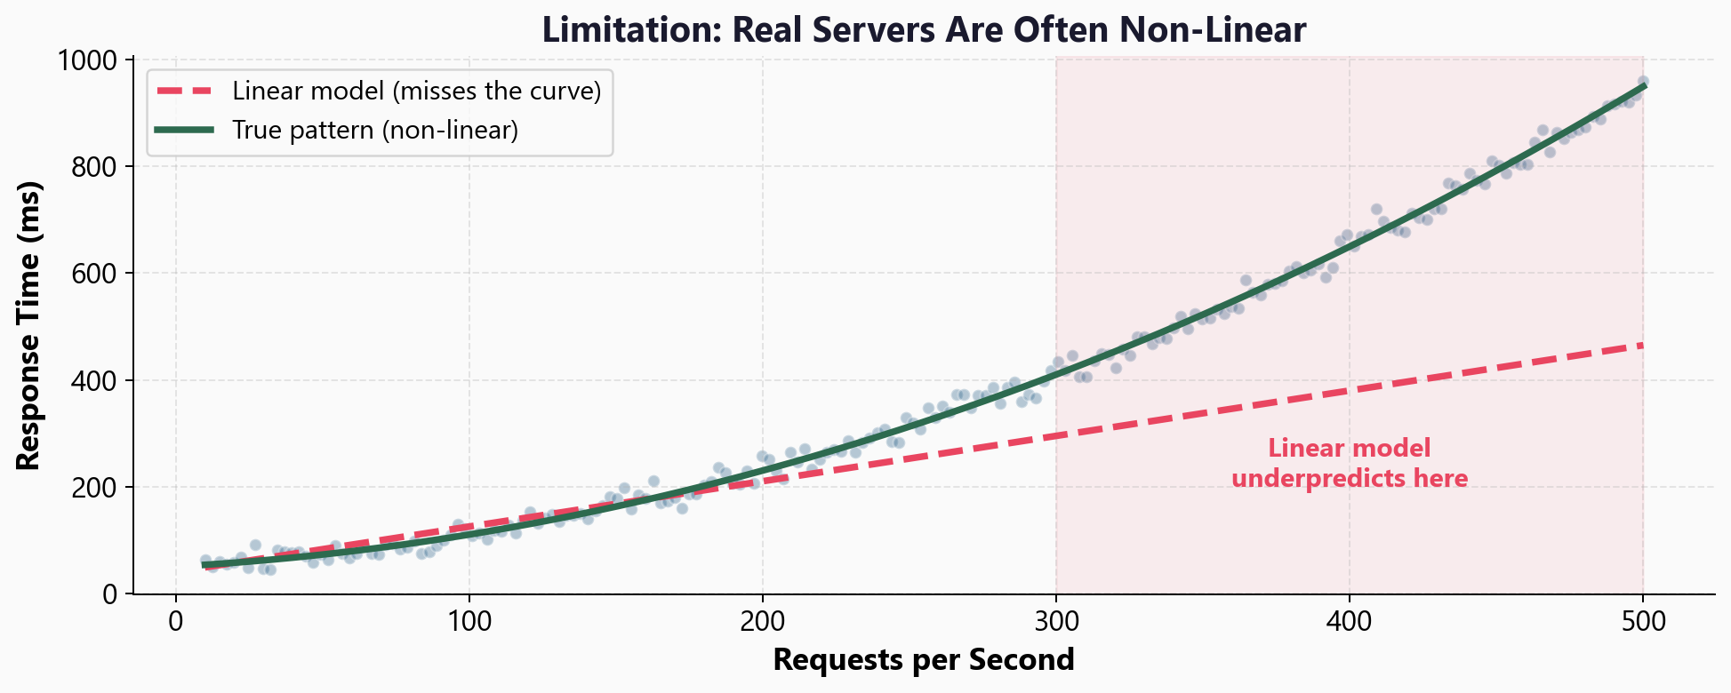
Limitation: Only Captures Linear Relationships

Slide 19
Workshop: 4 Hands-On Exercises
Exercise 1: Regression vs classification - explore the dataset
Exercise 2: Train/test split - why we hold out data
Exercise 3: Fit and predict - train the model, plot the line
Exercise 4: Evaluate - R-squared, RMSE, MAE, build a security baseline
Each exercise: lecture.md (concept) + handson.md (build it yourself)
Solution files provided to check your work

Slide 20
Key
Takeaways
Linear regression predicts a number: y = coefficient x x + intercept
The model learns just two values: slope and intercept
R-squared, RMSE, and MAE measure how well the line fits
A trained baseline flags anomalous response times (possible DoS)
Limitation: only works for linear relationships
Next: Logistic Regression - from numbers to yes/no decisions

Slide 21
Linear Regression
Next: Lesson 1.3 - Logistic Regression

