Slide 1
Logistic Regression
Lesson 1.3 | Stage 1: Classic Machine Learning
AI Basic Training
From Numbers to Decisions - Building a Phishing Classifier

Slide 2
What We'll Cover
From regression to classification - the sigmoid function
Phishing URL features - what makes a URL suspicious
Training the model and interpreting coefficients
Probabilities vs hard labels - predict_proba()
Threshold tuning - balancing precision and recall

Slide 3
01
From Numbers
to Decisions

Slide 4
Linear vs Logistic Regression
Linear Regression
Predicts a number:
Response time = 247.3 ms
Output range: any number
Use case:
'How much response time?'
Logistic Regression
Predicts a probability:
P(phishing) = 0.87
Output range: 0 to 1
Use case:
'Is this URL phishing?'

Slide 5
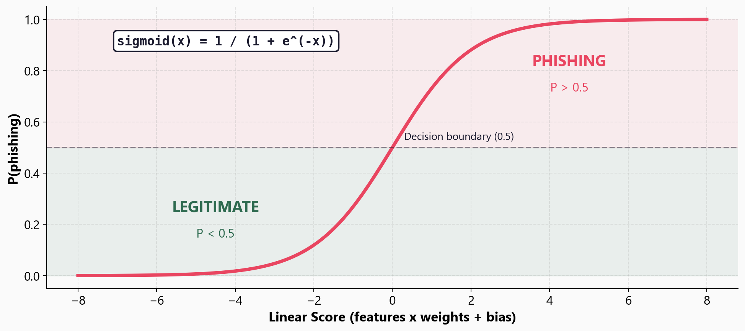
The Sigmoid Function - Squashing Scores into Probabilities

Slide 6
02
Phishing URL
Feature Engineering

Slide 7
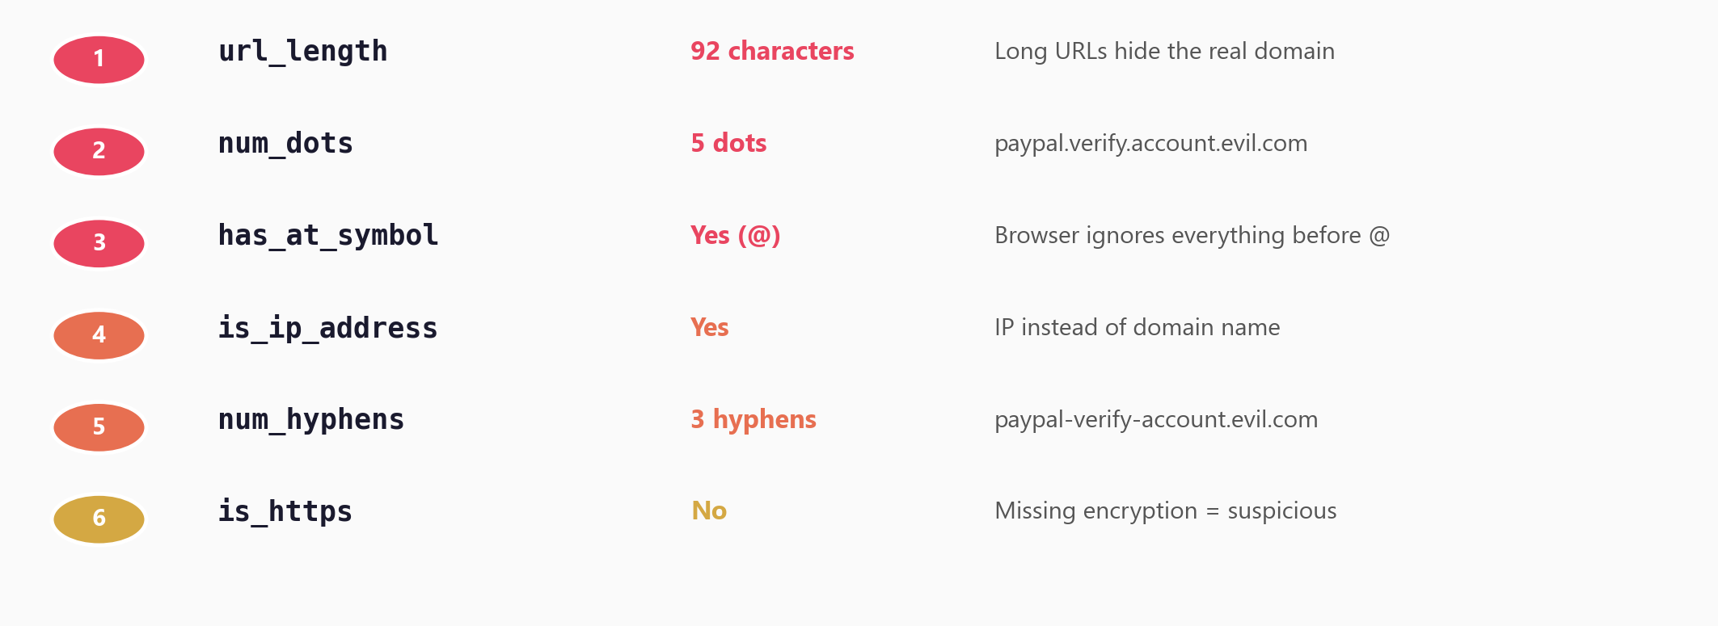
Six Signals Extracted from Every URL

Slide 8
Feature Engineering for Security
Every URL becomes a row of numbers:
[92, 5, 1, 1, 3, 0]
The model never sees the raw URL
- only the extracted features
Feature quality determines model
quality - garbage in, garbage out
Feature engineering is where
domain expertise matters most.
A security analyst knows which
URL patterns are suspicious -
the model just quantifies it.

Slide 9
03
Training the Model
and Reading Results

Slide 10
The Code - Familiar Pattern from Lesson 1.2
from sklearn.linear_model import LogisticRegression
from sklearn.preprocessing import StandardScaler
scaler = StandardScaler()
X_train_scaled = scaler.fit_transform(X_train)
X_test_scaled = scaler.transform(X_test)
model = LogisticRegression()
model.fit(X_train_scaled, y_train)
y_pred = model.predict(X_test_scaled)

Slide 11
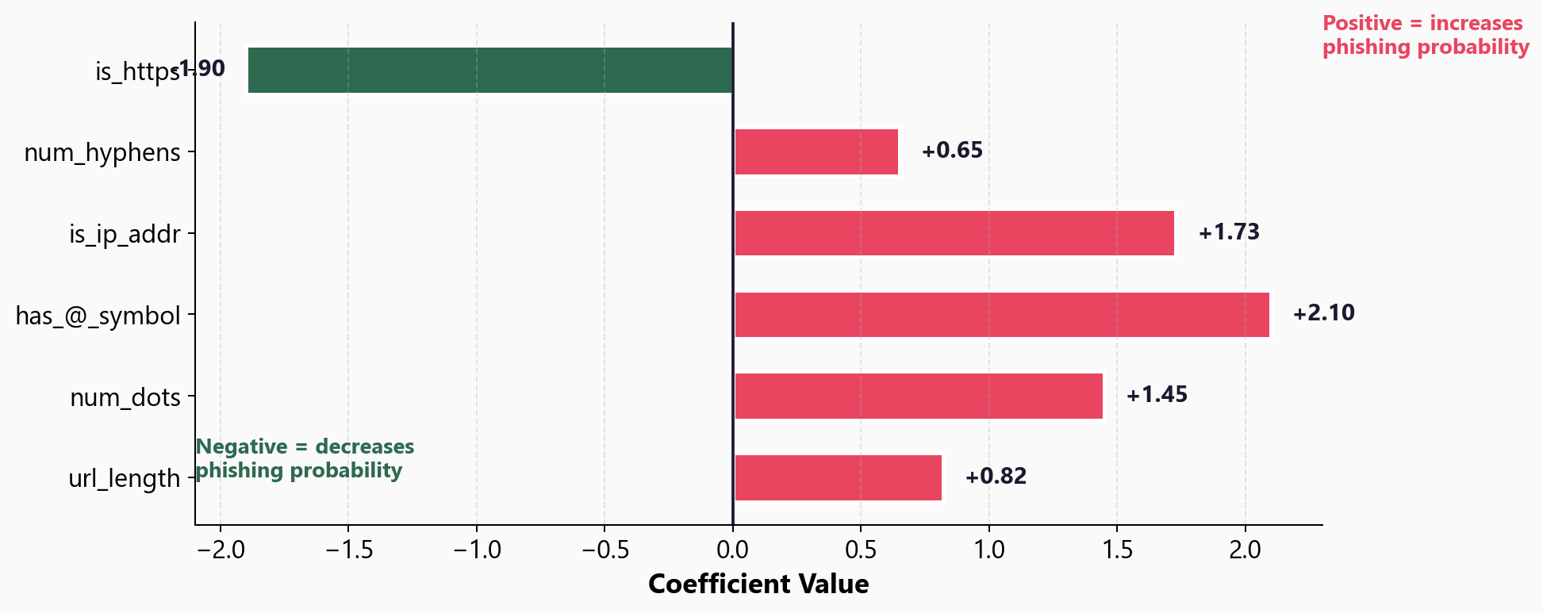
Feature Coefficients - What Drives the Prediction

Slide 12
Why Interpretability Matters
model.coef_ tells you:
which features increase risk
which features decrease risk
how much each one contributes
You can explain to stakeholders:
'This URL was flagged because
it has 5 dots, uses an IP address,
and contains an @ symbol.'
In security, a model that
cannot be explained will
not be trusted.
Logistic regression gives
you built-in transparency.

Slide 13
04
Probabilities
and Thresholds

Slide 14
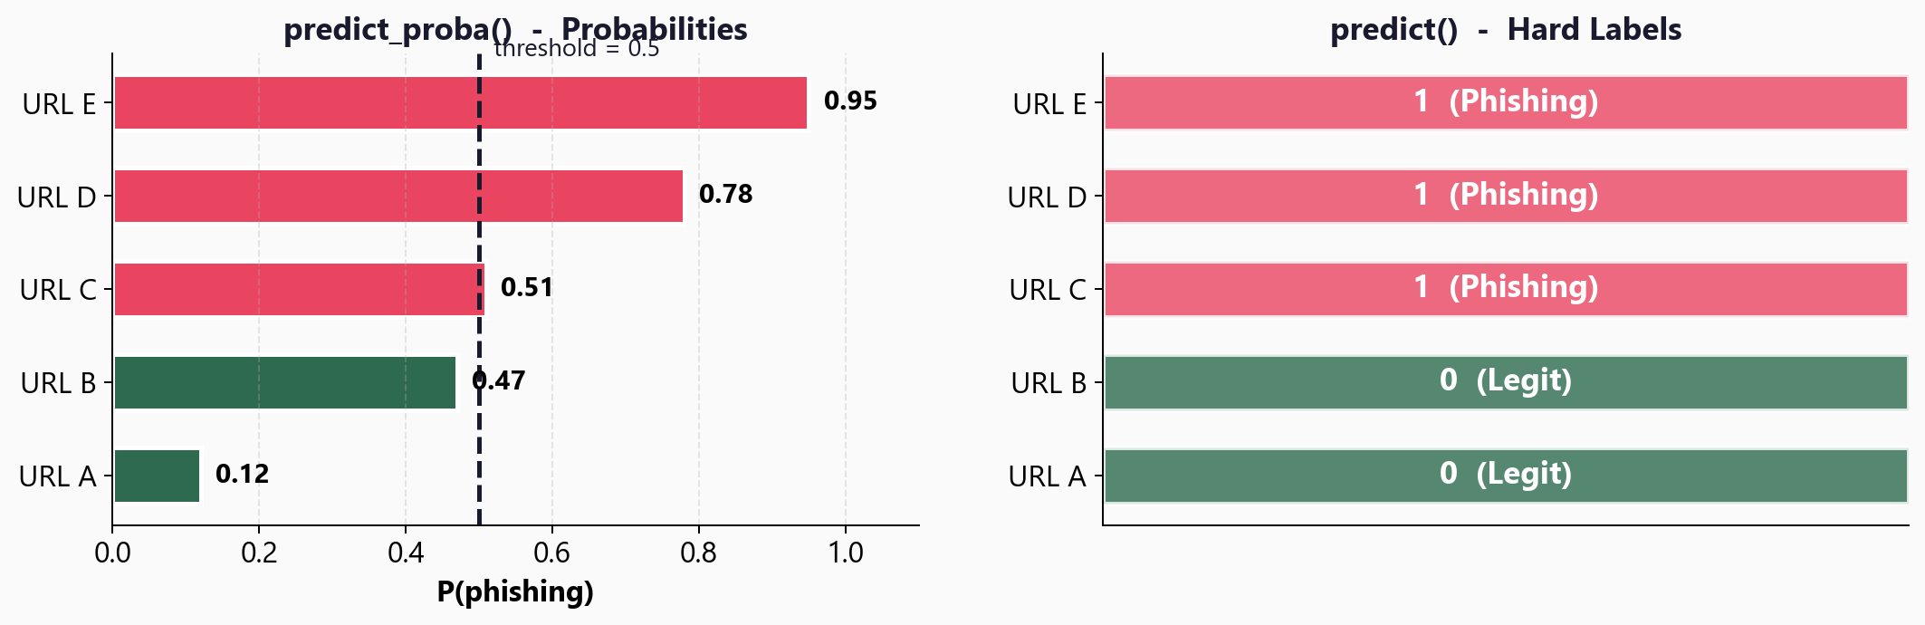
Two Ways to Get Predictions

Slide 15
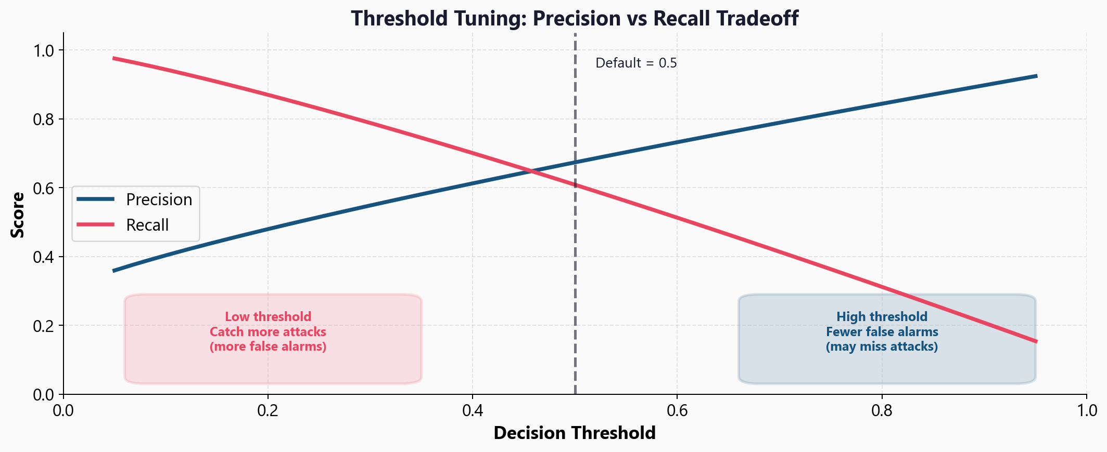
Tuning the Decision Threshold

Slide 16
Choosing the Right Threshold
Lower threshold (e.g. 0.3)
Catches more phishing URLs
More false alarms
Best when:
Missing an attack is costly
SOC team can handle volume
Alerting, not blocking
Higher threshold (e.g. 0.8)
Fewer false alarms
May miss some phishing
Best when:
Auto-blocking URLs
Blocking legit = major cost
Small team, less capacity

Slide 17
05
Workshop
and Next Steps

Slide 18
Workshop: 4 Hands-On Exercises
Exercise 1: From regression to classification - the sigmoid function
Exercise 2: Feature engineering - build phishing URL features from scratch
Exercise 3: Train and evaluate - classification report, confusion matrix
Exercise 4: Threshold tuning - find the right balance for your use case
Each exercise: lecture.md (concept) + handson.md (build it yourself)
Solution files provided to check your work

Slide 19
Key
Takeaways
Logistic regression predicts probability (0 to 1) via the sigmoid function
Feature engineering turns raw URLs into numbers the model can learn from
Coefficients reveal which features drive predictions - built-in interpretability
predict_proba() gives probabilities; predict() gives hard labels at threshold 0.5
Threshold tuning balances precision (fewer false alarms) vs recall (catch more attacks)
Next: Decision Trees - a different approach that learns if/else rules

Slide 20
Logistic Regression
Next: Lesson 1.4 - Decision Trees

