Slide 1
Decision Trees
Lesson 1.4 | Stage 1: Classic Machine Learning
AI Basic Training
Learning Rules from Data - Network Traffic Classification

Slide 2
What We'll Cover
How decision trees work - a flowchart of learned rules
Gini impurity - how splits are chosen
Network attack signatures - the security scenario
Feature importance - which features matter most
Overfitting and how to control it

Slide 3
01
How Decision
Trees Work

Slide 4
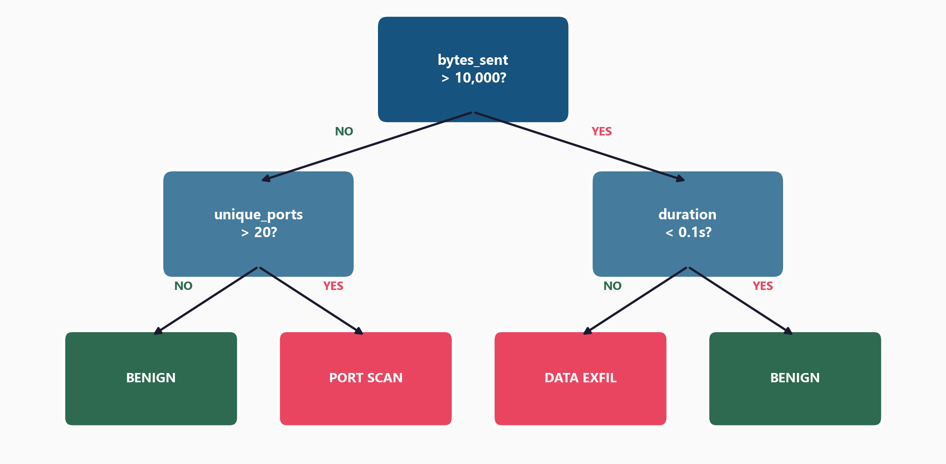
A Flowchart of Learned Yes/No Questions

Slide 5
What Makes Trees Special
The model learns which questions to ask
and at what thresholds to split
No feature scaling needed
(unlike logistic regression)
Handles non-linear patterns
(combinations of thresholds)
The rules are human-readable
A decision tree is the only
model so far that you can
print and read like a
flowchart.
Great for security audits.

Slide 6
02
How Splits
Are Chosen

Slide 7
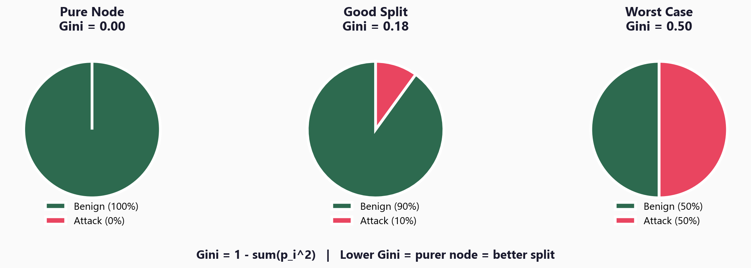
Gini Impurity - Measuring Split Quality

Slide 8
The Splitting Algorithm
At each node, the tree tries every possible split:
For each feature (bytes_sent, duration, ports, ...):
For each possible threshold value:
Split the data into two groups
Calculate Gini impurity of each group
Pick the split with lowest weighted Gini
Repeat recursively until stopping condition is met
(max_depth, min_samples, or pure nodes)

Slide 9
03
Network Traffic
Classification

Slide 10
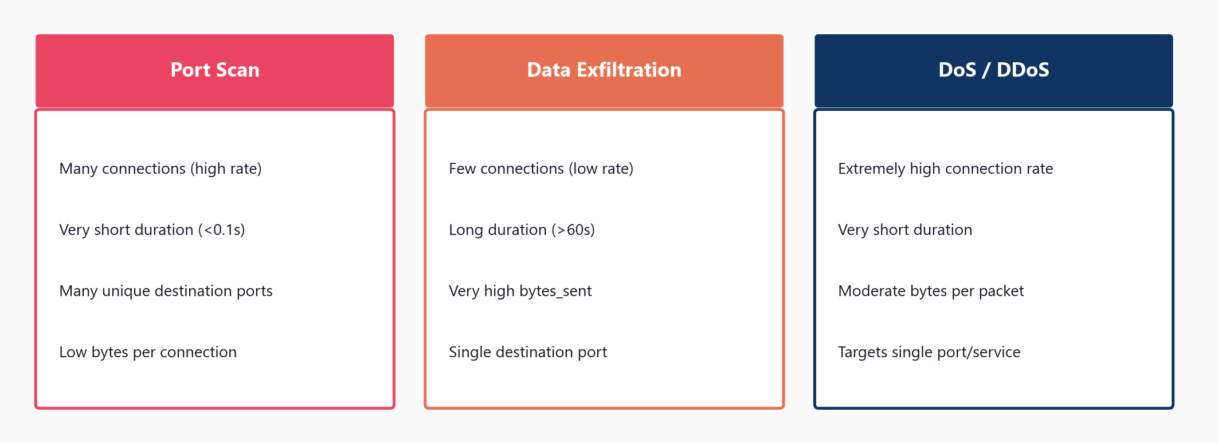
Three Attack Types - Distinct Feature Signatures

Slide 11
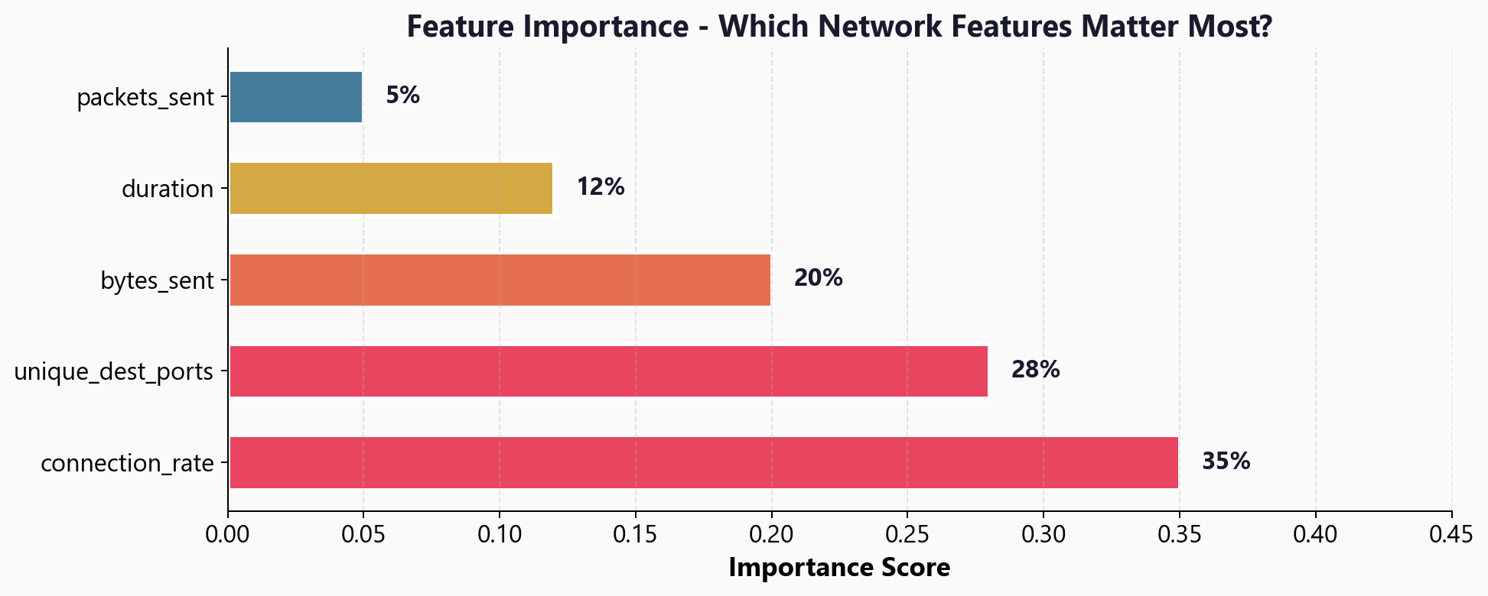
Feature Importance - Which Network Features Matter Most?

Slide 12
The Code - Training and Visualising the Tree
from sklearn.tree import DecisionTreeClassifier, plot_tree
model = DecisionTreeClassifier(max_depth=4, random_state=42)
model.fit(X_train, y_train)
# See the actual rules the model learned:
plot_tree(model, feature_names=feature_names,
class_names=['Benign','PortScan','Exfil','DoS'],
filled=True, fontsize=8)
# Which features matter most?
print(model.feature_importances_)

Slide 13
04
Overfitting and
How to Control It

Slide 14
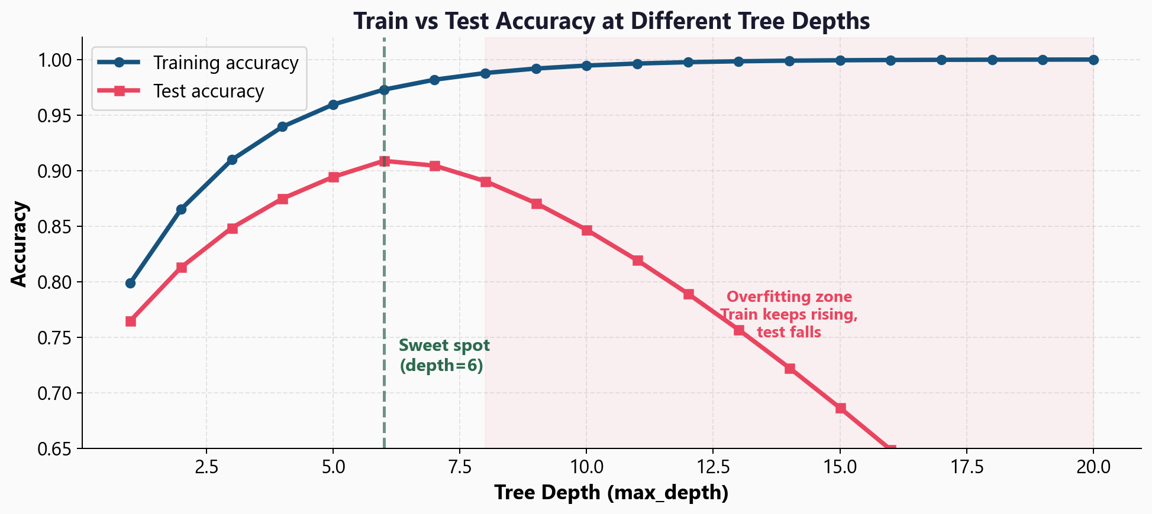
Train vs Test Accuracy at Different Depths

Slide 15
Two Controls to Prevent Overfitting
max_depth
Limits how deep the tree grows
Low depth (2-3):
Simple, may underfit
High depth (15+):
Complex, will overfit
Sweet spot: usually 4-8
min_samples_split
Minimum samples to split a node
High value (50+):
Prevents tiny leaf nodes
More generalisation
Default is 2 (very permissive)
Try 10-50 for security data

Slide 16
05
Comparison
and Next Steps

Slide 17
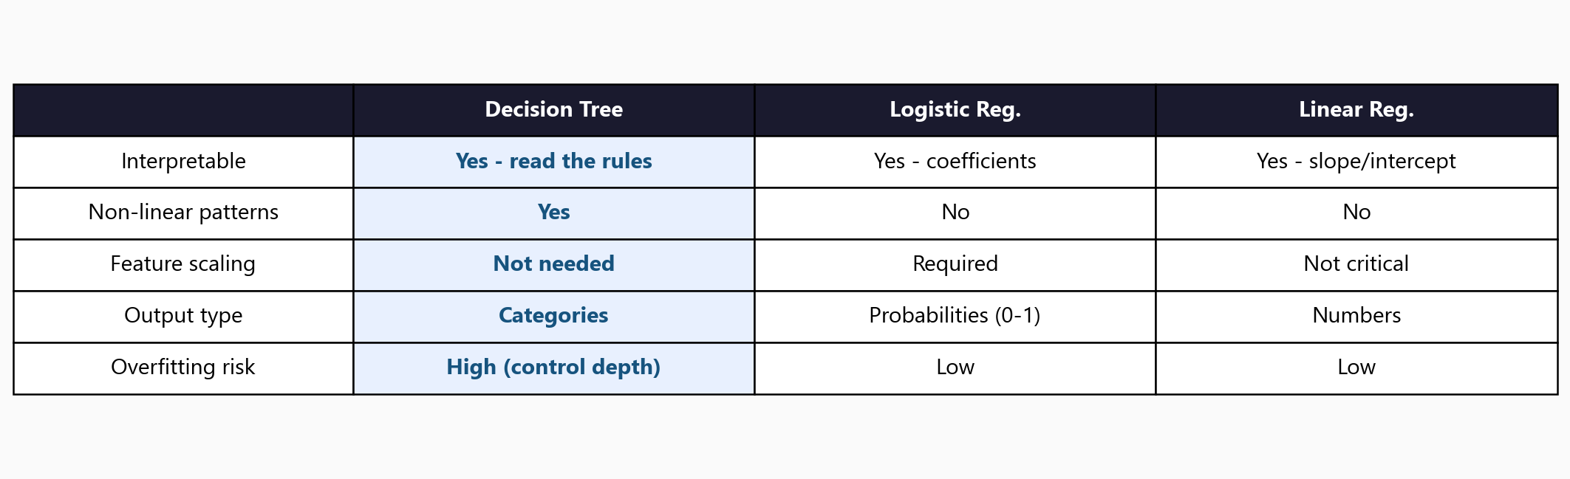
How Decision Trees Compare to Previous Models

Slide 18
Workshop: 4 Hands-On Exercises
Exercise 1: How trees split - Gini impurity, information gain
Exercise 2: Train the tree and read the rules with plot_tree()
Exercise 3: Feature importance - which network features matter
Exercise 4: Depth sweep - find the sweet spot, see overfitting live
Each exercise: lecture.md (concept) + handson.md (build it yourself)
Solution files provided to check your work

Slide 19
Key
Takeaways
Decision trees learn if/else rules from data - like a flowchart
Gini impurity measures split quality: lower = purer = better
Feature importance reveals which inputs the tree relies on most
Trees handle non-linear patterns without feature scaling
max_depth controls overfitting - find the sweet spot (usually 4-8)
Next: Model Evaluation - why accuracy alone is dangerous in security

Slide 20
Decision Trees
Next: Lesson 1.5 - Model Evaluation

