Slide 1
Model Evaluation
Lesson 1.5 | Stage 1: Classic Machine Learning
AI Basic Training
Beyond Accuracy - Metrics That Matter in Security

Slide 2
What We'll Cover
The accuracy trap - why 99% can be useless
The confusion matrix - four possible outcomes
Precision, recall, and F1 score
ROC curves and AUC
Threshold tuning for operational priorities

Slide 3
01
The Accuracy Trap

Slide 4
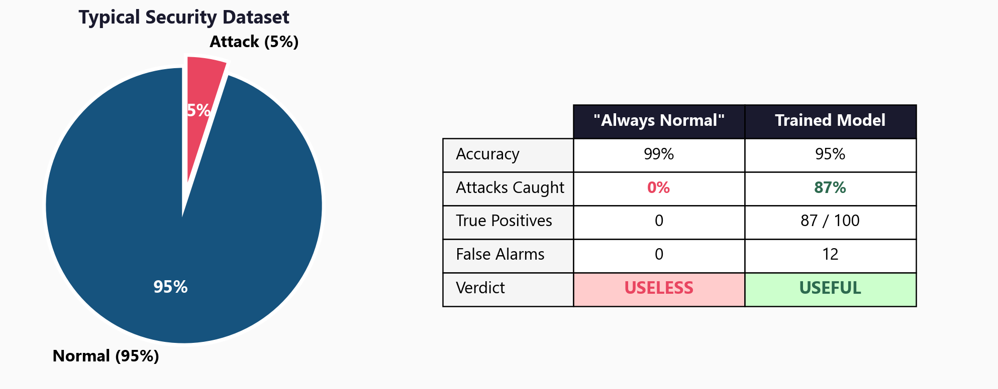
99% Accuracy That Catches Zero Attacks

Slide 5
Why Accuracy Misleads in Security
10,000 connections per hour
100 are attacks (1%)
9,900 are normal (99%)
A model that always says 'normal':
Accuracy = 99%
Attacks caught = 0
This is everywhere in security:
Network IDS, fraud, malware
When classes are imbalanced,
accuracy rewards ignoring
the rare class.
You need metrics that
focus on the minority.

Slide 6
02
The Confusion
Matrix

Slide 7
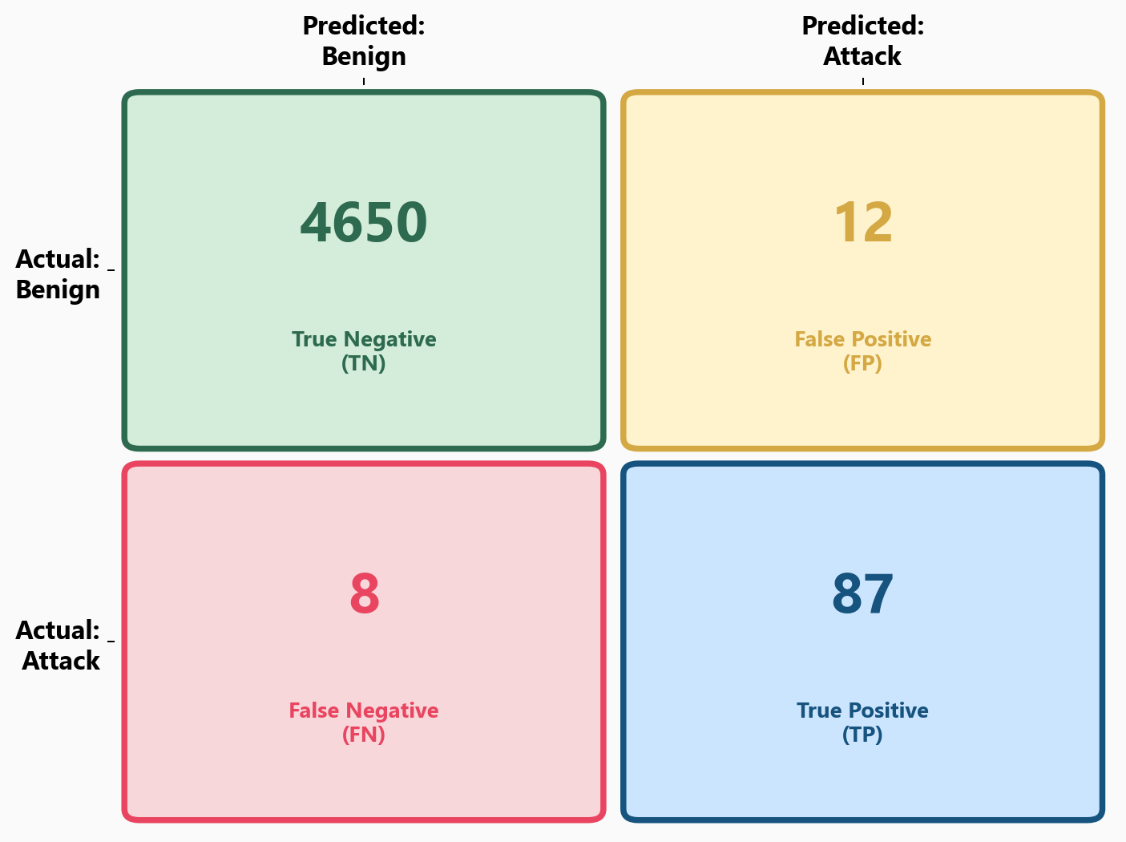
Every Prediction Falls Into One of Four Buckets

Slide 8
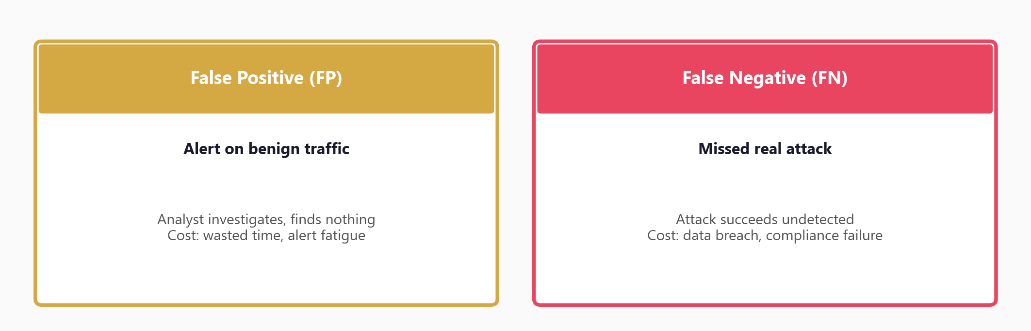
The Cost of Each Error Type in Security

Slide 9
Reading the Confusion Matrix
Diagonal = correct predictions
(TN + TP) - you want these large
Off-diagonal = errors
FP = false alarm (benign flagged)
FN = missed attack (attack missed)
In security, FN is usually worse:
A missed breach > a false alert
In most security contexts,
a false negative (missed attack)
is far more costly than
a false positive (false alarm).

Slide 10
03
Precision, Recall,
and F1 Score

Slide 11
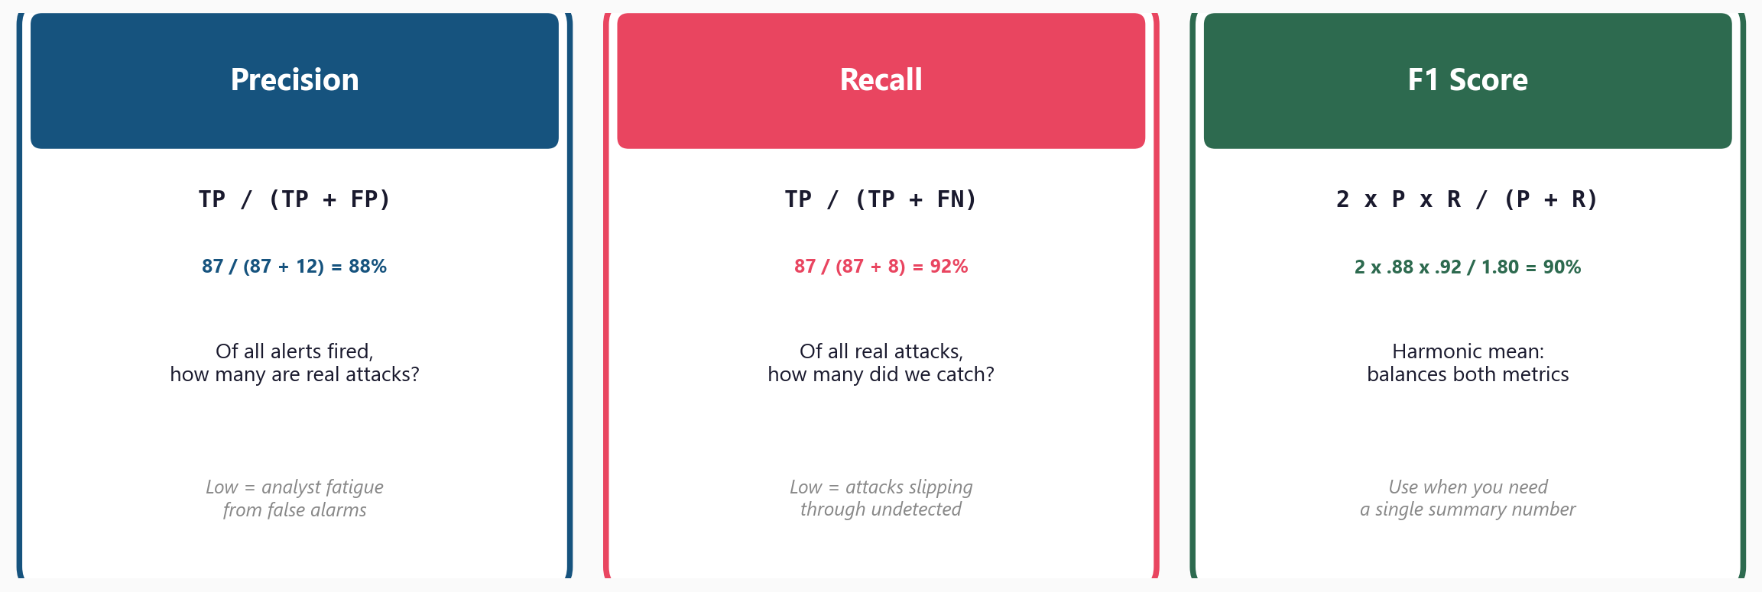
The Three Metrics You Need for Security ML

Slide 12
When Each Metric Matters Most
Prioritise Precision when:
Auto-blocking is enabled
(blocking legit = revenue loss)
Small team, limited capacity
(can't handle many false alarms)
High-confidence actions only
Prioritise Recall when:
Missing attacks is unacceptable
(APT detection, compliance)
Alerting, not blocking
(analysts triage the alerts)
Cost of a breach is very high

Slide 13
04
ROC Curves
and Thresholds

Slide 14
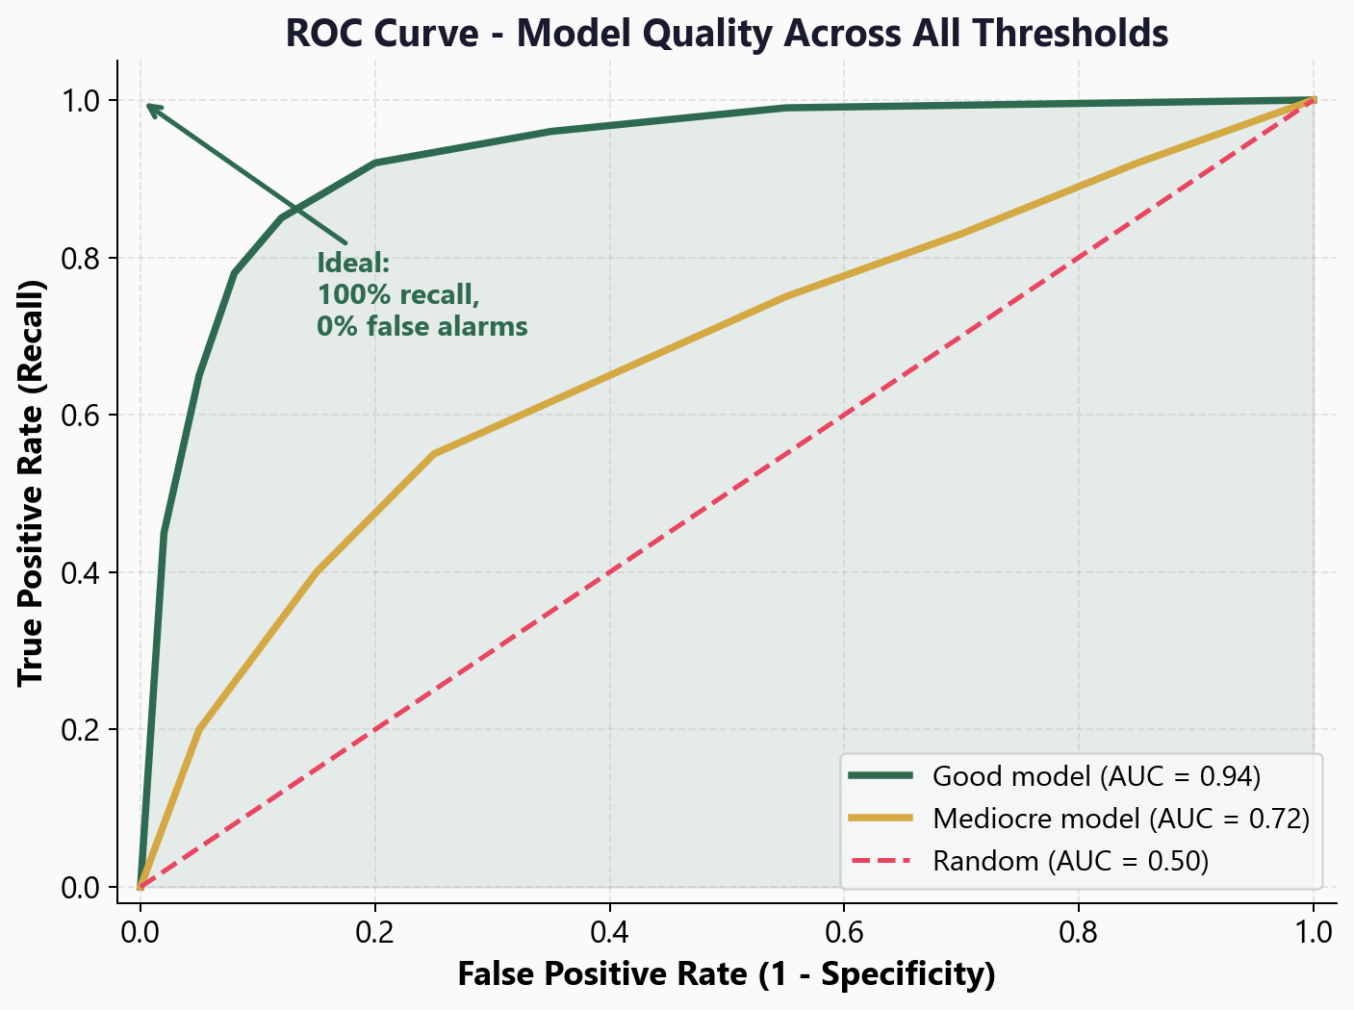
ROC Curve - Model Quality Across All Thresholds

Slide 15
Reading the ROC Curve and AUC
AUC = Area Under the Curve
AUC = 1.0: Perfect separation (never happens in practice)
AUC > 0.90: Excellent model
AUC > 0.80: Good model
AUC = 0.50: No better than random (the diagonal line)
The ROC curve shows performance at EVERY threshold at once
- no need to pick a threshold first
- compare models fairly regardless of threshold choice

Slide 16
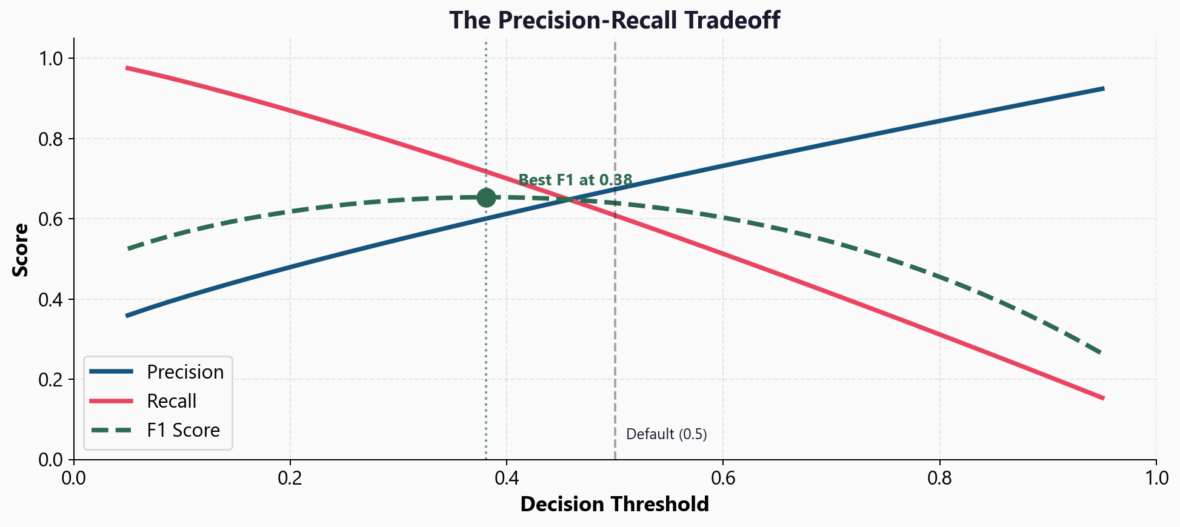
The Precision-Recall Tradeoff

Slide 17
Choosing the Right Threshold
SOC with analyst team
Lower threshold (e.g. 0.3)
Higher recall
More alerts to triage
Fewer missed attacks
Goal: catch everything,
analysts filter the noise
Automated blocking rule
Higher threshold (e.g. 0.8)
Higher precision
Fewer false blocks
May miss subtle attacks
Goal: only act when
confidence is very high

Slide 18
05
Workshop
and Next Steps

Slide 19
The sklearn Evaluation Toolkit
from sklearn.metrics import (classification_report,
confusion_matrix, roc_auc_score, RocCurveDisplay)
print(classification_report(y_test, y_pred))
print(confusion_matrix(y_test, y_pred))
print(f'ROC AUC: {roc_auc_score(y_test, y_proba):.4f}')
RocCurveDisplay.from_predictions(y_test, y_proba).plot()

Slide 20
Workshop: 5 Hands-On Exercises
Exercise 1: The accuracy trap - DummyClassifier on imbalanced data
Exercise 2: Confusion matrix - compute TP/FP/TN/FN by hand and with sklearn
Exercise 3: Precision, recall, F1 - classification report on attack data
Exercise 4: ROC curve and AUC - compare three models visually
Exercise 5: Threshold tuning - find the right balance for your use case
Each exercise: lecture.md (concept) + handson.md (build it yourself)

Slide 21
Key
Takeaways
Accuracy is misleading on imbalanced data - a 99% model can catch 0 attacks
The confusion matrix reveals TP, FP, TN, FN - the full picture
Precision (alert quality) vs recall (attack coverage) is the core tradeoff
F1 balances both; use it as a single summary metric
ROC AUC compares models across all thresholds (>0.90 = excellent)
Next: Stage 2 - feature engineering, ensembles, and real-world pipelines

Slide 22
Model Evaluation
Next: Stage 2 - Intermediate ML

