Slide 1
Feature Engineering
Lesson 2.1 | Stage 2: Intermediate ML
AI Basic Training
Turning Raw Security Logs into ML-Ready Features

Slide 2
What We'll Cover
Why raw logs fail - sklearn needs numbers
Five types of features to extract from security data
The feature engineering pipeline
Feature selection - removing noise and redundancy
Impact on model performance

Slide 3
01
Why Raw
Logs Fail

Slide 4
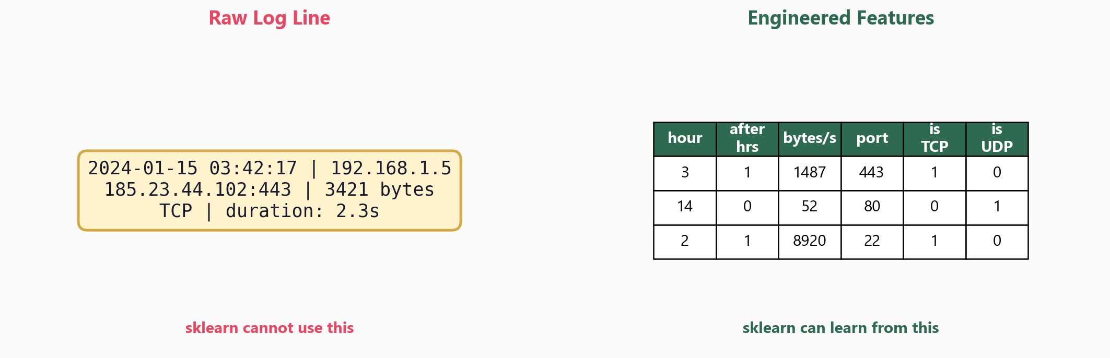
Raw Data vs Engineered Features

Slide 5
The Core Problem
sklearn accepts only numerical matrices
No strings, no timestamps, no IPs
Raw log line has all the signal
but in the wrong format
Feature engineering is the bridge
from raw data to model input
Feature engineering is often
where the most value comes
from in a real ML project.
80% of the work, 80% of
the impact.

Slide 6
02
Five Types of
Security Features

Slide 7
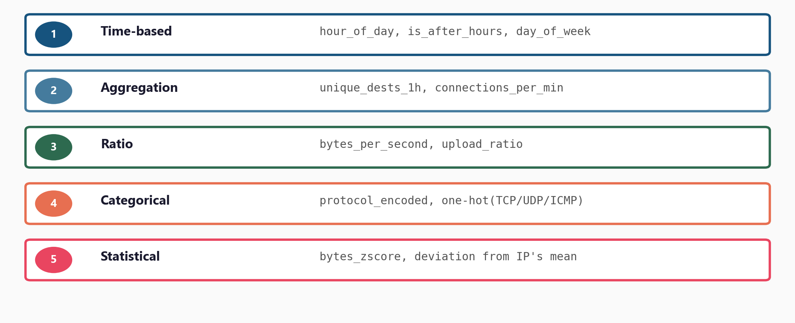
Feature Types for Security Log Data

Slide 8
Examples in Code
Time-based:
df['hour'] = df['ts'].dt.hour
df['after_hrs'] = hour < 6 | hour > 22
Aggregation:
df.groupby('src_ip')['dest_ip']
.transform('nunique')
Ratio:
df['bytes/s'] = bytes / duration
df['upload_ratio'] = up / total
Categorical:
pd.get_dummies(df['protocol'])
or LabelEncoder()

Slide 9
03
The Feature
Engineering Pipeline

Slide 10
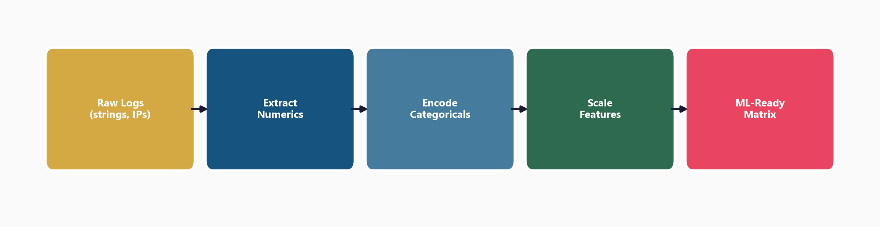
Five Steps from Raw Logs to Model Input

Slide 11
Scaling - Why and How
Many algorithms are sensitive to feature scale:
bytes_sent ranges 0 - 1,000,000
duration ranges 0 - 300
StandardScaler: mean=0, std=1 (most common)
MinMaxScaler: range [0, 1]
Critical rule: fit on training data only
scaler.fit_transform(X_train)
scaler.transform(X_test) # never fit on test!

Slide 12
04
Feature Selection
and Validation

Slide 13
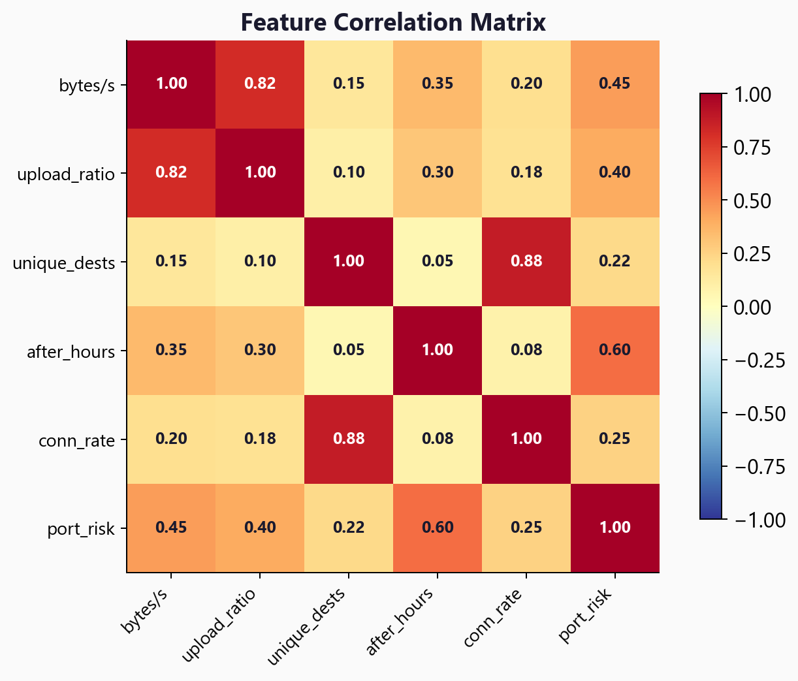
Correlation Matrix - Find Redundant Features

Slide 14
The Golden Rule of Feature Engineering
Every feature is a hypothesis:
'This signal distinguishes attack
from normal traffic'
Remove features that:
Are highly correlated (redundant)
Have near-zero variance
Don't correlate with the label
Use tree-based feature importance
Random feature addition
hurts performance.
More features is not
always better -
this is the curse
of dimensionality.

Slide 15
05
Impact and
Next Steps

Slide 16
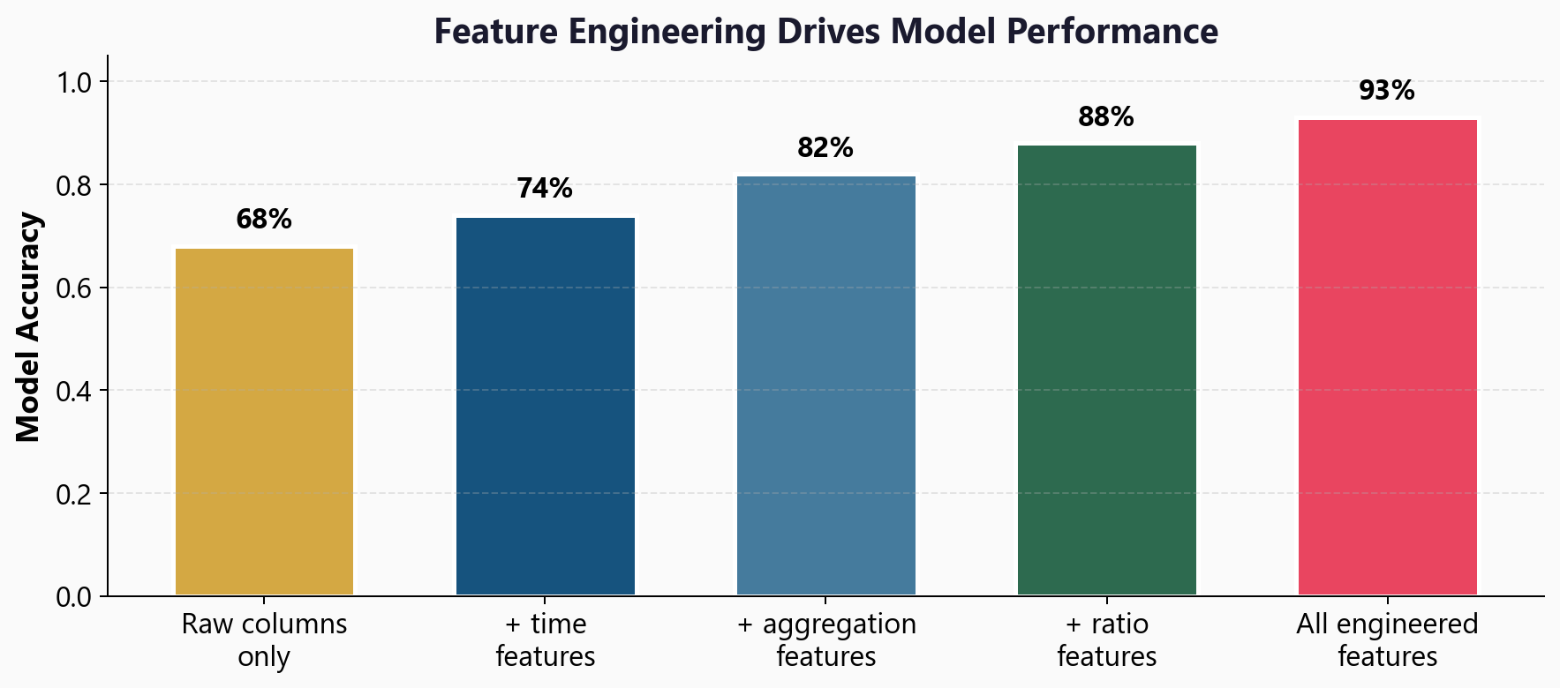
Feature Engineering Drives Model Performance

Slide 17
Workshop: 4 Hands-On Exercises
Exercise 1: Why raw logs fail - see sklearn reject string data
Exercise 2: Numeric extraction - bytes/s, packet rate, port risk
Exercise 3: Categorical encoding - one-hot, LabelEncoder, dummy trap
Exercise 4: Scaling and validation - StandardScaler, fit on train only
Each exercise: lecture.md (concept) + handson.md (build it yourself)

Slide 18
Key
Takeaways
Raw logs are unusable - sklearn needs a numerical matrix
Five feature types: time, aggregation, ratio, categorical, statistical
Every feature is a hypothesis about what makes attacks different
Always scale features - fit on training data only
Remove redundant features (correlation, variance, importance)
Next: Random Forests - feed engineered features into a powerful ensemble

Slide 19
Feature Engineering
Next: Lesson 2.2 - Random Forests

