Slide 1
Random Forests
Lesson 2.2 | Stage 2: Intermediate ML
AI Basic Training
Wisdom of the Crowd - Ensemble Learning for Malware Detection

Slide 2
What We'll Cover
From one tree to many - the ensemble concept
How Random Forests work - bootstrap + feature subsampling
Single tree vs forest - why ensembles win
The malware classifier - PE file features
OOB error, learning curves, and tuning

Slide 3
01
From One Tree
to Many

Slide 4
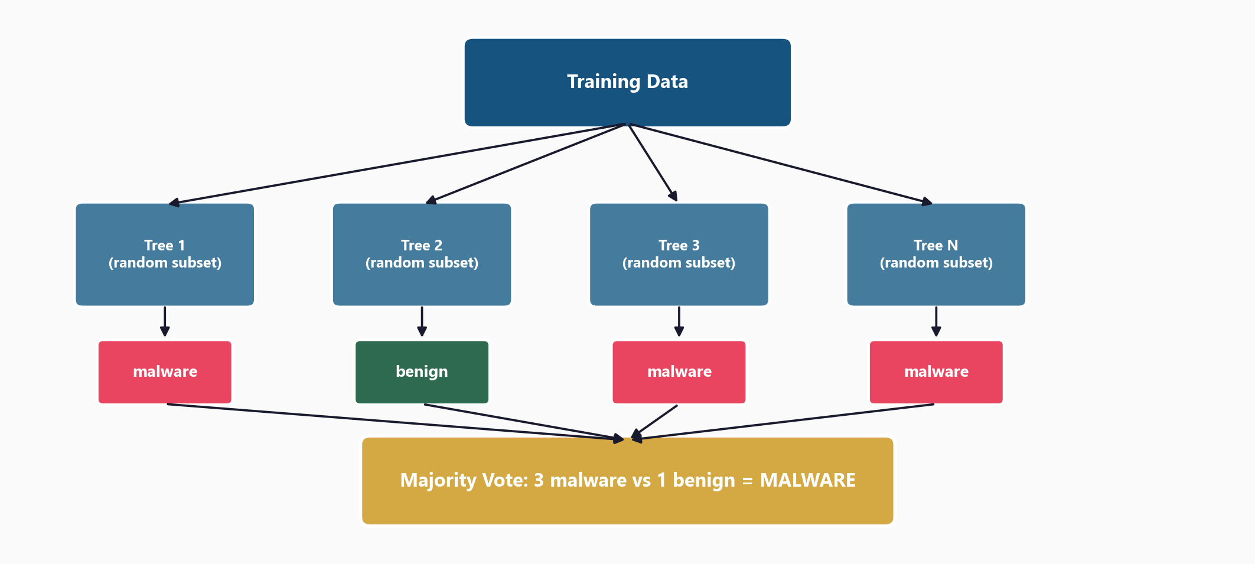
Random Forest: Train Many Trees, Take a Vote

Slide 5
The Two Sources of Randomness
1. Bootstrap sampling
Each tree sees a random 63% of data
(sampling with replacement)
2. Random feature subsets
At each split, only sqrt(n) features
considered (not all of them)
Result: diverse trees that make
different mistakes
A single tree is one analyst.
A Random Forest is 100 analysts
voting.
The crowd averages out
individual mistakes.

Slide 6
02
Single Tree
vs Forest

Slide 7
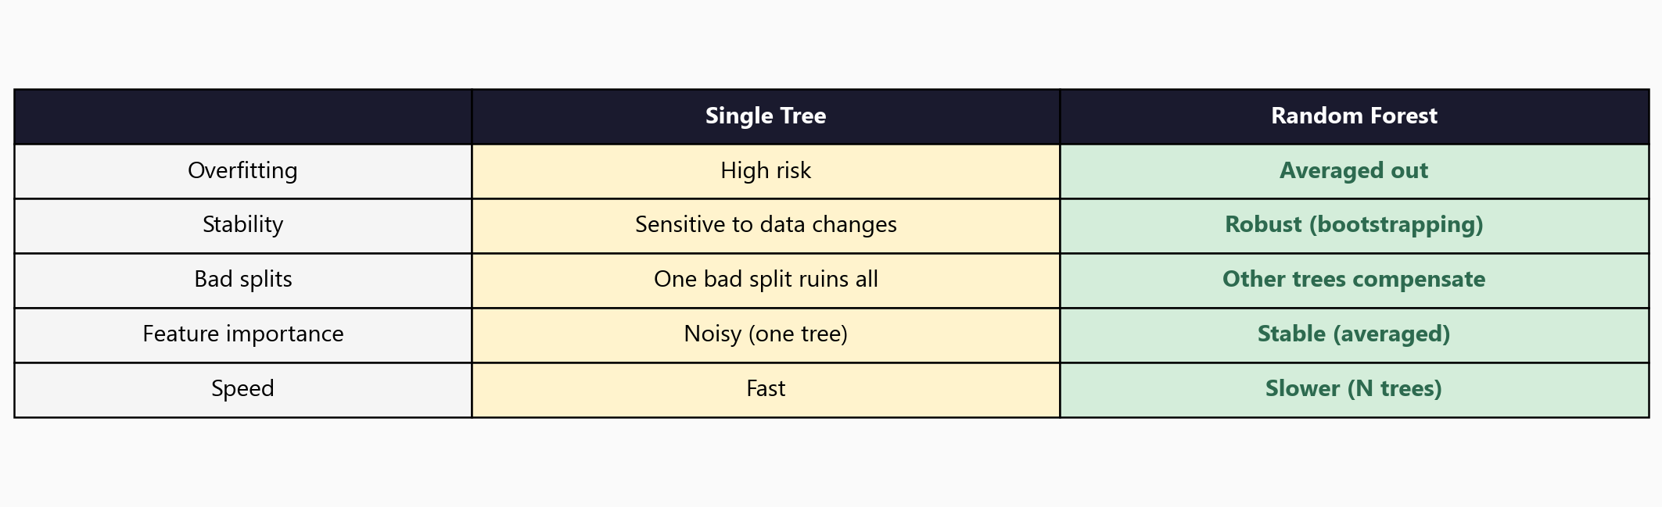
Why Ensembles Beat Individual Trees

Slide 8
03
The Malware
Classifier

Slide 9
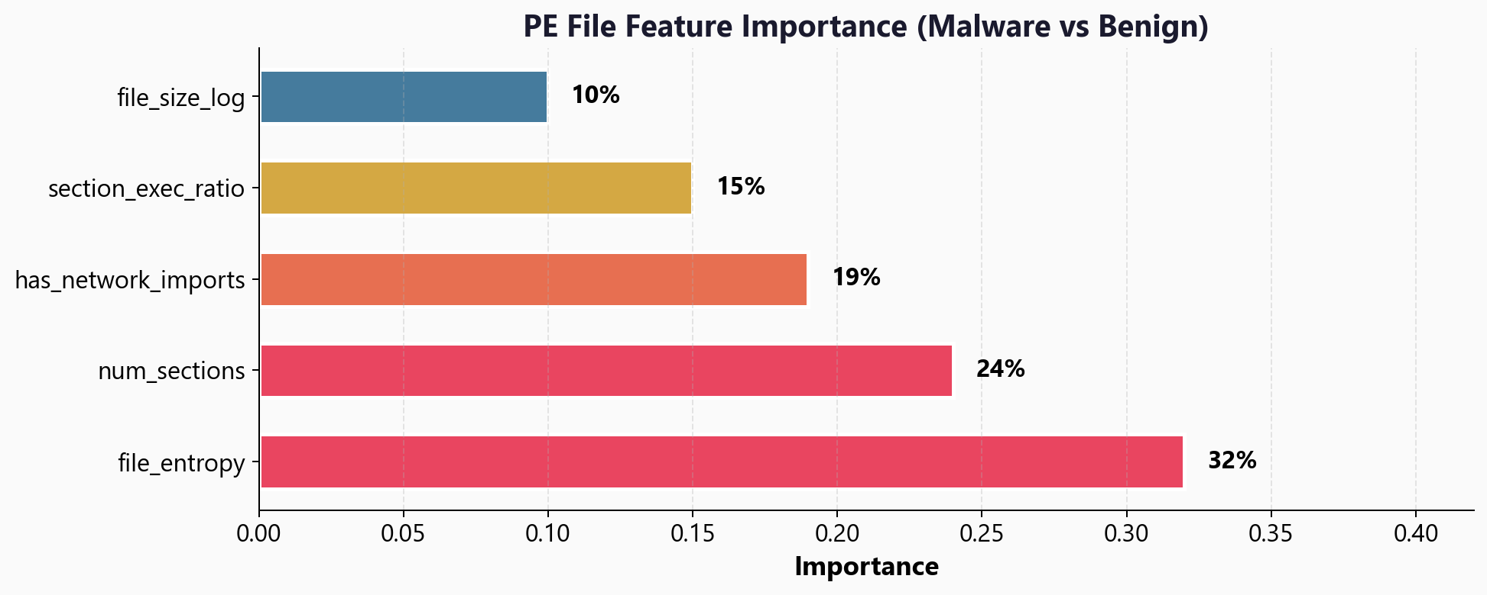
PE File Feature Importance - What Matters Most?

Slide 10
The Code - Training a Random Forest
from sklearn.ensemble import RandomForestClassifier
model = RandomForestClassifier(
n_estimators=200, # 200 trees
max_depth=None, # let trees grow fully
oob_score=True, # free validation estimate
n_jobs=-1, # use all CPU cores
random_state=42
)
model.fit(X_train, y_train)
print(f'OOB accuracy: {model.oob_score_:.4f}')

Slide 11
04
OOB Error and
Tuning the Forest

Slide 12
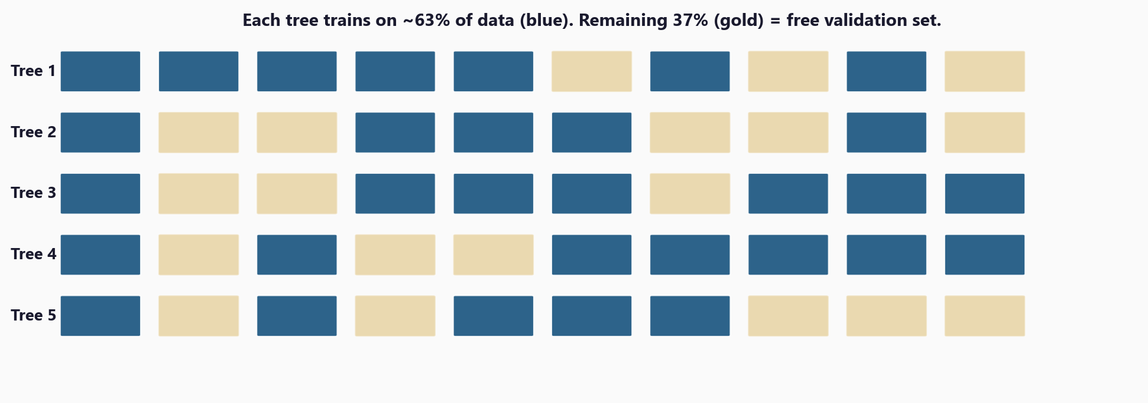
Out-of-Bag: Free Validation from Bootstrap Sampling

Slide 13
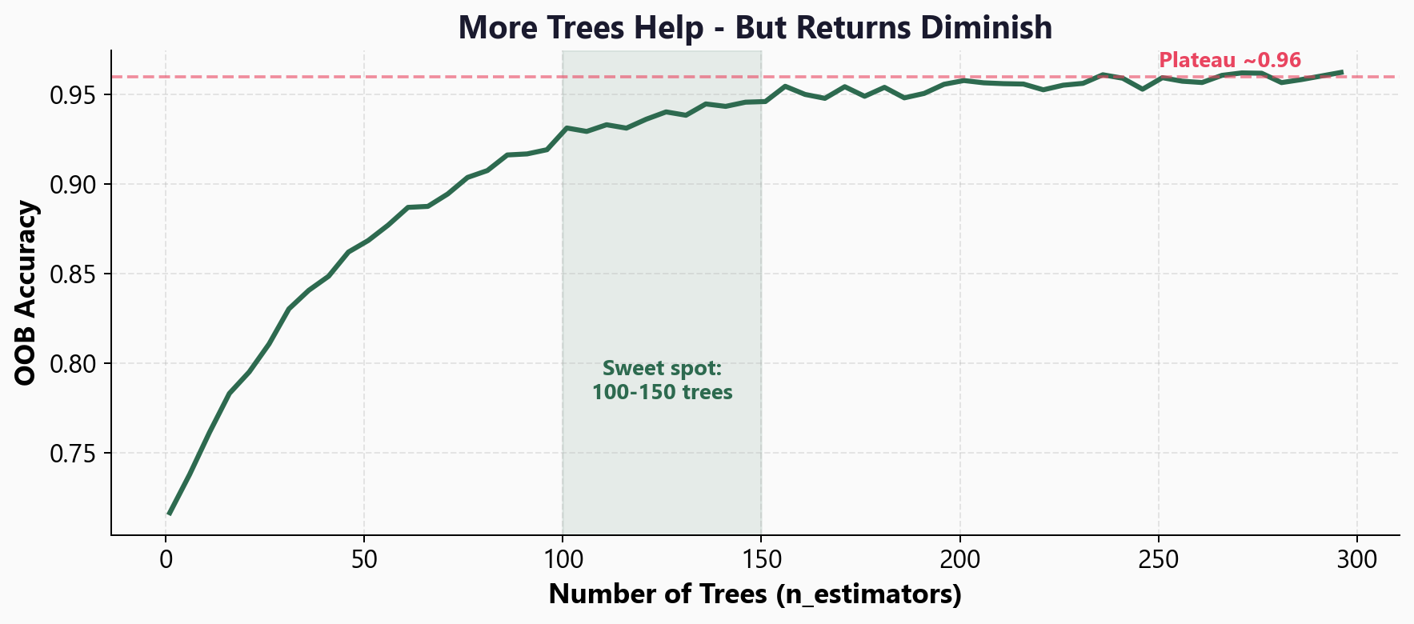
Learning Curve: More Trees Help, But Returns Diminish

Slide 14
05
Workshop
and Next Steps

Slide 15
Workshop: 4 Hands-On Exercises
Exercise 1: Single tree overfitting demo vs forest stability
Exercise 2: Train a Random Forest - OOB score, tree vs forest accuracy
Exercise 3: Feature importance - stable vs noisy (single tree vs forest)
Exercise 4: Tune the forest - n_estimators sweep, max_features, learning curve
Each exercise: lecture.md + handson.md + solution file

Slide 16
Key
Takeaways
Random Forest = many diverse trees voting together
Bootstrap sampling + random features = diversity that reduces overfitting
OOB score gives free validation - no separate test set needed during training
Feature importance is more stable than a single tree
100-300 trees is usually sufficient - diminishing returns beyond that
Next: Clustering - detect anomalies without any labels at all

Slide 17
Random Forests
Next: Lesson 2.3 - Clustering and Anomaly Detection

