Slide 1
Clustering & Anomaly Detection
Lesson 2.3 | Stage 2: Intermediate ML
AI Basic Training
Finding Threats Without Labels - Unsupervised Learning

Slide 2
What We'll Cover
Supervised vs unsupervised - what if you have no labels?
How k-Means clustering works - step by step
Choosing k with the elbow method
Anomaly detection via centroid distance
Scaling and practical considerations

Slide 3
01
The Unsupervised
Problem

Slide 4
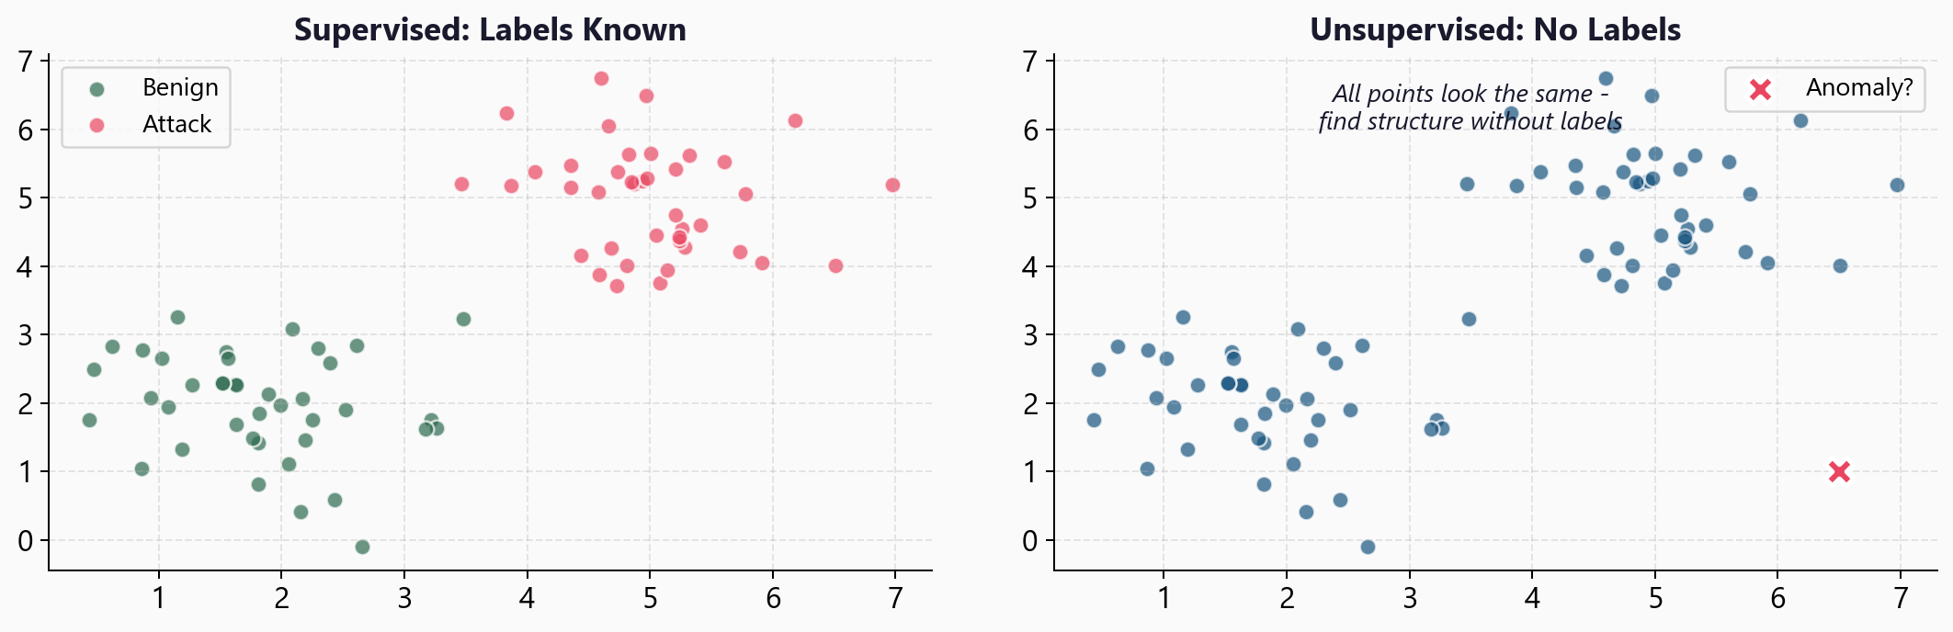
Supervised vs Unsupervised Learning

Slide 5
Why Unsupervised Matters for Security
You almost never have perfect labels
No one hand-labels every firewall connection
k-Means can:
Find behavioural clusters (users, servers, IoT)
Flag outliers (anomalous connections)
Baseline normal without a single label
I don't need to know what
an attack looks like.
I just need to know when
something looks different
from normal.

Slide 6
02
How k-Means
Works

Slide 7
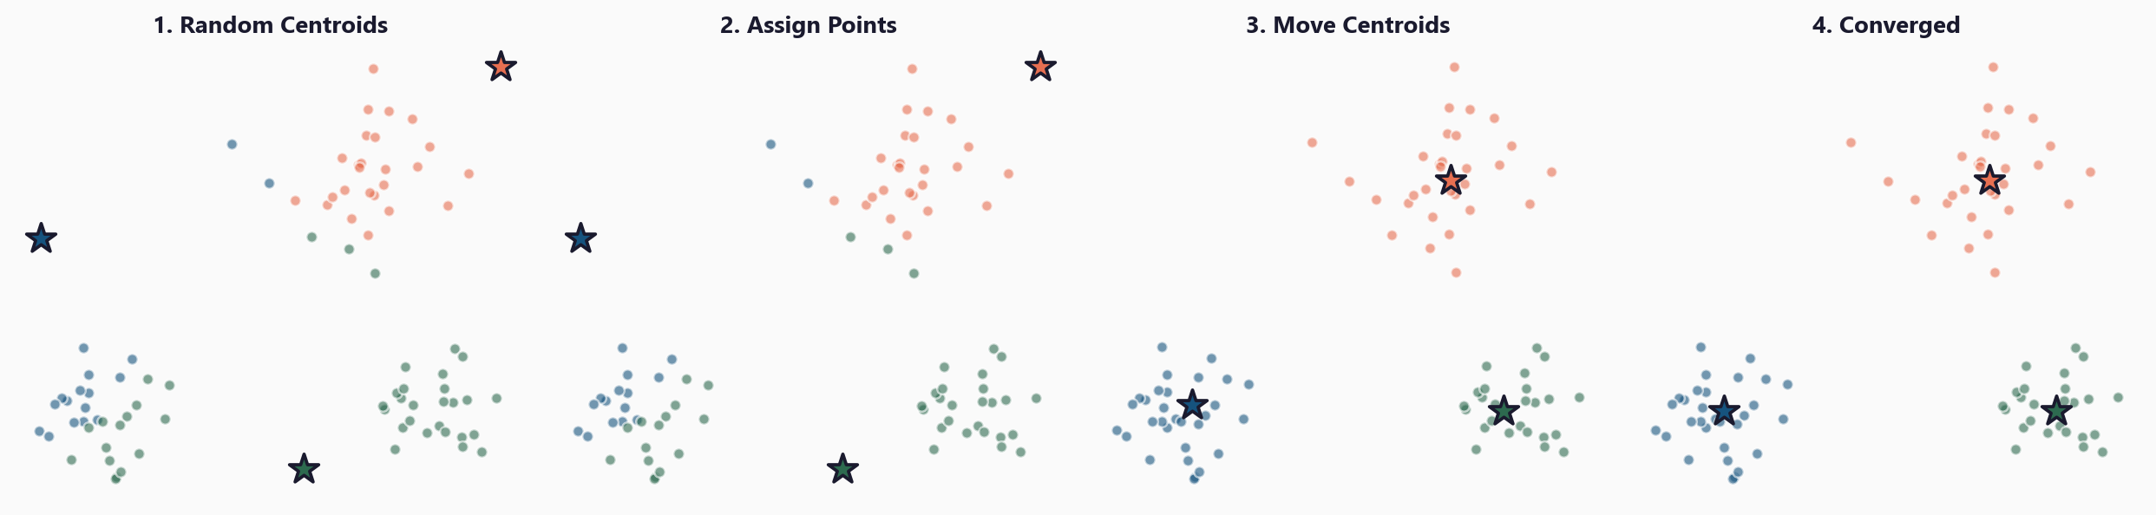
The k-Means Algorithm in Four Steps

Slide 8
The Algorithm
1. Choose k (number of clusters)
2. Place k centroids randomly
3. Assign each point to its nearest centroid
4. Move each centroid to the mean of its assigned points
5. Repeat steps 3-4 until assignments stop changing
Converges in ~10-20 iterations for most datasets
Uses Euclidean distance - features MUST be scaled first

Slide 9
03
Choosing k

Slide 10
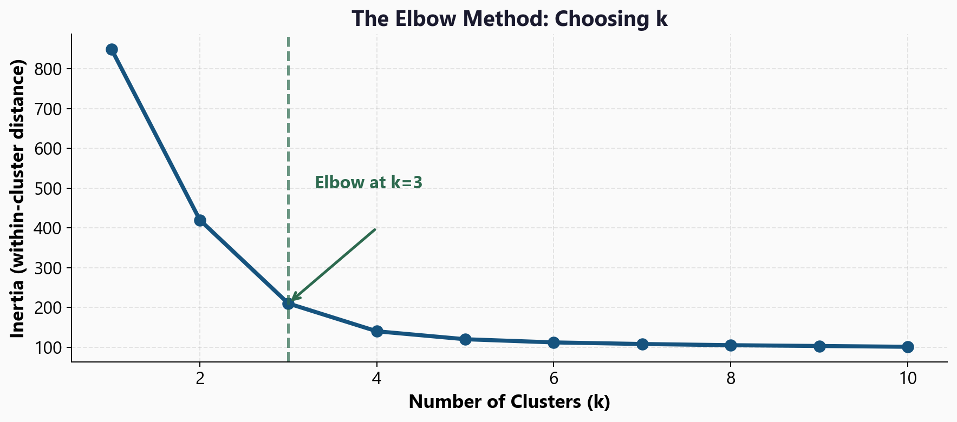
The Elbow Method: Where Does Adding Clusters Stop Helping?

Slide 11
Interpreting the Elbow Plot
Inertia = sum of squared
distances to nearest centroid
Lower inertia = tighter clusters
The 'elbow' is where adding
more clusters gives diminishing
returns
Also consider:
Silhouette score
How well-separated are clusters?
Range: -1 to 1 (higher = better)
Domain knowledge
Does the number of clusters
make sense for your network?

Slide 12
04
Anomaly Detection
via Distance

Slide 13
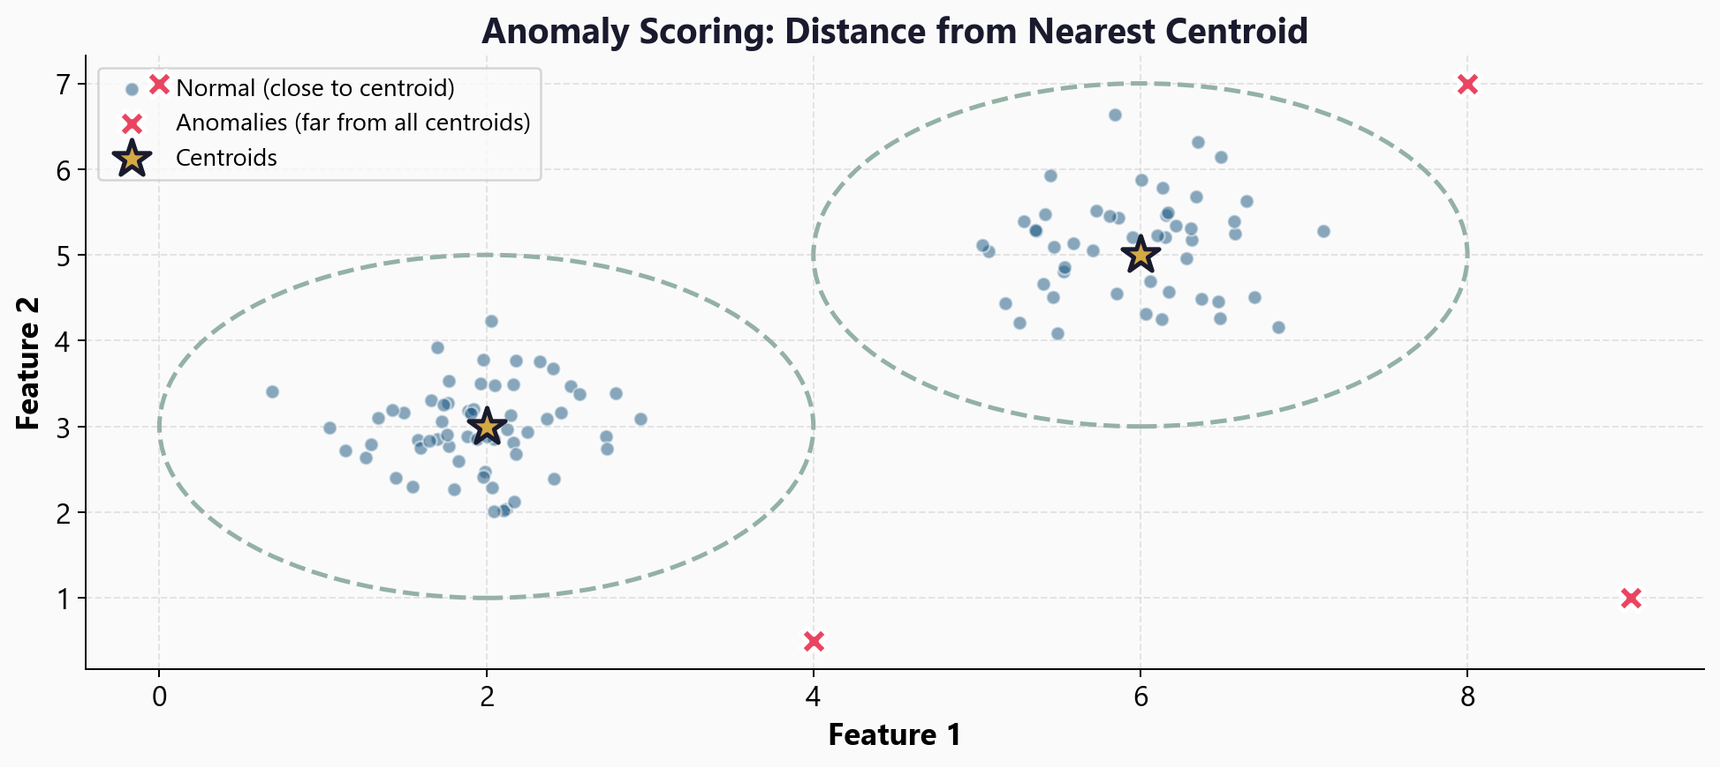
Flagging Anomalies by Distance from Centroids

Slide 14
The Anomaly Detection Pipeline
1. Fit k-Means on baseline (known-good) traffic
2. For each new connection:
distance = min distance to any centroid
3. If distance > threshold: FLAG as anomalous
distances = km.transform(X_new).min(axis=1)
anomalies = X_new[distances > threshold]
Critical: always StandardScaler before clustering
(bytes_sent 0-1M vs duration 0-300 would break distances)

Slide 15
05
Workshop
and Next Steps

Slide 16
Workshop: 4 Hands-On Exercises
Exercise 1: Unsupervised framing - no labels, what can clustering find?
Exercise 2: k-Means + PCA visualisation - colour-coded 2D cluster plot
Exercise 3: Choosing k - elbow method, silhouette score
Exercise 4: Anomaly scoring - distance thresholds, flag top anomalies
Each exercise: lecture.md + handson.md + solution file

Slide 17
Key
Takeaways
Unsupervised learning finds structure without labels - essential for security
k-Means groups similar points into k clusters via iterative centroid updates
The elbow method helps choose k - look for diminishing returns
Anomalies = points far from all centroids (high distance score)
Always scale features before clustering - Euclidean distance requires it
Next: Cross-Validation - how to know if your model truly generalises

Slide 18
Clustering & Anomaly Detection
Next: Lesson 2.4 - Cross-Validation and Overfitting

