Slide 1
Cross-Validation & Overfitting
Lesson 2.4 | Stage 2: Intermediate ML
AI Basic Training
Does Your Model Actually Generalise?

Slide 2
What We'll Cover
Overfitting - when the model memorises instead of learns
The bias-variance tradeoff
K-fold cross-validation - reliable performance estimates
Regularisation techniques for every model type
Finding the sweet spot

Slide 3
01
What is
Overfitting?

Slide 4
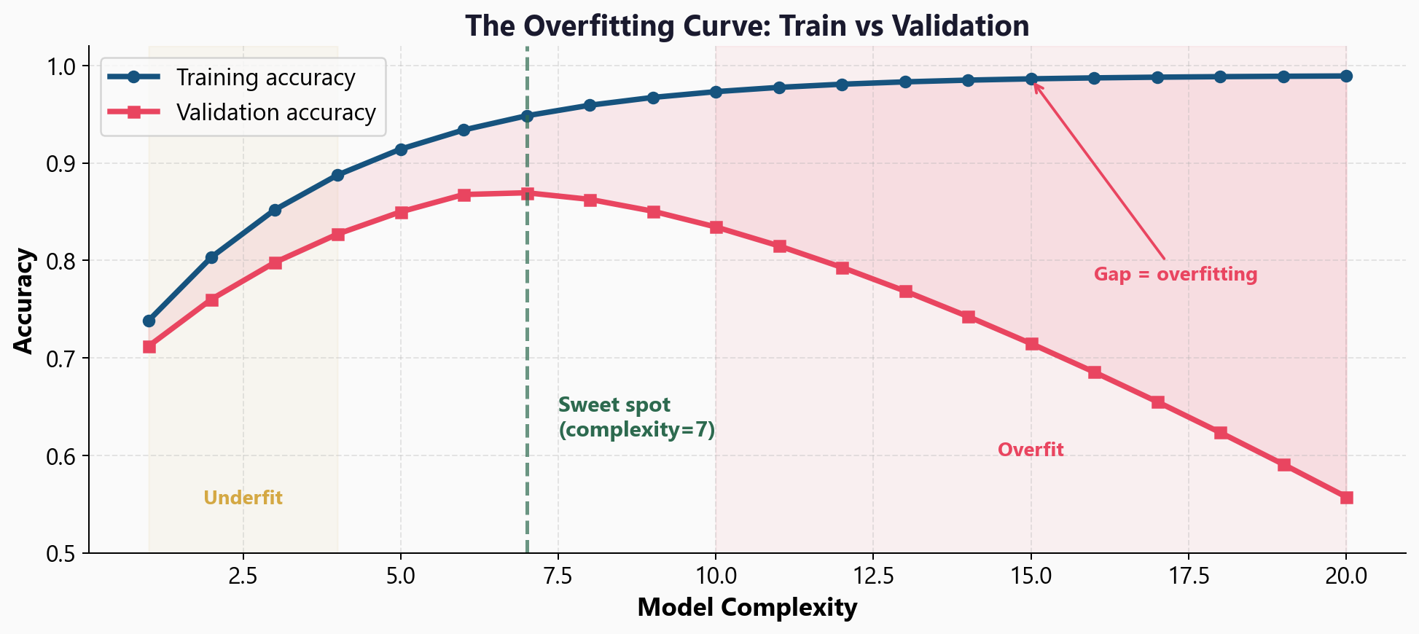
Train vs Validation: The Gap Is the Problem

Slide 5
Overfitting vs Underfitting
Overfitting
Train accuracy: 99.8%
Test accuracy: 71.2%
Large gap
Model memorised noise
Too complex for the data
Underfitting
Train accuracy: 65%
Test accuracy: 64%
Small gap - but both poor
Model hasn't learned enough
Too simple for the pattern

Slide 6
02
The Bias-Variance
Tradeoff

Slide 7
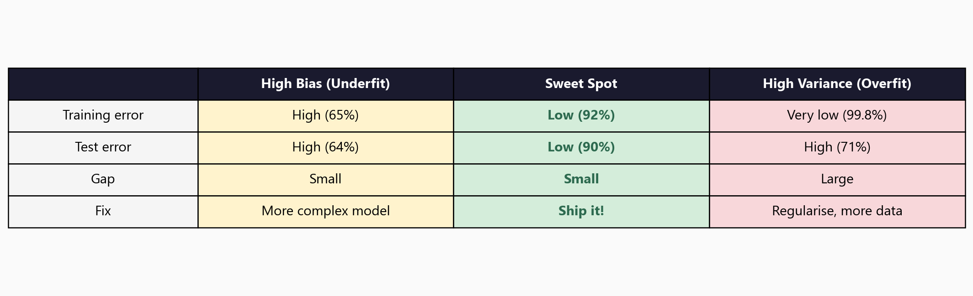
Three Regimes: Underfit, Sweet Spot, Overfit

Slide 8
The Most Important Concept Before Neural Networks
High bias = model too simple
Misses real patterns in the data
High variance = model too complex
Fits noise that doesn't generalise
Goal: lowest test error
Not lowest training error
A model that scores 99%
on training data but 70%
on new data is useless.
It memorised rather
than learned.

Slide 9
03
K-Fold
Cross-Validation

Slide 10
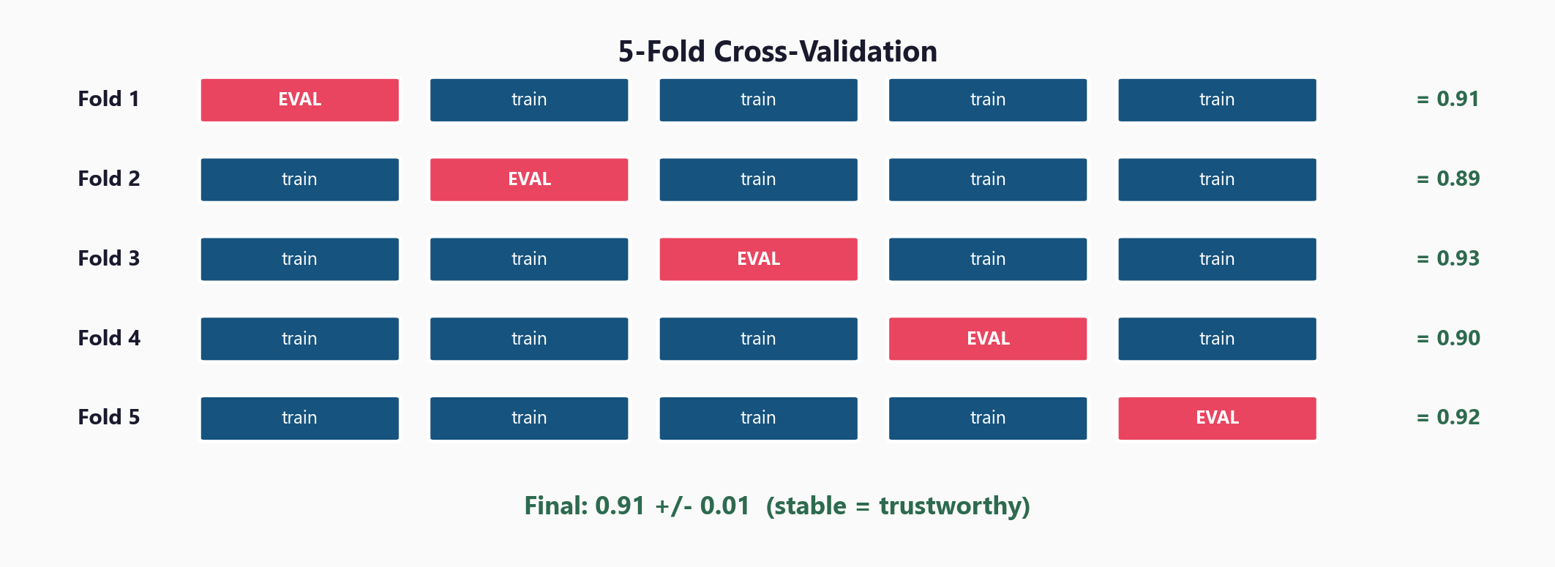
Rotate the Evaluation Fold for a Reliable Estimate

Slide 11
The Code - Two Lines
from sklearn.model_selection import cross_val_score
scores = cross_val_score(model, X, y, cv=5, scoring='roc_auc')
print(f'AUC: {scores.mean():.4f} +/- {scores.std():.4f}')
Low std = stable across splits = trustworthy
High std = model is sensitive to which data it sees
5 or 10 folds is standard
5 = faster, 10 = slightly more reliable

Slide 12
04
Regularisation
Techniques

Slide 13
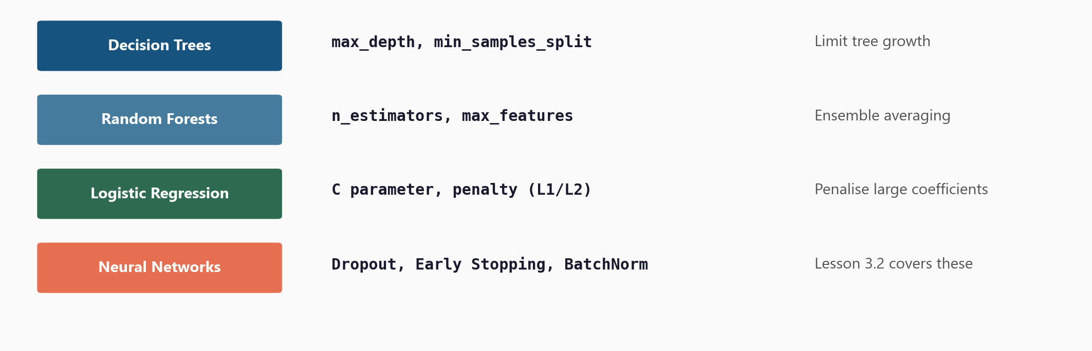
Regularisation: One Technique Per Model Family

Slide 14
05
Workshop
and Next Steps

Slide 15
Workshop: 4 Hands-On Exercises
Exercise 1: Overfitting demo - watch train vs val accuracy diverge
Exercise 2: Bias-variance - visualise underfit, good fit, overfit models
Exercise 3: K-fold cross-validation - compare to single train/test split
Exercise 4: Validation curve - automatic parameter sweep to find sweet spot
Each exercise: lecture.md + handson.md + solution file

Slide 16
Key
Takeaways
Overfitting = large gap between train and test performance
The bias-variance tradeoff: find the complexity sweet spot
Cross-validation gives reliable estimates - better than a single split
Low std across folds = trustworthy model
Every model family has regularisation tools to control overfitting
Next: Stage 3 - Neural Networks (where overfitting gets serious)

Slide 17
Cross-Validation & Overfitting
Next: Stage 3 - Neural Networks

